Slide 1
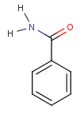
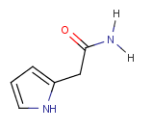



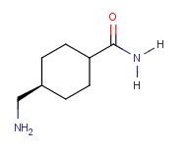
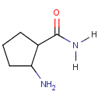

100 molecules from MOE CoreHopping results (Top100_MOE_SIRT3_aADPR_add group01.pdf)
Substructure search (all the parameter settings are based on Lipinski’s rule of five)
  Molecular weight, from 180 to 500 daltons
  LogP( octanol-water partition coefficient, not greater than 7
  Rotatable bonds, no more than 5
  hDon (hydrogen bond donors), no more than 5
  hAcc (hydrogen bond acceptors), no more than 10
CHEM BRIDGE database/Hit2Lead/Substructure search
The substructure used for searching are listed as following
sss_A_1 sss_A_2 sss_A_3 sss_A_4 sss_A_5
Total 3239 molecules were found.
Total 7 molecules were found.
Total 557 molecules were found.
Total 8 molecules were found.
Total 18 molecules were found.
sss_A_6 sss_A_7 sss_A_8
Total 8 molecules were found.
Total 16 molecules were found.
Total 407 molecules were found.
Total 4260 molecules have been sent to Ping for docking study. The top 20 with MMGBSA dG binding has been listed as following the word file.

