Slide 1
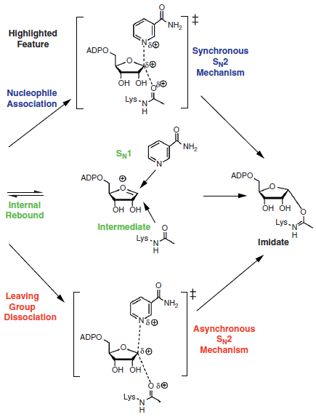
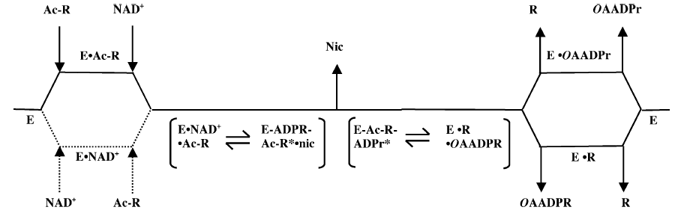
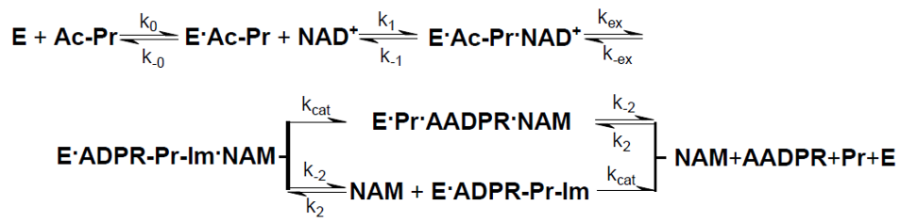
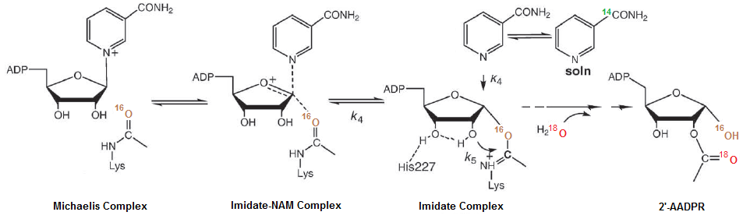
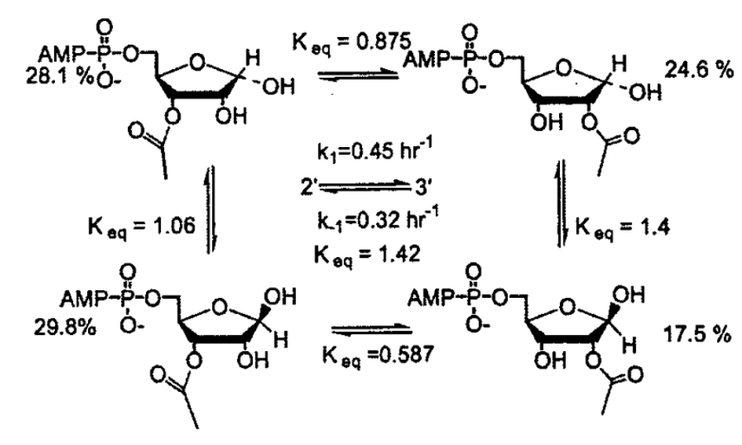
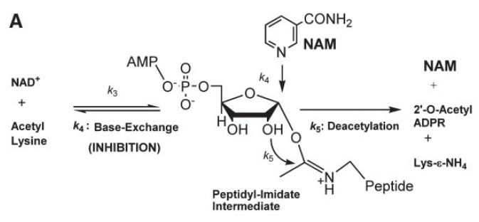
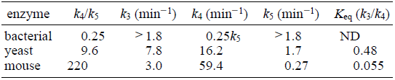

(A) Substrate Binding
$k_{d}$= $\frac{k_{−0}}{k_{0}}$
=150 μM
Not
determined
(B) Transition State
(D) Spontaneous non-enzymatic equilibration
(C) Base Exchange
3’ –AADPR  2’-AADPR is with a first-order rate constant for acetyl migration of 0.32 h⁻¹ at pH 6.25. Keq was 1.4 at 15ºC and the rate constant for 2’ –AADPR  3’-AADPR is 0.45 h⁻¹
(A) Borra, MT et al. Biochemistry (2004) 43: 9877-9887
(B-1) Hawse, WF et al. Structure (2008) 16: 1368-1377.
(B-2) Hu, P et al. JACS (2008) 130:16721-16728.
(B-3) Cen, Y et al. JACS(2010) 132:12286-12298.
(C-1) Sauve AA, et al. Biochemistry (2003) 42: 9249–9256.
(C-2) Sauve AA, et al. Mol. Cell (2005) 17: 595–601.
(D-1) Sauve AA, et al. Biochemistry (2001) 40: 15456-15463.
(D-2) Smith BC, et al. Biochemistry (2006) 45: 272-282.

