Slide 1
Analysis of carba NAD solubility in New Buffer by HPLC
4/19/2017

Slide 2
Analysis of c-NAD solubility in New Buffer by HPLC
Solvent A: 20 mM NaH2PO4 + 10 mM HexSSS, pH 6.0
Solvent B: CAN
Method:
Time %B
0.0 0.0
10.0 2.0
30.0 20.0
Flow: 0.3 ml/min
Detection: UV at 263 nm. Sig = 263, 16 ; Ref = 360, 100
Injection: 5 uL
Temperature: 25 C
c-NAD standard: 3 mM solution in H2O
Test sample: 3 mM c-NAD in New Buffer (20 mM Tris-Cl, 150 mM NaCl, 5% DMSO, pH 7.8)

Slide 3
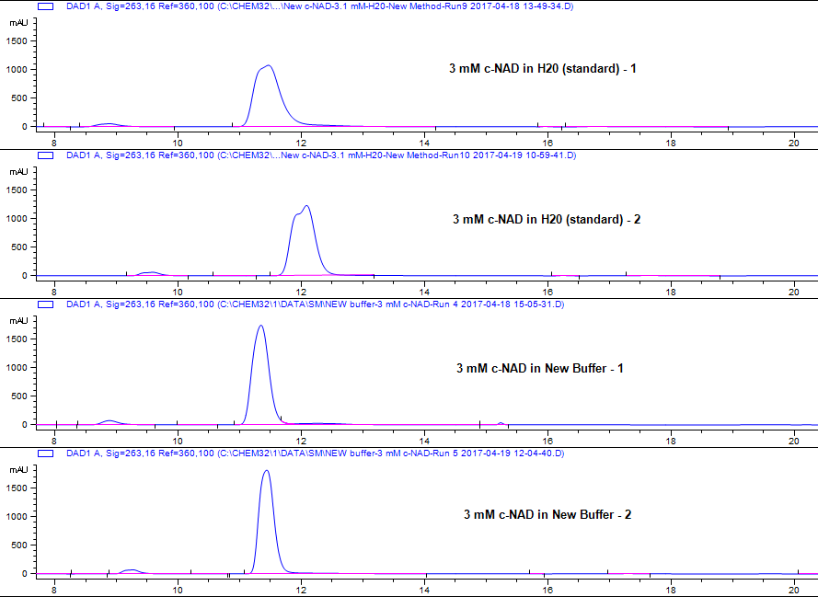
HPLC chromatograms – 5 uL injection/sample

Slide 4
Data Analysis
Based on comparison of peak area’s, there is equal solubility of 3 mM carba-NAD in both, H2O and New Buffer (20 mM Tris-Cl, 150 mM NaCl, 5% DMSO, pH 7.8)

Slide 5
Conclusions
c-NAD is stable in solution for > 1 week, stored at -80 C.
Results from comparing the peak area’s of c-NAD, H2O standard and New Buffer suggest that comparable amounts of c-NAD are present in 3 mM samples in these two cases, accounting for weighing/sample preparation errors.
Based on these results, 3 mM c-NAD samples can be accurately prepared in the New Buffer and thus can be used for MST studies

