Slide 1
HPLC analysis of carba NAD solubility 4/6/2017

Slide 2
Analysis of c-NAD solubility by HPLC
Solvent A: 20 mM NaH2PO4 + 10 mM HexSSS, pH 6.0
Solvent B: CAN
Method:
Time %B
0.0 0.0
10.0 2.0
30.0 20.0
Flow: 0.3 ml/min
Detection: UV at 263 nm. Sig = 263, 16 ; Ref = 360, 100
Injection: 5 uL
Temperature: 25 C

Slide 3
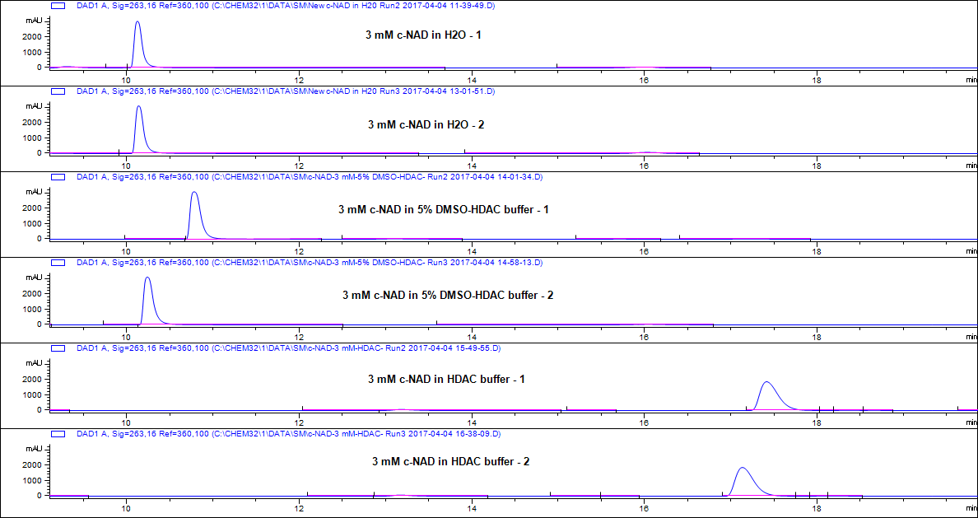
HPLC chromatograms – 5 uL injection/sample

Slide 4
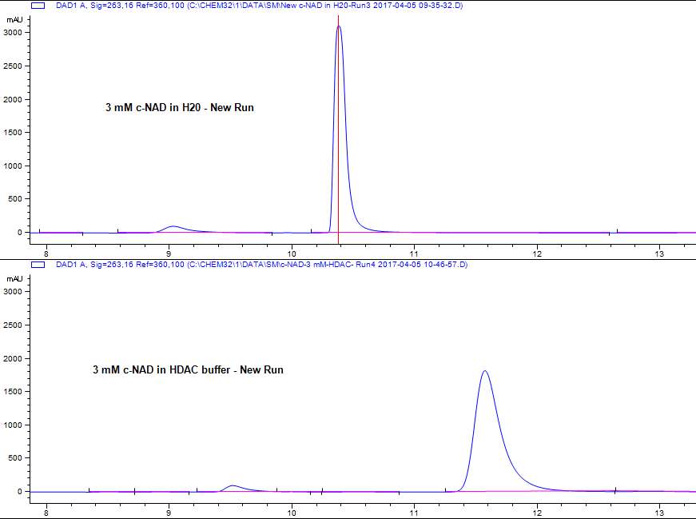
Inter-day variability in “c-NAD” peak retn. time in HDAC buffer
Inter-day varibility of the retention time of the “c-NAD” peak in HDAC buffer was compared relative to H2O standard.
H2O standard had similar retention time as before (~10 min), while the HDAC peak shifted from ~17 min to ~11.5 min.

Slide 5
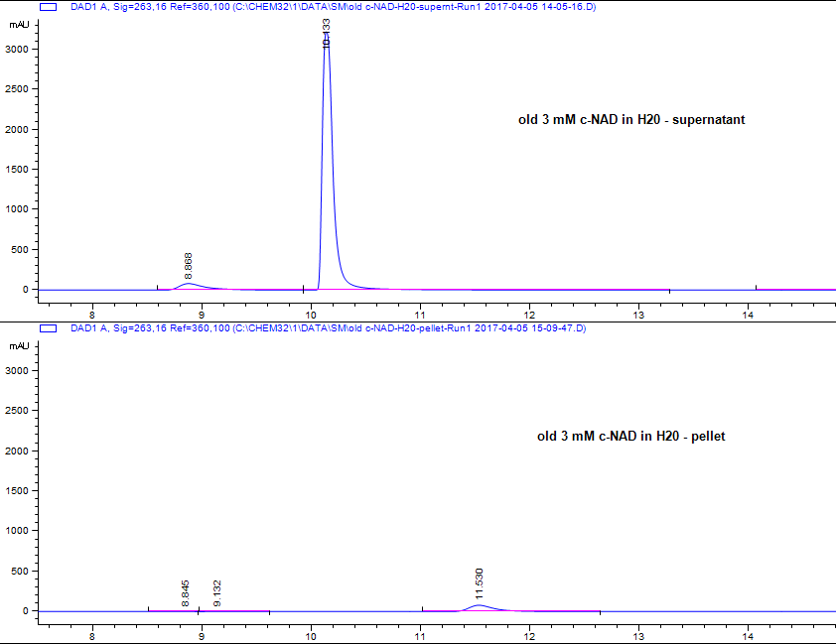
Analysis of the supernatant and pellet formed in old c-NAD solution in H2O
The “c-NAD” peak seen in the pellet (reconstituted with 100 ul H2O) is shifted relative to the c-NAD peak in the supernatant.
If this peak truly represents c-NAD in the pellet, then a significant amount would be insoluble.
However the results are not clear and suggest degradation products.

Slide 6
Data Analysis
(**) = Retention time of “c-NAD” peak significantly different from standard

Slide 7
Conclusions
c-NAD is not stable in solution for > 1 week, stored at -20 C.
Freshly made c-NAD solution in water can be accurately quantified and used as a standard to test solubility in different solvents.
Results from comparing the peak area’s of H2O standard and 5% DMSO-HDAC buffer suggest that comparable amounts of c-NAD are present in 3 mM samples in these two cases (based on peak: shape, area, retention time), accounting for weighing/sample preparation errors.
However, the “c-NAD” peaks in HDAC buffer and pellet (old H2O sample) have different retention times and peak shapes, compared to standard, making comparisons inconclusive.
Based on these results, we could send a new c-NAD sample to 2bind, but we would need to do some more tests, as described in the next slide.

Slide 8
Recommendations for next steps
Now that we know that freshly made c-NAD solution in water can be accurately quantified and used as a standard, we can use that to estimate c-NAD concentration in 5%-DMSO-HDAC buffer and New buffer (20 mM Tris-Cl, 150 mM NaCl, 5% DMSO, pH 7.8).
We can make a 3 mM solution in the new buffer to check for: a) formation of pellet b) concentration in supernatant by HPLC
Even if pellet is formed in freshly made buffer solutions, we can accurately quantify the concentration in the supernatant by comparison with H2O standard.
Upon systematically doing multiple runs with different injection volumes, we can identify the factor difference (if any) in the concentration in 3 mM water and buffer solutions. For example, “3 mM” c-NAD in buffer may actually correspond to 2.5 mM.
By the above method, at least we would be able to accurately determine the concentration of c-NAD in the respective buffers.

Slide 9
Plan for next steps
Send Thomas ~ 3 mg c-NAD sample on Tuesday, 4/11/17.
Prepare fresh 3 mM solutions in a) 5% DMSO-HDAC buffer b) New Buffer
- ~ 1. 1.5 mg would be required for the above two solutions.
Do the comparative concentration analysis by HPLC (3 mM solutions in buffers compared to H2O standard).
Let Thomas know the results:
- if 100% solubility in 5% DMSO-HDAC / New buffer, OR, if not, what is the real concentration of the “3 mM” stock.

