Slide 1
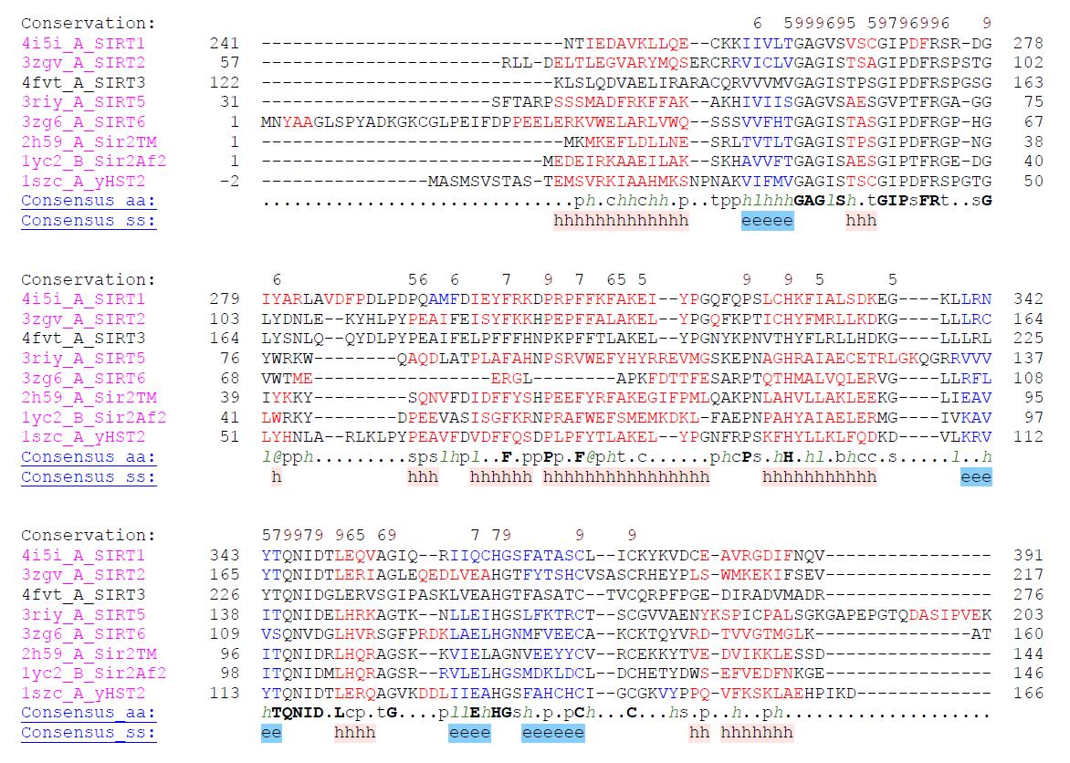
Helix in the loop
as in SIRT3
H116A mutant of Sir2TM
Helix in the binding loop in 4FVT (SIRT3) ranges from GLY163-TYR171, β-turn in 2H59 (Sir2TM) ranges from GLY35-GLY38 and is shown in the red rectangle.

Slide 2
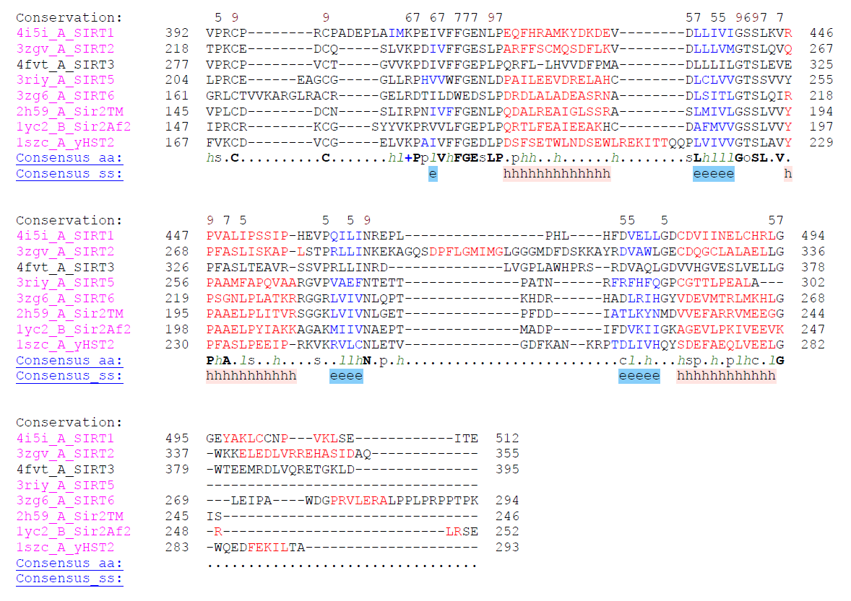

Slide 3
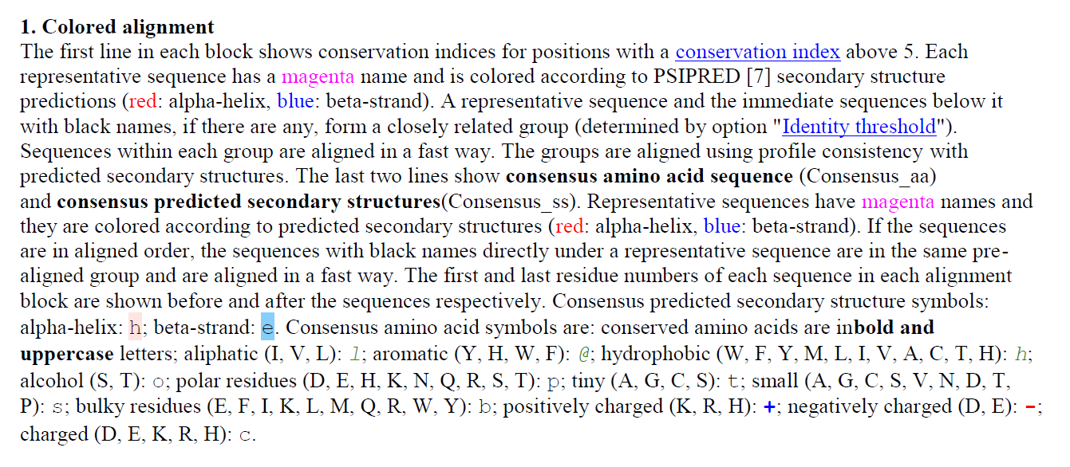

Slide 4
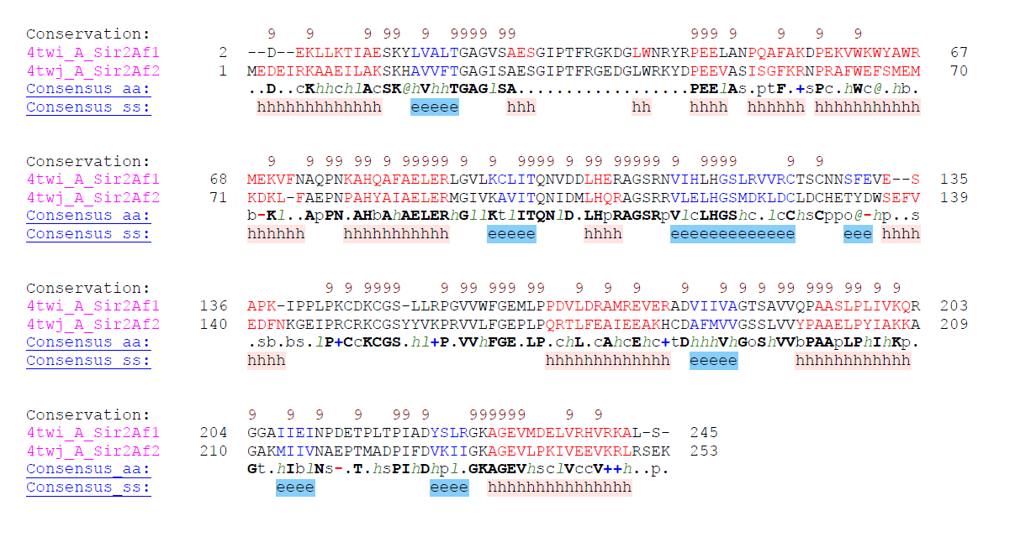
Sir2Af1 (4TWI) is available only recently and doesn’t have NAD+ or analog in the binding site, therefore not used in the comparison with others.

