Slide 1
Validation of SIRTainty DHP1c/SIRT1 result by HPLC

Slide 2
HPLC-based assay
Experimental conditions
[SIRT1] = 5U
[NAD⁺] =200 μM
[H3K9 peptide] =25 μM
%DMSO = 0, 2%
[DHP1c] = 50 uM
Time points= 0, 30 min
Temp.= 37oC
 | SIRTainty buffer |  | 2% DMSO |  | 50uM DHP1c |  | Avg | Stdv | cv%
 | no SIRT1 | yes SIRT1 | no SIRT1 | yes SIRT1 | no SIRT1 | yes SIRT1
Rt_H3K9 peptide, min | 10.900 | 10.900 | 10.867 | 10.917 | 10.850 | 10.867 | 10.884 | 0.0258 | 0.24
Rt_product, min |  | 10.050 |  | 10.050 |  | 10.000 | 10.033 | 0.0289 | 0.29
ΔRt, min |  | 0.850 |  | 0.867 |  | 0.867 | 0.861 | 0.0098 | 1.14
Peak Are_H3K9 peptide |  | 187957 |  | 151758 |  | 149271
Peak Are_product |  | 34730 |  | 31371 |  | 31281
Total Area |  | 222687 |  | 183129 |  | 180552
% Product |  | 15.60 |  | 17.13 |  | 17.33
pmoles |  | 156.0 |  | 171.3 |  | 173.3
% Activity |  |  |  | 100.0 |  | 101.1
Remarks
HPLC results shown that the SIRT1 activity has 1.1% increase in the presence of 50uM DHP1c.
Under same experimental condition, about 80% SIRT1 activation (slides 9 and 10) by 50 uM DHP1c was detected by SIRTainty assay. However, it was not detected using HPLC.
SIRTainty assay provides false positive for those small compounds (like DHPs) who have intrinsic fluoresecence.

Slide 3
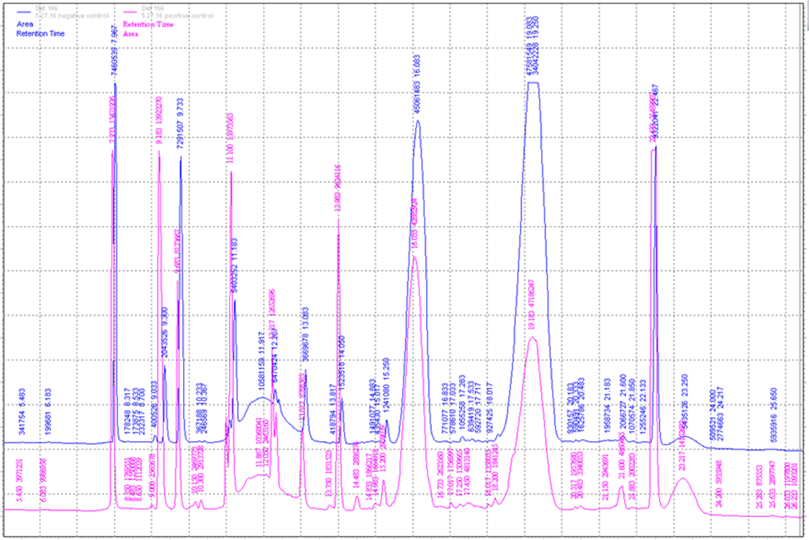
Step 1. Run samples were collected from TeCan
Experimental conditions
[NAD⁺] =200 μM
[H3K9 peptide] =25 μM
Time points= 0, 30 min
Temp.= 37oC
__________ No 5U SIRT1
__________ Yes 5U SIRT1
Samples were collected from 96-well after read on TeCan and run on HPLC.
Except NAD+, NAM, acetyl/deacetyl H3 peptide peaks, there were other peaks from nicotinamidase, developer, which made the chromatogram very “massy”.
It was hard to identify all the peaks since the compositions of SIRTainty buffer, developer solution were unknown.
It’s difficult to identify product peaks directly from TeCan sample.

Slide 4
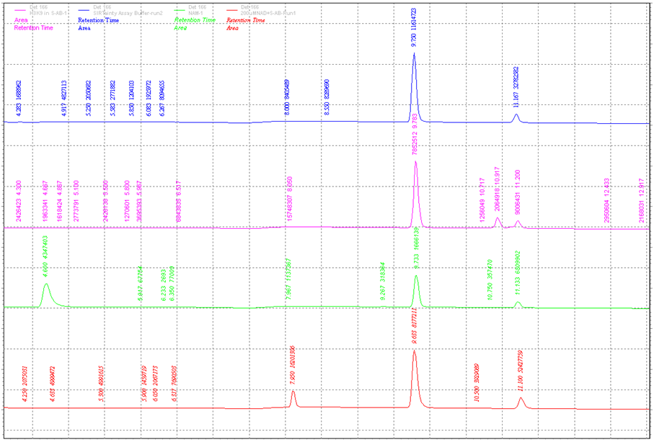
Step 2. Run individual component included in SIRTainty assay.
SIRTainty Buffer
H3K9 peptide
NAM⁺
NAD⁺

Slide 5
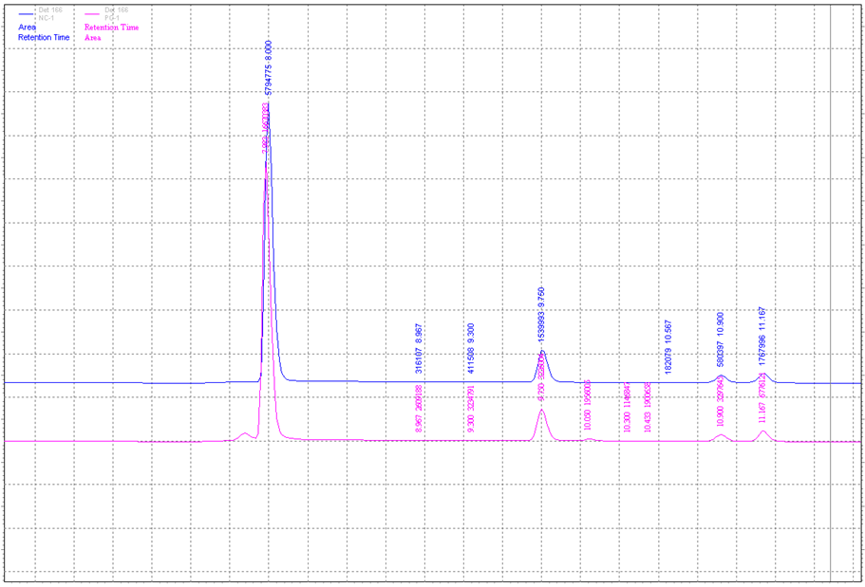
Step 3-1. Run reactions under same condition as it on TeCan- Assay buffer
Experimental conditions
[NAD⁺] =200 μM
[H3K9 peptide] =25 μM
Time points= 0, 30 min
Temp.= 37oC
__________ No 5U SIRT1
__________ Yes 5U SIRT1
Product
peak

Slide 6
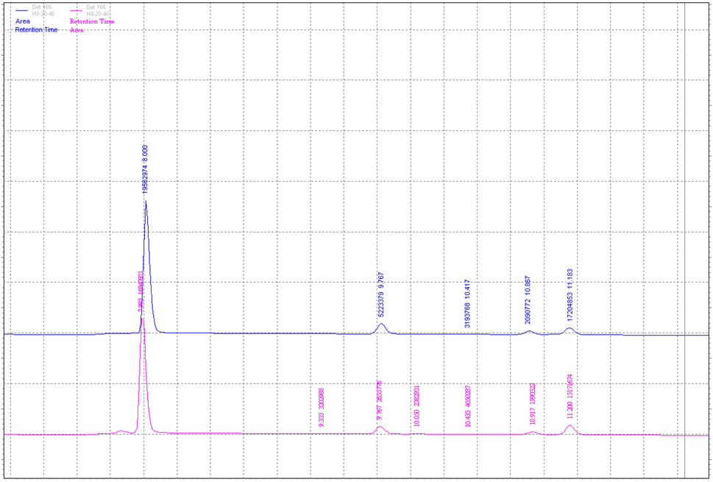
Step 3-2. Run reactions under same condition as it on TeCan- 2% DMSO
Experimental conditions
[NAD⁺] =200 μM
[H3K9 peptide] =25 μM
%DMSO= 0, 2%
Time points= 0, 30 min
Temp.= 37oC
__________ No 5U SIRT1
__________ Yes 5U SIRT1
Product
peak

Slide 7
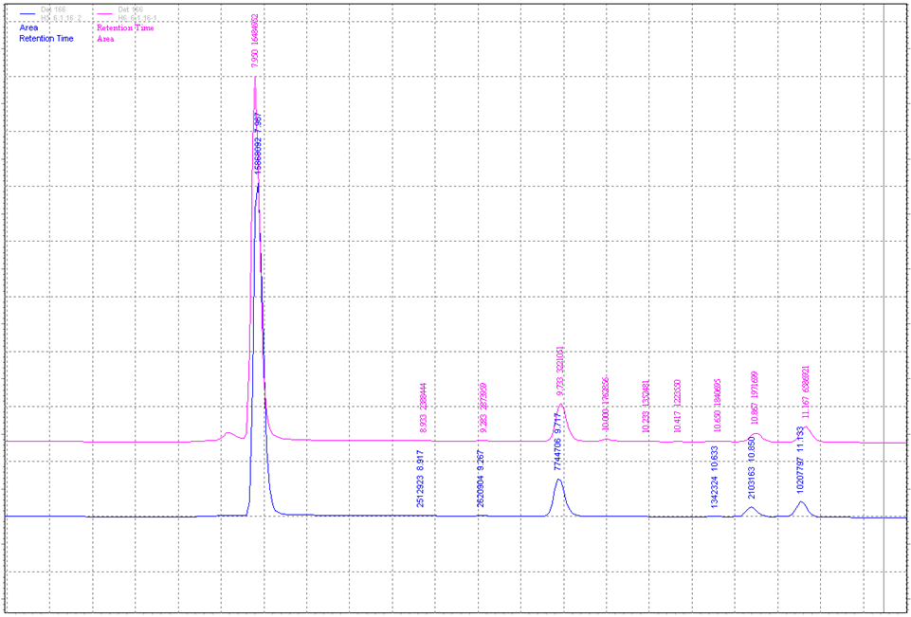
Step 3-3. Run reactions under same condition as it on TeCan- 50uM DHP1c
Experimental conditions
[NAD⁺] =200 μM
[H3K9 peptide] =25 μM
%DMSO= 0, 2%
[DHP1c]= 0, 50uM
Time points= 0, 30 min
Temp.= 37oC
__________ No 5U SIRT1
__________ Yes 5U SIRT1
SIRTainty Assay
__________ 50uM DHP1c (no SIRT1)
__________ 50uM DHP1c (yes SIRT1)
Product
peak

Slide 8
SIRTainty assay on TeCan

Slide 9
Repeat JMC 2015 experiment in PMC-AT Lab
Experimental conditions
[SIRT1] =5U/reaction
[NAD⁺] =200 μM
[H3K9 peptide] =25 μM
[DHP1c] = 50uM
% DMSO= 2%
Time points= 0, 30 min
Temp.= 37oC
Gain (TeCan )=65
Operation procedure
The deacetylation reaction was initiated by addition of SIRT1 enzyme. The mix was incubated at 37oC for 30min. Developer was added upon the desired time point and incubated at room temperature for 30min avoiding light. Then read the sample on TeCan at Ex/Em=420nm/460nm.
 | Run 1 |  | Run 2 |  | Avg_0min | Avg_60min | Δ AFU | % Activity
 | 0 min | 60 min | 0 min | 60 min
Buffer only (no SIRT1) | 247 | 166 | 161 | 153 | 204.0 | 159.5
Negative control (NAD+ peptide substrate+PNCA1+Assay buffer-no SIRT1) | 342 | 305 | 280 | 303 | 311.0 | 304.0
Positive control (NAD+ peptide substrate+PNCA1+Assay buffer+ SIRT1) | 277 | 417 | 297 | 408 | 287.0 | 412.5 | 125.5
2% DMSO (NAD+ peptide substrate+PNCA1+Assay buffer + DMSO-no SIRT1) | 315 | 233 | 275 | 253 | 295.0 | 243.0
2% DMSO (NAD+ peptide substrate+PNCA1+Assay buffer+DMSO+SIRT1) | 276 | 347 | 250 | 312 | 263.0 | 329.5 | 66.5 | 100.0
DHP1c (NAD+ peptide substrate+PNCA1+Assay buffer+DHP1c-no SIRT1) | 1149 | 1105 | 1221 | 1099 | 1185.0 | 1102.0
DHP1c (NAD+ peptide substrate+PNCA1+Assay buffer+DHP1c + SIRT1) | 1153 | 1234 | 1042 | 1212 | 1097.5 | 1223.0 | 125.5 | 188.7
Calculation details (Method A) : ΔAFU = AFU _{60min} – AFU _{0min}

Slide 10
Repeat JMC 2015 experiment in PMC-AT Lab
Experimental conditions
[SIRT1] =5U/reaction
[NAD⁺] =200 μM
[H3K9 peptide] =25 μM
[DHP1c] = 50uM
% DMSO= 2%
Time points= 0, 30 min
Temp.= 37oC
Gain (TeCan )=65
Operation procedure
The deacetylation reaction was initiated by addition of SIRT1 enzyme. The mix was incubated at 37oC for 30min. Developer was added upon the desired time point and incubated at room temperature for 30min avoiding light. Then read the sample on TeCan at Ex/Em=420nm/460nm.
 | Run 1 |  | Run 2 |  | Avg_0min | Avg_60min | Background Subtraction |  | Δ AFU | % Activity
 | 0 min | 60 min | 0 min | 60 min |  |  | ΔAFU_0min | ΔAFU_60min
Buffer only (no SIRT1) | 247 | 166 | 161 | 153 | 204.0 | 159.5
Negative control (NAD+ peptide substrate+PNCA1+Assay buffer-no SIRT1) | 342 | 305 | 280 | 303 | 311.0 | 304.0
Positive control (NAD+ peptide substrate+PNCA1+Assay buffer+ SIRT1) | 277 | 417 | 297 | 408 | 287.0 | 412.5 | -24.0 | 108.5 | 132.5
2% DMSO (NAD+ peptide substrate+PNCA1+Assay buffer + DMSO-no SIRT1) | 315 | 233 | 275 | 253 | 295.0 | 243.0
2% DMSO (NAD+ peptide substrate+PNCA1+Assay buffer+DMSO+SIRT1) | 276 | 347 | 250 | 312 | 263.0 | 329.5 | -32.0 | 86.5 | 118.5 | 100.0
DHP1c (NAD+ peptide substrate+PNCA1+Assay buffer+DHP1c-no SIRT1) | 1149 | 1105 | 1221 | 1099 | 1185.0 | 1102.0
DHP1c (NAD+ peptide substrate+PNCA1+Assay buffer+DHP1c + SIRT1) | 1153 | 1234 | 1042 | 1212 | 1097.5 | 1223.0 | -87.5 | 121.0 | 208.5 | 175.9
Calculation details (Method B) :
ΔAFU = ΔAFU_60min – ΔAFU_0min
ΔAFU_0min = AFU(with SIRT1) – AFU(without SIRT1) at 0min time point
ΔAFU_60min =AFU(with SIRT1) – AFU(without SIRT1) at 60min time point

