Slide 1
Validation of DMSO effect by HPLC
5.13.16-5.17.16

Slide 2
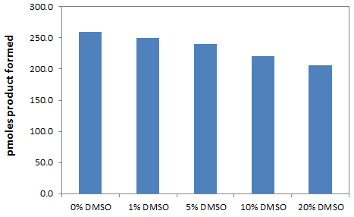
HPLC-based assay
Experimental conditions
[SIRT3]=8U/reaction
[NAD⁺]=1500 μM
[FdL2 peptide]=100 μM
% DMSO= 0, 1%, 5%, 10%, 20%
Time points= 0, 45 min
Temp.= 37oC
Intraday
variation

Slide 3
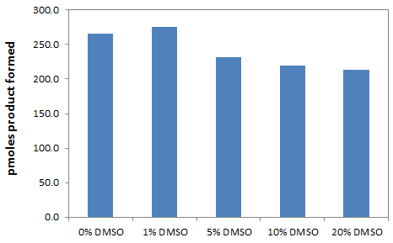
HPLC-based assay
Experimental conditions
[SIRT3]=8U/reaction
[NAD⁺]=1500 μM
[FdL2 peptide]=100 μM
% DMSO= 0, 1%, 5%, 10%, 20%
Time points= 0, 45 min
Temp.= 37oC
Intraday
variation

Slide 4
Enzo FdL assay
Experimental conditions
[SIRT3]=8U/reaction
[NAD⁺]=1500 μM
[FdL2 peptide]=100 μM
% DMSO= 0, 1%, 5%, 10%, 20%
Time points= 0, 60 min
Temp.= 37oC
Intraday
variation

Slide 5
Remarks
HPLC results (slides 2 and 3) shown that pmoles of product formed decreases as increasing the percentage of addition of DMSO. It may suggest
DMSO inhibits enzo SIRT3
High % DMSO denature the enzo SIRT3
Under same condition, the FdL assay was carried out (Slide 4). % Activity decreases as increasing the %DMSO.
The reason we choose up to 20%DMSO is because in 2015 Nat. Commun. Paper (Pumpf T et al. Selective Sirt2 inhibition by ligand-induced rearrangement of the active site. Nat. Commun. (2015) 6, 6263.), it was mentioned 5-20% DMSO (v/v) were used to dissolve the inhibitors.
It is clear that the addition of high% DMSO will inhibit/denature the enzyme based on current HPLC results. Although respective % DMSO solution was used as control (the DMSO background will be subtracted), if SIRT3 was denatured partially by 20% DMSO, the detected inhibition effect will be questioned.

