Slide 1
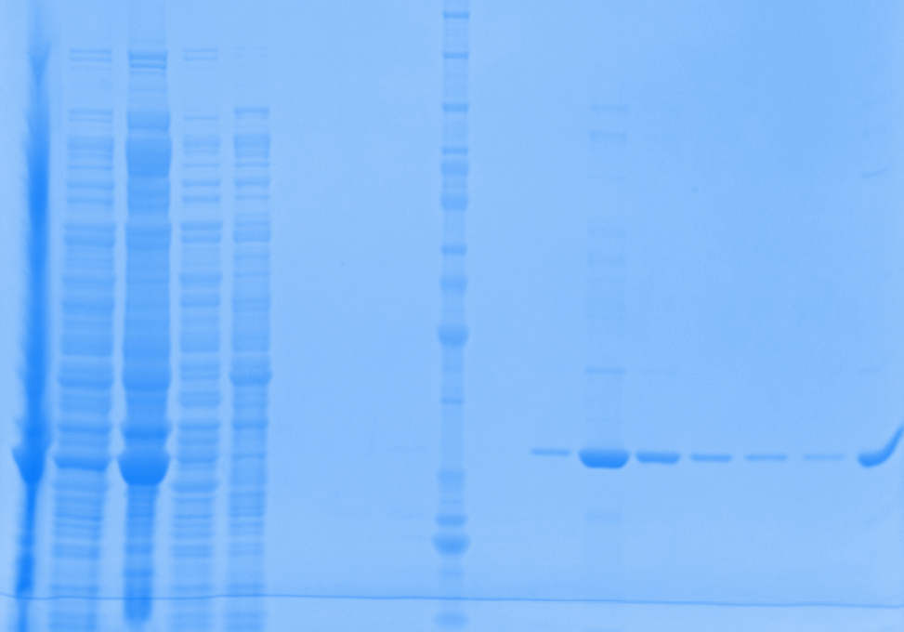
Week of 11.02.2015
New Batch III
1mM IPTG induction (4X200mL)
8M Urea
Gel 1
Elution 3
Elution 4

Slide 2
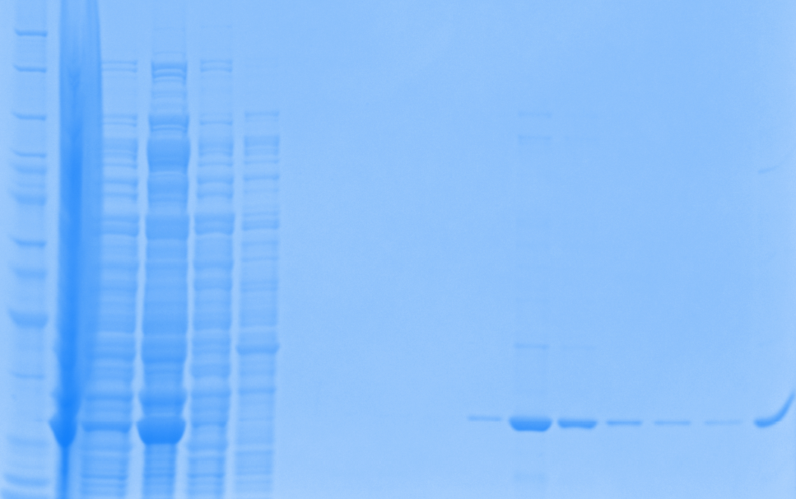
Week of 11.02.2015
New Batch III
1mM IPTG induction (4X200mL)
8M Urea
Gel 2
Elution 3
Elution 4

Slide 3
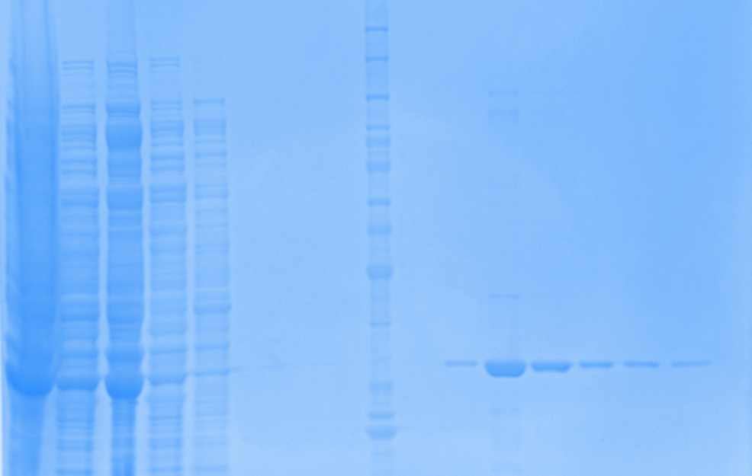
Week of 11.02.2015
New Batch III
1mM IPTG induction (4X200mL)
8M Urea
Gel 3
Elution 3
Elution 4

Slide 4
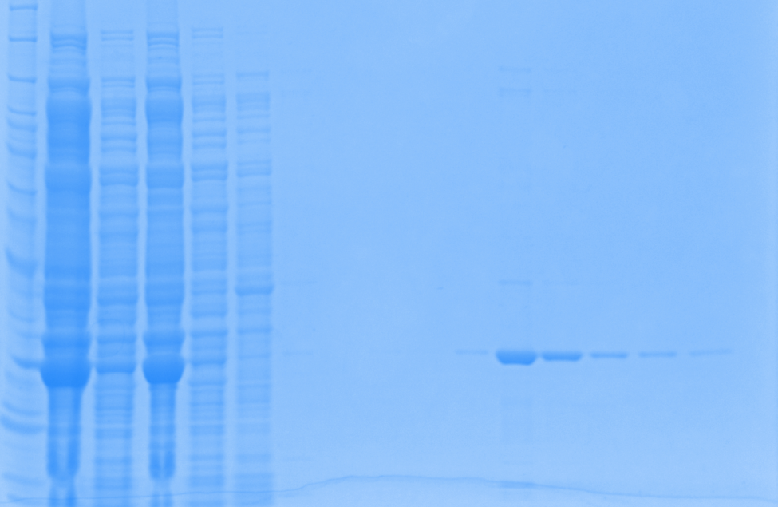
Week of 11.02.2015
New Batch III
1mM IPTG induction (4X200mL)
8M Urea
Gel 4
Elution 3
Elution 4

Slide 5
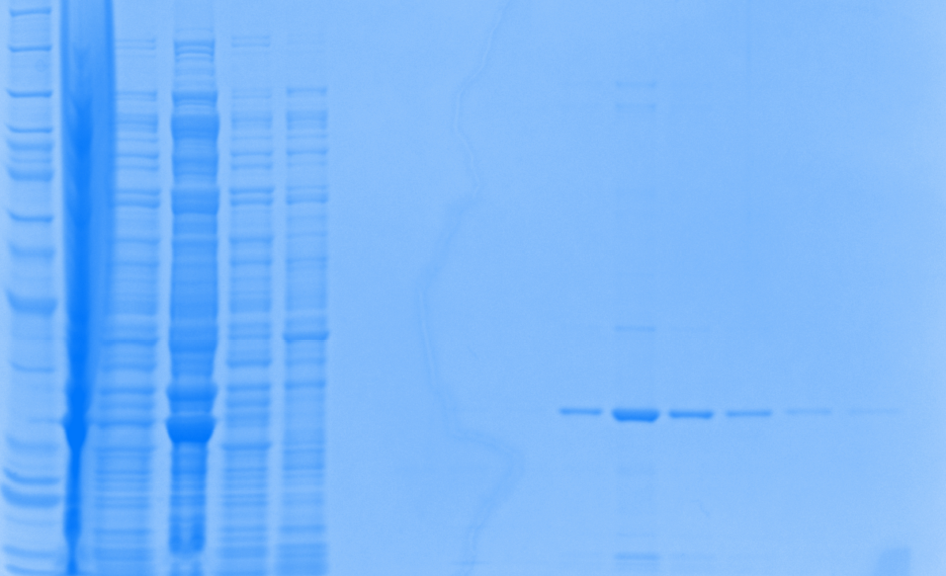
Week of 11.02.2015
New Batch IV
1mM IPTG induction (4X200mL)
8M Urea
Gel 5
Elution 3
Elution 4

Slide 6
Week of 11.02.2015
New Batch IV
1mM IPTG induction (4X200mL)
8M Urea
Gel 6
Elution 3
Elution 4

Slide 7
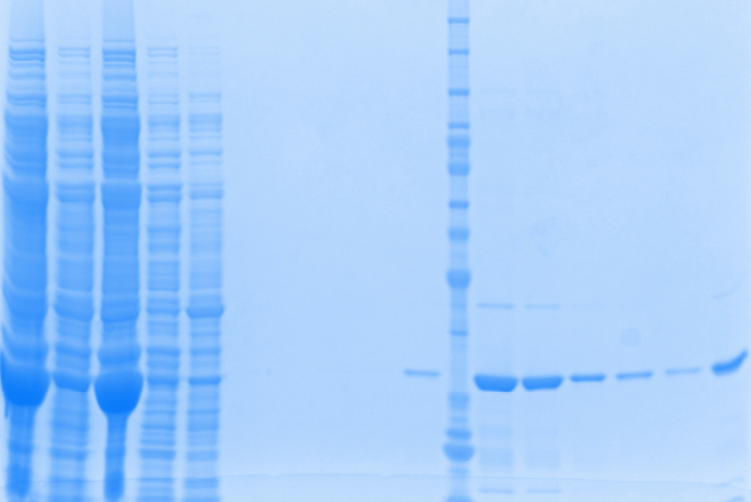
Week of 11.02.2015
New Batch IV
1mM IPTG induction (4X200mL)
8M Urea
Gel 7
Elution 3
Elution 4

Slide 8
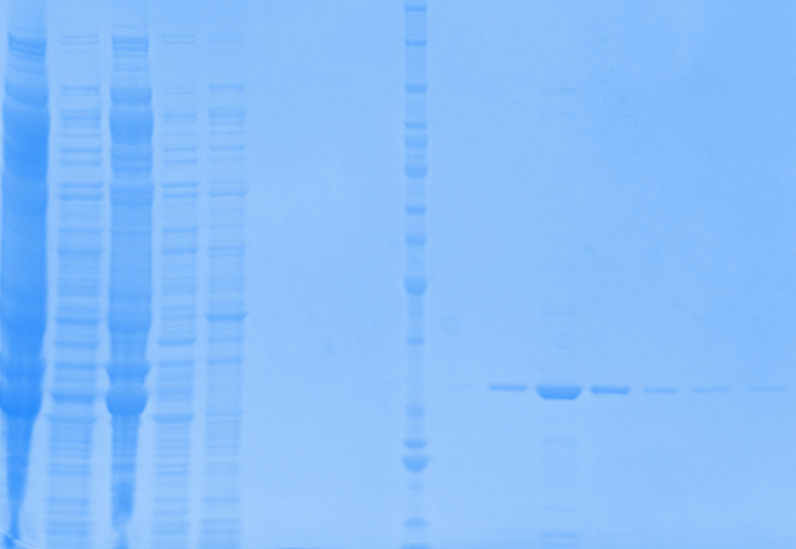
Week of 11.02.2015
New Batch IV
1mM IPTG induction (4X200mL)
8M Urea
Gel 8
Elution 3
Elution 4

Slide 9
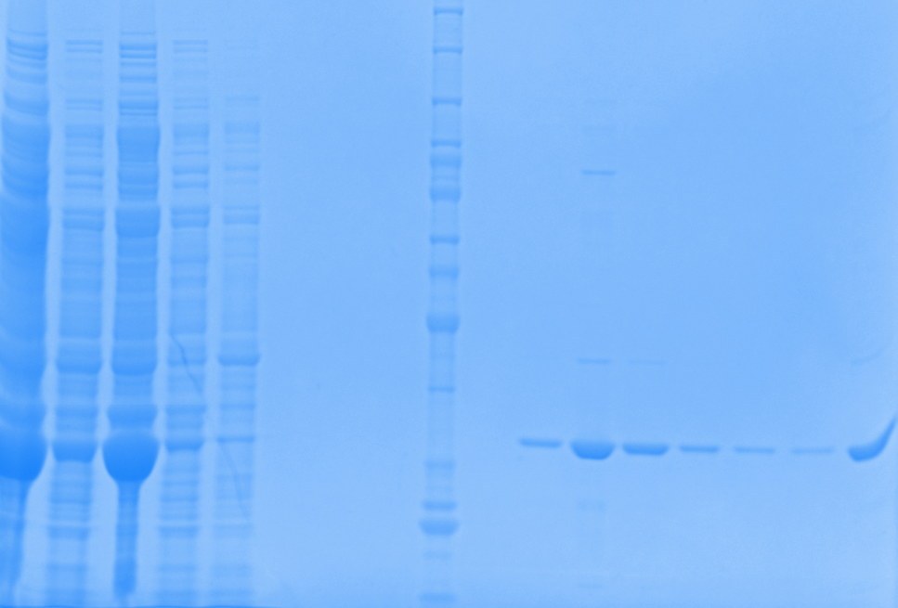
Week of 11.02.2015
New Batch IV-regenerated column
1mM IPTG induction (4X200mL)
8M Urea
Gel 9
Elution 3
Elution 4

Slide 10
1mM IPTG induction at 30 ºC, 8M Urea treatment | New Batch III_800mL (week of 11.02.2015) | New Batch IV_800mL (week of 11.02.2015) | New Batch IV_200mL used column (week of 11.02.2015)
[Purified Protein], ug/ul | 0.6012 | 0.8105 | 0.9261
V_{Total}, ul | 7000 | 7150 | 1000
Total protein, ug | 4208.4 | 5797.1 | 926.1
Specific activity, U/ug | 0.4953 | 0.2991 | 0.2123
Total Reactions | 834 | 693 | 79
Purity | 95% | 95% | 95%
How many batches required for one series of initial rate Exp. | Good | Good | --
1mM IPTG induction at 30 ºC, 8M Urea treatment | New Batch I_800mL (week of 10.26.2015) | New Batch II_600mL (week of 10.26.2015) | Batch I_800mL (week of 10.19.2015) | Batch II_800mL (week of 10.19.2015)
[Purified Protein], ug/ul | 0.3706 | 0.4259 | 0.7657 | 0.7441
V_{Total}, ul | 6150 | 4350 | 2500 | 2500
Total protein, ug | 2279.1 | 1852.7 | 1914.3 | 1860.3
Specific activity, U/ug | 0.4862 | 0.4289 | 0.2821 | 0.2426
Total Reactions | 443 | 318 | 216 | 181
Purity | >95% | >95% | 80-85% | 80-85%
How many batches required for one series of initial rate Exp. | Good | Good | 1.4 | 1.7

Slide 11
Conclusion:
9 bottles (200ml each) cultures were used for purification, in which 8 out of 9 was newly grow, and 1 of them was from last week culture (harvested and storage into -80oC)
Batch III (4X200mL) has good yield, purity, and activity. It provides 834 reactions (very good).
Batch IV (4X200mL) has good yield, purity, but less activity. It provides 693 reactions (good).
Batch IV_used column was from last week culture which was culture harvested and stored into -80oC
The regenerated column was used
Whole story: The single column cost $24. For the last week’s purification work, 8 columns were used which cost $192. Then GE HealthCare (where we got column from) claims on their web, that the column can be reused up to 5 times by regenerating the column. Therefore, Alok did few last week, and I took one to test the performance of the regenerated column.
Test result indicates
The regenerated column can be used for quick checkup, such as check if the Chapron is been removed using ATP+Mg method.
We may need to test more to confirm “the regenerated column is not suitable for purification work”.
Adding up together, we now have enough protein to run the experiments listed on WIKI. 390 (batch I) + 365 (batch II) + 834 ((batch III) + 693 (batch IV) = 2285 reactions.
Next Step:
On Monday, I will combine all four batches and measure concentration/ specific activity for the calculation of further experiments. Also make aliquots. These will be combined with DHP 1c EC50 experiments. The schedule will keep the same.

