Slide 1
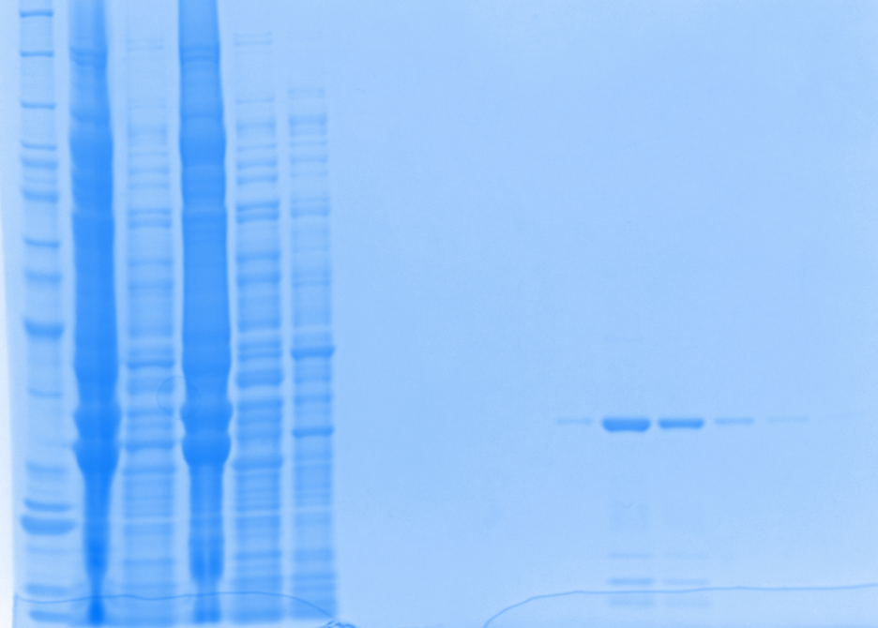
Week of 10.26.2015
New Batch I
1mM IPTG induction (4X200mL)
8M Urea
Gel 1
Elution 3
Elution 4

Slide 2
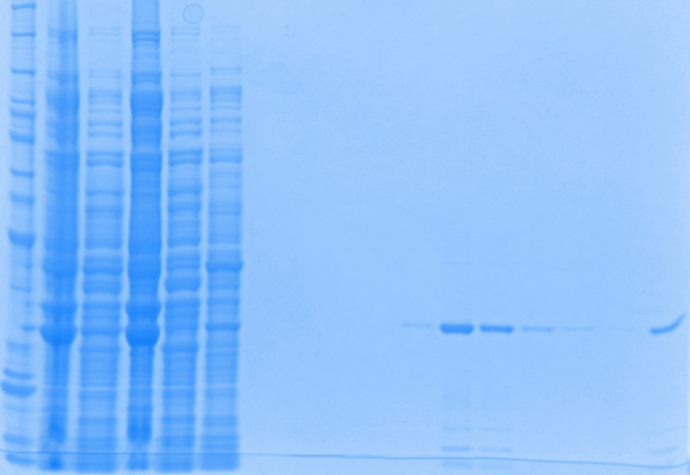
Week of 10.26.2015
New Batch I
1mM IPTG induction (4X200mL)
8M Urea
Gel 2
Elution 3
Elution 4

Slide 3
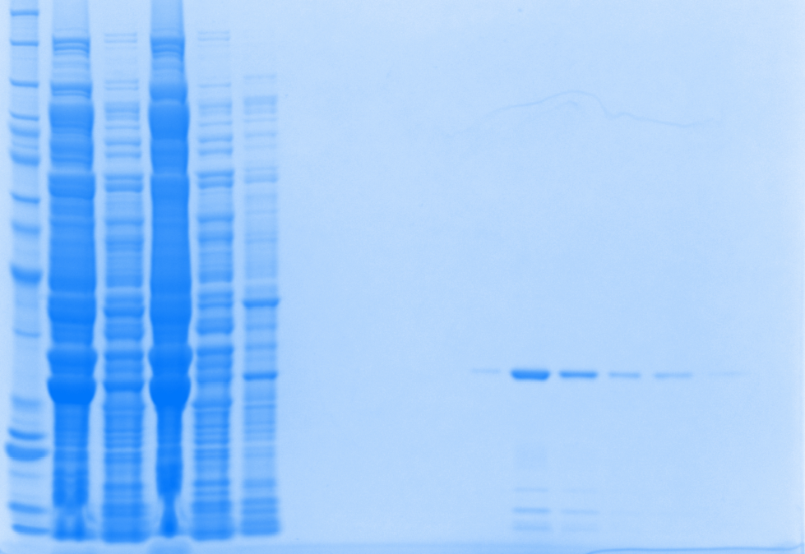
Week of 10.26.2015
New Batch I
1mM IPTG induction (4X200mL)
8M Urea
Gel 3
Elution 3
Elution 4

Slide 4
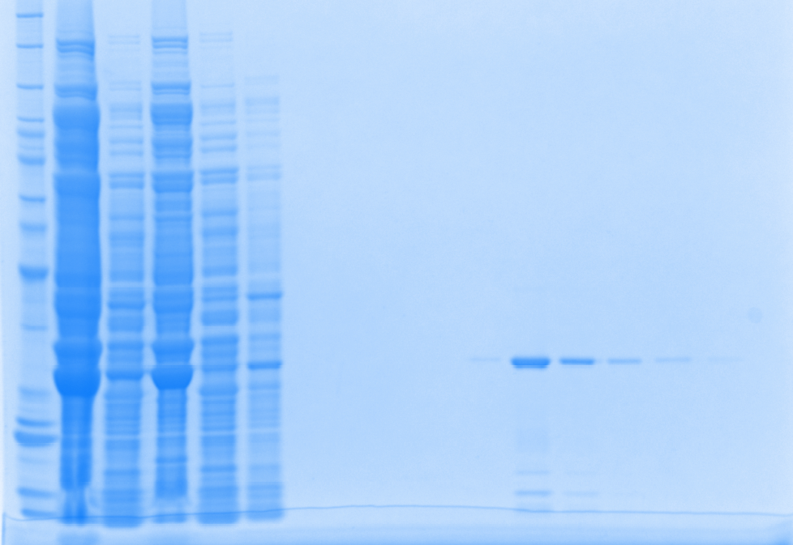
Week of 10.26.2015
New Batch I
1mM IPTG induction (4X200mL)
8M Urea
Gel 4
Elution 3
Elution 4

Slide 5
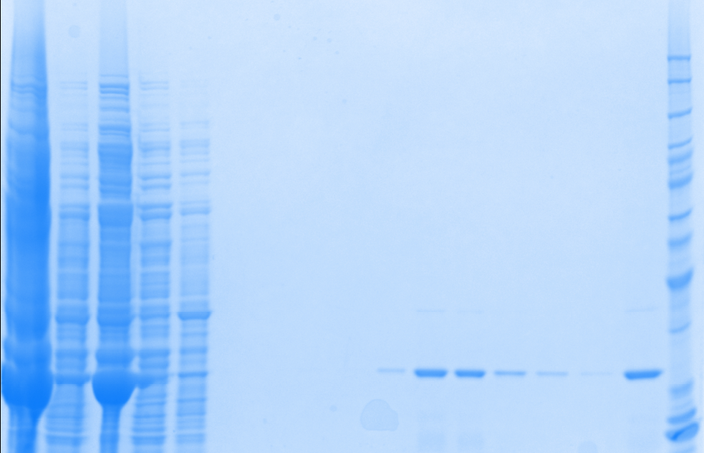
Week of 10.26.2015
New Batch II
1mM IPTG induction (3X200mL)
8M Urea
Gel 5
Elution 3
Elution 4

Slide 6
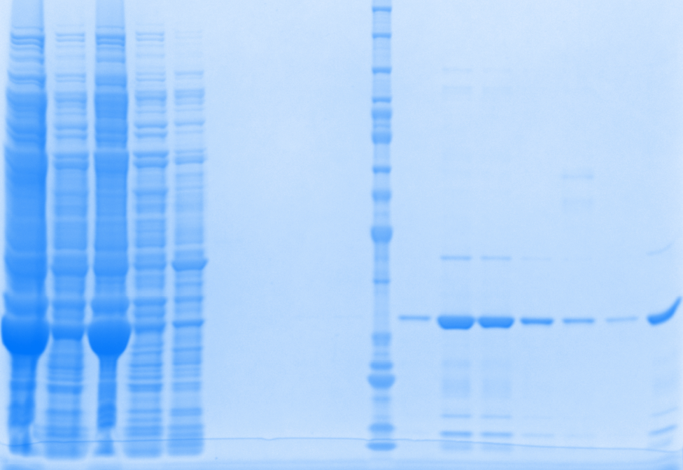
Week of 10.26.2015
New Batch II
1mM IPTG induction (3X200mL)
8M Urea
Gel 6
Elution 3
Elution 4

Slide 7
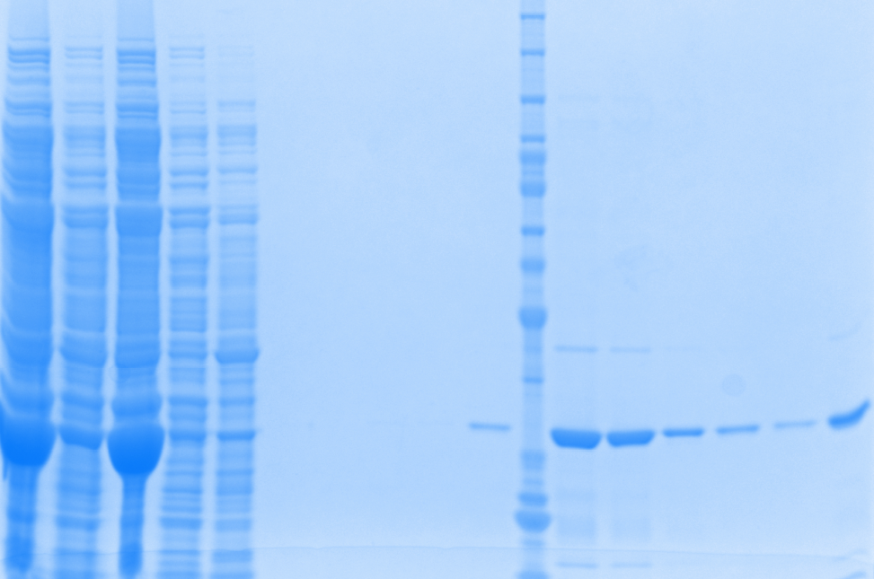
Week of 10.26.2015
New Batch II
1mM IPTG induction (3X200mL)
8M Urea
Gel 7
Elution 3
Elution 4

Slide 8
1mM IPTG induction at 30 ºC 8M Urea treatment | New Batch I_800mL (week of 10.26.2015) | New Batch II_600mL (week of 10.26.2015) | Batch I_800mL (week of 10.19.2015) | Batch II_800mL (week of 10.19.2015)
[Purified Protein], ug/ul | 0.3706 | 0.4259 | 0.7657 | 0.7441
V_{Total}, ul | 6150 | 4350 | 2500 | 2500
Total protein, ug | 2279.1 | 1852.7 | 1914.3 | 1860.3
Specific activity, U/ug | 0.4862 | 0.4289 | 0.2821 | 0.2426
Total Reactions | 443 | 318 | 216 | 181
Purity | >95% | >95% | 80-85% | 80-85%
How many batches required for one series of initial rate Exp. | Good | Good | 1.4 | 1.7
Conclusion:
By loading through different column and pool together for dialysis
The purity of the protein is good >95%
The specific activity is OK.
The amount of protein from one batch will be enough for one series of initial rate Exp. (repeat is not included)
The concentration and specific activity from two batches are comparable.
Next step:
As mentioned, the amount of protein from one batch will be enough for one series of initial rate Exp. without duplication.
Should we run another round of purification ?
Or start the kinetic study without repeat?
Please keep in mind, the comparison of control experiments, which will proceed from tomorrow as shown on schedule, will use 50 reactions from each batch.

