Slide 1
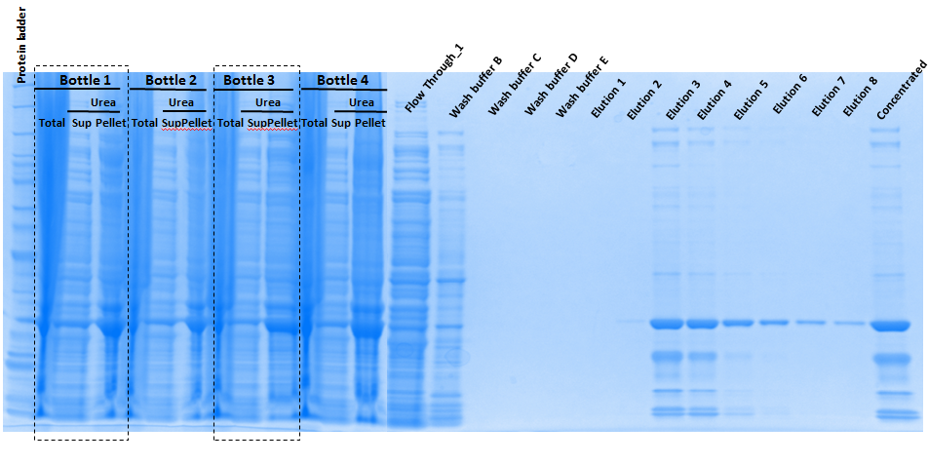
10.23.2015
Large scale _ Batch I
1mM IPTG induction (4X200mL)
8M Urea

Slide 2
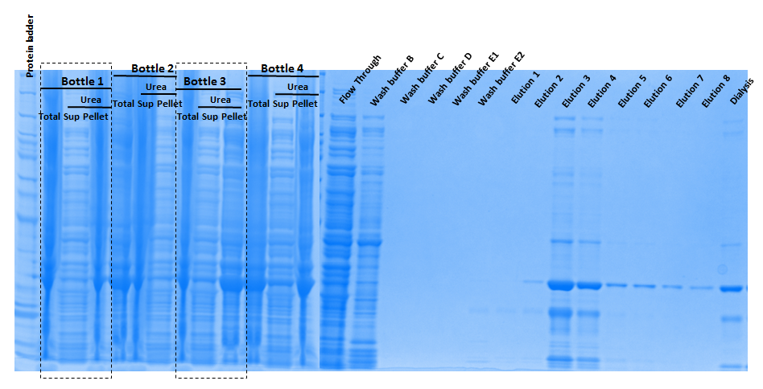
10.23.2015
Large scale _ Batch II
1mM IPTG induction (4x200mL)
8M Urea

Slide 3
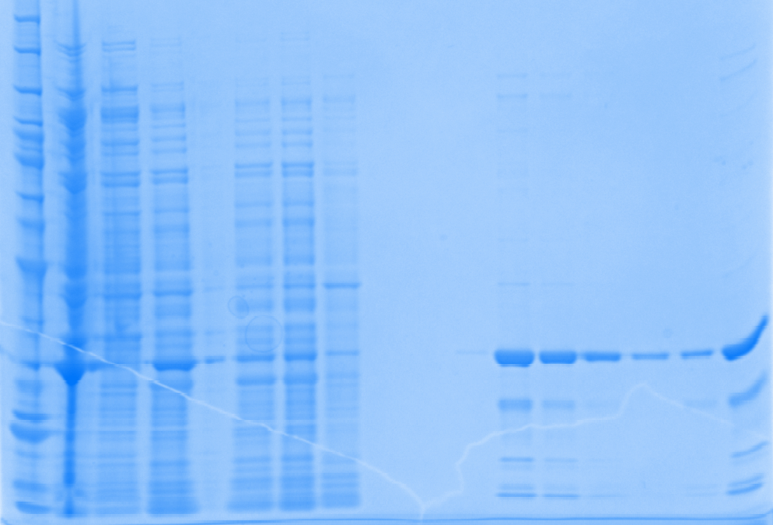
10.16.2015
1mM IPTG induction _ 200mL
8M Urea
Flow Through_1
Protein ladder
Supernatant
Urea (Pellet)
Flow Through_2
Wash buffer B
Urea (sup)
Wash buffer E
Concentrated
Total
Elution 1
Elution 2
Elution 3
Elution 4
Elution 5
Elution 6
Dialysis

Slide 4
1mM IPTG induction at 30 ºC 8M Urea treatment | 200mL | Batch I_800mL | Batch II_800mL
[Purified Protein], ug/ul | 0.5196 | 0.7657 | 0.7441
V_{Total}, ul | 2500 | 2500 | 2500
Total protein, ug | 1299.0 | 1914.3 | 1860.3
Specific activity, U/ug | 0.4052 | 0.2821 | 0.2426
Total Reactions | 211 | 216 | 181
Purity | 95% | 80-85% | 80-85%
How many batches required for one series of initial rate Exp. | 1.4 | 1.4 | 1.7
Conclusion:
Large scale purification
  Purified protein concentration was increased
  Total amount protein was increased
  Purity was decreased
  Specific activity was decreased
  Total reactions can be done for one batch stay the same.
Possible reasons
  For each 200mL culture, it takes quite a while to suspend and proceed for Urea treatment. Proceeding time was too long for 4-fold of cell (800ml) in one day. Homogenizer is needed for speed up these particular steps.
  Loading 4X samples on 1 single column does not provide 4x amount of protein
    Some loss from FlowThrough indicated the binding was not sufficient
    Purity was decreased which indicated extra wash is needed
Possible solutions
  Purify the protein as 200mL per unit
  Load them into different column separately
  Pool them together for dialysis

