Slide 1
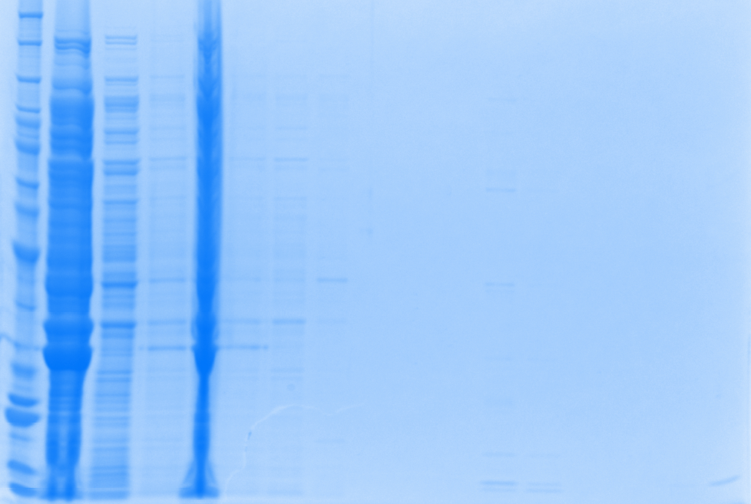
1mM IPTG induction
1M Urea
Protein ladder
Flow Through_1
Supernatant
Urea (Pellet)
Flow Through_2
Wash buffer B
Urea (sup)
Wash buffer E
Concentrated
Total
Elution 1
Elution 2
Elution 3
Elution 4
Elution 5
Elution 6
Dialysis
?
?

Slide 2
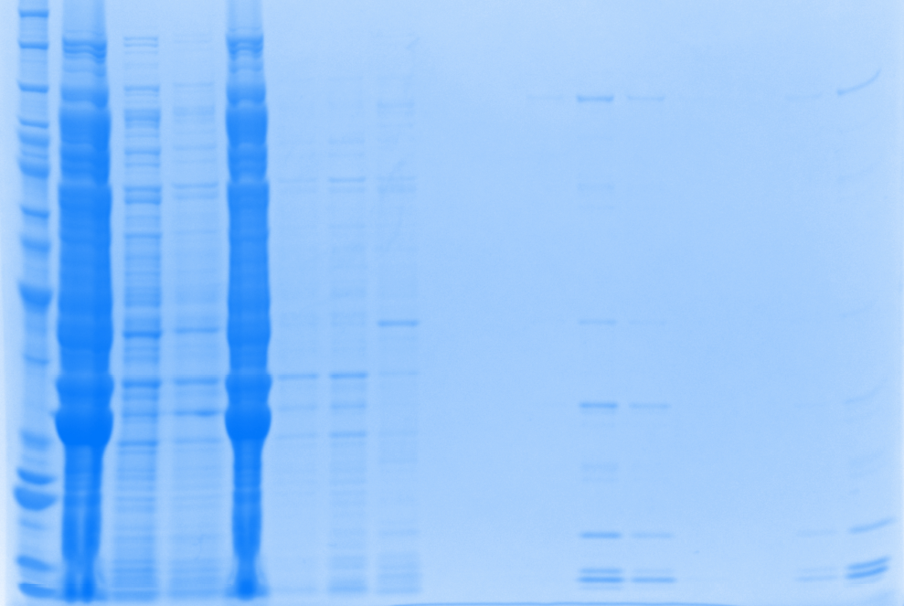
1mM IPTG induction
4M Urea
Protein ladder
Flow Through_1
Supernatant
Urea (Pellet)
Flow Through_2
Wash buffer B
Urea (sup)
Wash buffer E
Concentrated
Total
Elution 1
Elution 2
Elution 3
Elution 4
Elution 5
Elution 6
Dialysis

Slide 3
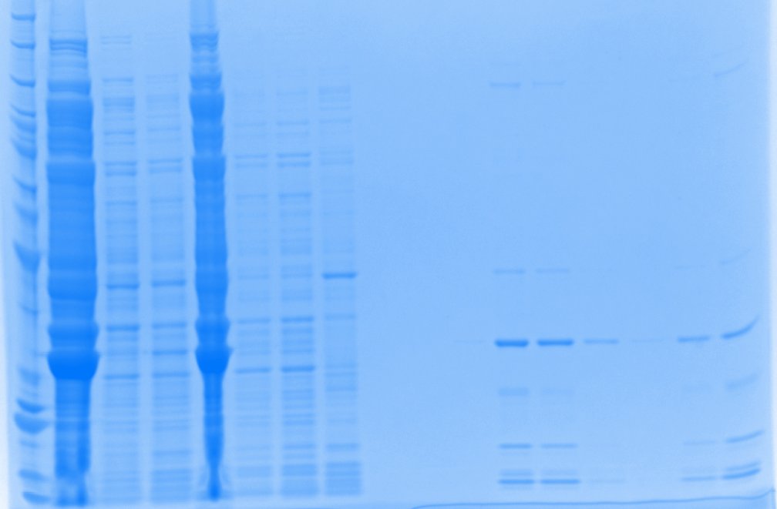
1mM IPTG induction
6M Urea
Protein ladder
Flow Through_1
Supernatant
Urea (Pellet)
Flow Through_2
Wash buffer B
Urea (sup)
Wash buffer E
Concentrated
Total
Elution 1
Elution 2
Elution 3
Elution 4
Elution 5
Elution 6
Dialysis

Slide 4
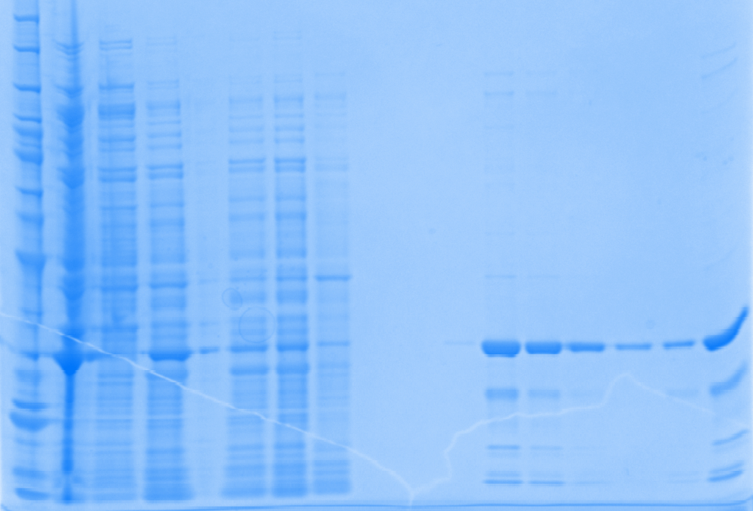
1mM IPTG induction
8M Urea
Protein ladder
Flow Through_1
Supernatant
Urea (Pellet)
Flow Through_2
Wash buffer B
Urea (sup)
Wash buffer E
Concentrated
Total
Elution 1
Elution 2
Elution 3
Elution 4
Elution 5
Elution 6
Dialysis

Slide 5
1mM IPTG induction at 30 ºC | 1M Urea | 4M Urea | 6M Urea | 8M Urea
[Purified Protein], ug/ul | 0.1451 | 0.1863 | 0.2725 | 0.5196
V_{Total}, ul | 2500 | 2500 | 2500 | 2500
Total protein, ug | 362.8 | 465.8 | 681.3 | 1299.0
Specific activity, U/ug | 0.0452 | 0.0964 | 0.4453 | 0.4052
Total Reactions | 7 | 18 | 121 | 211
How many batches required for one series of initial rate Exp. | 45.7 | 16.7 | 2.5 | 1.4
Conclusion:
1M and 4M Urea do not work well in terms of restoring the target protein.
The protein treated with 6M Urea has slightly better specific activity (0.4453 U/ug vs. 0.4052U/ug)
Compare with 50uM IPTG and 1mM IPTG induction in which 8M Urea was applied
  Total amount of protein: 478.3 ug vs. 1299 ug
  Total reactions from one batch: 76 vs. 211
  Total batches needed for one series of initial rate Exp: 3.8 vs. 1.4
  Purity: 90% vs. 95%

