Slide 1
Concentration of in-house Sirt3 batches, based on two different types of Bradford Assay
4/26/2017

Slide 2
Issues with concentration of protein samples:
The protein concentrations measured in-house were done using a BSA standard curve from the absorbance of the BSA standards and samples at 280 nm.
However, from the SEC results it was discovered that there was a lot of DNA present in the T-Sirt3 protein samples.
Since DNA absorbs at 260 nm, the absorbance at 280 nm (used to estimate protein concentration) is mostly from the DNA.
Therefore the concentrations determined from the BSA standard curve are wrong (much higher than the correct concentrations).
Thus to determine the correct protein concentrations, Bradford assay was used.
Two different versions of Bradford assay was done to verify the concentration values.

Slide 3
Concentration of Sirt3 batches using microassay-Bradford assay procedure
Manufacturers instructions were followed for the microplate based Bradford assay procedure.
Absorbance of the standards and samples were measured at 595 nm.
Concentrations of the T-Sirt3 samples (dilutions) were determined from the standard curve.

Slide 4
Concentrations of the T-Sirt3 batches
Based on the Bradford assay, concentrations are:
Batch 1 = 0.51 mg/ml
Batch 2A = 0.21 mg/ml
Batch 2B = 0.16 mg/ml
However, since Batch 1 is impure, based on comparison with Batches 2A and B and densitometric analysis, the correct concentration of Batch 1 is 0.3 mg/ml.

Slide 5
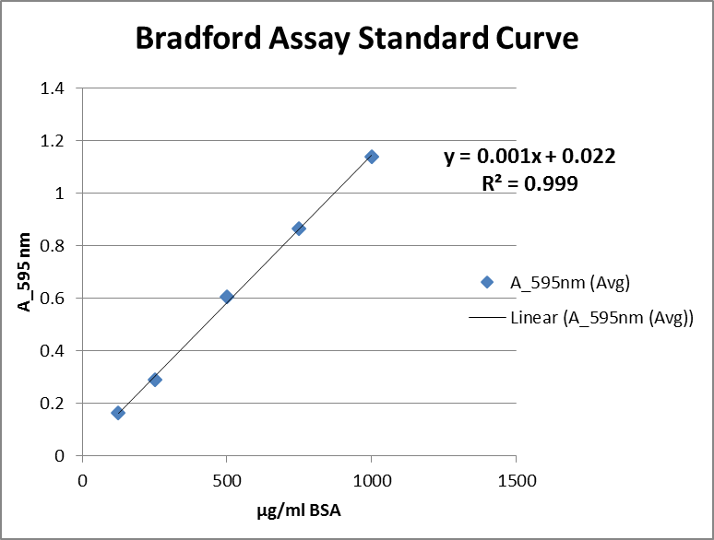
Concentration of Sirt3 batches using standard-Bradford assay procedure
Manufacturers instructions were followed for the cuvette-based standard Bradford assay procedure.
Absorbance of the standards and samples were measured at 595 nm.
Concentrations of the Sirt3 samples were determined from the standard curve.

Slide 6
Average values for the concentration of Sirt3 batches determined using two different Bradford assay procedures
Samples | Micro-assay (mg/ml) | Standard-assay (mg/ml) | Average (mg/ml)
T-Sirt3-Batch 1 | 0.3 | 0.25 | 0.275
T-Sirt3-Batch 2A | 0.21 | 0.16 | 0.185
T-Sirt3-Batch 2B | 0.16 | 0.093 | 0.1265
Sirt3(102-399)-8/9 | NA | 0.13 | 0.13

