Slide 1
Objective: To develop a standardised method for measuring annealing/ melting rates for complementary DNA oligomers by UV absorbance spectroscopy.
Briefly,
  Complementary oligomers are mixed together in a standard buffer in equal molarity.
  Both ssDNA and dsDNA concentration is measured at 260nm. During a melt run, as temperature is increased, absorbance_{(260nm)} increases with increasing single-stranded DNA. Alternatively, as temperature is decreased, absorbance_{(260nm)} decreases with decreasing single-stranded DNA.
  Thus the absorbance at any instant of time in a thermal (melt) run can be correlated to the ds/ ss DNA concentration at that instant by using the absorbance at 25ºC (when the oligos are completely annealed or ds) or using the absorbance at 90ºC (when the oligos are completely melted or ss form) respectively.
  To determine the rate of annealing/ melting at any given temperature, two approaches have been tried:
    The complementary oligomers are cooled from 90ºC to the hold temperature being tested, say, 70ºC. The ramp down rate and hold time are known (and user programmed). Once at the desired temperature, the sample is incubated for a prolonged period of time so that the change in absorbance over time can be monitored in real time.
    the complementary oligomers are heated from 60ºC to the temperature being tested, say 70ºC. The ramp-up rate and the hold time are known (and user programmed). Once at the desired temperature, the sample is incubated for a prolonged period of time so that the change in absorbance over time can be monitored in real time.
  The data in the following slides used the first protocol ie Prcl 1.

Slide 2
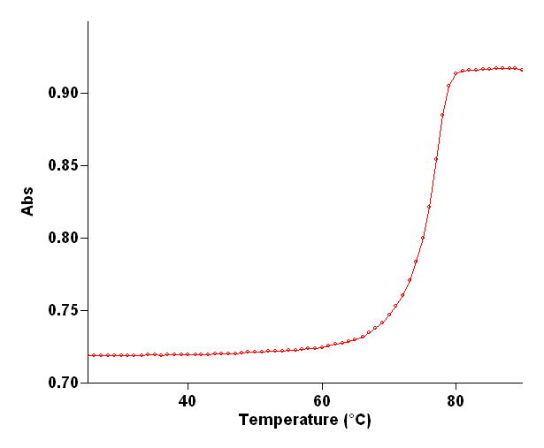
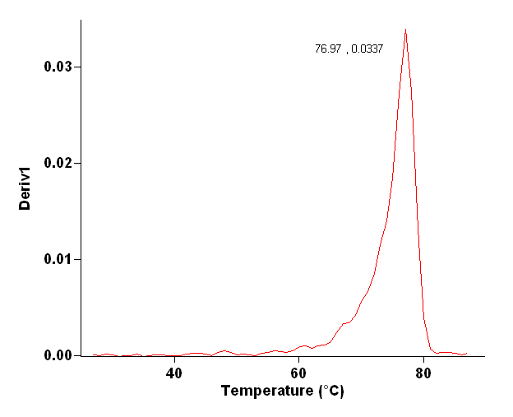
Oligomer details
Name | Size | Sequence | %GC | Melting Temperature, Tm* (width/ range of melting)
A1a16 | 40bases | 5’- GACTGCAAAGATGGAAACGACCTTCTATGACGATGCCCTC-3' | 50 | 77ºC (3ºC)
A2 (complementary oligo) | 40bases | 5'-GAGGGCATCGTCATAGAAGGTCGTTTCCATCTTTGCAGTC-3' | 50
*: This is the melting temperature in the absence of any dye
75.02
78.02
Melt Curve of oligo pair A1a16-A2 performed as part of this experiment (also in the absence of dye)
First derivative of the melt curve of A1a16-A2, the positive peak represents the melting temperature (Tm = 77ºC, see table above).
Second derivative of the melt curve of A1a16-A2, the positive and negative peaks represent the limits of the range of temperatures over which melting occurs (width = 3ºC, see table above); the point at which the plot cuts the X-axis is the Tm (77ºC).

Slide 3
Methods: Protocol 1
The experiment is carried out in the Cary 100 UV-Vis Spectrophotometer
Reaction Sample prepared as follows:
Reaction sample denatured as follows (program used is denat mthd 2):
  Heated up to 95ºC at 10ºC/min
  Held at 95oC for 1.5min
  Returned to 90ºC
Reaction sample subjected to melt - kinetic run at desired temperature (74/ 75/ 76ºC) (program used is prcl1 mthd 1).
Protocol 1 Mthd 1 details:
  Start thermal run at high end (90ºC)
  Ramp down to desired temperature (74/ 75/ 76ºC) for thermal (melt) profile
  Hold at desired temperature for kinetic run until equilibration
  See following slide for instrument parameters
Component | Source | Concentration
Native Taq Polymerase buffer | Life Technologies | 1X
MgCl₂ | Life Technologies | 2mM
Oligo 1 (A1a16) | Sigma Custom Oligos | 1uM
Oligo 2 (A2) | Sigma Custome Oligos | 1uM
Total vol |  | 1500ul

Slide 4
Comparison of melting kinetics of A1a16-A2 oligo pair (40bp, %GC = 50) at
74-75-76-78ºC as measured by UV absorbance spectroscopy
Thermal (melt) run from 90 to 74/ 75/ 76/ 78ºC
Kinetic run at 74/ 75/ 76/ 78ºC for 120secs*
*See following slide for scale up of kinetic plots
Thermal Run Instrument Parameters
Start Temp |  | 90ºC
End Temp |  | 74/ 75/ 76ºC
Ramp Rate |  | 0.5ºC/min
Avg Time |  | 2sec
Data Interval |  | 1ºC
Kinetic Run Instrument Parameters
Stop Time | 2min
Signal Averaging Time (SAT) | 0.1secs
Data Interval | 1sec

Slide 5
Scale up of Kinetic Plots for A1a16-A2 at 74-75-76-78ºC to view the trend of the first 5secs and the first 20secs
Kinetic run at: 74ºC 75ºC 76ºC 78ºC
0secs -120secs
0secs -5secs
A_{(260nm)}
0secs -20secs

Slide 6
Summary of results
Both ssDNA and dsDNA concentration is measured at 260nm. During a melt run, as temperature is increased, absorbance_{(260nm)} increases with increasing single-stranded DNA. Alternatively, as temperature is decreased, absorbance_{(260nm)} decreases with decreasing single-stranded DNA.
As expected, as the end temperature of the melt run is increased from 74 to 78ºC, the Δ absorbance increases (see below). Also as kinetic run temperature is increased from 74 to 76ºC, the Δ absorbance at the end of 2mins increases. There is a trend from 74 to 76ºC, however the increase is not very significant.
The temperatures chosen for this experiment were based on the Tm of the ds oligo complex in the absence of dye (~77ºC).
Also, please note last 2 columns of kinetic run (bordered in black): These show the distinct trend in the first 5 secs which is temperature dependent. This can also be seen in the plots in the previous slide.
Expt end (kinetic run) temp | Thermal run |  |  | Kinetic run
 | Absorbance_{[start]} (90ºC) | Absorbance_{[end]} (74/ 75/ 76ºC) | Δabsorbance = A_{(end)} – A _{(start)} | Absorbance_{[start]} (t=0) | Absorbance_{[end]} (t=120) | Δabsorbance = A_{(end)} – A _{(start)} | Absorbance (t=5) | Δabsorbance = A_{(t=5)} – A _{(t=0)}
74ºC | 1.0767 | 0.9376 | -0.1391 | 0.9359 | 0.9393 | 0.0033 | 0.9322 | -0.0037
75ºC | 0.8875 | 0.7657 | -0.1218 | 0.7646 | 0.7706 | 0.0059 | 0.7643 | -0.0003
76ºC | 1.0871 | 0.9923 | -0.0948 | 0.9892 | 0.9986 | 0.0094 | 0.9916 | 0.0024
78ºC | 0.9174 | 0.8780 | -0.0394 | 0.8799 | 0.8804 | 0.0005 | 0.8809 | 0.0010

