Slide 1
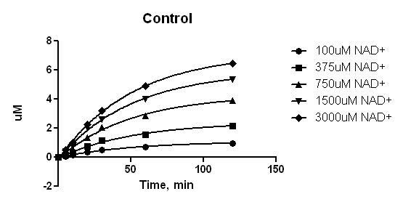
[DHP1c]=0 uM
[Enzo SRIT3]=5U
[FdL peptide]=100uM
37oC
Time, min | 100uM NAD+ | 375uM NAD+ | 750uM NAD+ | 1500uM NAD+ | 3000uM NAD+
0 | 255 | 261 | 332 | 267 | 274
5 | 285.6 | 322.4 | 413.7 | 400 | 451
10 | 314.7 | 380.7 | 491.3 | 552 | 622
20 | 393.4 | 538.6 | 701.5 | 966 | 1080
30 | 467.9 | 688.1 | 900.5 | 1159 | 1408
60 | 542.4 | 837.6 | 1127 | 1645 | 2016
120 | 658.2 | 1070 | 1409 | 2109 | 2549

Slide 2
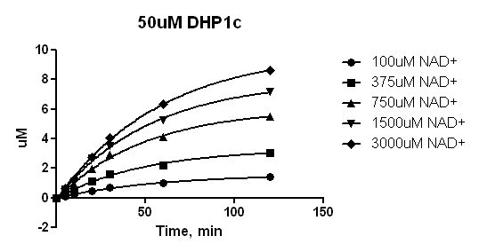
[DHP1c]=50 uM
[Enzo SRIT3]=5U
[FdL peptide]=100uM
37oC
Time, min | 100uM NAD+ | 375uM NAD+ | 750uM NAD+ | 1500uM NAD+ | 3000uM NAD+
0 | 822 | 1232 | 1370 | 1578 | 1764
5 | 870 | 1334 | 1504 | 1783 | 1995
10 | 909 | 1429 | 1623 | 1974 | 2216
20 | 1018 | 1658 | 1913 | 2489 | 2741
30 | 1108 | 1835 | 2176 | 2786 | 3199
60 | 1227 | 2059 | 2504 | 3378 | 4008
120 | 1401 | 2365 | 2897 | 4035 | 4813

