Slide 1
Taq Polymerase Activity
Supplementary 1: August 2013
(Assays at 50-75ºC with dNTP concentration variation: Jun-July 2013)
Review of previous experiments to determine validity of one phase association kinetics for curve fitting of RFU vs time plots
Recalculation of initial rate vs [dNTP] plots based on substrate inhibition model

Slide 2
Summary
The Jan 2012 data which was reviewed before finalizing conditions for the current series of experiments is presented (slides 3-4).
Template concentration 100nM has lower background (~1.5 for 100nM vs ~ 3 for 200nM template) but a smaller net RFU gain in 10mins (~2 units for 100nM at 70ºC vs ~3.5 for 200nM template at 70ºC). Initial rate calculations were comparable.
The following are the limitations of the Jan 2012 data (which were also discussed):
The equilibration step was not included in the assay.
The 20ul reaction was aliquoted (5ul) into microtitre wells for quantitation introducing an extra pipetting step
As can be seen, straight line curves have been previously obtained for similar assay conditions. Plateauing of the curve depends on assay conditions (assay temperature, substrate concentration etc.) One Phase Association Kinetics for RFU vs time need not be changed.
The Jan 2012 and July 2013 data for corresponding assays is compared (slide 5):
The Jan 2012 and July 2013 curves for 75, 65 and 55ºC assays are parallel. However, please note, equilibrartion was not included in the Jan experiments.
The Jan 2012 and July 2013 curves for 75, 65 and 55ºC assays are parallel but do not overlay. Batch to batch variation in Picogreen and its dilution appears to make a difference in raw RFU values.
Date | Assay Conditions | Quant conditions
Jan 2012 | 200nM template; 0.36nM Taq; 400uM dNTP in 20ul reaction (no equilibration) | 5ul aliquot of reaction + 45ul of 1:200 diluted PG; transferred into microtitre plate
July 2013 | 200nM template; 0.36nM Taq; 400uM dNTP in 20ul reaction (30min equilibration) | 20ul reaction (entire contents) + 80ul of 1:178 diluted PG; in the PCR plate itself

Slide 3
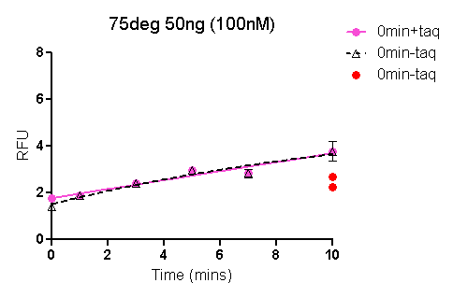
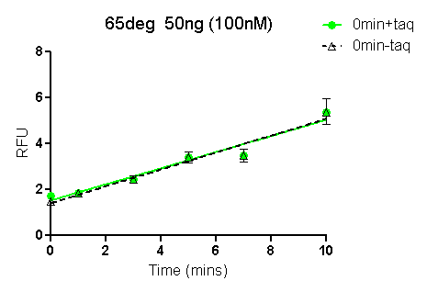
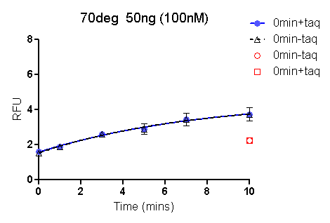
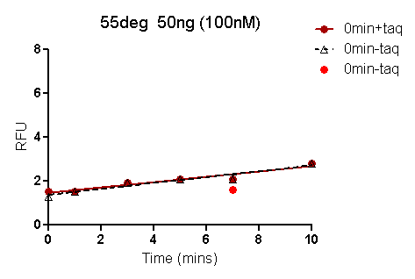
Taq Polymerase Activity (Jan 2012) 100nM template; 0.36nM Taq; 400uM dNTP in 20ul reaction (no equilibration) 5ul aliquot of reaction + 45ul of 1:200 diluted PG for quantitation

Slide 4
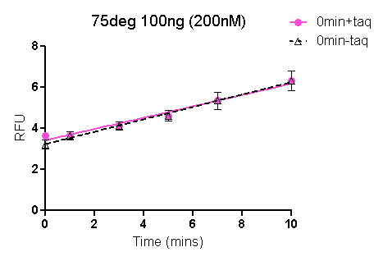
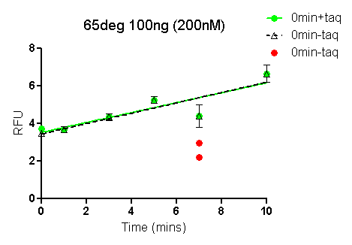
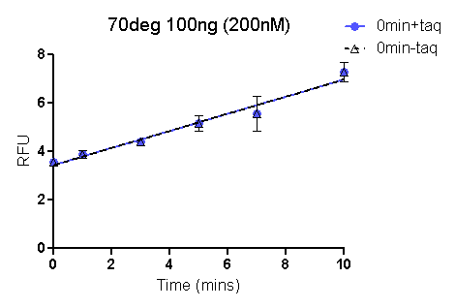
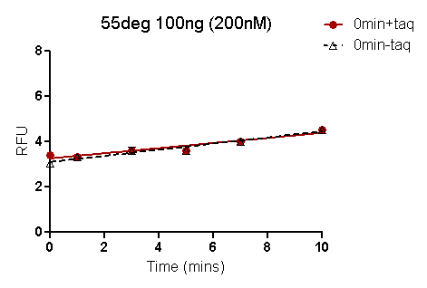
Taq Polymerase Activity (Jan 2012) 200nM template; 0.36nM Taq; 400uM dNTP in 20ul reaction (no equilibration) 5ul aliquot of reaction + 45ul of 1:200 diluted PG for quantitation

Slide 5
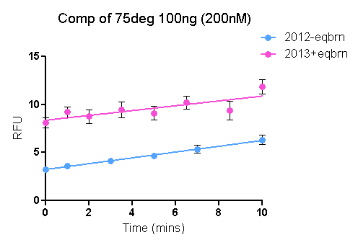
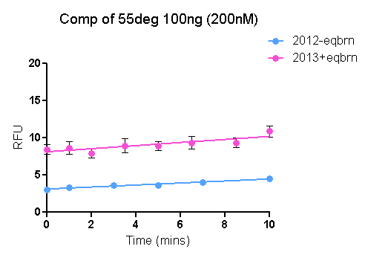
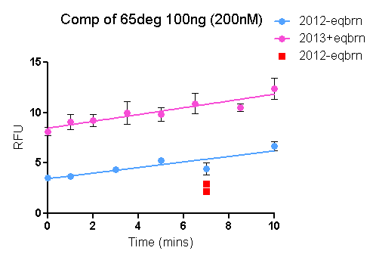
Comparison of Corresponding Taq Polymerase Assays Jan 2012 and July 2013
Date | Assay Conditions | Quant conditions
Jan 2012 | 200nM template; 0.36nM Taq; 400uM dNTP in 20ul reaction (no equilibration) | 5ul aliquot of reaction + 45ul of 1:200 diluted PG; transferred into microtitre plate
July 2013 | 200nM template; 0.36nM Taq; 400uM dNTP in 20ul reaction (30min equilibration) | 20ul reaction (entire contents) + 80ul of 1:178 diluted PG; in the PCR plate itself

Slide 6
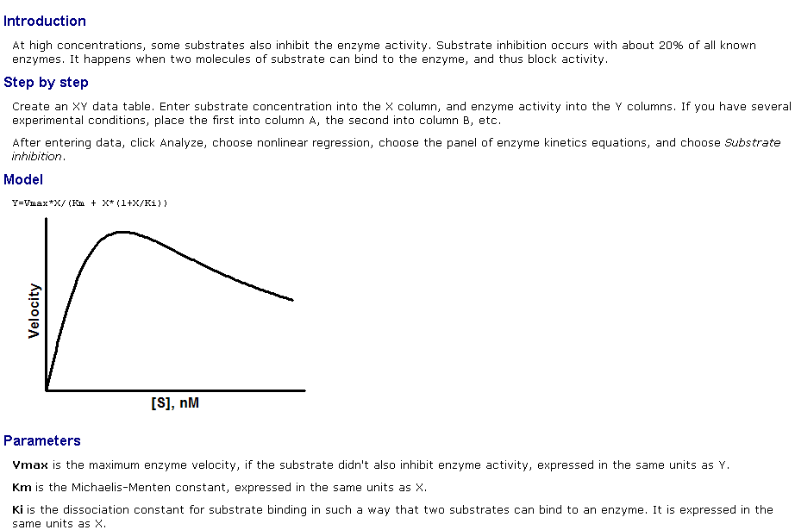
Equation for rate vs [dNTP]: Substrate Inhibition Initial reaction rate of Taq polymerase increases with increasing [dNTP] up to a point; further increase in [dNTP] inhibits enzyme activity; the equation for substrate inhibition may be a better fit than the standard Michaelis-Menten equation.

Slide 7
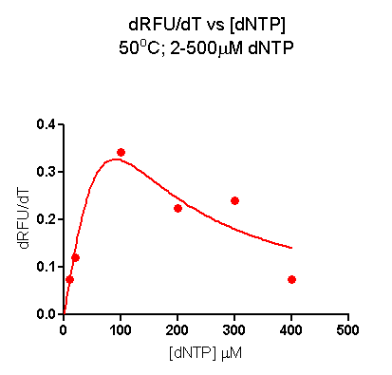
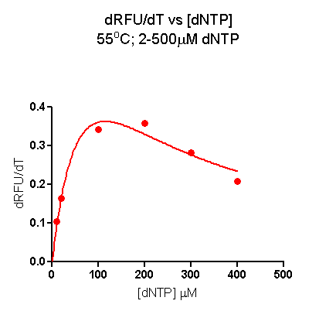
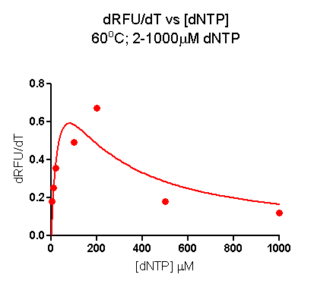
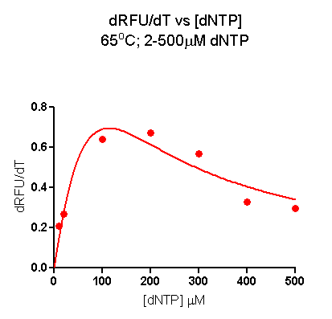
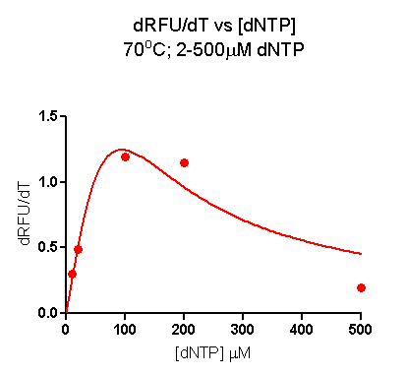
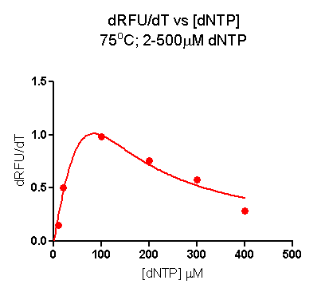
Taq Polymerase Initial Rate Vs dNTP concentration 50-75ºC

