Slide 1
Sirtuins reaction mechanism & binding loop structural changes

Slide 2
hSIRT3
A flexible binding loop ILE154-GLU177 with ILE154-TYR165 having the potential to interact with substrates (NAD+, Intermediates, etc.)
The loop conformation highly depends on the substrate bound.
Using carba-NAD+ in place of NAD+ doesn’t change the loop conformation significantly comparing to SIRT3 (3GLS) and SIRT3/ACS2 complex (3GLR). The loop features a helix structure in SER162-GLN170. Similar structure is found in yHST2/carba-NAD+/H4 complex (1SZC).
Upon convertion to intermediate (4BVG), or binding to thioimidate intermediate (3GLT), or products with Ex-527 inhibitor (4BVH), the helix unwinds and PHE157 rotate and the phenyl ring occupies part of the C pocket, TYR165 from unwinded helix also comes closer to interact with intermediate with intermediate is formed. These structures often feature a α-turn in SER159-GLY163.
Szczepankiewicz BG, Dai H, Koppetsch KJ, Qian D, Jiang F, et al. (2012) Synthesis of carba-NAD and the structures of its ternary complexes with SIRT3 and SIRT5. J Org Chem 77: 7319–7329.
Gertz M, Fischer F et al (2013) Ex-527 inhibits Sirtuins by exploiting their unique NAD+-dependent deacetylation mechanism. Proc Natl Acad Sci U S A 110: E2772–E2781.
Zhao K, Harshaw R, Chai X, Marmorstein R (2004) Structural basis for nicotinamide cleavage and ADP-ribose transfer by NAD(+)-dependent Sir2 histone/protein deacetylases. Proc Natl Acad Sci U S A 101: 8563–8568.

Slide 3
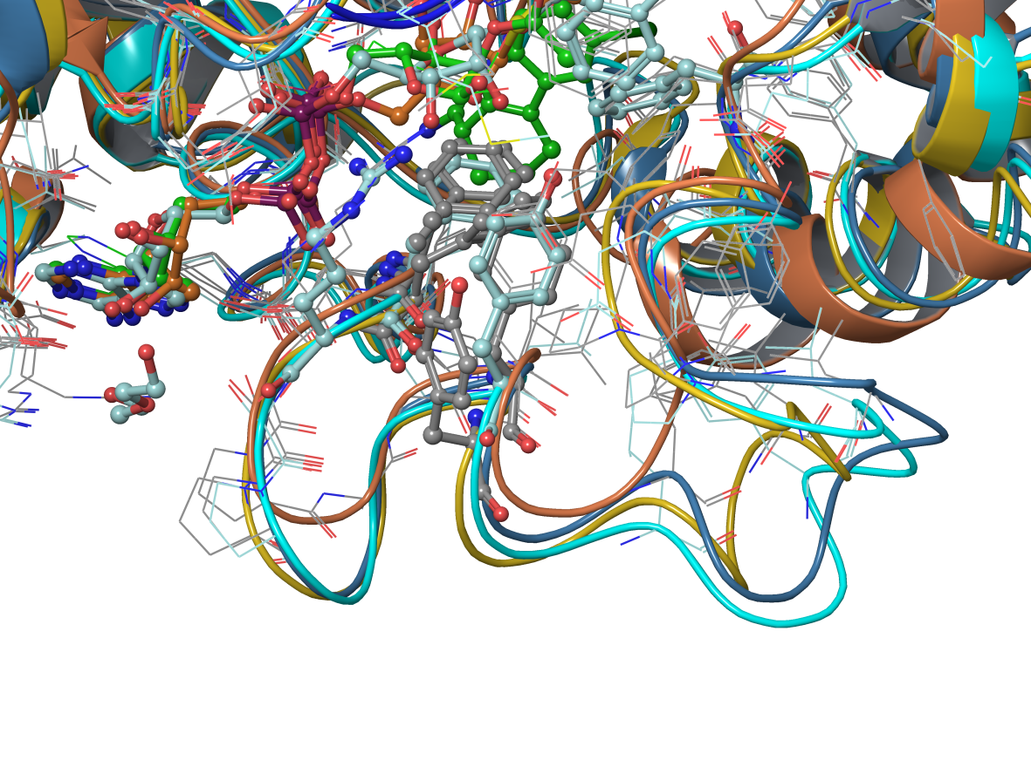
The loop conformation
The helix
The turn

Slide 4
Sir2TM
2H4F, 2H4H (H116Y) suggested HIS116 not essential for NAD+ binding and PHE33 may be important for NAD+ positioning.
In 2H59 (H116A) there are significant change in the N-ribose position and the binding loop also get close to the substrates (ARG34 and TYR40 are getting closer), PHE33 rotates and occupies C pocket (in a similar position when NAM is presented (1YC5)). A β-turn is formed in GLY35-GLY38.
Hoff, K. G., Avalos, J. L., Sens, K., Wolberger, C. (2006) Insights into the Sirtuin mechanism from ternary complexes containing NAD+ and acetylated peptide, Structure 14, 1231-1240.
PHE33 is found to critical for blocking NAM exchange as seen from ySir2-F274N and crystal structure with thioimidate intermediate (3D81). F33A is more sensitive to NAM inhibition.
Armstrong, C.M., Kaeberlein, M., Imai, S.I., and Guarente, L. (2002). Mutations in Saccharomyces cerevisiae gene SIR2 can have differential effects on in vivo silencing phenotypes and in vitro histone deacetylation activity. Mol. Biol. Cell 13, 1427–1438.
Hawse WF, Hoff KG, Fatkins DG, Daines A, Zubkova O V, et al. (2008) Structural insights into intermediate steps in the Sir2 deacetylation reaction. Structure 16: 1368–1377.
QM/MM/MD study by Zhang’s group suggested a loop conformation changes in the second step of the reaction, which bring TYR40 close to interact with intermediate. However, the initial loop conformation is not created from the X-ray crystal structure as ARG34-SER44 were not resolved (3D81).
Shi Y, Zhou Y, Wang S, Zhang Y (2013) Sirtuin Deacetylation Mechanism and Catalytic Role of the Dynamic Cofactor Binding Loop. J Phys Chem Lett 4: 491–495.

Slide 5
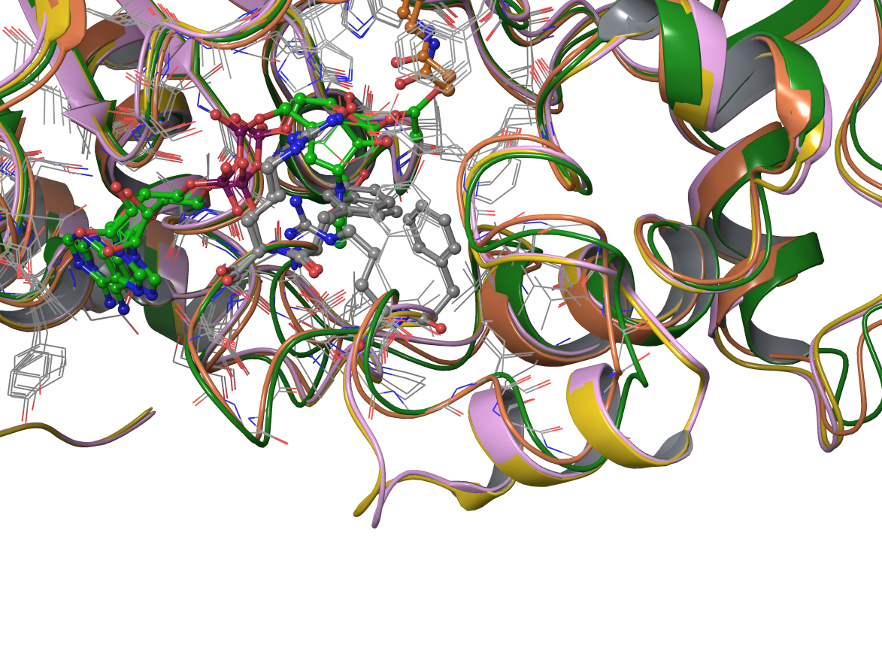
yHST2
The crystal structures of yHST2 complex show similar loop structure: stable helix (1SZC, 1SZD) vs α-turn (1Q1A, 1Q17).
Zhao K, Harshaw R, Chai X, Marmorstein R (2004) Structural basis for nicotinamide cleavage and ADP-ribose transfer by NAD(+)-dependent Sir2 histone/protein deacetylases. Proc Natl Acad Sci U S A 101: 8563–8568.
Zhao K, Chai X, Marmorstein R (2003) Structure of the Yeast Hst2 Protein Deacetylase in Ternary Complex with 2′-O-Acetyl ADP Ribose and Histone Peptide. Structure 11: 1403–1411.
The QM/MM study by Jiang’s group is based on the 1SZC structure, suggesting the first step of the reaction can proceed without the loop conformation change.
Liang Z, Shi T, Ouyang S, Li H, Yu K, et al. (2010) Investigation of the catalytic mechanism of Sir2 enzyme with QM/MM approach: SN1 vs SN2? J Phys Chem B 114: 11927–11933.
The turn
The helix

Slide 6
Ternary complex and its analogs
2H4F (Sir2TM), 4FVT(SIRT3,carba-NAD+), 1SZC(Hst2, carba-NAD+)
In SIRT3, the hydrophobic pocket: ILE179, PHE180, LEU195, LEU199, ILE230, PHE294; and the amide binding pocket: ALA146(backbone, water bridged), ILE154 (backbone, water bridged), ASP231, THR250 (backbone); are all well conserved.
The binding loop PRO155-ALA178 can take multiple conformations and often change its conformation upon ligand binding and selective to ligands.
The only true ternary structure 2H4F suggests that PHE33 is already fold near the C-pocket after NAD+ and acetyl-Lys are bound.

Slide 7
There are studies on Sir2Af2, hSIRT5 complexes and the references and structures are yet to be further analyzed.

