Slide 1
Substrate Binding
Method:
Equilibrium dialysis
Target enzyme(s):
HST2
Data analysis:
The concentrations of bound [³H]AcH3 was plotted vs. the concentrations of free [³H]AcH3 and fitted into equation below.
$\left[AcH3∙enzyme\right]=\frac{{\left[AcH3∙enzyme\right]}_{max}[AcH3]}{K_{d}+[AcH3]}$ , K_{d} is the dissociation constant.
Results:
No NAD⁺ binding was detected with HST2. AcH3 can bind to the HST2 with a K_{d} of 150 uM.
Conclusion:
The acetylated substrate is the first to bind.
Not
determined
$k_{d}$= $\frac{k_{−0}}{k_{0}}$
Borra, MT et al. Substrate specificity and kinetic mechanism of the Sir2 family of NAD⁺-dependent histone/protein deacetylases. Biochemistry (2004) 43: 9877-9887

Slide 2
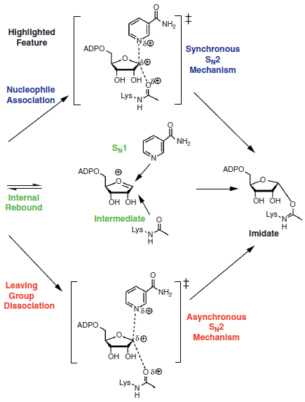
Transition state (TS) or intermediates proposed for ADP-ribosylation of acetyllysine.
TS
Identification of a novel intermediate –ADPR-peptidyl-imidate intermediate –
α-1’-O-alkylamidate intermediate
Proposed mechanisms of reaction of NAD⁺ with acetyllysine nucleophile
Stepwise S_{N}1 mechanism
Synchronous S_{N}2 mechanism
Asynchronous S_{N}2 mechanism
The reaction is initiated by dissociation of the leaving group. The electrophilic C1’ of NAD⁺ develops translational movement during the TS from its position on nicotinamide to its destination position on the nucleophilic acetyl-carbonyl.
X-ray structure data of TS-type analogues on the active site of sirtuins support this comcept.
A QM/MM computational study of TmSir2 was interpreted in favor of this mechanism.
A computational study of the Sir2Af2 catalyzed reaction of NAD⁺ with acetyllysine reached a similar conclusion, fortified with experimental kinetic isotope effects (KIE) data (calculated for candidate transition state structure using computational methods like Gaussian 03 and ISOEFF 98)-see next slide for details.
How crucial is transition state stabilization and how is it achieved?
Is there room for variability of mechanism of NAD+ reactivity?
Hawse, WF et al. Structural insights into intermediate steps in the Sir2 deacetylation reaction. Structure (2008) 16: 1368-1377.
Hu, P et al. Highly dissociative and concerted mechanism for the nicotinamide cleavage reaction in Sir2Tm enzyme suggested by ab initio QM/MM molecular dynamics
simulations. J Am Chem Soc 2008, 130:16721-16728.

Slide 3
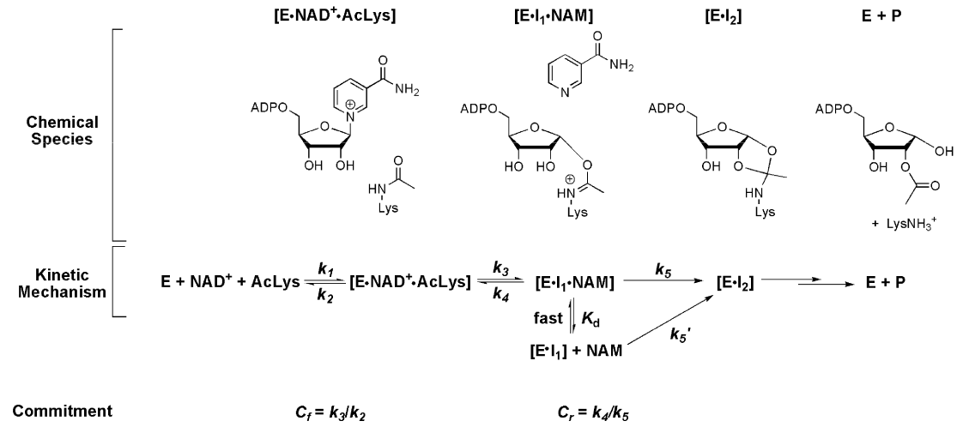
Transition state (TS) of ADP-ribosylation of acetyllysine catalyzed by Sir2Af2 (KIE, Gaussian 03, and ISOEFF 98)
KIE was applied for the study and refers to the change in the rate of a chemical reaction upon substitution of an atom in the reactants with one of its isotopes. Formally, it is defined as the ratio of rate constants for the reactions involving the light (k_{L}) and the heavy (k_{H}) isotopically substituted reactants, KIE= K_{L}/K_{H}.
Not
determined
0.95 mM
Proposed kinetic mechanism, including relevant rate constants and definitions of forward and reverse commitments relevant to the V/K KIE measurement for the ADP-ribosylation of acetyllysine. The base exchange reaction described in the text occurs via reaction of NAD⁺ forward to form the imidate complex (EI₁), dissociation of nicotinamide from the EI₁·NAM complex, reassociation of radiolabeled nicotinamide to the complex (as shown by fast equilibrium), reformation of NAD⁺ via step governed by k₄, and release of reformed NAD⁺ back into solution.
k₄ is the reverse rate of nicotinamide return to NAD⁺ from the imidate complex, k₅ is the forward rate of reaction from the fully nicotinamide complexed imidate, the value of C_{r} was computed using Michaelis parameters for Sir2Af2 using the peptide substrate using the assumption that K_{d} ≈ K_{m} (nicotinamide) for base exchange and with the assumption that k₅ ≈ k_{deacetyl} and k₄ ≈ k_{B.E}.
Cen, Y et al. Transition state of ADP-ribosylation of acetyllysine catalyzed by Sir2AF2 determined by KIE and computational approaches. JACS(2010) 132:12286-12298.
Notes:
The effect of forward and reverse commitment factors govern observed KIEs and are predicted by the Northrop’s equation
${KIE}_{obs}$= $\frac{{KIE}_{int}+C_{f}+C_{r}∙{KIE}_{eq}}{1+C_{f}+C_{r}}$
Because the forward commitment factor is negligible, where k₂>>k₃ and C_{f}= k₃/k₂,
then ${KIE}_{obs}$= $\frac{{KIE}_{int}+C_{r}∙{KIE}_{eq}}{1+C_{r}}$,
where KIE_{obs} is the observed isotope effect,
KIE_{int} is the intrinsic isotope effect,
KIE_{eq} is the equilibrium isotope effect of E·I₁ (the imidate complex) with the free enzyme and reactants
C_{r} is the reverse commitment defined by the rate of the intermediate proceeding forward, before E·I₁·NAM can react backward.
As such the observed commitment is sensitive to the fraction of E·I₁ that resides in the E·I₁·NAM complex. i.e.
$C_{r(obs)}=\frac{k_{4}[{E∙I}_{1}∙NAM]}{k_{5}\left[{E∙I}_{1}∙NAM\right]+k_{5}^{′}[{E∙I}_{1}]}$, and k₅′≈k₅
then $C_{r(obs)}=\frac{k_{4}[{E∙I}_{1}∙NAM]}{k_{5}(\left[{E∙I}_{1}∙NAM\right]+ \left[{E∙I}_{1}\right])}$
$\frac{ [{E∙I}_{1}∙NAM]}{ \left[{E∙I}_{1}∙NAM\right]+ \left[{E∙I}_{1}\right]}=\frac{[NAM]}{\left[NAM\right]+K_{d}}$,
Therefore, $C_{r(obs)}$=$\frac{k_{4}∙[NAM]}{k_{5}∙(\left[NAM\right]+K_{d})}$
${KIE}_{obs}$= $\frac{{KIE}_{int}+\frac{C_{r}∙{KIE}_{eq}∙[NAM]}{k_{d}+[NAM}}{1+C_{r}∙\frac{[NAM]}{k_{d}+[NAM]}}$

Slide 4
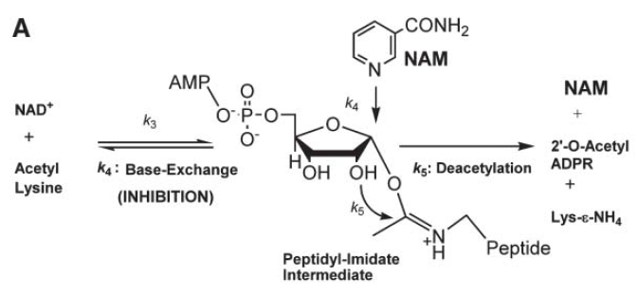
Base Exchange
Method:
[Carbonyl-¹⁴C]NAM, ¹⁸O-NAMHPLC
Target enzyme(s):
ySir2, Sir2Af, SIRT1
Data analysis:
The lines were fit to the equation V ) kcat - kp([I]/Ki + [I]).
Results:
Conclusion:
A strategy for increasing Sir2 enzyme catalytic activity in vivo by inhibition of chemical exchange.
NAM and isoNAM activation of Sir2 deacetylase activity is achieved without affecting substrate or NAD+ binding by altering the proportion of imidate-enzyme complexes proceeding toward the deacetylated product.
A.A. Sauve, V.L. Schramm, Sir2 regulation by nicotinamide results from switching between base exchange and deacetylation chemistry, Biochemistry 42 (2003)9249–9256.
A.A. Sauve, R.D. Moir, V.L. Schramm, I.M. Willis, Chemical activation of Sir2- dependent silencing by relief of nicotinamide inhibition, Mol. Cell 17 (2005) 595–601.

Slide 5
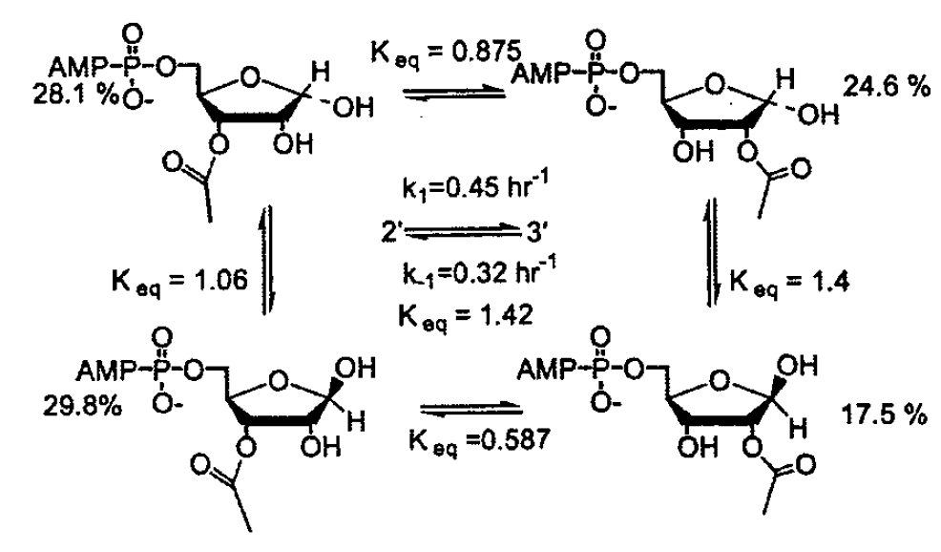
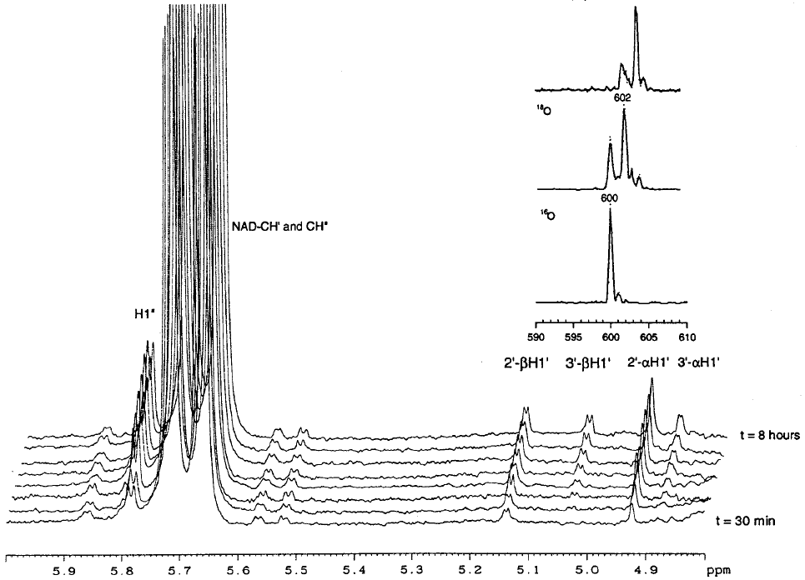
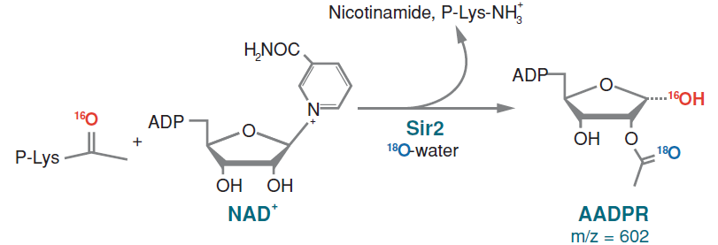
Method:
¹H NMR, 2D NMR, MS/MS, ¹⁸O exchange, and HPLC
Target enzyme(s):
Sir2Af2, Sir2Tm, and ySir2
Data analysis:
The percentage of 3’-AADPR was fit to
, where P_{a} + P_{f} = P_{o}
P_{a} is the % of the 3’AADPR above equilibrium at t=0
t is time; K is the first-order rate constant;
P_{f} is the equilibrium percentage; P_{o} is the initial percentage
Spontaneous non-enzymatic equilibration
Results:
The Sir2 reaction produced 2’- and 3’-AADPR and their α, β enantiomers.
2’-AADPR forms early in the Sir2 reaction followed by the production of the 3’-AADPR.
3’ –AADPR  2’-AADPR is with a first-order rate constant for acetyl migration of 0.32 h⁻¹ at pH 6.25. Keq was 1.4 at 15ºC and the rate constant for 2’ –AADPR  3’-AADPR is 0.45 h⁻¹.
Conclusions:
The mechanism of acetyl transfer to NAD⁺ includes (1) ADP ribosylation of the peptide acyl oxygen to form a high-energy O-alkyl amidate intermediate, (2) attack of the 2’-OH group on the amidate to form a 1’,2’-acyloxonium species, (3) hydrolysis to 2’-AADPR by the attack of water on the carbonyl carbon, and (4) an SIR2-independent transesterification equilibrating the 2’- and 3’-AADPRs.
Sauve AA et al. Chemistry of Gene Silencing: The Mechanism of NAD⁺-Dependent Deacetylation Reactions. Biochemistry (2001) 40: 15456-15463.
Smith, BC et al. Sir2 protein deacetylases: Evidence for chemical intermediates and functions of a conserved histidine. Biochemistry (2006) 45: 272-282.

