Slide 1
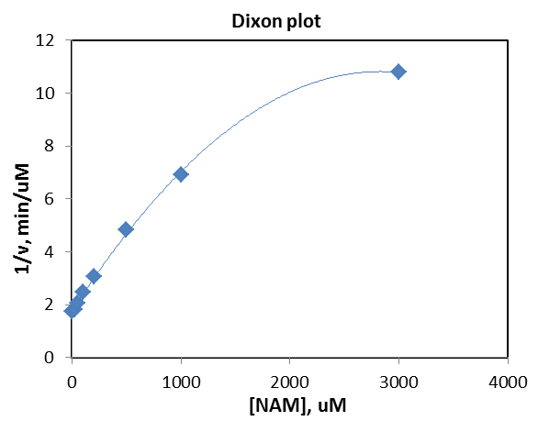
Exp1: Sirt3 inhibition by NAM on K122-MnSOD peptide
Reaction conditions-
3000 uM NAD⁺
600 uM K122-MnSOD
5U/rxn Enzo Sirt3 (0.214 uM = 10.7 pmoles)
5% DMSO
[NAM] = 25, 50, 100, 200, 500, 1000, 3000 uM
30 min reaction at 37^{O}C
Previous
[NAM], uM | 1/v, min/uM
0 | 1.74
25 | 1.82
50 | 2.05
100 | 2.48
200 | 3.06
500 | 4.85
1000 | 6.91
3000 | 10.79
New, combined
[NAM], uM | % activity | [P], uM
0 | 100.00 | 17.29
25 | 95.51 | 16.514
50 | 84.67 | 14.64
100 | 70.04 | 12.11
200 | 56.77 | 9.815
500 | 35.80 | 6.19
1000 | 25.10 | 4.34
3000 | 16.08 | 2.78

Slide 2
Exp2: Sirt3 inhibition by NAM on K122-MnSOD peptide
Reaction conditions-
100 uM NAD⁺
600 uM K122-MnSOD
5U/rxn in-house Sirt3 (1.85 uM or 92.5 pmoles)
5% DMSO
[NAM] = 100, 200, 300 uM
30 min reaction at 37^{O}C
100 uM NAD+ | [Product formed], uM |  | % Actitiy remain |  | % Inhibition
[NAM], uM | without 200 uM HKL | with 200 uM HKL | without 200 uM HKL | with 200 uM HKL | without 200 uM HKL | with 200 uM HKL
0 | 5.831 |  | 100.00 |  | 0
100 | 2.753 | 2.002 | 47.22 | 34.33 | 52.783 | 65.668
200 | 2.279 | 2.003 | 39.08 | 34.35 | 60.922 | 65.652
300 | 2.018 | 1.858 | 34.61 | 31.86 | 65.388 | 68.137
100 uM NAD+ | [Product formed], uM |  | [Product formed], pmoles
[NAM], uM | without 200 uM HKL | with 200 uM HKL | without 200 uM HKL | with 200 uM HKL
0 | 5.831 |  | 291.56
100 | 2.753 | 2.002 | 137.67 | 100.10
200 | 2.279 | 2.003 | 113.94 | 100.15
300 | 2.018 | 1.858 | 100.91 | 92.90

Slide 3
Exp2: Sirt3 inhibition by NAM on K122-MnSOD peptide ([NAD+] = 3000 uM)
Reaction conditions-
3000 uM NAD⁺
600 uM K122-MnSOD
5U/rxn in-house Sirt3 (1.85 uM or 92.5 pmoles)
5% DMSO
[NAM] = 100, 200, 300 uM
30 min reaction at 37^{O}C
3000uM NAD+ | [Product formed], uM |  | % Actitiy remain |  | % Inhibition
[NAM], uM | without 200 uM HKL | with 200 uM HKL | without 200 uM HKL | with 200 uM HKL | without 200 uM HKL | with 200 uM HKL
0 | 21.223 |  | 100.0 |  | 0.0
100.00 | 15.035 | 6.789 | 70.8 | 32.0 | 29.2 | 68.0
200.00 | 10.973 | 5.222 | 51.7 | 24.6 | 48.3 | 75.4
300.00 | 9.589 | 4.246 | 45.2 | 20.0 | 54.8 | 80.0
3000uM NAD+ | [Product formed], uM |  | [Product formed], pmoles
[NAM], uM | without 200 uM HKL | with 200 uM HKL | without 200 uM HKL | with 200 uM HKL
0 | 21.223 |  | 1061.2
100.00 | 15.035 | 6.789 | 751.765 | 339.471
200.00 | 10.973 | 5.222 | 548.633 | 261.106
300.00 | 9.589 | 4.246 | 479.437 | 212.293

