Slide 1
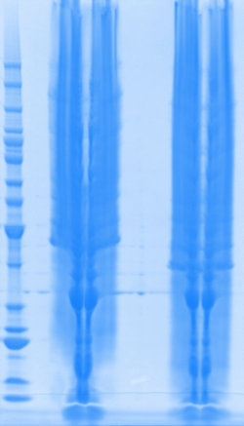
SIRT3 Purification
SIRT3 plasmids were transformed to BL21 cell.
Plate the above chemical transformation product on LB argar with Ampicillin (1:1000) at 37oC overnight.
Single colonies were detected and were cultured firstly in 500 ul LB broth/Amp till OD to 0.6.
Transfer 20 ul of above culture to 5mL LB broth/Amp overnight at 37oC with 250 rpm
Scale up for 100ml of cell culture.
Add IPTG for final concentration (2mM) at 37oC 250 rpm for 3 hours.
Centrifuge to get the cell pellet and stored at -80oC till use.
Add lysis buffer + bugbuster and sonication.
Centrifuge to obtain supernatant
SIRT3 (102-399)
UniProt ID: Q9NTG7
Length: 298
Mass (Da): 32,700
SIRT3A SIRT3B
Under current condition, protein expression level is good.

Slide 2
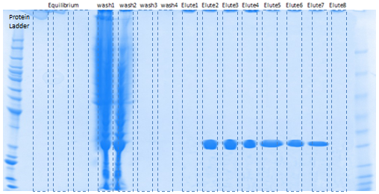
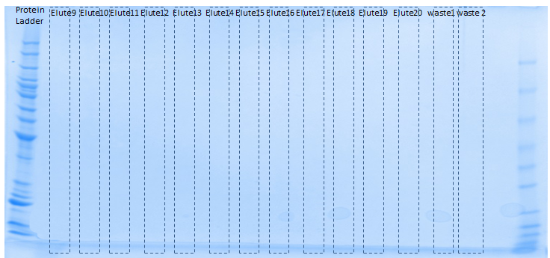
10. AKTA first Ni-column purification
Equilibration 4.5 ml
Wash 20 column volume (20 ml,5ml /fraction)
Elution 10 cv (10 ml, 0.5 ml/fraction)
Waste
11. Run protein gel to check
SIRT3 protein expression level
Fraction content
First 2 wash (10 ml) are enough
First 7 elution (3.5ml) are good
Modify AKTA program
Reduce wash volume to 10 CV
Reduce elution to 5 CV

Slide 3
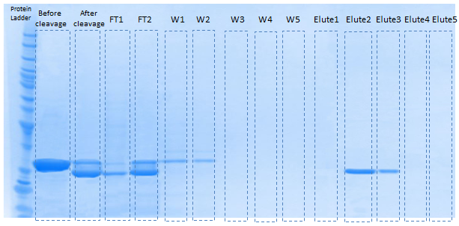
12. rTEV cleavage
Transfer the last step protein into dialysis tube with addition of rTEV (0.15 ml, 2mg/ml)
1uint cleaves >85% of 3ug protein
10units/ug
Dialysis at 4oC overnight
Cleavage efficiency need to be improved
13. AKTA second Ni-column purification
Equilibration 2 ml
Wash 5 column volume (5 ml,1ml /fraction)
Elution 5 cv (10 ml, 1 ml/fraction)
Equilibrium column using ethanol buffer

Slide 4
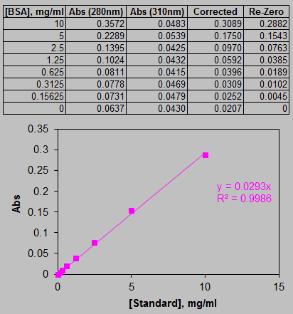
14. Protein concentration measurement
First Step FPLC
 | Abs (280 nm) | [Protein], mg/ml
After sonication | 0.3534 | 12.0619
FT1 | 0.0152 | 0.5197
FT2 | 0.0572 | 1.9505
W1 | 0.1039 | 3.5469
W2 | 0.0428 | 1.4603
W3 | 0.0238 | 0.8114
W4 | 0.0169 | 0.5764
W5 | 0.0172 | 0.5858
E1 | 0.0213 | 0.7257
E2-4 | 0.2166 | 7.3933
E5-7 | 0.1200 | 4.0947
E8-20 | 0.0203 | 0.6937
[Final purified SIRT3^{His}]= 2.3144mg/ml

Slide 5
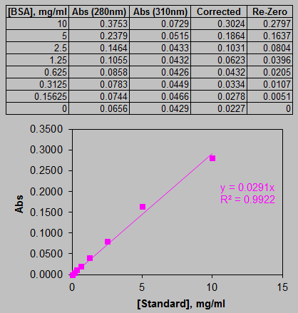
Second Step FPLC
 | Abs (280 nm) | [Protein], mg/ml
Cleavage-Before | 0.1760 | 6.0481
Cleavage-After | 0.1241 | 4.2631
FT1 | 0.0315 | 1.0838
FT2 | 0.1258 | 4.3222
W1 | 0.0656 | 2.2543
W2 | 0.0458 | 1.5734
W3 | 0.0316 | 1.0844
W4 | 0.0106 | 0.3657
W5 | 0.0043 | 0.1487
E1 | 0.0417 | 1.4340
E2 | 0.1370 | 4.7069
E3 | 0.0815 | 2.7997
E4 | 0.0285 | 0.9804
E5 | 0.0122 | 0.4207
[Final purified SIRT3]= 1.085mg/ml

Slide 6
15. Protein activity measurement
[NAD+]=750 uM
[Fluor-de-Lys substrate]= 25 uM
purified protein= 5ul, 10ul, 20 ul
1xdeveloperII/ 2mM NAM
37oC 40 min incubation
Ex=360 nm
Em= 460 nm
% | Control | 5ul | 10ul | 20ul
No protein | 120
His-tage (yes) | 100 | 103 | 105 | 111
His-tage (No) | 100 | 106 | 113 | 127
[Protein], mg/ml |  | Protein, ug
His-tag (yes) | 11.572 | 23.144 | 46.288
His-tag (No) | 5.425 | 10.85 | 21.7
% activity per ug protein | 5ul | 10ul | 20ul
His-tage (yes) | 0.220 | 0.220 | 0.238
His-tage (No) | 1.103 | 1.182 | 1.260
Commons:
SIRT3^{His} also has activity.
2-mercaptoethanol has adsorbtion at 280 nm.
Cleavage step needs more modification.
Purified protein need to be concentrated.
Specific activity need to be measured
Activity comparison between commercial protein and in-house made protein need to be done.

