Slide 1
Comparison of Enzo FdL assay and SIRTainty assay
 | Enzo FdL assay | SIRTainty assay
Plate | half volume white plate | half-volume black plate
Total reaction volume | 50ul | 25ul
Developer | 50ul of 1xdeveloper II (diluted from concentrated solution) | 25ul of ready to use Developer
Standard | FdL standard solution | NAM solution
Peptide substrate | FdL1, FdL2 substrate peptide | Acetylated peptide substrate
Ex wavelength | 360 nm | 420 nm
Em. wavelength | 460 nm | 460 nm
Assay buffer | FdL assay buffer | SIRTainty assay buffer

Slide 2
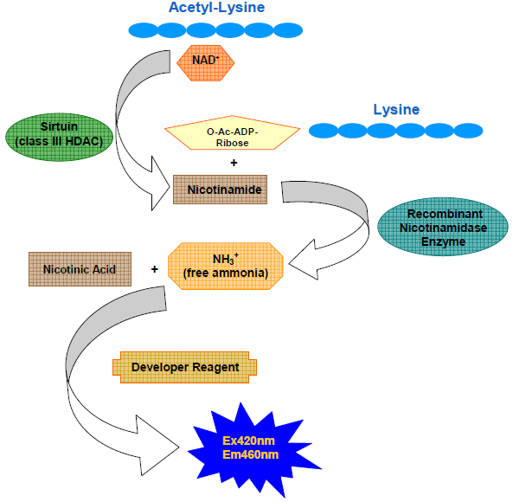
SIRTainty™ Class III HDAC Assay - Mechanism
Step I: NAM formation, then nicotinamidase converts NAM into free amino and nicotinic acid.
Step II: To generate a signal for readout, a proprietary developer reagent is added and the signal is read using a fluorescent plate reader.
(Chemistry behind is :The obtained ammonia is then quntized by reacting with ortho-phathalaldehyde (OPT) and dithiothreitol (DTT), with the formation of 1-alkylthioisoindoles detected at 460nnm.)

Slide 3
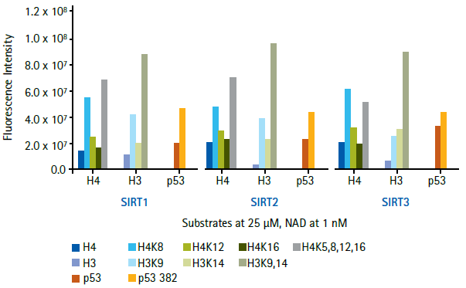
SIRTainty™ Class III HDAC Assay – Advantages
Flexibility in the choice of peptide substrate
Flexibility in the choice of SIRTUIN enzyme
Avoid potential artifacts due to the presence of bulky fluorophore.
Activity of Sirt1, 2, and 3 with a panel of Acetylated Peptide Substrates. Peptide substrates corresponding to p53, histone H3 and histone H4 acetylation sites were selected. Peptides were either unacetylated (H4, H3 and p53), acetylated at one site (e.g. H4K8), or acetylated at more than one site (e.g. H3K9,14). All peptides used are available from Millipore. Recombinant Sirt1 (5 Unit), Sirt2 (0.7 Unit) and Sirt3 (3 Unit) were incubated with indicated acetylated peptide substrates (25 μM) and 1mM β-NAD with the SIRTainty assay. H3K9, H3K9/14, H4K8, and H4K5/8/12/16 displayed high efficiency for deacetylation as compared to the corresponding non-acetylated peptides for all 3 enzymes tested.

Slide 4
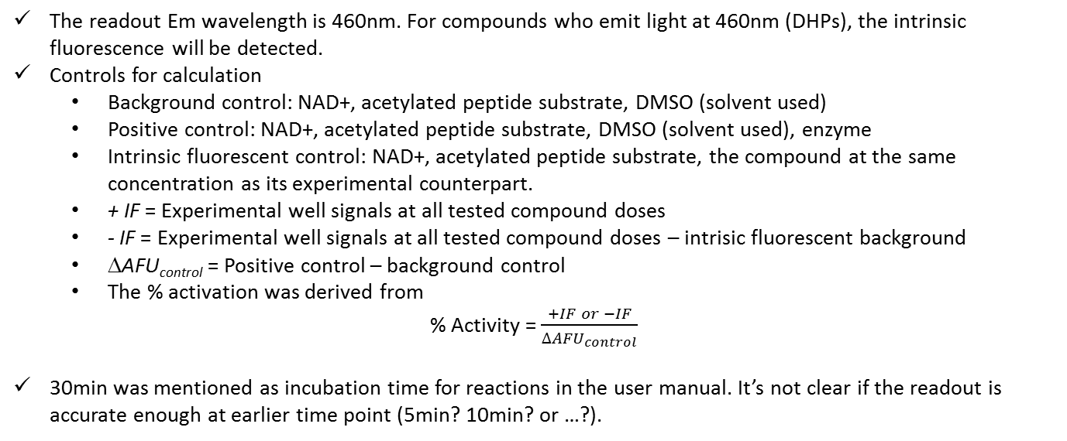
SIRTainty™ Class III HDAC Assay – Disadvantages
The readout Em wavelength is 460nm. For compounds who emit light at 460nm (DHPs), the intrinsic fluorescence will be detected.
Controls for calculation
  Background control: NAD+, acetylated peptide substrate, DMSO (solvent used)
  Positive control: NAD+, acetylated peptide substrate, DMSO (solvent used), enzyme
  Intrinsic fluorescent control: NAD+, acetylated peptide substrate, the compound at the same concentration as its experimental counterpart.
  + IF = Experimental well signals at all tested compound doses
  - IF = Experimental well signals at all tested compound doses – intrisic fluorescent background
  ΔAFU_{control} = Positive control – background control
  The % activation was derived from
% Activity = $\frac{+IF or −IF}{{∆AFU}_{control}}$
30min was mentioned as incubation time for reactions in the user manual. It’s not clear if the readout is accurate enough at earlier time point (5min? 10min? or …?).

Slide 5
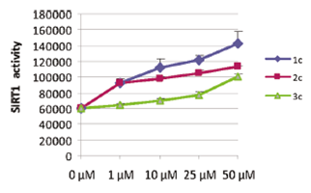
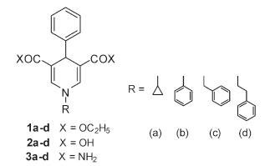
Reported SIRT1 activation by DHP1c Results - I
Antonello Mai et. al. Study of 1,4-Dihydropyridine Structural Scaffold: Discovery of Novel Sirtuin Activators and Inhibitors (2009) J. Med. Chem. 52, 5496–5504.
In the FdL SIRT1 assay, 1c and 2c were the most potent derivatives, with a EC150 (effective concentration able to increase the enzyme activity of 150%) around 1 μM,

Slide 6
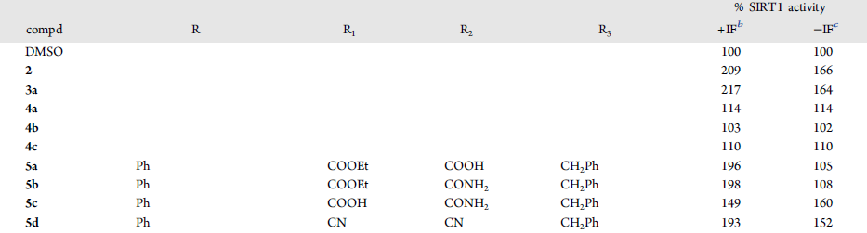
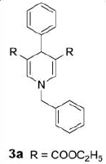
Reported SIRT1 activation by DHP1c Results-II
Sergio Valente et. al. 1,4-Dihydropyridines Active on the SIRT1/AMPK Pathway Ameliorate Skin Repair and Mitochondrial Function and Exhibit Inhibition of Proliferation in Cancer Cells (2015) J. Med. Chem. xx, xxxx.
In the SIRTainty assay, 50uM of compound 3a (DHP1c) provide 217% (with intrinsic fluorescence) and 164% (after intrinsic fluorescence subtraction) SIRT1 activity.
It would be necessary to purchase a SIRTainty assay kit to repeat the SIRT1/DHP1c experiment.

