Slide 1
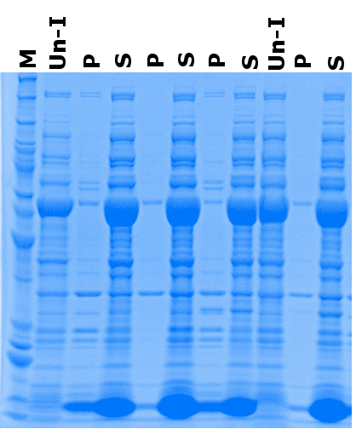
SIRT3 expression using Arctic cells
0.5 % NP-40
M = Marker
P = Pellet
S = Supernatant
Un-I = Un-induced
Red Arrow = Target Protein
50 µM IPTG
0.4 % SDS
0.5 % NP-40
Cpn60
50 kDa
1 mM IPTG
40 kDa
0.4 % SDS
30 kDa
20 kDa
Cpn10

Slide 2
IPTG optimization in Arctic Express cells
50 kDa-
40 kDa-
30 kDa-
UI 1 3 5 10
UI 1 3 5 10
UI 1 3 5 10
Clone 1
Clone 2
Clone 5

Slide 3
SIRT3 purification from clone 2 using Arctic express cells, 3 mM IPTG; 0.5% NP-40
?
50 kDa-
40 kDa-
30 kDa-
SIRT3
M T P S FT W1 W2 W3 XG E1 E2 E3 E4 E5 E6 E7

Slide 4
Protein expression analysis in different clones in Arctic express, 2 mM IPTG; 0.5% NP-40
Date: 10/16/2015
50 kDa-
40 kDa-
Sirt3
30 kDa-
M UI 2 6 7 8 9 10 11
Clones

Slide 5
Protein expression analysis in clone 2 in Arctic express, 200 uM-2 mM IPTG; 0.5% NP-40
Date: 10/16/2015
50 kDa-
40 kDa-
Sirt3
30 kDa-
Modification from previous analysis: Fresh IPTG

Slide 6
Protein expression analysis in clone 2 in Arctic express, 1uM-200 uM IPTG; 0.5% NP-40
Date: 10/16/2015
50 kDa-
40 kDa-
Sirt3
30 kDa-
M UI 1 5 25 50 100 200 uM IPTG

