Slide 1
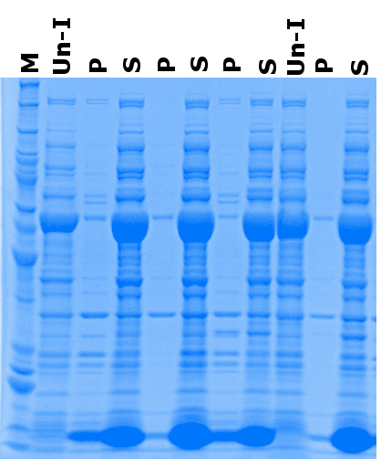
SIRT3 expression using Arctic cells
0.5 % NP-40
M = Marker
P = Pellet
S = Supernatant
Un-I = Un-induced
Red Arrow = Target Protein
50 µM IPTG
0.4 % SDS
0.5 % NP-40
Cpn60
50 kDa
1 mM IPTG
40 kDa
0.4 % SDS
30 kDa
20 kDa
Cpn10

