Slide 1
SIRT1 activation by Resveratrol
Remarks
At sub-saturating conditions, SIRT1 activation by Resveratrol was detected. At fixed NAD concentration, % activation decreased as FdL1peptide concentration increasing (Slide2).
At sub-saturating conditions, SIRT1 activation by Resveratrol was detected. On reaction set was repeated in triplicated to check the reproducibility (Slide3).
At saturating conditions, SIRT1 activation by Resveratrol was not detected. Two peptide concentrations were used (Slide4).
The experiment with previous conditions (500uM NAD+ and 100uM peptide with 50uM resveratrol) was repeated. The activation was observed(Slide5).
Related methods are in Slides 6 and 7.

Slide 2
Resveratrol/SIRT1 _ 04.13.2016 - 04.18.2016
400uM NAD | 0uM resveratrol in 1% DMSO |  |  | 50uM resveratrol in 1% DMSO |  |  | %activation
 | 0 min | 30min | ΔAFU | 0 min | 30min | ΔAFU
25uM FdL1 peptide | 60 | 721 | 661 | 84 | 2936 | 2852 | 431.5
50uM FdL1 peptide | 130 | 1424 | 1294 | 270 | 3319 | 3049 | 235.6
400uM NAD⁺
[SIRT1]=1U/reaction
[NAD⁺]=400 μM
[Substrate]=25, 50 μM
[Resveratrol]=50 μM in 1% DMSO
Control = 1% DMSO
Time point = 0, 30 min

Slide 3
Resveratrol/SIRT1 _ 04.13.2016 - 04.18.2016
 | Control |  |  | 50uM resveratrol |  |  | %Activation
 | 0min | 30min | ΔAFU | 0min | 30min | ΔAFU
Run 1 | 130 | 1424 | 1294 | 270 | 3319 | 3049 | 235.6
Run 2 | 133 | 1478 | 1345 | 274 | 3611 | 3337 | 248.1
Run 3 | 174 | 1466 | 1292 | 498 | 3592 | 3094 | 239.5
 |  |  |  |  |  | AVG | 241.1
 |  |  |  |  |  | Stdv | 6.4
 |  |  |  |  |  | cv% | 2.7
[SIRT1]=1U/reaction
[NAD⁺]=400 μM
[Substrate]=50 μM
[Resveratrol]=50 μM in 1% DMSO
Control = 1% DMSO
Time point = 0, 30 min

Slide 4
Resveratrol/SIRT1 _ 04.13.2016 - 04.18.2016
Experimental conditions |  | 0min | 60min | ΔAFU | % Activation
300uM FdL1 peptide 2000uM NAD⁺ | Control | 462 | 5310 | 4848 | 100.0
 | Resveratrol | 473 | 6012 | 5539 | 114.3
400uM FdL1 peptide 2000uM NAD⁺ | Control | 835 | 6324 | 5489 | 100.0
 | Resveratrol | 900 | 6587 | 5687 | 103.6
[SIRT1]=1U/reaction
[NAD⁺]=2000 μM
[Substrate]=300, 400 μM
[Resveratrol]=50 μM in 1% DMSO
Control = 1% DMSO
Time point = 0, 30 min

Slide 5
Resveratrol/SIRT1 _ 04.13.2016 - 04.18.2016
Modulators / SIRT1 _ 09.04.2014
[SIRT1]=1U/reaction
[NAD⁺]=500 μM
[Substrate]=100 μM
[Resveratrion]=50 μM in 1% DMSO
Control = 1% DMSO
Time point = 0, 30 min
[SIRT1]=1U/reaction
[NAD⁺]=500 μM
[Substrate]=100 μM
[Resveratrol]=50 μM in 5% DMSO
Control = Assay buffer
Time point = 0, 30min
 | 0min | 60min | DAFU | % Activation
Control | 149 | 1806 | 1657 | 100.0
Resveratrol | 107 | 3321 | 3214 | 193.9
 | 0min | 60min | Delta AFU | % Activity
Positive control | 566.1 | 905.6 | 339.5 | 100.0
NAM | 560.4 | 772.1 | 211.7 | 62.4
Resveratrol | 566.2 | 1097.1 | 530.9 | 156.4
1b derivative | 954.7 | 1828.6 | 873.9 | 257.4
1c | 988.1 | 2497.1 | 1509 | 444.5

Slide 6
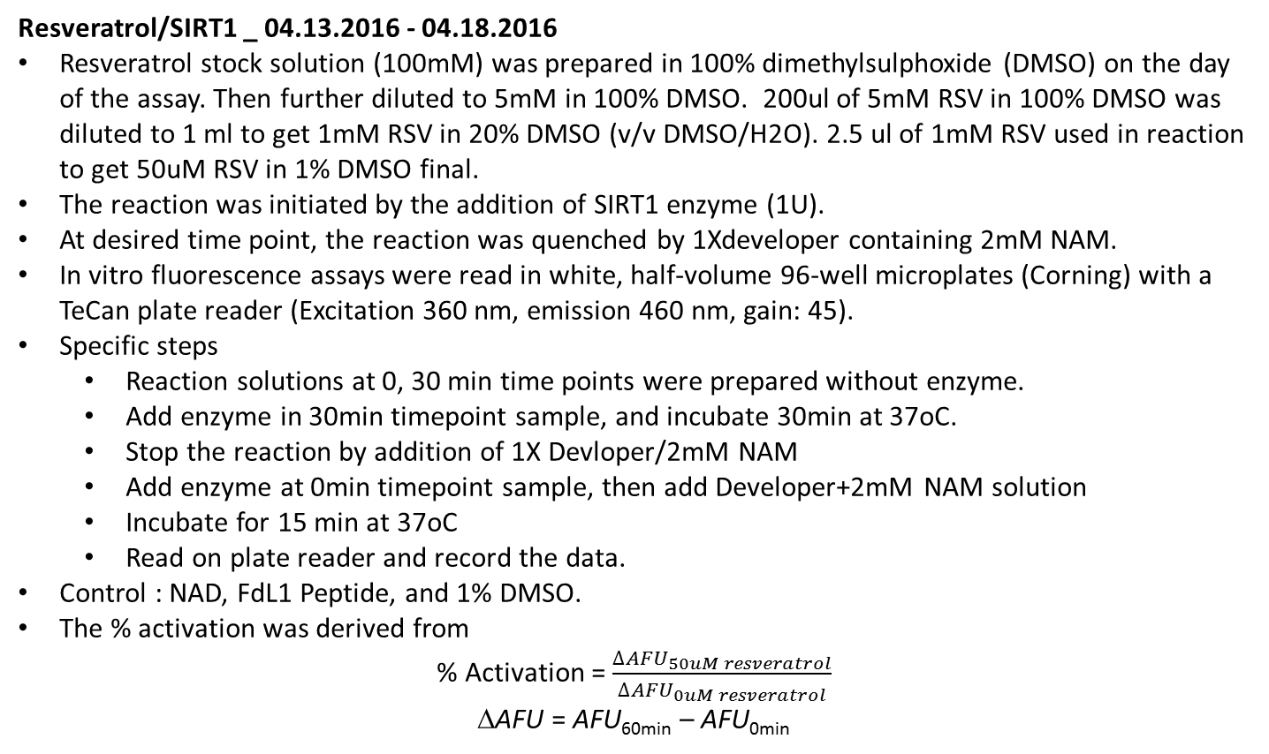
Resveratrol/SIRT1 _ 04.13.2016 - 04.18.2016
Resveratrol stock solution (100mM) was prepared in 100% dimethylsulphoxide (DMSO) on the day of the assay. Then further diluted to 5mM in 100% DMSO. 200ul of 5mM RSV in 100% DMSO was diluted to 1 ml to get 1mM RSV in 20% DMSO (v/v DMSO/H2O). 2.5 ul of 1mM RSV used in reaction to get 50uM RSV in 1% DMSO final.
The reaction was initiated by the addition of SIRT1 enzyme (1U).
At desired time point, the reaction was quenched by 1Xdeveloper containing 2mM NAM.
In vitro fluorescence assays were read in white, half-volume 96-well microplates (Corning) with a TeCan plate reader (Excitation 360 nm, emission 460 nm, gain: 45).
Specific steps
  Reaction solutions at 0, 30 min time points were prepared without enzyme.
  Add enzyme in 30min timepoint sample, and incubate 30min at 37oC.
  Stop the reaction by addition of 1X Devloper/2mM NAM
  Add enzyme at 0min timepoint sample, then add Developer+2mM NAM solution
  Incubate for 15 min at 37oC
  Read on plate reader and record the data.
Control : NAD, FdL1 Peptide, and 1% DMSO.
The % activation was derived from
% Activation = $\frac{{∆AFU}_{50uM resveratrol}}{{∆AFU}_{0uM resveratrol}}$
ΔAFU = AFU_{60min} – AFU_{0min}

Slide 7
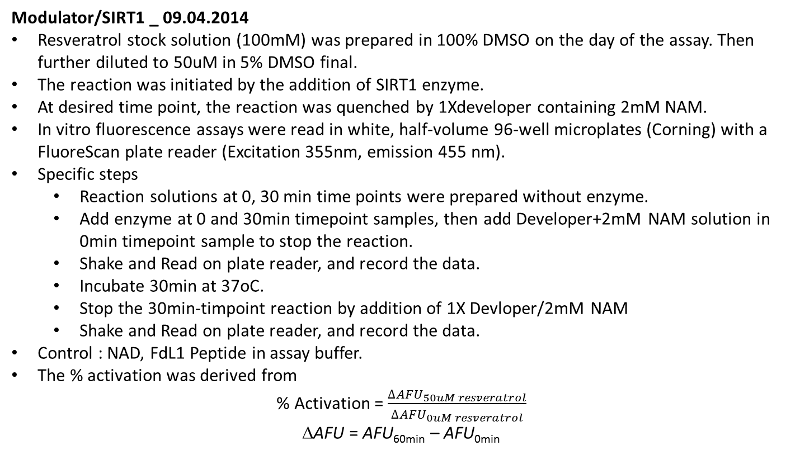
Modulator/SIRT1 _ 09.04.2014
Resveratrol stock solution (100mM) was prepared in 100% DMSO on the day of the assay. Then further diluted to 50uM in 5% DMSO final.
The reaction was initiated by the addition of SIRT1 enzyme.
At desired time point, the reaction was quenched by 1Xdeveloper containing 2mM NAM.
In vitro fluorescence assays were read in white, half-volume 96-well microplates (Corning) with a FluoreScan plate reader (Excitation 355nm, emission 455 nm).
Specific steps
  Reaction solutions at 0, 30 min time points were prepared without enzyme.
  Add enzyme at 0 and 30min timepoint samples, then add Developer+2mM NAM solution in 0min timepoint sample to stop the reaction.
  Shake and Read on plate reader, and record the data.
  Incubate 30min at 37oC.
  Stop the 30min-timpoint reaction by addition of 1X Devloper/2mM NAM
  Shake and Read on plate reader, and record the data.
Control : NAD, FdL1 Peptide in assay buffer.
The % activation was derived from
% Activation = $\frac{{∆AFU}_{50uM resveratrol}}{{∆AFU}_{0uM resveratrol}}$
ΔAFU = AFU_{60min} – AFU_{0min}

