Slide 2
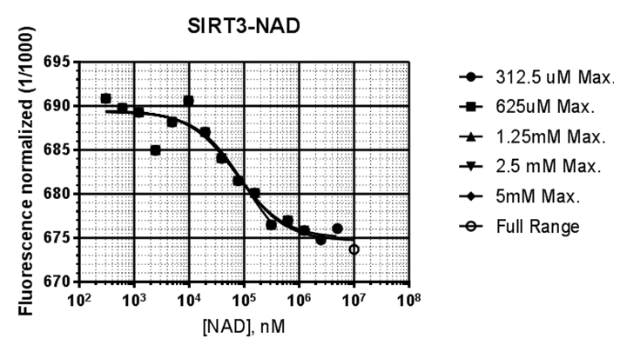
 | PMC-AT Refitting
 | 325uM Max. | 625uM Max. | 1.25 mM Max. | 2.5mM Max. | 5mM Max. | Full Range
Kd, uM | 104.8 | 79.4 | 76.3 | 79.1 | 73.3 | 78.7
Fu | 689.4 | 689.5 | 689.5 | 689.5 | 689.5 | 689.5
Fb | 672.5 | 674.6 | 674.8 | 674.6 | 675 | 674.6
Std. Error
Kd | 74427 | 42000 | 32996 | 29290 | 25245 | 24996
Fu | 0.8664 | 0.8468 | 0.7986 | 0.7535 | 0.7386 | 0.717
Fb | 4.619 | 2.243 | 1.509 | 1.151 | 0.9225 | 0.8019
R square | 0.8759 | 0.9003 | 0.9208 | 0.9351 | 0.9398 | 0.9457
Ab. Sum of Squares | 27.89 | 29.37 | 29.45 | 29.58 | 30.66 | 32.15
Sy.x | 1.867 | 1.806 | 1.716 | 1.64 | 1.598 | 1.573
Sirt3-NAD⁺

Slide 3
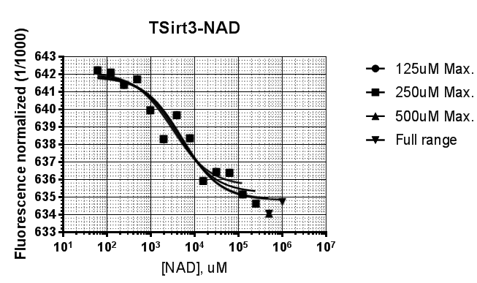
 | PMC-AT Refitting
 | 125uM Max. | 250uM Max. | 500uM Max. | Full range _1mM Max.
Kd, uM | 3.1 | 4.0 | 5.0 | 5.2
Fu | 642.1 | 642 | 641.9 | 641.9
Fb | 635.6 | 635.2 | 634.9 | 634.8
Std. Error
Kd | 1405 | 1635 | 1945 | 1836
Fu | 0.5046 | 0.4794 | 0.467 | 0.4437
Fb | 0.5373 | 0.4839 | 0.4506 | 0.384
R square | 0.9198 | 0.9264 | 0.9295 | 0.9362
Ab. Sum of Squares | 5.858 | 6.657 | 7.746 | 7.767
Sy.x | 0.8067 | 0.8159 | 0.8391 | 0.8045
TSirt3-NAD⁺

Slide 4
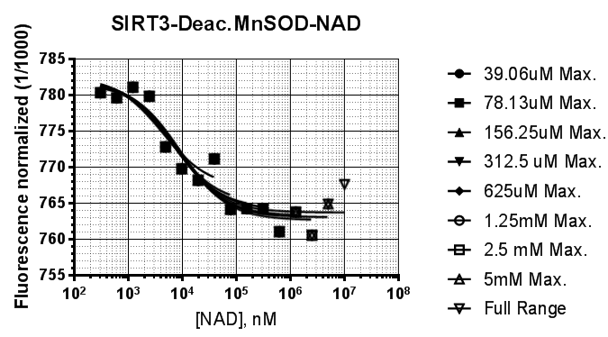
Sirt3-Deac-MnSOD-NAD⁺
 | 39.06uM Max. | 78.13uM Max. | 156.25uM Max. | 325uM Max. | 625uM Max. | 1.25 mM Max. | 2.5mM Max. | 5mM Max. | Full Range
Kd, uM | 4.3 | 6.0 | 6.7 | 6.9 | 8.5 | 8.2 | 9.4 | 8.6 | 7.4
Fu | 782.6 | 782.3 | 782.1 | 782.1 | 781.8 | 781.8 | 781.6 | 781.7 | 782
Fb | 767.1 | 764.9 | 764.3 | 764.1 | 763.1 | 763.3 | 762.7 | 763.1 | 763.7
Std. Error
Kd | 3814 | 4200 | 3788 | 3342 | 3789 | 3377 | 3656 | 3317 | 3224
Fu | 2.517 | 2.182 | 1.926 | 1.759 | 1.684 | 1.604 | 1.556 | 1.58 | 1.815
Fb | 3.063 | 2.562 | 1.891 | 1.444 | 1.317 | 1.088 | 1.005 | 0.8998 | 0.9027
R square | 0.8503 | 0.8792 | 0.903 | 0.9175 | 0.9208 | 0.927 | 0.9284 | 0.9255 | 0.9029
Ab. Sum of Squares | 30.44 | 38.04 | 39.05 | 39.18 | 46.85 | 47.06 | 53.11 | 57.09 | 74.83
Sy.x | 2.467 | 2.518 | 2.362 | 2.213 | 2.282 | 2.169 | 2.197 | 2.181 | 2.399

