Slide 2
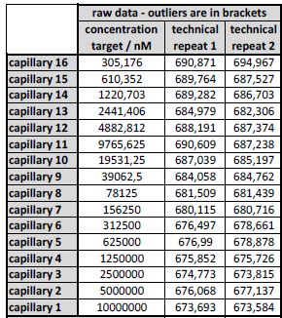
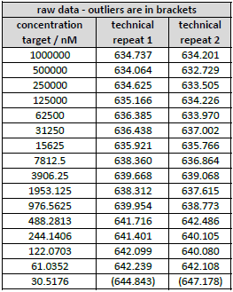
Raw Date:
Sirt3-NAD⁺
T-Sirt3-NAD⁺

Slide 3
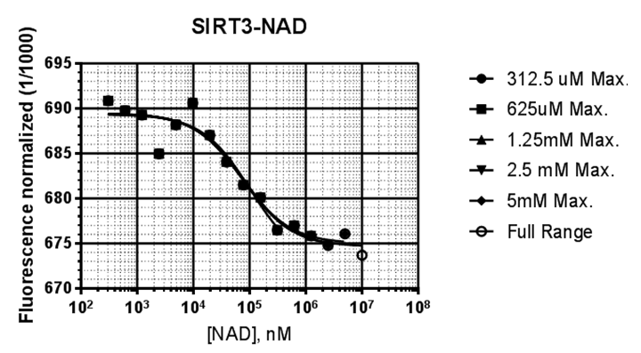
 | PMC-AT Refitting
 | 325uM Max. | 625uM Max. | 1.25 mM Max. | 2.5mM Max. | 5mM Max. | Full Range
Kd, nM | 104799 | 79420 | 76343 | 79072 | 73313 | 78667
Fu | 689.4 | 689.5 | 689.5 | 689.5 | 689.5 | 689.5
Fb | 672.5 | 674.6 | 674.8 | 674.6 | 675 | 674.6
Std. Error
Kd | 74427 | 42000 | 32996 | 29290 | 25245 | 24996
Fu | 0.8664 | 0.8468 | 0.7986 | 0.7535 | 0.7386 | 0.717
Fb | 4.619 | 2.243 | 1.509 | 1.151 | 0.9225 | 0.8019
R square | 0.8759 | 0.9003 | 0.9208 | 0.9351 | 0.9398 | 0.9457
Ab. Sum of Squares | 27.89 | 29.37 | 29.45 | 29.58 | 30.66 | 32.15
Sy.x | 1.867 | 1.806 | 1.716 | 1.64 | 1.598 | 1.573
Sirt3-NAD⁺

Slide 4
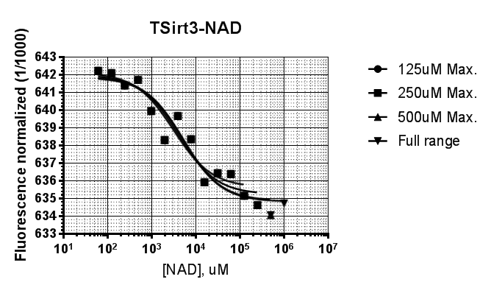
 | PMC-AT Refitting
 | 125uM Max. | 250uM Max. | 500uM Max. | Full range _1mM Max.
Kd, nM | 3130 | 3990 | 5038 | 5173
Fu | 642.1 | 642 | 641.9 | 641.9
Fb | 635.6 | 635.2 | 634.9 | 634.8
Std. Error
Kd | 1405 | 1635 | 1945 | 1836
Fu | 0.5046 | 0.4794 | 0.467 | 0.4437
Fb | 0.5373 | 0.4839 | 0.4506 | 0.384
R square | 0.9198 | 0.9264 | 0.9295 | 0.9362
Ab. Sum of Squares | 5.858 | 6.657 | 7.746 | 7.767
Sy.x | 0.8067 | 0.8159 | 0.8391 | 0.8045
TSirt3-NAD⁺

