Slide 1
SIRT3 purification from clone 2 using Arctic express cells, 3 mM IPTG; 0.5% NP-40
?
50 kDa-
40 kDa-
30 kDa-
SIRT3
M T P S FT W1 W2 W3 XG E1 E2 E3 E4 E5 E6 E7

Slide 2
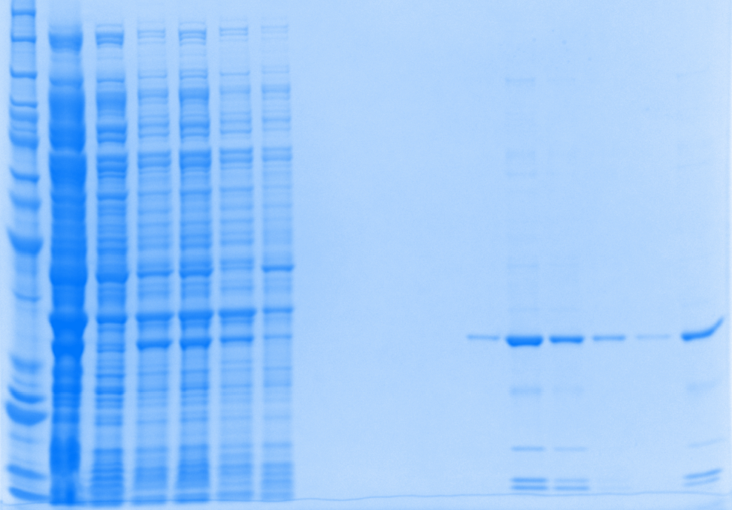
50uM IPTG induction, BL21
Urea medium
Protein ladder
Supernatant
Urea (Pellet)
Flow Through
Wash buffer B
Wash buffer D
Total
Urea (sup)
Wash buffer C
Wash buffer E
Elution 1
Elution 2
Elution 3
Elution 4
Elution 5
Elution 6
Dialysis
220
160
120
100
90
80
70
60
50
40
30
25
20
15
10
After treatment of 8M Urea solution, ~50% of the target protein goes to pellet
In Flow through, 20-30% target protein was observed, which indicated that some lost during binding
From Elution 2, the target protein was observed and the purity is >90%

Slide 3
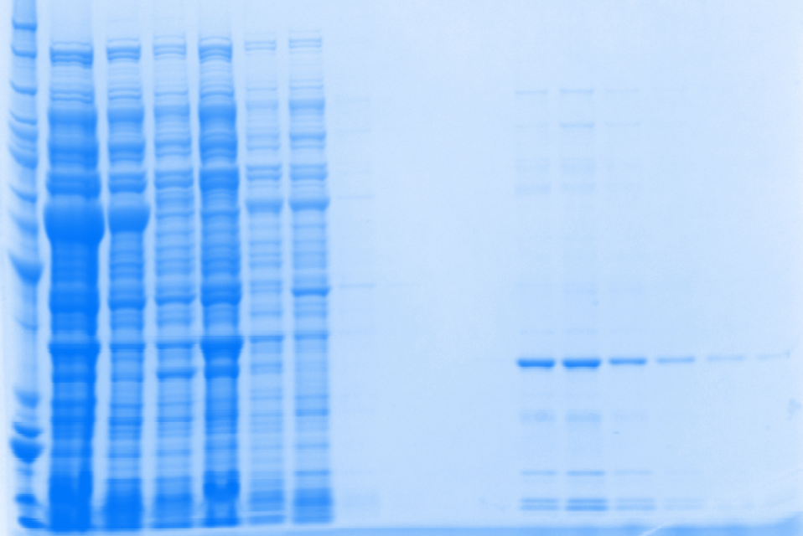
25uM IPTG induction, BL21
Urea
Protein ladder
Supernatant
Urea (Pellet)
Flow Through
Wash buffer B
Wash buffer D
Total
Urea (sup)
Wash buffer C
Wash buffer E
Elution 1
Elution 2
Elution 3
Elution 4
Elution 5
Elution 6
Elution 7
220
160
120
100
90
80
70
60
50
40
30
25
20
15
10
After treatment of 8M Urea solution, ~50% of the target protein goes to pellet
In Flow through, ~15% target protein was observed, which indicated that some lost during binding
From Elution 2, the target protein was observed and the purity is >90%

Slide 4
Specific Activity
Enzo protein: 1.5 - 2.5U/ug
Purified protein- Arctic Express
Purified protein (3mM IPTG, Clone 2, 0.5 % NP40) : 0.9787 U/ug
Purified protein-BL 21
Purified protein (3uM IPTG, 0.4% SDS): 0.1339 U/ug
Purified protein (50uM IPTG, 8M urea): 0.4134 U/ug
Purified protein (25uM IPTG, 8M urea): 0.3869 U/ug
Conclusion:
Arctic express cells gives about 30% soluble protein with 0.5 % NP-40
40-45% purity with high specific activity (~1U/ug)- purified once!
There is extra protein band eluting with the target protein ~70kDa, we don’t know what it is. Because of this the overall purity is low. If this extra band is not there, the purity will be >80%
To get better idea, we might have to screen more clones to see if others have better expression and subsequent purity data.
We have dye which binds specifically to His-tag. We will use this to see if the higher molecular band also contain His-tag or not. In any case, we have to find out why this band is eluting with the target protein? Is Chaperon 60 binding to Sirt3 and co-eluting (a speculation)?
Urea method increase the purity of protein to > 90%. The results from this method is reproducible.
Specific activity was increased compare to 0.4% SDS method. However, the value is still relative low compare to Enzo’s
The use of high concentration of Urea might damage some of the target protein.
Decrease the Urea concentration to eliminate the damage from use of urea
1M to 8M Urea can be applied (need to discuss within the group)
There is 50% lost during urea treatment step (50% of protein was in the pellet after urea treatment). Therefore, further modification of the protocol of urea treatment is needed,
Increase the incubation time with urea from 5 min to 10 – 15 min
Put the sample on rocker Instead of staying on ice

