Slide 1
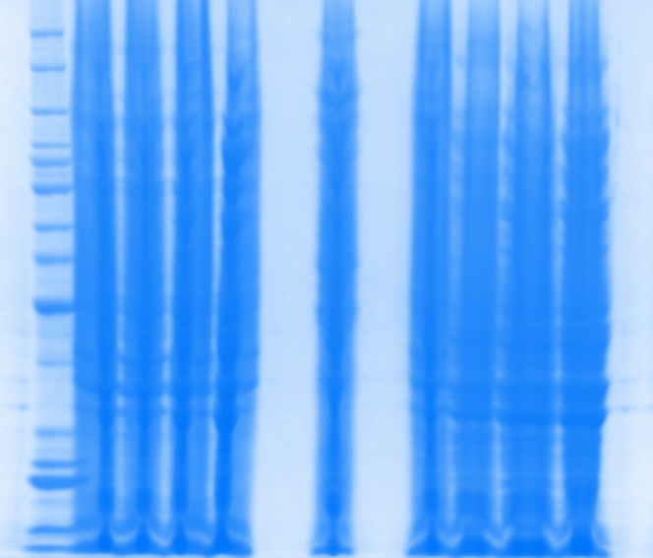
Protein Expression • 1mM IPTG induction • 8X200ml SIRT3(102-399)
Protein
ladder
Gel 1 Gel2 Gel3 Gel4 un-induced Gel5 Gel6 Gel7 Gel8
220
160
120
100
90
80
70
60
50
40
30
25
20
15
10

Slide 2
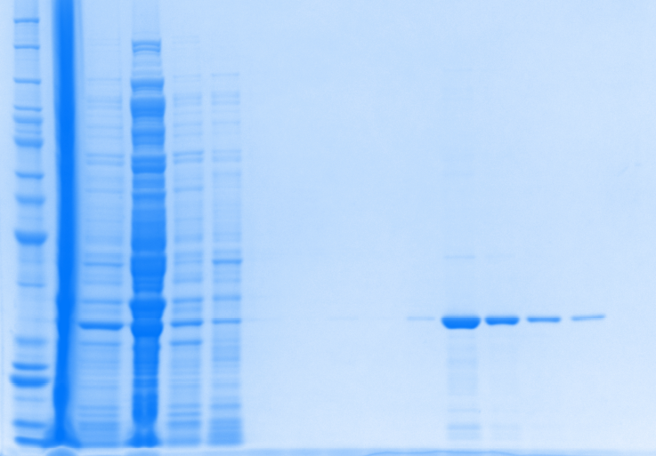
1mM IPTG induction_8M Urea
03.09.16_Gel 1
Protein ladder
Urea (sup)
Urea (Pellet)
Flow Through
C buffer
D buffer
E buffer
Total
B buffer
Elution 1
Elution 2
Elution 3
Elution 4
Elution 5
Elution 6
>95%

Slide 3
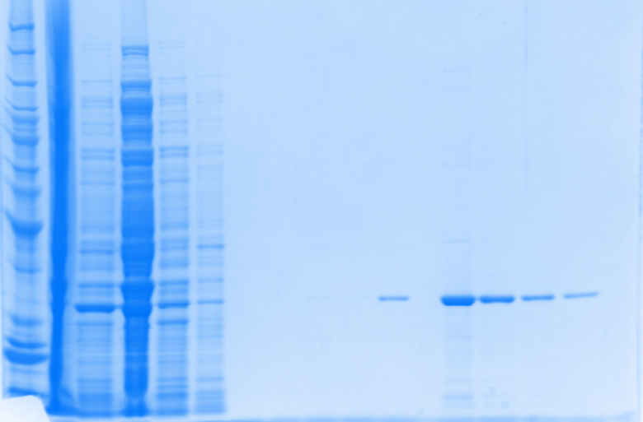
1mM IPTG induction_8M Urea
03.09.16_Gel 2
Protein ladder
Flow Through
Urea (sup)
Urea (Pellet)
C buffer
B buffer
D buffer
E buffer
Total
Elution 1
Elution 2
Elution 3
Elution 4
Elution 5
Elution 6
>95%

Slide 4
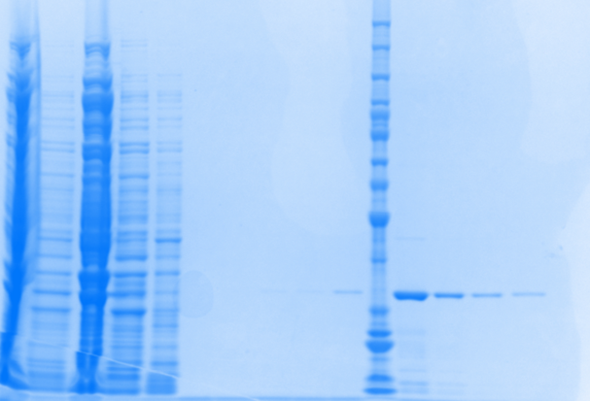
1mM IPTG induction_8M Urea
03.10.16_Gel 3
Urea (sup)
Urea (Pellet)
Flow Through
C buffer
Protein ladder
B buffer
D buffer
Elution 1
Total
E buffer
Elution 2
Elution 3
Elution 4
Elution 5
Elution 6
>95%

Slide 5
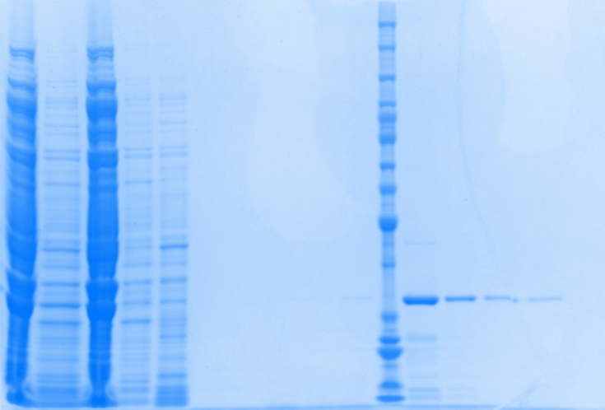
1mM IPTG induction_8M Urea
03.10.16_Gel 4
Urea (sup)
Urea (Pellet)
Flow Through
C buffer
Protein ladder
B buffer
D buffer
Elution 1
Total
E buffer
Elution 2
Elution 3
Elution 4
Elution 5
Elution 6
>95%

Slide 6
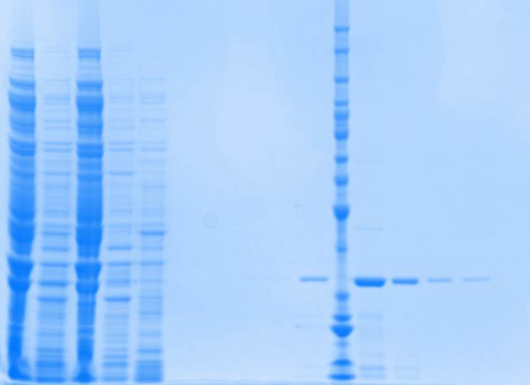
1mM IPTG induction_8M Urea
03.10.16_Gel 5
Urea (sup)
Urea (Pellet)
Flow Through
C buffer
Protein ladder
B buffer
D buffer
Elution 1
Total
E buffer
Elution 2
Elution 3
Elution 4
Elution 5
Elution 6
>95%

Slide 7
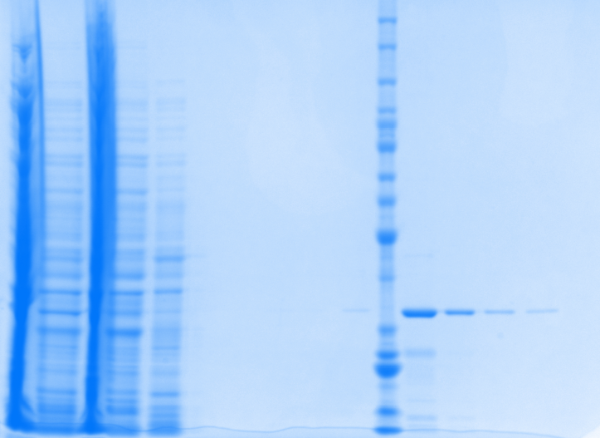
1mM IPTG induction_8M Urea
03.11.16_Gel 6
Urea (sup)
Urea (Pellet)
Flow Through
C buffer
Protein ladder
B buffer
D buffer
Elution 1
Total
E buffer
Elution 2
Elution 3
Elution 4
Elution 5
Elution 6
>90%

Slide 8
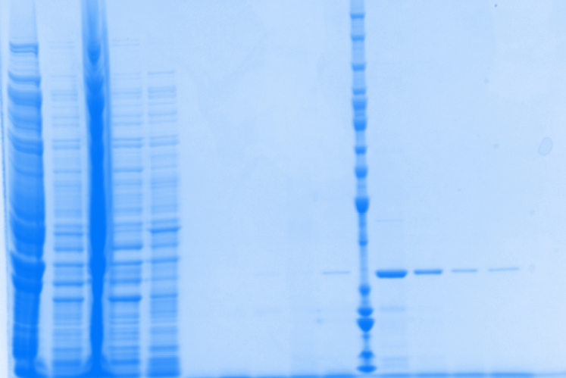
1mM IPTG induction_8M Urea
03.11.16_Gel 7
Urea (sup)
Urea (Pellet)
Flow Through
C buffer
Protein ladder
B buffer
D buffer
Elution 1
Total
E buffer
Elution 2
Elution 3
Elution 4
Elution 5
Elution 6
>95%

Slide 9
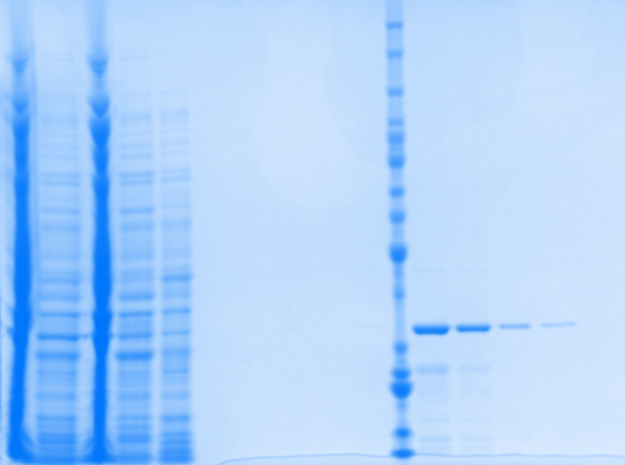
1mM IPTG induction_8M Urea
03.11.16_Gel 8
Urea (sup)
Urea (Pellet)
Flow Through
C buffer
Protein ladder
B buffer
D buffer
Elution 1
Total
E buffer
Elution 2
Elution 3
Elution 4
Elution 5
Elution 6
>90%

Slide 10
Concentration and Activity
1mM IPTG induction at 30 ºC | Batch I | Batch II | Batch III
[Purified Protein], ug/ul | 0.652 | 0.687 | 0.466
V_{Total}, ml | 4.17 | 4.51 | 3.74
Total protein, ug | 2718.8 | 3098.4 | 1742.8
pmoles produced by 20 ul enzyme in 60 min | 34.8 | 44.2 | 24.0
Specific activity (U/ug) One U= 1 pmol/min at 37oC, 100uM FdL substate, 1.5mM NAD+ | 0.045 | 0.054 | 0.043
Specific activity (U/ug) One U= 1 pmol/min at 37oC, 500uM FdL substate, 500uM NAD+ | 0.125 | 0.151 | 0.121

Slide 11
Michaelis-Menten Fitting
 | Batch I | Batch II | Batch III
Best-fit values
Vmax | 0.02938 | 0.02879 | 0.02781
Km | 795 | 889.5 | 1687
Std. Error
Vmax | 0.0009612 | 0.00204 | 0.0001782
Km | 70.64 | 163.6 | 22.03
95% Confidence Intervals
Vmax | 0.02524 to 0.03351 | 0.02002 to 0.03757 | 0.02704 to 0.02857
Km | 491.0 to 1099 | 185.5 to 1594 | 1592 to 1781
Goodness of Fit
Degrees of Freedom | 2 | 2 | 2
R square | 0.9961 | 0.9864 | 1
Absolute Sum of Squares | 4.045E-07 | 0.000001551 | 3.808E-09
Sy.x | 0.0004497 | 0.0008806 | 0.00004364
Constraints
Km | Km > 0.0 | Km > 0.0 | Km > 0.0
Number of points
Analyzed | 4 | 4 | 4

Slide 12
Remarks
As planned, three batches of protein were purified.
Batch I was from 2x200ml of culture and 2 new column for purification.
Batch II was from 3X200ml of culture and 2 new column + 1 used column for purification.
Batch III was from 3X 200ml of culture and 3 used column for purification
The protein concentrations of Batch I and II are comparable.
The enzyme activity among the batches vary not much. The “U” was newly defined as
One U= 1 pmol/min at 37oC, 100uM FdL substate, 1.5mM NAD+.
The Km and Vmax of Batch I and II were comparable. The km and Vmax for Batch III was off. The used column may not perform well so that direct the batch III enzyme have
Lower concentration
Relatively low activity

Slide 13
Comparison to Old Batches
Michaelis-Menten
20 ul of enzyme | Old_Batch I | Old_Batch II | New_Batch I | New_Batch II | New_Batch III
Best-fit values
Vmax | 0.04357 | 0.03256 | 0.02938 | 0.02879 | 0.02781
Km | 924.8 | 813.3 | 795 | 889.5 | 1687
Std. Error
Vmax | 0.005317 | 0.001189 | 0.0009612 | 0.00204 | 0.0001782
Km | 222.6 | 61.36 | 70.64 | 163.6 | 22.03
95% Confidence Intervals
Vmax | 0.02070 to 0.06645 | 0.02744 to 0.03768 | 0.02524 to 0.03351 | 0.02002 to 0.03757 | 0.02704 to 0.02857
Km | 0.0 to 1883 | 549.3 to 1077 | 491.0 to 1099 | 185.5 to 1594 | 1592 to 1781
Goodness of Fit
Degrees of Freedom | 2 | 2 | 2 | 2 | 2
R square | 0.9863 | 0.9985 | 0.9961 | 0.9864 | 1
Absolute Sum of Squares | 0.00000279 | 1.828E-07 | 4.045E-07 | 0.000001551 | 3.808E-09
Sy.x | 0.001181 | 0.0003023 | 0.0004497 | 0.0008806 | 0.00004364
Constraints
Km | Km > 0.0 | Km > 0.0 | Km > 0.0 | Km > 0.0 | Km > 0.0
Number of points
Analyzed | 4 | 4 | 4 | 4 | 4

Slide 14
Michaelis-Menten
 | SM_Batch 2 (25ul) | SM_Batch 4 (40ul)
Best-fit values
Vmax | 0.0817 | 0.03425
Km | 2104 | 2180
Std. Error
Vmax | 0.004552 | 0.003223
Km | 221.1 | 310.9
95% Confidence Intervals
Vmax | 0.06211 to 0.1013 | -0.006708 to 0.07521
Km | 1153 to 3055 | 0.0 to 6131
Goodness of Fit
Degrees of Freedom | 2 | 1
R square | 0.9979 | 0.9988
Absolute Sum of Squares | 1.54E-06 | 4.81E-08
Sy.x | 0.0008763 | 0.0002194
Constraints
Km | Km > 0.0 | Km > 0.0
Number of points
Analyzed | 4 | 3

Slide 15
cv% analysis (K_{m, NAD+})
 | Old_Batch I | Old_Batch II | New_Batch I | New_Batch II | New_Batch III
K_{m, NAD+} | 924.8 | 813.3 | 795 | 889.5 | 1687
Std. Error_K_{m, NAD+} | 222.6 | 61.36 | 70.64 | 163.6 | 22.03
cv% | 24.1 | 7.5 | 8.9 | 18.4 | 1.3
Remarks
Data were taken from MM-fitting for control experiments in assay buffer for different batches of in-house enzyme.
Km from Old Batches I and II are comparable to New Batches I and II.
Km from XG New Batch III is off, may be due to the use of old column for purification.
Km from Sudipto Batch 2 and 4 was in the same range of XG new batch III. Sudipto mentioned that He use the old column for SM_batch 4 purification.
$$Coefficient of variation:cv\%=\frac{Standard deviation}{mean}×100$$

