Slide 1
Primer Design Software
̶ survey over selected PCR tools

Slide 2
PCR probe and primer design software
  Commercial
  Free proprietary
  Open-source
PCR control software (not discussed)
  Vendor specific
  Open source from Open PCR
PCR data analysis software (not discussed)
Primer properties calculators
In silico PCR (PCR simulation)

Slide 3
PCR Primer Design Guidelines
Some important design considerations
  Primer Length: 18-22 bp
  Primer Melting Temperature: in the range of 52-58 ºC
  Primer Annealing Temperature: avoid base pair mismatches
  GC Content: 40-60%
  GC Clamp: less than 3 G's or C's in the last 5 bases at the 3' end
  Primer Secondary Structures: Hairpins; Self Dimer; Cross Dimer
  Repeats: di-nucleotide repeats less than 4
  Runs: less than 4bp
  3' End Stability: more negative ΔG
  Avoid Template Secondary Structure
  Avoid Cross Homology
Parameters for Primer Pair Design
  Amplicon Length
  Product Position
  T_{m} of Product
  Optimum Annealing Temperature
  Primer Pair T_{m} Mismatch Calculation

Slide 4
PREMIER Biosoft
PrimerPlex
  Oligo Design for Multiplex PCR & High Throughput SNP Genotyping and Analysis
Primer Premier
  A Comprehensive PCR Primer Design Software
AlleleID®
  Assay Design for Bacterial Identification and More
Beacon Designer
  design optimal primer-probe sets for single tube multiplex assays using TaqMan®
……

Slide 5
DNASoftware, Corp.
VisualOMP
  VisualOMP improves assay sensitivity by accurately predicting the secondary structure and locating the sites on the target that are most thermodynamically accessible.
  ThermoBLAST solves the problem of primer and probe mishybridization by scanning against whole genome databases. ThermoBLAST uses the proper thermodynamic model which detects 100% of the false positive hits. ThermoBLAST fully accounts for the effects of temperature and solution conditions in addition to DNA, RNA, and modified strand types.
  Used by Biotechnology, Pharmaceutical, Agriculture companies, and Government and Academic Institutes.

Slide 6
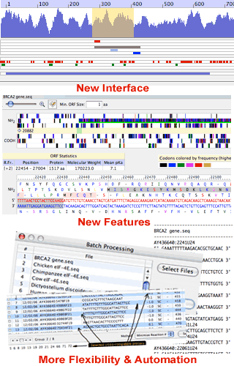
Molecular Biology Insights, Inc
OLIGO Primer Analysis Software (Current version is Oligo 7) is a tool for designing and analyzing sequencing and PCR primers, synthetic genes, and various kinds of probes including siRNA and molecular beacons.
  For each primer or primer pair, Oligo's various analysis windows show a multitude of useful data, such as DNA and RNA secondary structure, dimer formation, false priming and homology, internal stability, composition and physical properties.

Slide 7
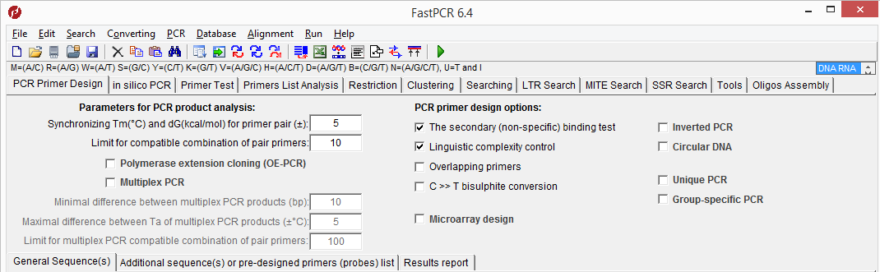
PrimerDigital, Ltd
FastPCR
  an integrated tools environment for designing various types of PCR primers
  “in silico” oligonucleotide search against whole genome(s) or a list of chromosome - prediction of probable PCR products and mismatching locations
  secondary structures analysis and the melting temperature calculation based on nearest neighbor thermodynamic parameters, primer's PCR efficiency

Slide 8
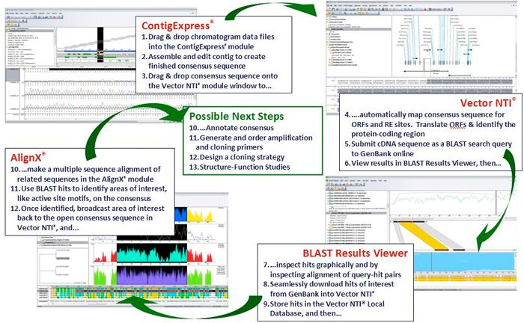
Life Technologies
Vector NTI Advance® Sequence Analysis Software
  Sold separately
Free tools for primer purchase
  Free online tool: OligoPerfect™ Designer
  Free online tool: Primer Designer™ Tool

Slide 9
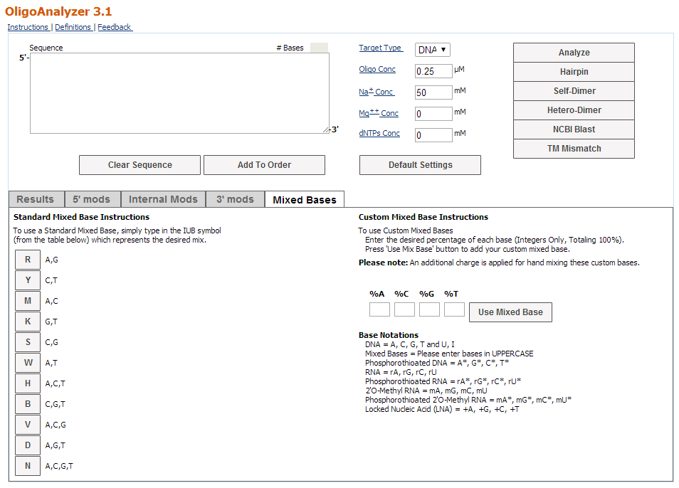
Some companies offer free primer design tools online in connection with primer purchase
  RealTimeDesign Software by Biosearch Technologies
  IDT SciTools® Web Tools, i.e. OligoAnalyzer, AntiSense Design, RealTime PCR, etc by Integrated DNA Technologies
  QuickChange Primer Design by Agilent Technologies
  PCReady primers by Eurofins Genomics
  OligoArchitect™ Primer and Probe Design Solutions by Sigma-Aldrich
  GenScript Real-time PCR (TaqMan) Primer Design
  ……

Slide 10
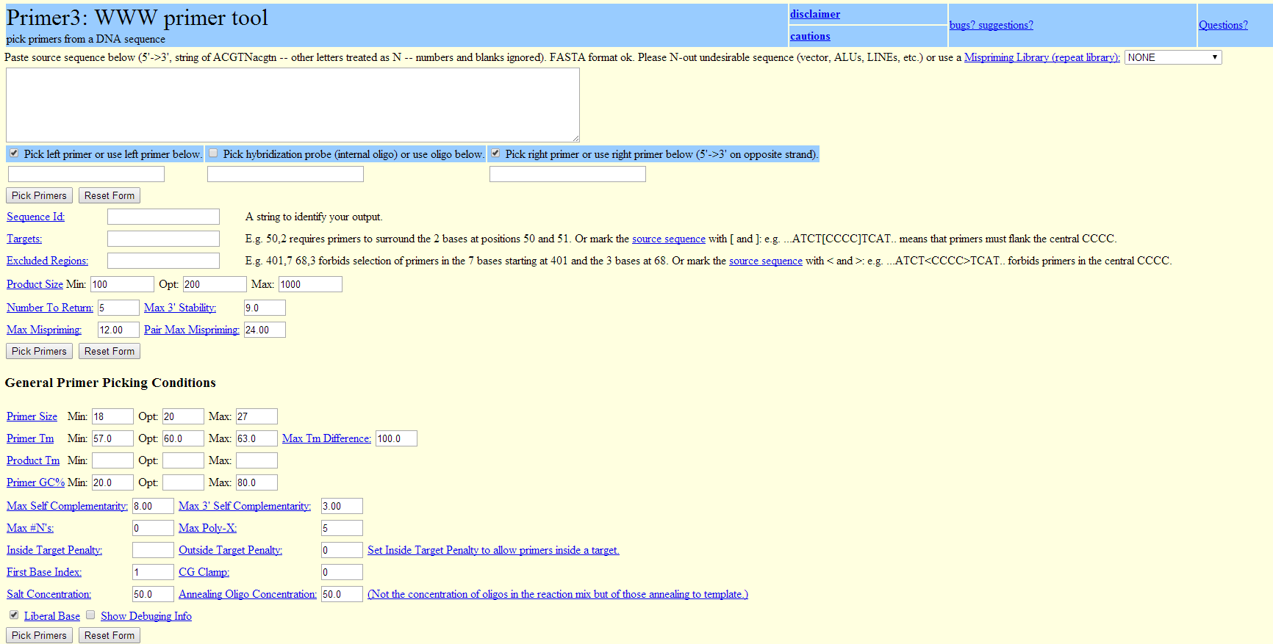
Free software with local access
Primer3: a widely used program for designing PCR primers, also design hybridization probes and sequencing primers. It incorporates more accurate thermodynamic models in the primer design process, both to improve melting temperature prediction and to reduce the likelihood that primers will form hairpins or dimers
Primer3 derivatives:
  Primer-BLAST from NCBI
  PCR Now: a web-accessible program
  Primer3Plus
  BatchPrimer3
  The PCR Suite on UC Santa Cruz
  AutoPrime: for cDNA generated from mRNA
  ……

Slide 11
Other tools
GeneFisher2: designing degenerate primers
BiSearch Web Server
MFEprimer-2.0: A fast thermodynamics-based program for checking PCR primer specificity
RAPD-primer generator: for RAPD-PCR
TmPrime: for designing oligonucleotide sets for LCR- and PCR-based gene synthesis
Primers4clades: for designing of PCR primers for cross-species amplification
Restriction-free cloning: for overlap extension PCR cloning
QuantPrime: offers design and specificity checking; ready to use with most publicly available eukaryotic transcriptomes
ROSO: A software to design optimized oligonucleotide probes for microarrays
OligoArray: Design of oligonucleotide probes for DNA microarrays using a thermodynamic approach
OligoWiz 2 Server: design of oligonucleotides for DNA microarrays
……

Slide 12
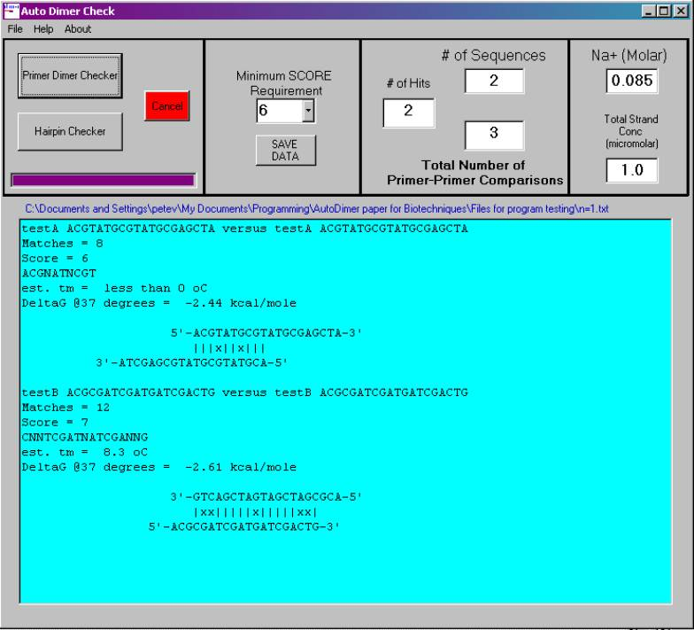
For oligonucleotide physicochemical parameters
MultiPLX: a tool for analyzing PCR primer compatibility and finding optimal multiplexing solution
AutoDimer: for rapidly screen selected PCR primers for primer-dimer and hairpin interactions, and provide T_{m}, extinction coefficient @260 nm, molecular weight, etc
OligoTM: calculates oligo melting temperature (T_{m}) and GC content.
Oligo Calc: Oligonucleotide Properties Calculator
OligoAnalyzer by Integrated DNA Technologies
Tm Calculator by New England Biolabs
……

Slide 13
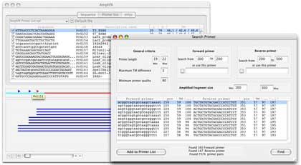
Search target sequence or test PCR products
AmplifX: Manage, test and design your primers for PCR
Amplify 3 is a program run on Mac OS to simulate the polymerase chain reaction using specified a target sequence and primers
UCSC In-Silico PCR: searches a sequence database with a pair of PCR primers
GenomeTester
……

