Slide 1
Materials
DNA Template and Primer: The template for the polymerase assay is an 80-mer single stranded DNA, TAT2, custom synthesized by Sigma Custom Oligos. A 17-mer primer TAP1, complementary to the 17 bases at the 3’ end of TAT2 was also custom synthesized by Sigma Custom Oligos. (see table 1 for GC content and calculated Tm).
Reaction Components: Native Taq Polymerase (with its buffer and MgCl₂) is obtained from Life Technologies, dNTP mix from New England Biolabs, Quant-iT PicoGreen ds DNA Reagent from Molecular Probes.
Instruments: The incubation for the activity assays are carried out in the BioRad CFX96 PCR machine (software: CFX Manager ver 1.6.541.1028). PicoGreen fluorescence is measured in the Lab Systems Fluoroskan Ascent Fluorescence 96/384 Well Plate Reader using a PCR plate adapter (Excitation 485nm; Emission 520nm).
Software: Calculation of T_{m}s of synthetic oligomers was done using Sigma DNA Calculator, http://www.sigma-genosys.com/calc/DNACalc.asp. Analysis of secondary structures and of primer-dimer formation was done according to Oligo Analyzer from IDT: http://biotools.idtdna.com/analyzer/applications/oligoanalyzer/ . GraphPad Prism was used for all curve fittings.
Table 1 : Oligos used in the study
Oligo (length) | Sequence | % GC | Tm | Description
TAT2 (80 bases) | 5’- ACA CGT TAG GAA GAT GGA ATT GAT TGG ATC GAA GGA AAT AAA AGA AAT TAA GGC AAT GGT CTC CCG TCG GCG GCG CGA GC-3’ | 47.5 | 92ºC | Template for Taq polymerase extension
TAT1 (17 bases) | 5’-GCT CGC GCC GCC GAC GG-3’ | 88 | 80ºC | Primer for TAT2

Slide 2
Method 1
Preparation of Template-Primer Mix (see Table 2 for details) :
The single stranded 80-mer template, TAT2 and it 17-mer primer TAP1 were mixed such that the primer was present in a 7 molar excess (this is the molar ratio used in the previous study) in 1X Taq reaction buffer (20 mM Tris-HCl, 50 mM KCl) containing 2mM MgCl₂.
The holding and cooling steps for annealing were as follows (as used in the previous study): hold at 95ºC for 1.5 minute, cool to 75ºC over 30 minutes, hold at 75ºC for 5 minutes, cool to 70ºC over 9 minutes, hold at 70ºC for 5 minutes, cool to 45ºC over 45 minutes and then to room temperature on the bench. (The annealed primer-template complex mix is stored at room temperature for the duration of the assay for up to 24hrs. It is neither chilled nor frozen).
Table 2: Composition of the Template-Primer mix
Initial Conc | Reaction Component | Final Conc
 | Template (TAT2) | 20nM
 | Primer (TAP1) | 140nM
10X | Taq Polymerase Buffer | 1X
50mM | MgCl₂ | 2mM

Slide 3
Method 2
Set up of the Reaction (see Table 3 for details):
In this initial trial of the new protocol, one complete time course at 70ºC was performed for two enzyme concentrations (0.36nM used previously and 0.02nM which achieves the template: enzyme ration of 1000). Each time point had 2 replicates each for reactions with the 5min equilibration and reactions with no equilibration. The template-primer mix was made/ annealed as a single batch for this entire set.
The template-primer mix was split into 11parts, one for each assay time point (see table) and one for a no-Taq control. Taq Polymerase (appropriately diluted in the dilution buffer to achieve the final concentration stated in the table in each 20ul reaction) was added to the test fractions and water was added to the no-Taq control fraction.
For each time point, two aliquots of the reaction were incubated at 70ºC in the CFX96 (PCR machine) for 5mins (for equilibration of the Taq polymerase with the primer-template complex).
After equilibration, the polymerase reaction was initiated by addition of dNTPs (see table for concentration). Simultaneously, two reactions were initiated without equilibration.
At the end of the incubation the reaction was immediately chilled to 0ºC and EDTA was added to a final conc of 20mM.
Table 3: Assay Variables
Temperature | 70ºC (in the initial trial)
Time points | 10secs, 20secs, 30secs, 40secs, 50secs, 1min, 1.5mins, 2mins, 5mins, 10mins
Enzyme Concentration | 0.02nM vs 0.36nM
dNTP Concentration | 200μM (for the initial trial)
Replicates | 2
Reaction Volume | 20ul

Slide 4
Method 3
Quantitation:
  80ul of Picogreen reagent freshly diluted 178-fold in 1X TE was added to each reaction. The reaction was incubated in the dark for 5min at room temperature and fluorescence is measured in the Fluoroskan with excitation at 485nm and emission at 520nm.
Plots:
  The measured RFU was plotted against time. The curves were fitted using the equation for one-phase association kinetics. The initial reaction rate (del RFU/sec) was calculated using the corrected RFU values from the fitted curve.

Slide 5
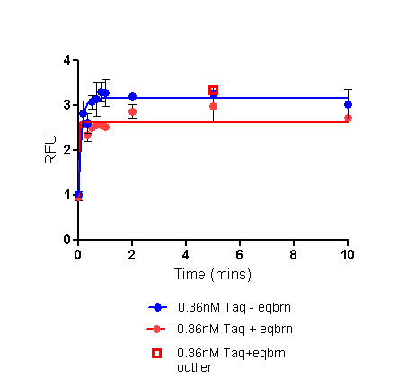
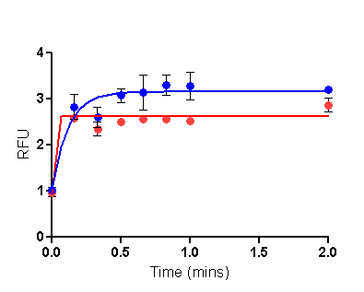
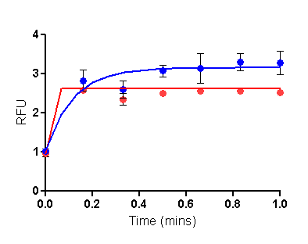
Taq Polymerase activity measured at 70ºC over 10mins
20nM Template and 0.36nM Taq in a 20ul reaction:
Comparison of 5min equilibration of Taq Polymerase with the primed template at 70ºC vs no equilibration
0.36nM Taq is the concentration used in the previous study. Equlibration with Taq polymerase at the assay temperature has not been done previously. Since activity is very high, even at the earliest time point of the assay (10secs) activity appears to have plateaued (see scale up of the first 1 or first 2mins on the right). Early time point RFUs are not accurate and curve fit is poor. (For this template and enzyme concentration, lower assay temperatures (lower measurable activity) will give more accurate RFU values.

Slide 6
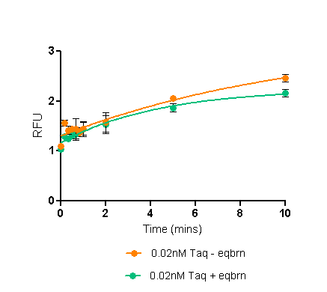
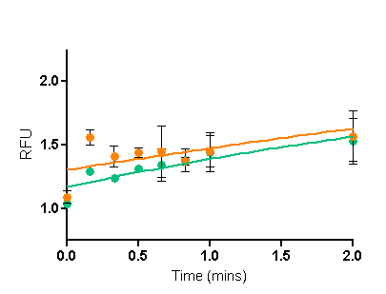
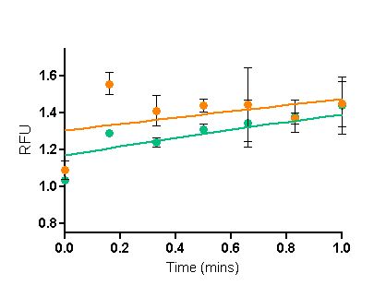
Taq Polymerase activity measured at 70ºC over 10mins
20nM Template and 0.02nM Taq in a 20ul reaction:
Comparison of 5min equilibration of Taq Polymerase with the primed template at 70ºC vs no equilibration
0.02nM is the recommended concentration of Taq Polymerase to give a primed-template:Taq ratio of 1000:1. Because of this low concentration of Taq, even the measurements at early time point of the assay are closer to the fitted curve (see scale up of the first 1 or first 2mins on the right). Also, even at 10mins, the activity does not seem to have plateaued. (For this template and enzyme concentration, low assay temperatures (eg., 45-50ºC as have been used previously) may not give measurable activity. Assay may need to include time points greater than 10mins.

Slide 7
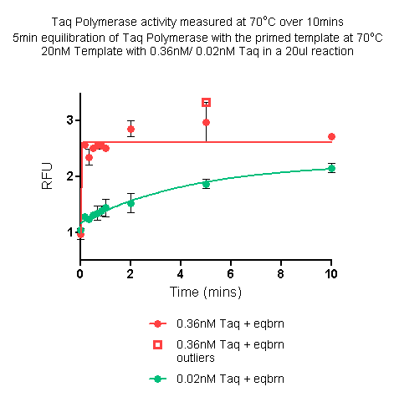
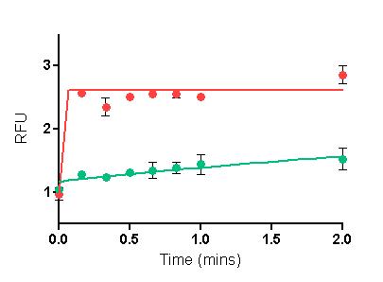
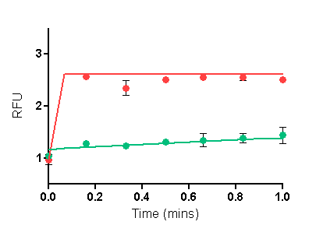
Taq Polymerase activity measured at 70ºC over 10mins
5min equilibration of Taq Polymerase with the primed template at 70ºC
20nM Template with 0.36nM vs 0.02nM Taq in a 20ul reaction
Activity of 0.02nM Taq (the recommended concentration of Taq Polymerase to give a primed-template:Taq ratio of 1000:1) is compared with 0.36nM Taq (as used previously) at 70ºC. These reactions had a pre-incubation at 70ºC for equilibration of Taq polymerase with the primed-template.

Slide 8
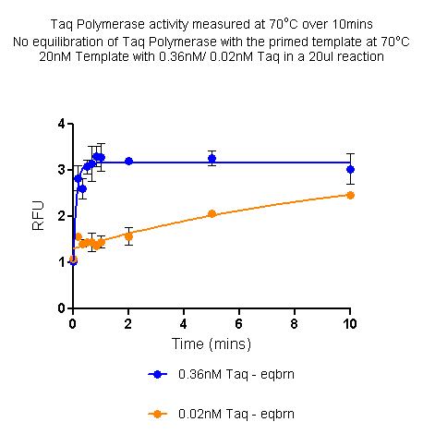
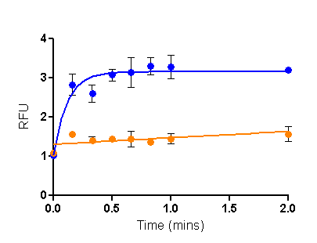
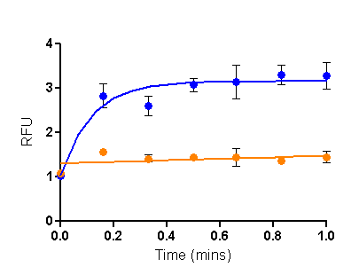
Taq Polymerase activity measured at 70ºC over 10mins
No equilibration of Taq Polymerase with the primed template at 70ºC
20nM Template with 0.36nM/ 0.02nM Taq in a 20ul reaction
Activity of 0.02nM Taq (the recommended concentration of Taq Polymerase to give a primed-template:Taq ratio of 1000:1) is compared with 0.36nM Taq (as used previously) at 70ºC. These reactions did not have a pre-incubation at 70ºC for equilibration of Taq polymerase with the primed-template.

Slide 9
Summary
Since the recommended enzyme concentration is very low, the trial activity assay was carried out at 70oC where previously the maximum activity has been noted.
  Initial reaction rate is quite low
  Early time point measurement seems reliable
  Even at 10mins the enzyme may not have saturated
  The initial reaction rate appears to be
    +eqbrn: 2.94 x 10⁻¹³ mols dNTP incorporated/sec by 0.01U Taq
    - eqbrn: 2.08 x 10⁻¹³ mols dNTP incorporated/sec by 0.01U Taq
  This difference in reaction rate may not be significant for the following reasons:
    The test condition has been assayed only once (reproducibility has not been determined)
    The equilibration time has not been varied (5min vs 10mins, 15mins, 20mins etc).
Next proposed experiments:
  Vary equilibration time (essential to understand if 5mins is enough)
  At the defined equilibration time, vary [dNTP] concentration (necessary to calculate the kinetic parameters)
  If required vary assay temperature (65ºC, 75ºC) (Optional)
  Replication of assays to test for reliability and reproducibility (Essential)
See table in the following page

Slide 10
Estimate of time for completion
Steps | Primed-template: Taq | dNTP concentration | Equilibration Time | Assay temperature | No. of Assays* | No. of weeks required
Standardisation of Equilibration time | 20nM:0.02nM | 200μM | 0, 5, 10, 20 mins | 70ºC | 4 | 0.8
Variation of [dNTP] | 20nM:0.02nM | 0.2X (ie 50μM), 1X (ie 200μM), 5X (ie 1000μM) | Determined from above | 70ºC | 3** | 0.5
Variation of assay temperatues | 20nM:0.02nM | Determined from above | Determined from above | 65ºC, 70ºC, 75ºC | 3 (at each dNTP conc)*** | 2.5
Replication | 20nM:0.02nM | Determined from above | Determined from above | 65ºC, 70ºC, 75ºC | 3 (at each dNTP conc) | 2.5
*: Each assay has 12 time points; involves ~3hrs for setting up the extension reactions and ~30mins for quantitation; and also involves 1 day’s prior work to prepare buffers etc and make and anneal the template-primer mix and ~1 days work afterword to plot the data on Prism and perform necessary calculations.
**: Three [dNTP] concentrations will not be enough to plot the Michaelis-Menten curves. But this would be an initial check to see that the range works.
***: Varying the assay temp is optional, however it WILL show that the experimental protocol is stable and robust. With the low concentration of Taq in these set of assays, temps lower than 65 may not give measurable activity.

Slide 11
Update 042513
Recommendation based on the results of the extension assay at 70ºC:
  Increase equilibration time to 30mins keeping all else same.
Given that melting temperature of the primer is 80ºC, this recommendation was revisited (for an oligo with a Tm of 80ºC, melting could already have started at 70ºC; thus prolonging equilibration time leads to conflict between DNA melting and enzyme binding.)
Alternative recommendation was to decrease the assay temperature (if melting is prevented, the effect of (prolonged) equilibration may be seen).
  Assay at 60ºC, compare 5min equilibration with no equilibration
The following slide represents the results from the extension assay at 60ºC.

Slide 12
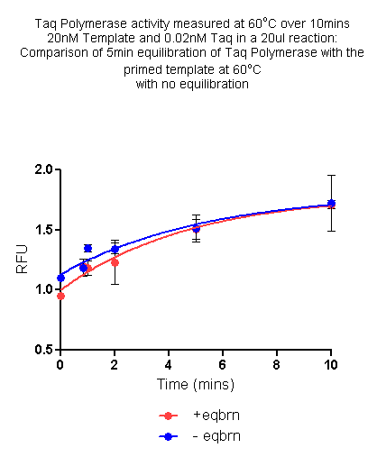
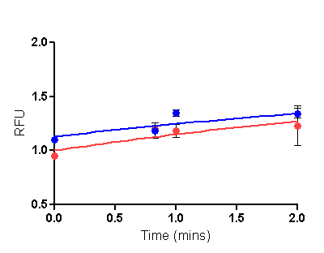
Taq Polymerase activity measured at 60ºC over 10mins
20nM Template and 0.02nM Taq in a 20ul reaction:
Comparison of 5min equilibration of Taq Polymerase with the primed template at 60ºC vs no equilibration
Activity of 0.02nM Taq (the recommended concentration of Taq Polymerase to give a primed-template:Taq ratio of 1000:1) at 60ºC. Reactions with a pre-incubation at 60ºC/ 5mins for equilibration of Taq polymerase with the primed-template are compared with reactions with no pre-incubation..

Slide 13
Update 050213
In all conditions tested so far, reactions without equilibration show higher initial activity.
There is a slight difference in the actual handling of reactions in the current set, since + and – eqbrn reactions are being treated simultaneously. This could account for differences. Can be controlled for by
  setting up +eqbrn and –eqbrn reactions separately.
  each time point can have its own no taq ctrl, this should ensure tighter control of background RFU.

Slide 14
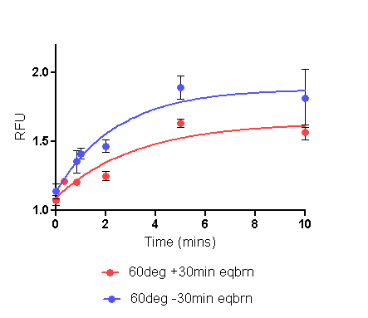
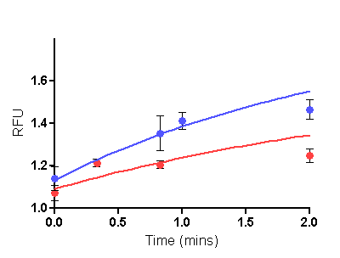
Taq Polymerase activity measured at 60ºC over 10mins
20nM Template and 0.02nM Taq in a 20ul reaction:
Comparison of 30min equilibration of Taq Polymerase with the primed template at 60ºC with no equilibration
Activity of 0.02nM Taq (the recommended concentration of Taq Polymerase to give a primed-template:Taq ratio of 1000:1) at 60ºC. Reactions with a pre-incubation at 60ºC/ 30mins for equilibration of Taq polymerase with the primed-template are compared with reactions with no pre-incubation. This was done because comparison of 5min eqbrn with no eqbrn was error-prone.

Slide 15
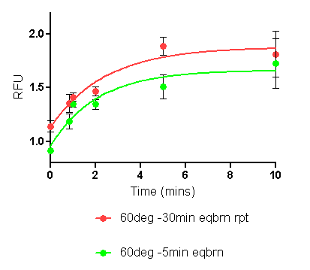
Taq Polymerase Activity at 60ºC:
No equilibration reactions from slides 12 and 14 plotted together show same initial rate of activity
Mins | Mean (-30min eqbrn rpt) | Mean (-5min eqbrn)
10.00 | 1.81 | 1.72
5.00 | 1.89 | 1.51
2.00 | 1.47 | 1.34
1.00 | 1.41 | 1.35
0.83 | 1.35 | 1.19
0.66
0.50
0.33
0.00 | 1.14 | 0.91
Curves do not superimpose on each other, however, bear in mind that these are experiments from different days. Also, given the small range, differences appear magnified. Please note RFU values (these are means of the 3 replicates set up in each experiment).

Slide 16
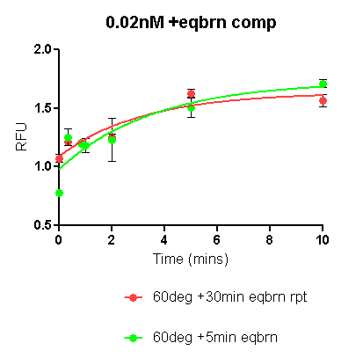
Taq Polymerase Activity at 60ºC:
Reactions with equilibration (5min-slide 12 and 30min-slide 14) plotted together
Equilibration for 5min/ 30min results in the same level of activity
Mins | Mean (+30min eqbrn rpt) | Mean ( +5min eqbrn rpt)
10.00 | 1.56 | 1.71
5.00 | 1.63 | 1.50
2.00 | 1.25 | 1.40
1.00 |  | 1.18
0.83 | 1.21 | 1.20
0.66
0.50
0.33 | 1.21 | 1.26
0.00 | 1.07 | 0.78
Curves almost superimpose on each other, thus 5/ 30min eqbrn does not seem to affect initial rate of activity. Bear in mind, given the small range, differences appear magnified. Please note RFU values (these are means of the 3 replicates set up in each experiment).

Slide 17
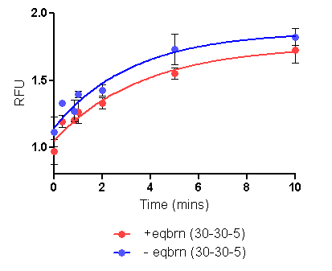
Taq Polymerase Activity at 60ºC:
Summary of +equilibration and –equilibration assays
Since activities for =eqbrn and –eqbrn states were similar, mean RFUs of the two experiments have been plotted. As expected, no eqbrn rate is higher than =eqbrn.

Slide 18
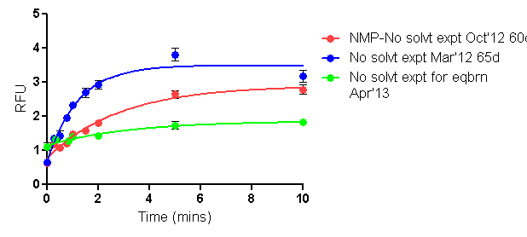
Comparisons of previous extension assays (0.36nM Taq no equilibration) with the current assay set (0.02nM Taq no equilibration reactions)
The net gain is RFU is much smaller in the current assay set. (This also magnifies the variation in replicates, particularly when viewed individually rather than in comparison with other test conditions.)
As can be seen here the slightly higher background RFU could be tolerated if the net RFU gain was higher.
Time | NMP-No solvt expt Oct'12 60ºC |  |  |  | No solvt expt Mar'12 65ºC |  |  |  | No solvt expt for eqbrn Apr'13 60ºC
 | Rep 1 | Rep 2 | Rep 3 | Mean | Rep 1 | Rep 2 | Rep 3 | Mean | Rep 1 | Rep 2 | Rep 3 | Mean
10.0 | 2.98 | 2.50 | 2.88 | 2.79 | 2.82 | 3.28 | 3.42 | 3.17 | 1.81 | 1.94 | 1.72 | 1.82
5.0 | 2.75 | 2.42 | 2.77 | 2.65 | 3.66 | 4.18 | 3.58 | 3.81 | 1.89 | 1.79 | 1.51 | 1.73
2.0 | 1.83 | 1.72 | 1.90 | 1.82 | 2.88 | 2.74 | 3.17 | 2.93 | 1.47 | 1.46 | 1.34 | 1.42
1.5 | 1.66 | 1.56 | 1.54 | 1.59 | 2.44 | 2.74 | 2.90 | 2.69
1.0 | 1.55 | 1.33 | 1.55 | 1.48 | 2.45 | 2.22 | 2.32 | 2.33 | 1.41 | 1.43 | 1.35 | 1.40
0.8 |  |  |  |  |  |  |  |  | 1.35 |  | 1.19 | 1.27
0.8 | 1.24 | 1.22 | 1.12 | 1.20 | 1.85 | 2.11 | 1.88 | 1.94
0.7
0.5 | 1.19 | 1.01 | 1.03 | 1.08 | 1.54 | 1.61 | 1.13 | 1.43
0.3 |  |  |  |  |  |  |  |  |  | 1.33 |  | 1.33
0.3 | 1.18 | 1.19 | 1.16 | 1.18 | 1.33 | 1.37 | 1.38 | 1.36
0.0 | 0.69 | 0.57 |  | 0.63 | 0.62 | 0.70 | 0.67 | 0.66 | 1.14 | 1.29 | 0.91 | 1.11

