Slide 1
Proposed Experiment PMC-XG3
Aim: Deacetylation reactions condition modification within HPLC detection limitation- NAD+.
[FdL2 peptide] = 250uM
[NAD+] = 10, 25, 50, 75, 100 uM
[Enzo SIRT3 and in-house SIRT3] = 10 U
Time point = 5, 30 min

Slide 2
Results for Experiment PMC-XG3

Slide 3
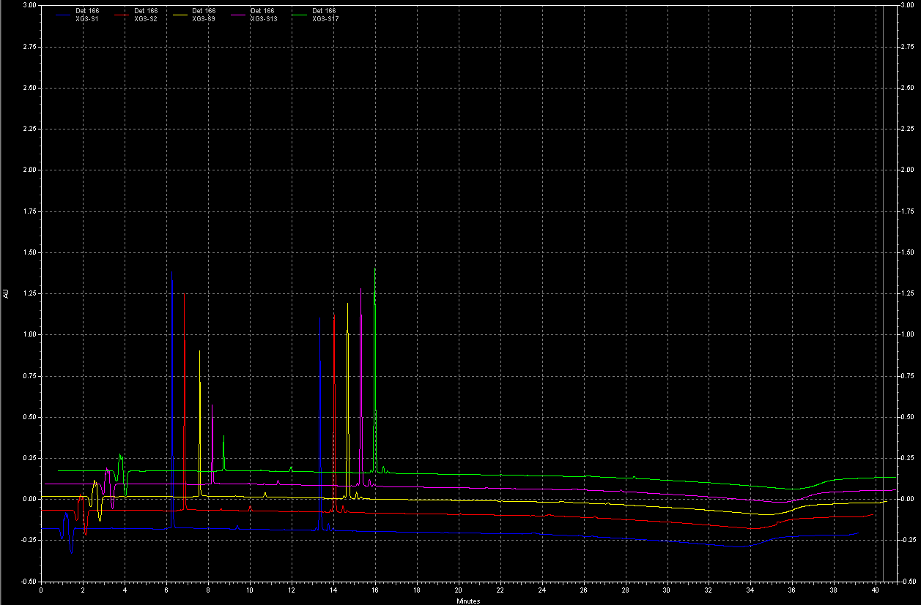
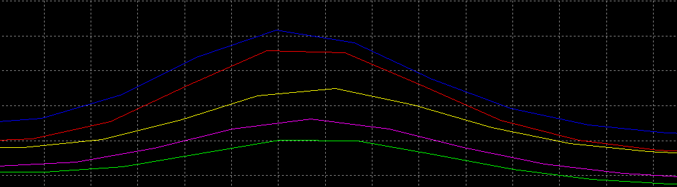
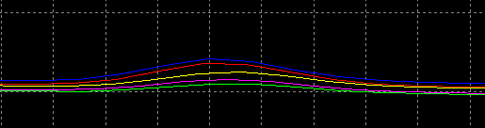
Overview of Chromatograph
[FdL2 peptide]=250uM
[NAD⁺]=10, 25, 50, 75, 100uM
Time point= 5min
Enzo SIRT3=10 U
NAD⁺
peaks
Product
peaks
[NAD⁺]=10uM
[NAD⁺]=25uM
[NAD⁺]=50uM
[NAD⁺]=75uM
[NAD⁺]=100uM

Slide 4
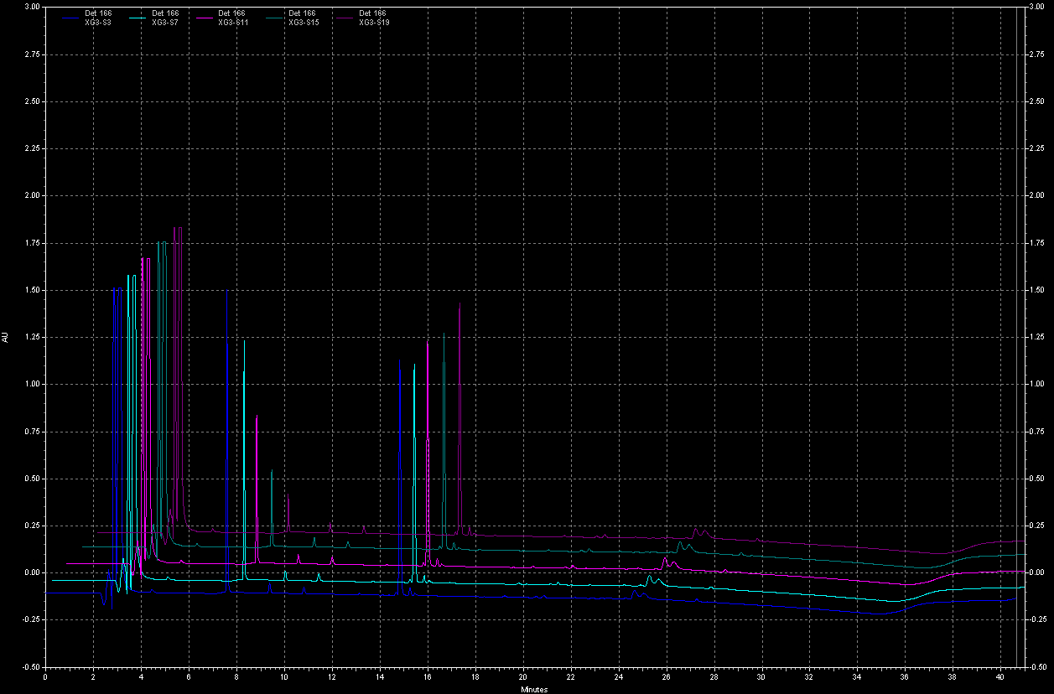
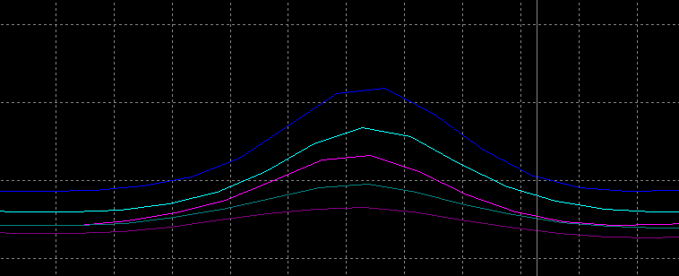

Chromatograph
[FdL2 peptide]=250uM
[NAD⁺]=10, 25, 50, 75, 100uM
Time point= 5min
In-house SIRT3=10 U
NAD⁺
peaks
Product
peaks
[NAD⁺]=10uM
[NAD⁺]=25uM
[NAD⁺]=50uM
[NAD⁺]=75uM
[NAD⁺]=100uM

Slide 5
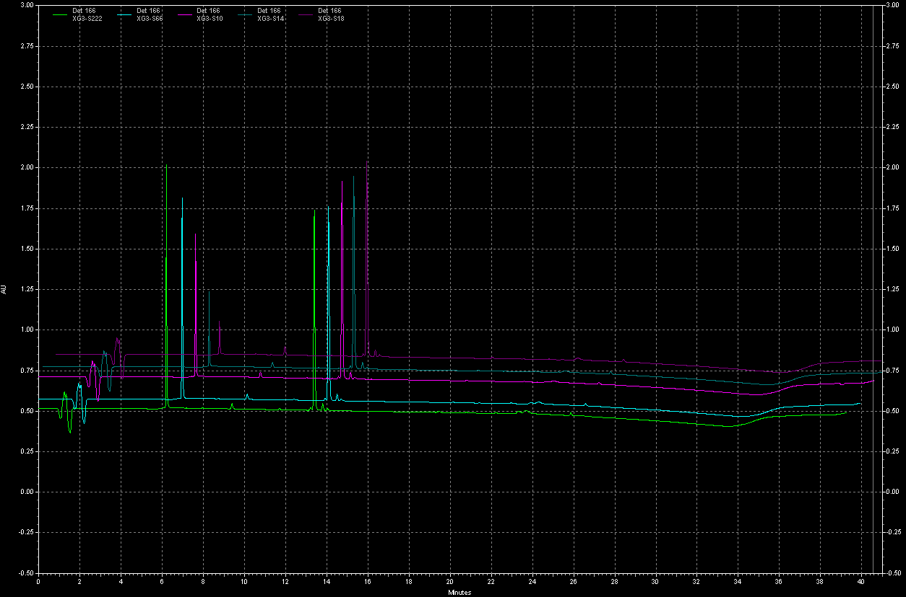
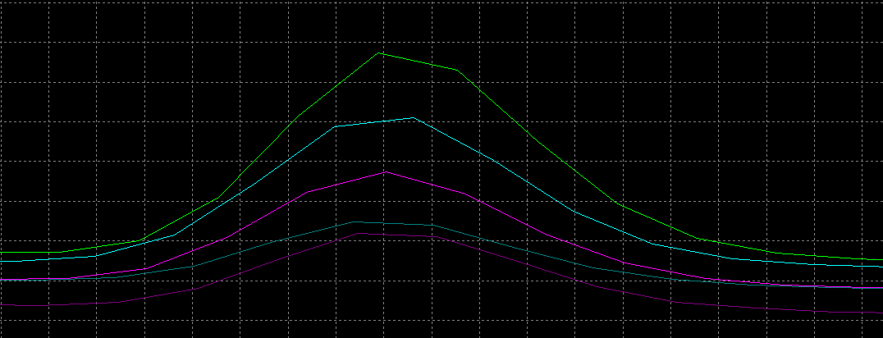

Chromatograph
[FdL2 peptide]=250uM
[NAD⁺]=10, 25, 50, 75, 100uM
Time point= 30min
Enzo SIRT3=10 U
[NAD⁺]=10uM
[NAD⁺]=25uM
[NAD⁺]=50uM
[NAD⁺]=75uM
NAD⁺
peaks
[NAD⁺]=100uM
Product
peaks

Slide 6
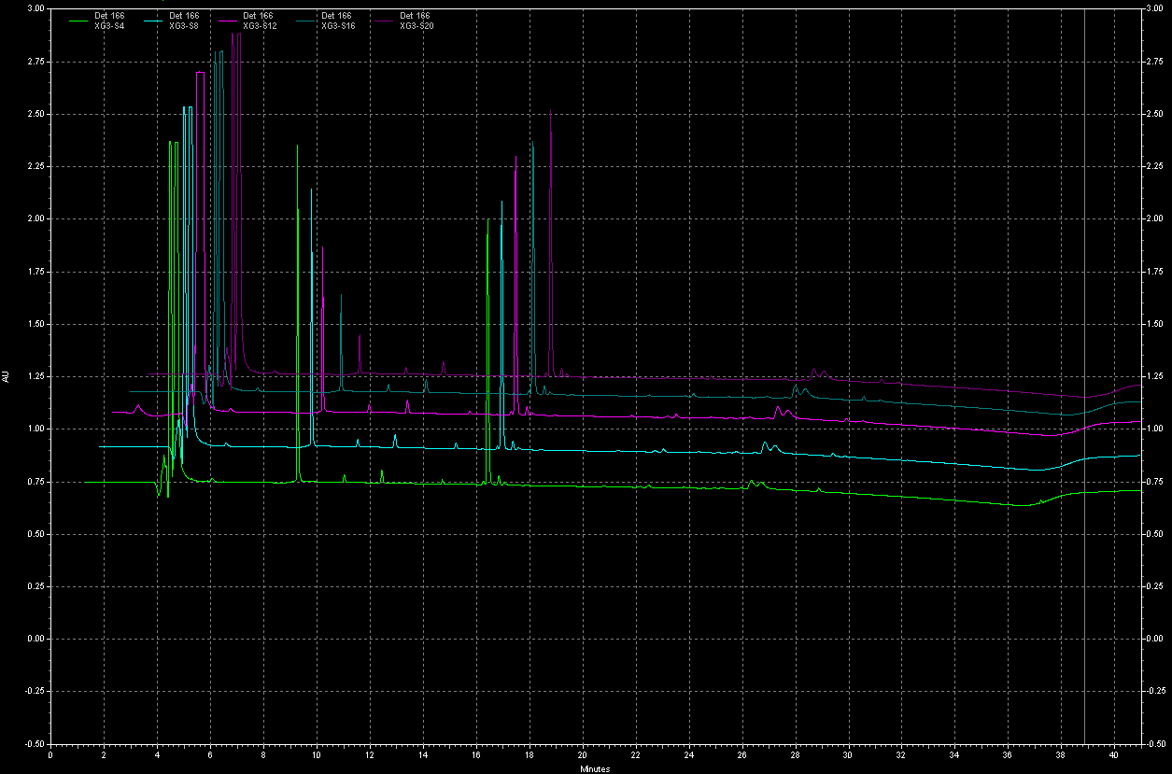
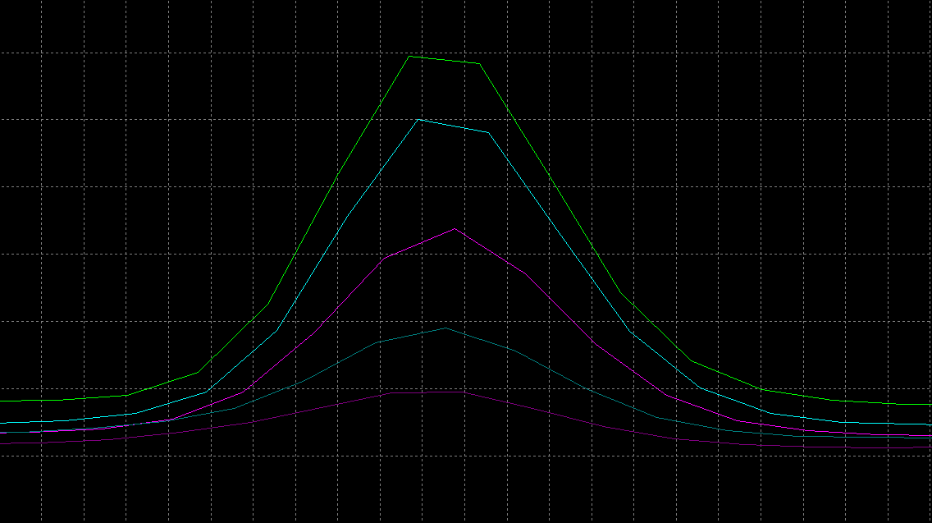
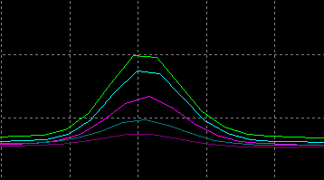
Chromatograph
[FdL2 peptide]=250uM
[NAD⁺]=10, 25, 50, 75, 100uM
Time point= 30min
In-house SIRT3=10 U
NAD⁺
peaks
[NAD⁺]=10uM
[NAD⁺]=25uM
[NAD⁺]=50uM
[NAD⁺]=75uM
[NAD⁺]=100uM
Product
peaks

Slide 7
Overview of the results 1:
Inter-day variation
[FdL2 peptide]=250uM
[NAD+]=10, 25, 50, 75, 100uM
Time point= 5, 30min
In-house SIRT3=10 U
 | [NAD+], uM | % product formation |  | Avg | Stdv | %cv
 |  | Day1 | Day2
5min | 100 | 0.4942 | 0.6916 | 0.5929 | 0.1396 | 23.5
 | 75 | 0.4446 | 0.5404 | 0.4925 | 0.0677 | 13.7
 | 50 | 0.3687 | 0.3311 | 0.3499 | 0.0266 | 7.6
 | 25 | 0.2382 | 0.2308 | 0.2345 | 0.0052 | 2.2
 | 10 | 0.1732 | 0.1903 | 0.1818 | 0.0121 | 6.6
30min | 100 | 1.9395 | 1.6835 | 1.8115 | 0.1810 | 10.0
 | 75 | 1.6216 | 1.5401 | 1.5808 | 0.0577 | 3.6
 | 50 | 1.1060 | 1.1060 | 1.1060 | 0.0000 | 0.0
 | 25 | 0.5596 | 0.4976 | 0.5286 | 0.0438 | 8.3
 | 10 | 0.3247 | 0.2758 | 0.3003 | 0.0346 | 11.5
Peak split, may due to inline bubble
Remarks
Deacetylation reaction can proceed at conditions of 10uM of NAD+ with saturating FdL2 peptide (250uM).
10uM NAD will be used for the dose response experiments.
%cv for In-house SIRT3 inter-day repeat is less than 15%.

Slide 8
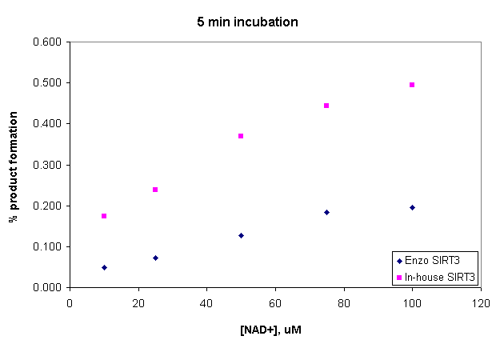
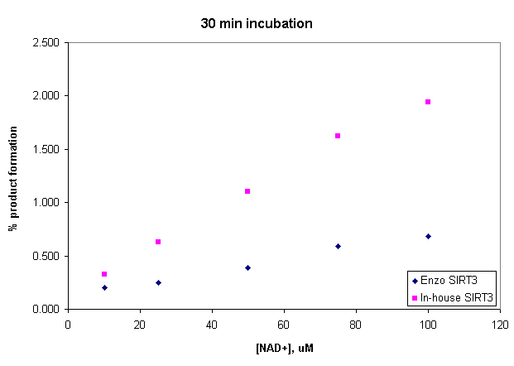
Overview of the results 2: Comparison of Enzo and in-house SIRT3
% Product formation
 | 5 min incubation |  | 30 min incubation
[NAD⁺], uM | Enzo | In-house | Enzo | In-house
100 | 0.196 | 0.494 | 0.686 | 1.939
75 | 0.184 | 0.445 | 0.591 | 1.622
50 | 0.127 | 0.369 | 0.389 | 1.106
25 | 0.072 | 0.238 | 0.251 | 0.629
10 | 0.049 | 0.173 | 0.204 | 0.325
[FdL2 peptide]=250uM
[NAD+]=10, 25, 50, 75, 100uM
Time point= 5, 30min
Enzo / In-house SIRT3=10 U
Remarks
For 5 min incubation, % product formation for Enzo and in-house SIRT3 (100uM NAD+ 250uM FdL2 peptide) are 0.196 and 0.494 respectively.
For 30 min incubation, % product formation for Enzo and in-house SIRT3 (100uM NAD+ 250uM FdL2 peptide) are 0.686 and 1.939 respectively.
The finding indicates that at the range of 10 – 100uM NAD⁺ with saturating FdL2 peptide substrate, In-house SIRT3 is more efficient for deacetylation reaction than Enzo SIRT3.

Slide 9
Overview of the results 2: Comparison of Enzo and in-house SIRT3
Total peptide + product peak Area
[FdL2 peptide]=250uM
[NAD+]=10, 25, 50, 75, 100uM
Time point= 5, 30min
Enzo / In-house SIRT3 = 10 U
 | Enzo SIRT3 |  | In-house SIRT3 |  | All runs
[NAD+], uM | 5min | 30min | 5min | 30min
100 | 5607361 | 5689806 | 5888312 | 5455618
75 | 5570814 | 5401695 | 5490043 | 5834298
50 | 5508521 | 5474515 | 5601343 | 5607018
25 | 5651671 | 5462344 | 5488834 | 5603503
10 | 5761649 | 5552438 | 5568839 | 5777581
Avg | 5620003 | 5516160 | 5607474 | 5655604 | 5599810
Stdv | 94966 | 110907 | 164519 | 151558 | 133437
%cv | 1.69 | 2.01 | 2.93 | 2.68 | 2.38
Remark
%cv for total peak area vary a little, which indicates the amount of sample loading is very consistent.

Slide 10
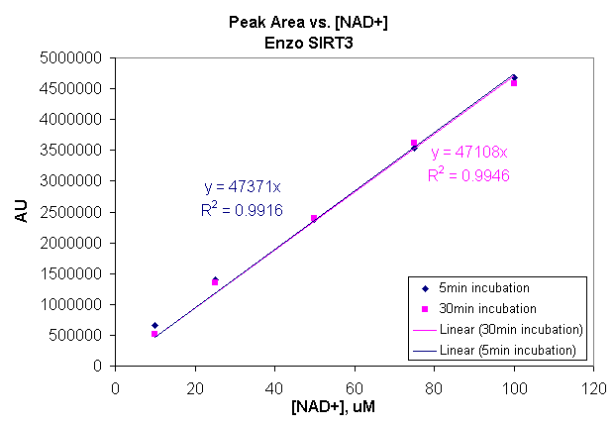
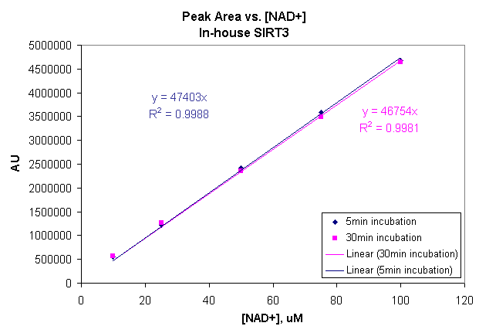
Overview of the results 3 :
NAD⁺ peak area comparison between Enzo and in-house SIRT3
Enzo SIRT3 | NAD+ Peak Area
[NAD⁺], uM | 5min | 30min
100 | 4670707 | 4577822
75 | 3542025 | 3615760
50 | 2371903 | 2401025
25 | 1398654 | 1350265
10 | 666384 | 520436
In-house SIRT3 | NAD+ Peak Area
[NAD⁺], uM | 5min | 30min
100 | 4673260 | 4643237
75 | 3592980 | 3497940
50 | 2415700 | 2346779
25 | 1220413 | 1264011
10 | 544322 | 569917
Remarks
(1) The current program + Beckman HPLC system can successfully separate the NAD⁺ peak.
(2) Good linear correlation has been achieved between NAD⁺ peak area and [NAD⁺]
(3) Focus on 5 min and 30 min plots, it is interesting to observed that
  Slope of 5 min is greater than that of 30min for both Enzo SIRT3 and In-house SIRT3. This indicates that the deacetylation reactions under lower [NAD⁺]s proceed further.
  The degree of slope decreasing between Enzo and In-house SIRT3 varies,
    Enzo SIRT3: 47371 to 47108
    In-house SIRT3: 47403 to 46754
(4) The finding indicates that at the range of 10 – 100uM NAD⁺ with saturating FdL2 peptide substrate, In-house SIRT3 is more efficient for deacetylation reaction than Enzo SIRT3. This difference may due to the purity of the SIRT3

