Slide 1
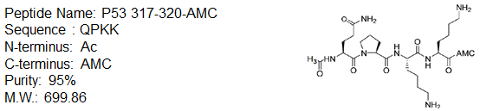
Proposed Experiment PMC-XG1-1
Aim: Deacetylated FdL2 peptide to check the detection limitation of old HPLC
Peptide-3 (P53 317-320-AMC) is the deacetylation product of FdL2 peptide.
[Peptide 3]= 0.25, 0.5, 1, 1.5 uM (10, 20, 40, 60 pmole)
The samples will be run 2/3 times for intra/inter-day variation.

Slide 2
Results for Experiment PMC-XG1-1

Slide 3
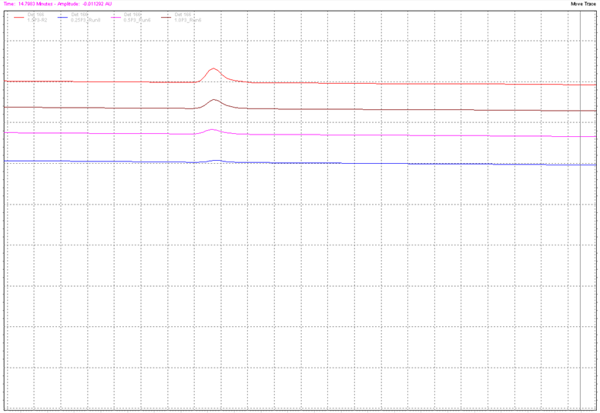
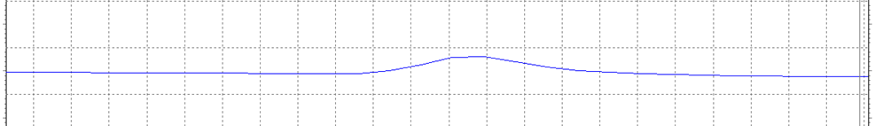
Overview Chromatograph
1.50uM
1.00uM
0.50uM
0.25uM

Slide 4
Overview of the Results
Intra-day repeat
[Peptide3], uM | # of repeats | Avg | Stdv | cv%
0.25 | 3 repeats | 11394.5 | 382.1 | 3.4
 | 4 repeats | 10861.0 | 108.7 | 1.0
0.50 | 4 repeats | 25355.0 | 1224.9 | 4.8
 | 3 repeats | 24379.0 | 680.2 | 2.8
1.00 | 2 repeats | 45223.5 | 743.2 | 1.6
 | 2 repeats | 49786.0 | 189.5 | 0.4
1.50 | 3 repeats | 75019.0 | 1476.8 | 2.0
 | 2 repeats | 77767.5 | 2535.0 | 3.3
Inter-day repeat
[Peptide3], uM | # of days | Avg | Stdv | cv%
0.25 | 2 days | 11165.9 | 397.8 | 3.6
0.50 | 2 days | 24936.7 | 1084.7 | 4.3
1.00 | 2 days | 47504.8 | 2671.1 | 5.6
2.00 | 2 days | 76118.4 | 2227.9 | 2.9

Slide 5
Details of the Results-[peptide-3] = 1.5 uM
Intra-day repeat
 | Retention time, min | Peak area
Day 1 | 13.417 | 73561
 | 13.450 | 76514
 | 13.417 | 74982
Average | 13.428 | 75019
Stdv | 0.01905 | 1476.8
cv% | 0.14 | 2.0
Day 2 | 13.400 | 75975
 | 13.367 | 79560
Average | 13.383 | 77767.5
Stdv | 0.02333 | 2535.0
cv% | 0.17 | 3.3
Inter-day repeat
 | Retention time, min | Peak area
Average | 13.410 | 76118.4
Stdv | 0.03019 | 2227.9
cv% | 0.23 | 2.9

Slide 6
Details of the Results-[peptide-3] = 1.0 uM
Intra-day repeat
 | Retention time, min | Peak area
Day 1 | 13.417 | 49652
 | 13.450 | 49920
Average | 13.434 | 49786
Stdv | 0.023 | 189.5
cv% | 0.17 | 0.4
Day 2 | 13.400 | 45749
 | 13.400 | 44698
Average | 13.400 | 45223.5
Stdv | 0 | 743.2
cv% | 0 | 1.6
Inter-day repeat
 | Retention time, min | Peak area
Average | 13.417 | 47504.8
Stdv | 0.02357 | 2671.1
cv% | 0.18 | 5.6

Slide 7
Details of the Results-[peptide-3] = 0.5 uM
Intra-day repeat
 | Retention time, min | Peak area
Day 1 | 13.383 | 25766
 | 13.350 | 25851
 | 13.383 | 26257
 | 13.383 | 23546
Average | 13.375 | 25355
Stdv | 0.0165 | 1224.9
cv% | 0.12 | 4.8
Day 2 | 13.417 | 24928
 | 13.417 | 24591
 | 13.483 | 23618
Average | 13.439 | 24379
Stdv | 0.03811 | 680.2
cv% | 0.28 | 2.8
Inter-day repeat
 | Retention time, min | Peak area
Average | 13.402 | 24936.7
Stdv | 0.04242 | 1084.7
cv% | 0.32 | 4.3

Slide 8
Details of the Results-[peptide-3] = 0.25 uM
Intra-day repeat
 | Retention time, min | Peak area
Day 1 | 13.417 | 11166
 | 13.400 | 10976
 | 13.400 | 11693
Average | 13.406 | 11394.5
Stdv | 0.010 | 382.1
cv% | 0.073 | 3.4
Day 2 | 13.450 | 11743
 | 13.400 | 10889
 | 13.417 | 10953
 | 13.450 | 10741
Average | 13.429 | 10861
Stdv | 0.02494 | 108.7
cv% | 0.19 | 1.0
Inter-day repeat
 | Retention time, min | Peak area
Average | 13.419 | 11165.9
Stdv | 0.022 | 397.8
cv% | 0.17 | 3.6

Slide 9
Remarks
0.25uM of peptide 3 (10 pmole) provide quantitable peak.
Assuming the % of product formation is 8.0%, then the lowest FdL2 peptide concentration can be used will be 3.125 uM. Therefore, 3uM will be chosen as the lowest FdL2 peptide concentration for experiment PMC-XG2.
The above finding need to be retested on PMC-XG2, which aim for the successful deacetylation of reaction under such conditions.
Intra/inter-day variations are reasonable (< 6%) under current conditions. Old HPLC + new column are in the good condition.

Slide 10
Proposed Experiment PMC-XG2
Aim: Deacetylation reactions condition modification within HPLC detection limitation-FdL2 peptide.
[FdL2 peptide] = 3uM from PMC XG1-1
[NAD+] = 3000 uM
[Enzo SIRT3 and in-house SIRT3] = 10 U
Enzo SIRT3: Bulk order, 11U/ul
In-house SIRT3: SM batch 6+7, 1.6U/ul, no FPLC used
Time point = 5, 30 min

Slide 11
Results for Experiment PMC-XG2

Slide 12
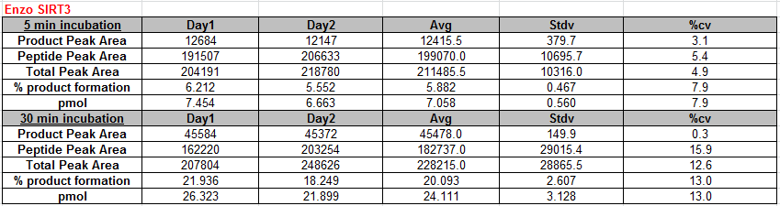
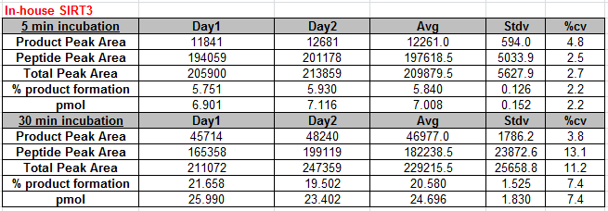
Overview of the Results - Interday variation

Slide 13
Details of the Results-Day1
5 min incubation
 | Enzo | In-house | Avg | Stdv | %cv
Product Peak Area | 12684 | 11841 | 12262.5 | 596.1 | 4.9
Peptide Peak Area | 191507 | 194059 | 192783.0 | 1804.5 | 0.9
Total Peak Area | 204191 | 205900 | 205045.5 | 1208.4 | 0.6
% product formation | 6.212 | 5.751 | 5.982 | 0.326 | 5.4
pmol | 7.454 | 6.901 | 7.178 | 0.391 | 5.4
30 min incubation
 | Enzo | In-house | Avg | Stdv | %cv
Product Peak Area | 45584 | 45714 | 45649.0 | 91.9 | 0.2
Peptide Peak Area | 162220 | 165358 | 163789.0 | 2218.9 | 1.4
Total Peak Area | 207804 | 211072 | 209438.0 | 2310.8 | 1.1
% product formation | 21.936 | 21.658 | 21.797 | 0.197 | 0.9
pmol | 26.323 | 25.990 | 26.157 | 0.235 | 0.9

Slide 14
Details of the Results-Day2
5 min incubation
 | Enzo | In-house | Avg | Stdv | %cv
Product Peak Area | 12147 | 12681 | 12414.0 | 377.6 | 3.0
Peptide Peak Area | 206633 | 201178 | 203905.5 | 3857.3 | 1.9
Total Peak Area | 218780 | 213859 | 216319.5 | 3479.7 | 1.6
% product formation | 5.552 | 5.930 | 5.741 | 0.267 | 4.6
pmol | 6.663 | 7.116 | 6.889 | 0.320 | 4.6
30 min incubation
 | Enzo | In-house | Avg | Stdv | %cv
Product Peak Area | 45372 | 48240 | 46806.0 | 2028.0 | 4.3
Peptide Peak Area | 203254 | 199119 | 201186.5 | 2923.9 | 1.5
Total Peak Area | 248626 | 247359 | 247992.5 | 895.9 | 0.4
% product formation | 18.249 | 19.502 | 18.876 | 0.886 | 4.7
pmol | 21.899 | 23.402 | 22.651 | 1.063 | 4.7

Slide 15
Remarks
Deacetylation reaction can proceed at conditions of 3uM of FdL2 peptide with saturating NAD (3mM).
Enzo and In-house SIRT3 were tested respectively. The product peak area for both of the enzyme (10 U) are comparable.
In-house SIRT3 provide smaller %cv for inter-day repeat, which are
  For Enzo SIRT3, Max. %cv: 13.0%
  For in-house SIRT3, Max. %cv: 7.4%

