Slide 1
Objective: To develop a standardised method for measuring annealing/ melting rates for complementary DNA oligomers.
Briefly,
Complementary oligomers are mixed together in a standard buffer in equal molarity. A dsDNA specific dye, SYBR Green I is added to the reaction mix to monitor the amount a dsDNA present at any given instant of time.
When SYBR Green I binds to dsDNA it is highly fluorescent. Thus, the fluorescent signal of a sample is directly proportional and therefore a measure of the amount of dsDNA present in the sample.
As the temperature of the sample is decreased, the complementary oligomers anneal resulting in the formation of dsDNA seen as increasing fluorescence. Conversely, when temperature is increased, annealed oligomers will denature/ melt , seen as decreasing fluorescence.
To determine the rate of annealing/ melting at any given temperature, two approaches have been tried:
The complementary oligomers are cooled from 90ºC to the hold temperature being tested, say, 70ºC. The ramp down rate and hold time are known (and user programmed), thus the time elapsed since start of incubation can be calculated. Once at the desired temperature, the sample is incubated for a prolonged period of time so that the change in fluorescence over time can be monitored in real time.
the complementary oligomers are cooled from 90ºC to 65ºC. Then the sample is heated up to the temperature being tested, say 70ºC. The ramp-up rate and the hold time are known (and user programmed), thus the time elapsed since start of incubation can be calculated. Once at the desired temperature, the sample is incubated for a prolonged period of time so that the change in fluorescence over time can be monitored in real time.

Slide 2
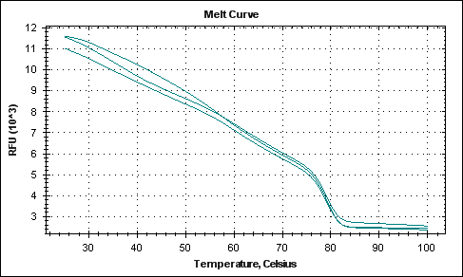
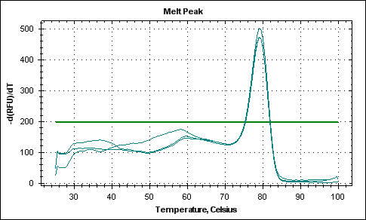
Oligomer details
Name | Size | Sequence | %GC | Melting Temperature, Tm* (width/ range of melting)
A1a16 | 40bases | 5’- GACTGCAAAGATGGAAACGACCTTCTATGACGATGCCCTC-3' | 50 | 79.8ºC (4.7ºC)
A2 (complementary oligo) | 40bases | 5'-GAGGGCATCGTCATAGAAGGTCGTTTCCATCTTTGCAGTC-3' | 50
*: This is the melting temperature in the presence of SYBR Green
Melt Curve of oligo pair A1a16-A2 previously performed (also in the presence of 1X SYBR Green)
Multiple plots represent replicate samples
First derivative of the melt curve of A1a16-A2, the positive peak represents the melting temperature (Tm = 79.8ºC, see table above).
Multiple plots represent replicate samples
Second derivative of the melt curve of A1a16-A2, the positive and negative peaks represent the limits of the range of temperatures over which melting occurs (width = 4.7ºC, see table above); the point at which the plot cuts the X-axis is the Tm (79.8ºC).

Slide 3
Reaction composition: Samples are prepared as below. Buffer blanks are prepared and run simultaneously. The melting experiment is carried out in BioRad CFX96, real time PCR equipment.
Component | Source | Concentration
Native Taq Polymerase buffer | Life Technologies | 1X
MgCl₂ | Life Technologies | 2mM
Oligo 1 (A1a16) | Sigma Custom Oligos | 2uM
Oligo 2 (A2) | Sigma Custome Oligos | 2uM
Dye (SYBR Green) | Life Technologies | 1X
The following are the drawbacks:
Lack of continuity in RFU numbers as the program progresses from one step to the next. The discontinuity is more obvious in approach II (step 2 to step 3) (see slide 10 for protocol II design and slides 11 and 12 for the described observation)
Sharp drop in RFU numbers in the first few cycles of step 4 protocol I (see slide 5 for protocol I design and slide 9 for described observation)
The measurement of the fluorescent signal by the moving optical head of CFX96 takes ~7secs. This results in data points every 8-9secs only and cannot be shortened any further.

Slide 4
Protocol I design
Step | Program | Description | Function | Time Point
1 | 90ºC/ 1:30mins |  | Initial denaturation
2 | 90ºC/ 1secs (+ Plate read) Increment -0.1ºC/cycle | 90ºC to 70ºC in 200 steps or cycles decrement 0.1ºC/ cycle At any cycle, Known temp Time calcd as 1sec hold + 7sec plate read = 8secs for each cycle | Slow ramp down of temperature for annealing | Time 0secs: 90ºC Time 1600secs: 70ºC
3 | GOTO 2 200 times
4 | 70ºC*/ 1sec (+ plate read) | 70ºC for 1sec looped 300 times At any cycle, Fixed temp Known cycle no., Time calcd as 1sec hold + 7sec plate read = 8sec for each cycle | Hold at 70ºC for extended time to determine extent of melting | Time 1608secs: 70ºC Time 4000secs: 70ºC
5 | GOTO 4 300 times
*: 3 different hold temperatures were tried on the same basic program: 70º, 75º, 80ºC. The start and stop times for steps 3 and 4 were re-calculated as above

Slide 5
Melting Curve (90ºC to 70ºC): RFU vs time
90ºC 70ºC

Slide 6
Melting Curve (90ºC to 75ºC): RFU vs time
90ºC 75ºC

Slide 7
Melting Curve (90ºC to 80ºC): RFU vs time
90ºC 80ºC

Slide 8
Normalized RFU vs time at fixed temperature: To determine the net gain or loss of fluorescent signal as a consequence of prolonged incubation at a particular temperature
Plot I
The starting RFUs (initial RFU at step 4) at each of the tested temperatures (70º, 75º, and 80ºC) was normalized to 0. The curves represent the change in fluorescent signal over a period of 40mins.
In the first few cycles of this incubation (up to cycle = 10, time = 80secs), there is a sharp drop in RFU ( at this point, the reason is unknown; see individual curves on slides 6, 7, 8 where this drop can be clearly seen).
Plot II
The RFUs at cycle 10 (step 4) at each of the tested temperatures (70º, 75º, and 80ºC) was normalized to 0. The curves represent the change in fluorescent signal over a period of 40mins.
The net gain in fluorescence at 70º and 75ºC is now positive

Slide 9
Protocol II design
Step | Program | Description | Function | Time Point
1 | 90ºC/ 1:30mins (+ Plate read) |  | Initial denaturation
2 | 65ºC/ 30secs at ramp rate of 0.1ºC/sec (+ Plate read) |  | Slow ramp down of temperature for annealing | Time 0secs: 65ºC
3 | Melt curve 65ºC to 70ºC at 0.2ºC increment and 2sec hold (+ plate read) | At any instant of time, Known temp, Time calcd as 2sec hold + 7sec plate read = 9sec for each temp | Melting of annealed oligos | Time 9secs: 65ºC Time 234secs: 70ºC
4 | 70ºC*/ 1sec (+ plate read) | 70ºC for 1sec looped 150 times At any cycle, Fixed temp Known cycle no., Time calcd as 1sec hold + 7sec plate read = 8sec for each cycle | Hold at 70ºC for extended time to determine extent of melting | Time 234secs: 70ºC Time 1434secs: 70ºC
5 | GOTO 4 150 times
*: 4 different hold temperatures were tried on the same basic program: 70º, 74º, 78º, 80ºC. The start and stop times for steps 3 and 4 were re-calculated as above

Slide 10
Melting Curve (65ºC to 70ºC): RFU vs time (to saturation)
65ºC 70ºC

Slide 11
Melting Curve (65ºC to 74ºC): RFU vs time (to saturation)
65ºC 74ºC

Slide 12
Melting Curve (65ºC to 78ºC): RFU vs time (to saturation)
65ºC 78ºC

Slide 13
Melting Curve (65ºC to 80ºC): RFU vs time (to saturation)
65ºC 80ºC

Slide 14
Normalized RFU vs time at fixed temperature
To determine the net gain or loss of fluorescent signal as a consequence of prolonged incubation at a particular temperature, the starting RFUs (initial RFU at step 4) at each of the tested temperatures (70º, 74º, 78º and 80ºC) was normalized to 0. The following curves represent the change in fluorescent signal over a period of 20mins.

