Slide 2
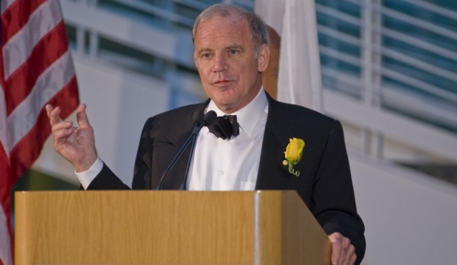
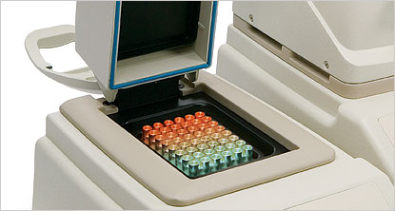
Polymerase Chain Reaction
Nobel Prize - One of the most cited papers in Science journal (~17000 in 26 years)
Central technology of modern microbiology.
Diagnosis, Genome Sequencing, Personalized Medicine, Evolutionary Studies etc.
Global market - $27.4 billion by 2015*.
* On line summary of PCR in medical application – (2009 – 2015)

Slide 3
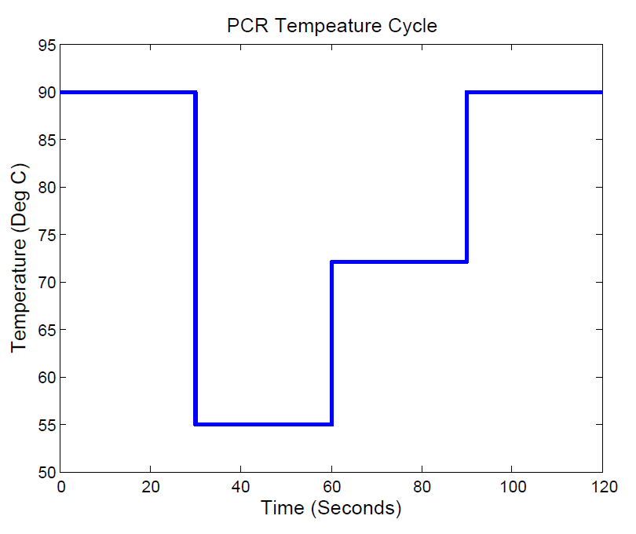

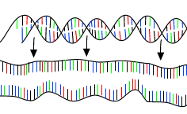
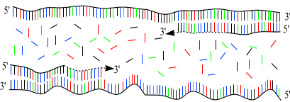
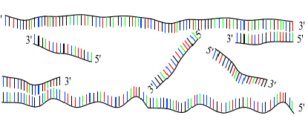
Single Strand – Primer Duplex
Extension
DNA Melting
Again
DNA Melting
Primer
Annealing

Slide 4
PCR Global Market Watch
The global PCR market is projected to reach around US$27.4 billion by 2015, with a Compounded Annual Growth Rate (CAGR) of 13.9% for the analysis period, 2009-2015. North America is estimated as the largest market with a market share of 40% of global market and projects US$10.7 billion by end-2010. Europe and Asia-Pacific together account for more than 50% of the global market share. Interestingly, Latin America is seen as the fastest growing market with a CAGR of 14.8%, to worth around US$1.3 billion in 2015.
Among the techniques used, Q-PCR appears to be the fastest growing market with a CAGR of 14.9%. Reverse-Transcription PCR (RT-PCR) and Assembly PCR are expected grow with a CAGR of 14.3% and 14% respectively.
Based on the classification by products/tools, PCR Reagents are expected to be fastest growing market with a CAGR of 14.6%. PCR Consumables and PCR Machines are expected grow with a CAGR of 14.2% and 13.1% respectively.
Global PCR Research market forecasts a CAGR of 13.3% during the analysis period 2009-2015. PCR Diagnosis market is expected to represent the market share of 29.9% by 2015. PCR Infectious Diseases stand as the fastest growing market.
Quoted from online summary of “Polymerase Chain Reaction (PCR) In Medical Application - An Analytical Report, 2009-2015” Published in June 2013

Slide 5
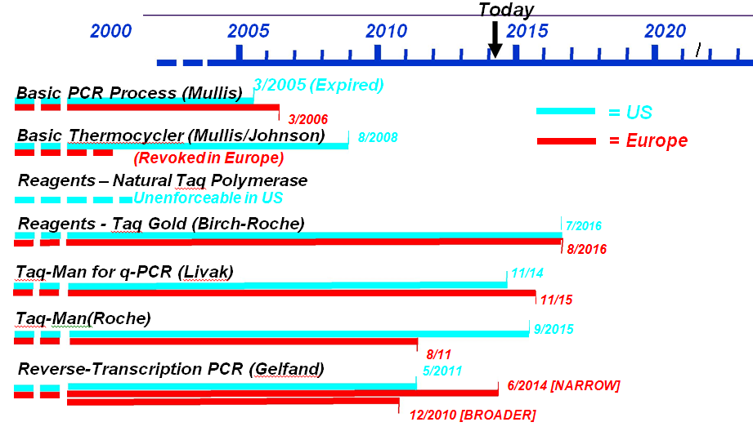
PCR Patent Landscape Summary- Some basics

Slide 6
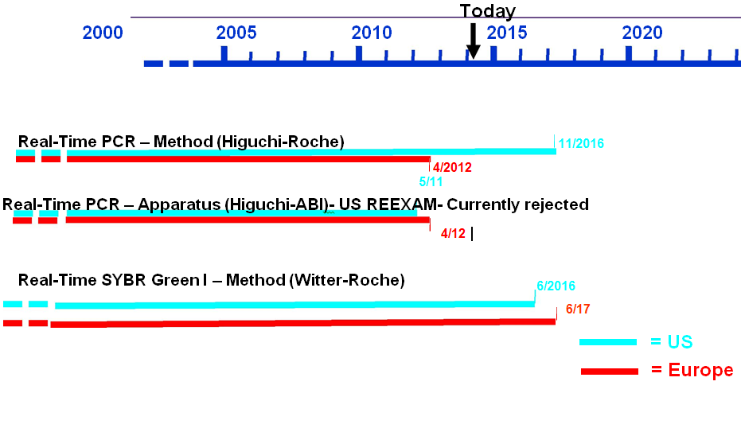
Real-Time PCR

Slide 7
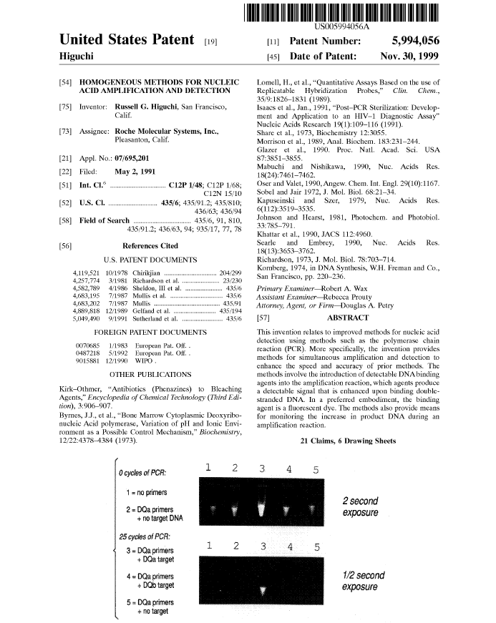
1. A method for detecting a target nucleic acid in a sample, said method comprising:
(a) providing a DNA amplification reaction mixture that comprises said sample, a DNA binding agent, wherein said agent is characterized as providing a detectable signal when bound to double-stranded DNA which signal is greater than the amount of said signal provided by said agent when it is unbound, and wherein said agent does not significantly inhibit the rate of nucleic acid amplification and reagents for amplification;
(b) determining the amount of said signal produced by the mixture of step (a);
(c) treating said mixture under conditions for amplifying said target nucleic acid to produce amplified double-stranded DNA;
(d) determining the amount of said signal produced by said mixture of step (c); and
(e) determining if amplification has occurred.
2. The method of claim 1, wherein said DNA binding agent is an intercalating agent.
3. The method of claim 2, wherein said intercalating agent is a fluorescent dye.
4. The method of claim 3, wherein at step (e) an increase in fluorescence indicates that amplification has occurred.
5. The method of claim 4, wherein at steps (b) and (d) the amount of signal produced is determined by exposing said mixture to UV light, and at step (e) comparing the relative amount of signal produced at steps (b) and (d) to determine if amplification has occurred.
6. The method of claim 4, wherein said fluorescent dye is ethidium bromide.
7. The method of claim 4, wherein the amount of signal produced is determined using a spectra fluorometer.
8. The method of claim 4, wherein said target nucleic acid is indicative of a genetic or infectious disease.
9. The method of claim 4, wherein the amount of target DNA in said sample, prior to amplification, is quantitated by determining the increase in fluorescence during amplification.
10. A method for monitoring the increase in double-stranded DNA during amplification of a target nucleic acid in a sample, wherein said method comprises the steps of:
(a) providing a mixture that comprises all components necessary for the selective amplification of said target nucleic acid by polymerase chain reaction (PCR) containing said sample and a DNA binding agent, wherein said agent is characterized as providing a detectable signal when bound to double-stranded nucleic acid which signal is greater than the amount of said signal provided by said agent when it is unbound:
(b) determining the amount of said signal produced by the mixture of step (a);
(c) treating said mixture under conditions for amplifying said target nucleic acid; and
(d) determining the amount of said signal produced by said mixture during said treating step (c).
11. The method of claim 10, wherein at steps (b) and (d), an optic fiber and spectra fluorometer are used to determine the amount of signal produced during said treating step.
12. The method of claim 11, wherein said DNA binding agent is an intercalating agent.
13. The method of claim 11, wherein at step (d) the amount of signal is determined continuously throughout the amplification reaction.
14. The method of claim 12, wherein said intercalating agent is a fluorescent dye.
15. The method of claim 14, wherein said fluorescent dye is ethidium bromide.
16. A kit for amplifying a target nucleic acid, that comprises a PCR buffer that comprises an intercalating age wherein said intercalating agent is characterized as providing a detectable signal when bound to double stranded DNA, which signal is greater than the signal provided by said intercalating agent when it is unbound and at least one pair of PCR amplification primers.
17. The kit of claim 16, wherein said intercalating agent is a fluorescent dye.
18. The kit of claim 17, wherein said fluorescent dye is ethidium bromide.
19. The kit of claim 18, wherein said ethidium bromide is present at a concentration suitable to provide between 0.15 .mu.M and 40.6 .mu.M dye in a PCR reaction.
20. The kit of claim 19, wherein said buffer also comprises Tris-HCl, pH 8.0-8.3 and KCl, each present in a concentration suitable for amplifying a target nucleic acid in a PCR.
21. The kit of claim 19 that also comprises a DNA polymerase, MgCl.sub.2, and dNTPs.

Slide 8
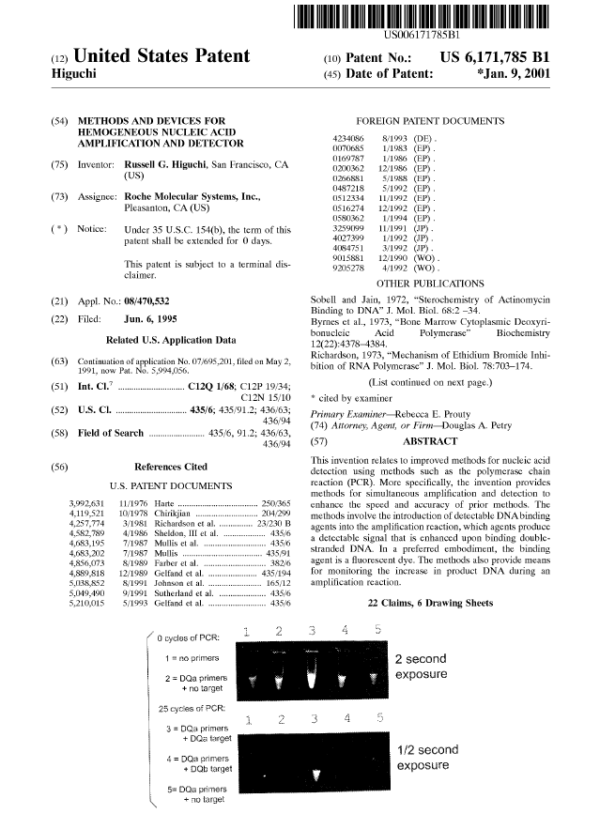
1. A method for detecting the presence of a target nucleic acid in a sample by amplification, said method comprising:
(a) providing a nucleic acid amplification reaction mixture that comprises said sample and a fluorescent dye, whose fluorescence intensity is increased upon intercalation into a double-stranded nucleic acid, wherein said reaction mixture is contained within a container which container is operably linked to a device suitable for inputting excitation light into said reaction mixture and conveying fluorescent light emitted by said reaction mixture to a detector;
(b) measuring said emitted light produced by the mixture of step (a);
(c) treating said mixture under conditions for amplifying said target nucleic acid to produce amplified double-stranded nucleic acid;
(d) measuring said emitted light produced by said mixture of step (c); and
(e) determining if amplification has occurred.
2. The method of claim 1, wherein at step (e) an increase in fluorescence indicates that amplification has occurred.
3. The method of claim 2, wherein at steps (b) and (d) the amount of emitted light produced by exposing said mixture to UV light is determined, and at step (e) the relative amount of emitted light produced at steps (b) and (d) is compared to determine if amplification has occurred.
4. The method of claim 3, wherein said fluorescent dye is ethidium bromide.
5. The method of claim 3, wherein the amount of target DNA in said sample, prior to amplification, is quantitated by determining the increase in fluorescence during amplification.
6. A method for monitoring the increase in the amount of double-stranded DNA during amplification of a target nucleic acid in a sample, wherein said method comprises the steps of:
(a) amplifying a region of said target nucleic acid by polymerase chain reaction method in the presence of a fluorescent pigment whose fluorescence intensity is increased upon intercalation into a double-stranded nucleic acid; which method comprises locating said sample in a container, which container is suitably located for inputting excitation light into said sample and conveying emission light to a detector for measuring said emissions, and wherein said method comprises the steps of:
(b) monitoring the fluorescence intensity of said fluorescent pigment during said polymerase chain reaction,
(c) determining the amount of fluorescence emission that is emitted by said sample.
7. The method of claim 6 wherein said monitoring is continuous during said amplification reaction.
8. The method of claim 7 wherein said container is contained in a vessel to be heated and cooled.
9. The method of claim 8 wherein said vessel is in contact with a block capable of being heated and cooled.
10. The method of claim 9 wherein said block is contained within a thermal cycler.
11. The method of claim 6, further comprising the step of calculating the change in fluorescence of said fluorescent pigment.
12. A method for detecting a target nucleic acid in a sample, comprising the steps of:
(a) amplifying a region of said target nucleic acid by a polymerase chain reaction method in the presence of a fluorescent pigment whose fluorescence intensity is increased upon intercalation into a double-stranded nucleic acid; and
(b) measuring the fluorescence intensity of said fluorescent pigment before and after said polymerase chain reaction by means of a device operably linked to a measuring devise, whereby an increase in fluorescence intensity is indicative of the presence of said target nucleic acid.
13. A method for quantifying a target nucleic acid in a test sample, comprising the steps of:
(a) amplifying a region of said target nucleic acid in a test reaction by the polymerase chain reaction in the presence of a fluorescent pigment whose fluorescence intensity is increased upon intercalation into a double-stranded nucleic acid;
(b) monitoring the fluorescence intensity of said fluorescent pigment during said polymerase chain reaction by use of a device operably linked to a container containing said polymerase chain reaction and to a detector suitable for measuring emitted light; and
(c) determining the quantity of said target nucleic acid in said sample.
14. The method of claim 13, wherein said test sample comprises an unknown amount of target nucleic acid and said method further comprises the steps of:
(a) performing a control experiment comprising repeating said amplifying and said monitoring steps on a control reaction which comprises a known amount of said target nucleic acid; and
(b) comparing the change in fluorescence of said fluorescent pigment in said test reaction during said reaction to the change in fluorescence of said fluorescent pigment in said control reaction during said control experiment.
15. The method of claim 14 wherein said amplifying step further comprises the step of measuring the fluorescence of said fluorescent pigment after each cycle of PCR, and said method further comprises the step of determining the number of cycles at which said fluorescence increases in said method relative to said control experiment.
16. The method of claim 2, wherein said measurement according to step (d) is carried out during step (c).
17. The method of claim 16, wherein said measurement according to step (d) is continuously carried out during step (c).
18. The method of claim 1 wherein said device suitable for inputting excitation light into said reaction mixture is a fiber optic device.
19. The method of claim 6, wherein a fiber optic device provides means for inputting said excitation light, said detector is operably linked to said fiber optic device, and said fluorescence emission is carried through said fiber optic device and detected by said detection means.
20. The method of claim 12 wherein said device is a fiber optic device.
21. The method of claim 13 wherein said device is a fiber optic device.
22. The method of claim 20 wherein said polymerase chain reaction is contained within a container which container is operably linked to a fiber optic device suitable for transmitting excitation light to said container and conveying emission light to said measuring devise.

Slide 9
The First Wave of PCR Patents Have Expired
The basic US PCR process patents have expired
– Expired March, 2006 in Europe
The basic US thermocycler patents (Mullis series) expired in 2008
– Revoked in Europe
– But note, there is one lingering Canadian patent
Natural Taq polymerase patent held unenforceable in US
• So, you can clearly perform basic PCR free of patents! BUT.............

Slide 10
Many Follow On Patents to Consider
Improved Polymerases (2016+)
– Roughly, they can be purchased/recommended, but may have DX limits
Real Time PCR- Divided by Roche and ABI
– Method (2016)- Roche- licensed reagents carry a “no DX” label license
– Device (2011/2012)- ABI- US in reexam, EP just survived opposition, and JP is revoked
    May only cover intercolating dyes
– SYBER Green 1 in Real time – Roche (2016)
    Reagents available, but no DX labels?

Slide 11
Follow On Patents (continued)
Taqman-
– Reagents available with license/ but with a no DX label?
Reverse Transcription
Miniaturized PCR
– In EP only, miniaturized PCR claims issued broadly to Caliper
– In US, Caliper & Affymetrix priority dispute recently resolved, but claims not issued
– settlement terms not public

Slide 12
AND THERE IS A THICKET OUT THERE!!
Owned by ABI (Applera)
US patents expire in December 2012
– Require a specific formula for calculating sample temperature and programming the computer to control the temperature. There are two US pending applications; one recites the formula and the other claims a particular sample tube design.
EP 1157744 expires in November 2011
Claim 1. Thermocyler apparatus suitable for automated performance of the polymerase chain reaction comprising:
a metal sample block (12) having a major top surface and a major bottom surface,
an array of spaced-apart sample wells formed in said major top surface,
means (49) for applying bias cooling constantly to said sample block at a rate sufficient to cause said block, if at a temperature within the range of 35-100°C, to cool uniformly at a rate of at least about 0.1 °C/sec unless external heat is supplied, and
computer-controllable heating means (156) responsive to said computer system capable of uniformly raising the temperature of said block at a rate greater than the bias cooling rate, said thermocycler apparatus being capable, under the control of a computer (20), of maintaining the array of sample wells at a constant in the range of 35-100°C within a tolerance band of plus or minus about 0.5 °C.

Slide 13
MORE THICKET
– US 5,972,716 expires on April 29, 2014
  relates to detecting fluorescence emitted from a sample tube (referenced Eppendorf tubes in the patent specification)

Slide 14
MORE THICKET- SAI
US6800452
Filed 8/8/1994, issued 10/5/2004
Related to EP775298A2 (2, Withdrawn), US6746864 (3), US7427380 (3)
– 1. A method for simultaneously performing a plurality of fluorescence assays using a multi-well plate containing a plurality of wells distributed throughout at least a portion of said multi-well plate, said method comprising the steps of:
distributing a predetermined amount of a liquid to a number of said plurality of wells;
projecting excitation radiation uniformly onto the portion of said multi-well plate throughout which the plurality of wells are distributed, thereby simultaneously and uniformly illuminating both said plurality of wells and the portion that is disposed between each of said plurality of wells;
receiving an image of fluorescence emitted from said plurality of wells simultaneously over a predetermined period of time; and
processing fluorescence data from the image.

Slide 15
University of Utah Research Foundation- Another thicket player
US7238321
Filed 7/13/2004, Earliest Non-Prov 6/4/1990
Related to US5455175 (3), US5935522 (3), US6787338 (3), US7273749 (3)
TD to 5,455,175 (Filed 1/10/1994, Issued 10/3/1995) (Expires 2011)
No EP detected
Independent claims
– 1. A thermal cycler for amplifying a nucleic acid comprising: a housing comprising a chamber;
a port in said housing for receiving at least one polymerase chain reaction (PCR) sample holder in said chamber;
a heating assembly for heating a sample comprising a nucleic acid contained in said sample holder, wherein said heating assembly is in thermal communication with said PCR sample holder when said sample holder is present in said chamber;
a cooling assembly for cooling said sample, wherein said cooling assembly is in thermal communication with said PCR sample holder when said PCR sample holder is present in said chamber; and
a controller programmed to control said heating and said cooling assemblies to cycle said sample holder and said sample through a predetermined temperature cycle corresponding to the denaturation, annealing and elongation steps of a polymerase chain reaction within a time range of 30-60 seconds;
wherein said PCR sample holder has a thermal mass which provides for completing said cycle of said polymerase chain reaction within said time range.
Licensed to Idaho technologies

Slide 16
Stratagene- Another player in the thicket
US2006289786
Filed:05/02/2006
Calculated to Expire:05/02/2026
1. An apparatus for sampling at least one sample of a biological material comprising:
– at least one light source that emits an excitation light at defined intervals, wherein the excitation light interacts with the at least one sample; and
– a detector sensitive to fluorescence emitted from the at least one sample; wherein the detector is continuously on.
Status: Under final 103 rejection
Family: No US children;
– EP1880175A1
    Claims have similar scope
    Status: No action yet by the EPO; the ISR cited X and Y art over all the claims

Slide 17
Even in the thicket, there are many subtle points
THE REAL TIME METHOD PATENT
An instrument for use in monitoring a nucleic acid amplification reaction comprising multiple thermal cycles, comprising:
an automated thermal cycler capable of alternately heating and cooling, and adapted to receive, at least one reaction vessel containing an amplification reaction mixture comprising a target nucleic acid, reagents for nucleic acid amplification, and a detectable nucleic acid binding agent; and
a detector operable to detect a fluorescence optical signal while the amplification reaction is in progress and without opening the at least one reaction vessel, which fluorescence optical signal is related to the
amount of amplified nucleic acid in the reaction vessel.

Slide 18
Higuchi Real-Time Thermocylcer Patents
The Higuchi specification indicates:
“prior to the present invention, nucleic acid detection methods required a third oligonucleotide reagent as a probe…. The present invention eliminates the need for using a hybridizing probe reagent or a capture procedure for detecting the amplified target.” Col. 5, 48-57
[emphasis added]

Slide 19
SO......
Basic PCR is now an open field
Many “tweak” patents exist
– Some are available via licenses that have been issued for purchase of reagents
    Of those, some are not available for diagnostics
– Some have subtle points that require very detailed analysis
– Many patents must be carefully reviewed to make sure a particular product is clear
– A large number of the “tweak” patents expire in the next 2 years, and present minimal business risk
In some cases, the situation in the US differs significantly from other countries

Slide 20
PCR IP Landscape 2009-2014
Original PCR Patents have expired, Real-Time PCR IP (Roche) – with its Diagnostics applications – dominates IP Landscape prior to 2009
Next Generation PCR technologies Such as COLD PCR and Digital PCR have now emerged, offering advantages in the context of growing Diagnostics market
Still no overarching PCR technology IP that can be used in any application
Enter Optimally Controlled PCR

Slide 21
Digital PCR significant IP and commercialization
1997 U.S. Patent “Method of sampling, amplifying and quantifying segment of nucleic acid, polymerase chain reaction assembly having nanoliter-sized sample chambers, and method of filling assembly” by Brown at Cytonix and Silver at the National Institutes of Health
1999 U.S. Patent “Digital Amplification” by Vogelstein and Kinzler at Johns Hopkins University
2004 U.S. Patent “Method and compositions for detection and enumeration of genetic variations” by Dressman, et al. at Johns Hopkins University
In 2006 Fluidigm introduced the first commercial system for digital PCR based on integrated fluidic circuits
In 2008, Inostics started to provide BEAMing digital PCR services for the detection of mutations in plasma/serum and tissue.
In 2013, RainDance Technologies launched a digital PCR platform based on its picoliter-scale droplet technology
Bio-Rad's QX100 Droplet Digital PCR emerged as the future leader in the digital polymerase chain reaction (dPCR)

Slide 22
1 | Digital analyte analysis | WO2011100604 A3 | 11-Feb-11 | 27-Mar-14 | PCT/US2011/024615 | Jonathan William Larson, Qun Zhong, Darren Roy Link | Jonathan William Larson, Qun Zhong, Darren Roy Link
 | The invention generally relates to droplet based digital PCR and methods for analyzing a target nucleic acid using the same. In certain embodiments, methods of the invention involve forming sample droplets containing, on average, a single target nucleic acid, amplifying the target in the droplets, excluding droplets containing amplicon from the target and amplicon from a variant of the target, and analyzing target amplicons.
2 | Methods for analyzing dna | US20140113300 A1 | 21-Oct-13 | 24-Apr-14 | US 14/058,799 | Michael Samuels | Raindance Technologies, Inc.
 | The invention generally relates to methods for increasing the amount of DNA available for analysis when using partitioned samples and parallel processing. For example, double-stranded DNA can be dissociated into two single-stranded components, and the single strands partitioned into different droplets prior to analysis. The disclosed methods are useful for performing digital PCR analysis on samples where the target DNA is not in abundance, for example when the sample originates from a body fluid or an FFPE sample.
3 | Methods for sequencing nucleic acid | US20130210638 A1 | 8-Feb-13 | 15-Aug-13 | US 13/762,843 | Jeffrey Charles Olson, James Brayer, Andrew Watson | Jeffrey Charles Olson, James Brayer, Andrew Watson
 | The invention generally relates to methods for sequencing a nucleic acid template from both a 5′ and a 3′ end in a single sequencing reaction. In certain embodiments, methods of the invention involve amplifying a nucleic acid template to produce a plurality of amplicons, splitting the amplicons into first and second portions, attaching a first oligonucleotide including a first universal primer site to a 5′ end of the amplicons in the first portion, and attaching a second oligonucleotide including a second universal primer site to a 3′ end of the amplicons in the second portion. The first and second primer sites may be the same or may be different. The method additionally involves pooling the first and second portions, and sequencing the pooled amplicons, thereby sequencing a nucleic acid template from both a 5′ and a 3′ end in a single sequencing reaction.
4 | Methods and compositions to enable multiplex cold-pcr | US20140051087 A1 | 30-Mar-12 | 20-Feb-14 | US 14/007,173 | Gerassimos Makrigiorgos | Dana-Farber Cancer Institute, Inc.
 | The present invention is directed to methods, compositions and reaction mixtures for multiplexing COLD-PCR/ice-COLD-PCR to enrich simultaneously several low abundance alleles (mutant target sequences) from a sample. The invention also involves COLD-PCR/ice-COLD-PCR amplification performed on DNA fragments that have different melting temperatures, and therefore different critical denaturation temperatures, in a graded temperature approach such that mutation enrichment is achieved on all diverse DNA fragments simultaneously (temperature-independent COLD-PCR or TI-COLD-PCR). The invention also involves methods for enabling identification of variant-sequence alleles in the presence of a large excess of non-variant alleles in nucleic acids without the complication of polymerase-introduced errors or other primer-introduced artifacts.
5 | Step-up method for cold-pcr enrichment | US20130309724 A1 | 15-Mar-13 | 21-Nov-13 | US 13/834,167 | Reyes Candau-Cachon | Transgenomic, Inc.
 | Methods of using polymerase chain reactions to enrich a target sequence in a sample containing reference sequences and target sequences having high homology and amplifiable by the same primer pair are provided herein. In particular the methods provide a robust means to improve the fold enrichment of the target sequence and minimize reaction-to-reaction, well-to-well and run-to-run variations in the enrichment methods.
6 | Full cold-PCR enrichment with reference blocking sequence | US8623603 B2 | 8-Mar-11 | 7-Jan-14 | US 13/042,549 | Gerassimos Makrigiorgos | Dana-Farber Cancer Institute, Inc.
 | The present invention is directed to methods, compositions and software for enriching low abundance alleles in a sample. It is directed in particular to the use of an excess amount of reference blocking sequence in an amplification reaction mixture in order to improve the enrichment efficiency, and reduce cycle time, of full COLD-PCR.
7 | Enrichment of a target sequence | WO2009017784 A2 | 31-Jul-08 | 5-Feb-09 | PCT/US2008/009248 | Gerassimos Makrigiorgos | Dana-Farber Cancer Institute, Inc.
 | The present invention is directed to methods, compositions, software and devices for enriching low abundance alleles from a sample. The method is based in part on a modified nucleic acid amplification protocol that includes incubating the reaction mixture at a critical denaturing temperature or 'Tc'. By employing the present invention the current detection limits of all PCR-based technologies are greatly improved.
8 | Microvesicle-based assays | CA2814507 A1 | 17-Oct-11 | 19-Apr-12 | CA 2814507 | Walter Chen, Xandra O. Breakefield, Leonora Balaj, Johan Karl Olov Skog | The General Hospital Corporation
 | Methods are disclosed herein for assaying a biological sample or a bodily fluid obtained from a subject by isolating, obtaining or using a microvesicle fraction from the biological sample or bodily fluid and detecting in the microvesicle fraction the presence or absence of a genetic aberration in an IDH1, IDH2, TP53, PTEN, CDKN2A, NF1, EGFR, RB1, PIK3CA, or BRAF gene. The methods may be used for aiding the diagnosis, prognosis, monitoring, or therapy selection in relation to a disease or other medical condition (e.g., a glioma) in a subject.

Slide 23
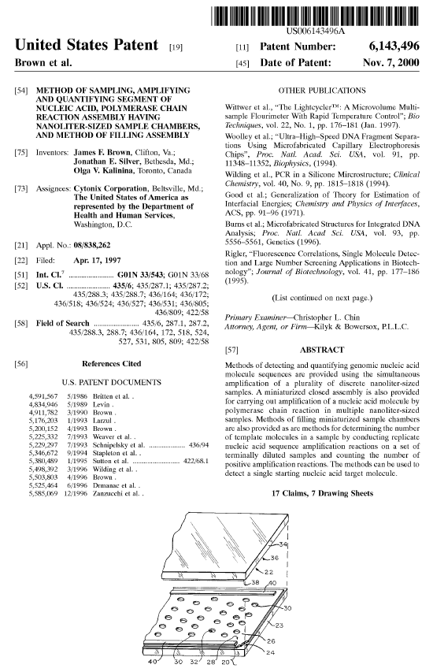
1. A method comprising:
providing a sample containing at least one target nucleic acid molecule to be amplified and constituents for enabling amplification of the target nucleic acid molecule;
loading the sample into a device, said device having multiple sample chambers;
subdividing the sample in the device into a plurality of sample portions, one sample portion in each of the multiple sample chambers, wherein at least one of said sample portions loaded into a respective sample chamber includes said at least one target nucleic acid molecule;
subjecting the sample portions loaded into the respective sample chambers to a homogeneous assay for detecting the amplified product including conditions under which amplification of said at least one target nucleic acid molecule occurs and a detectable amplified product of each target molecule in the sample chambers is formed;
detecting amplified product in said sample chambers; and
determining the number of said sample chambers that contain a sample portion from which said amplified product is formed, wherein
said sample chambers each have one or more dimensions such that the sample chambers that contain at least one target molecule before amplification attain a detectable concentration of amplified product in said sample chambers after a single round of amplification.
2. A method as claimed in claim 1, wherein said constituents include at least one probe that hybridizes to amplified target molecules and has a fluorescence property that changes upon hybridization or as a consequence of hybridizations, and wherein determining the number of said sample chambers that contain a sample portion from which said amplified product is formed comprises detecting the fluorescence change consequence to hybridization of said at least one probe.
3. A method as claimed in claim 1 wherein said sample chambers have volumes of about 1 .mu.l or less.
4. A method as claimed in claim 1 wherein said sample chambers have volumes of about 10 nl or less.
5. The method of claim 1, wherein said device comprises an assembly comprising: said plurality of sample chambers each confined in at least one dimension by opposing barriers separated by about 500 microns or less; means for sealing said plurality of sample chambers to prevent evaporation and contamination of sample constituents confined within said plurality of sample chambers; and means for restraining amplification product.
6. The method of claim 5, wherein said opposing barriers are separated by 100 microns or less.
7. The method of claim 1, wherein said device comprises an assembly, said assembly comprising: said plurality of sample chambers, each sample chamber being confined in at least one dimension by opposing barriers separated by about 500 microns or less; means for sealing said plurality of sample chambers to prevent evaporation and contamination of sample constituents confined within said plurality of sample chambers; and means for restraining amplification product comprising a patterned layer disposed on at least one of said opposing barriers and which at least partially defines said plurality of sample chambers.
8. The method of claim 7, wherein said opposing barriers are separated by 100 microns or less.
9. The method of claim 1, wherein said device comprises an assembly, said assembly comprising:
a substrate and a cover having facing surfaces spaced from one another, the facing surface of at least one of said substrate and said cover comprising a first material; a flow-through channel between said substrate and said cover; and one of said sample chambers bounded on at least one side thereof by said first material and being in communication with said flow-through channel, said sample chamber having a first affinity to said sample and a second affinity to a displacing fluid, said flow-through channel having a third affinity to the sample and a fourth affinity to said displacing fluid, wherein said first, second, third and fourth affinities are such that said one or more sample chambers retains a sample portion loaded into the assembly while the displacing fluid displaces sample from the flow-through channel without substantially displacing said sample portions from the sample chambers.
10. The method of claim 9, wherein each of said one or more sample chambers is confined in at least one dimension by opposing barriers separated by a dimension of about 100 microns or less.
11. The method of claim 9, wherein each of said one or more sample chambers has a volume of about 1 ml or less.
12. The method of claim 9, wherein each of said one or more sample chambers has a volume of about 10 nl or less.
13. The method of claim 9 wherein said flow-through channel contains a curable displacing fluid which isolates and seals off each of said one or more sample chambers and prevents evaporation of said sample portions from said one or more sample chambers.
14. The method of claim 1, wherein said sample chambers each include at cavity having an open upper end and a volume of about 1 ml or less, and said device includes:
means for loading said sample portions into said sample chambers;
means for displacing sample away from the open upper ends of said sample chambers to isolate said sample portions within said cavities; and
means for sealing the open upper ends of said cavities immediately after displacing sample fluid away from said open upper ends.
15. The method of claim 14, wherein each of said cavities has a volume of about 10 nl or less.
16. The method of claim 14, wherein said means for displacing comprises a curable adhesive.
17. The method of claim 14, wherein said means for displacing and said means for sealing both comprise a common single surface.

Slide 24
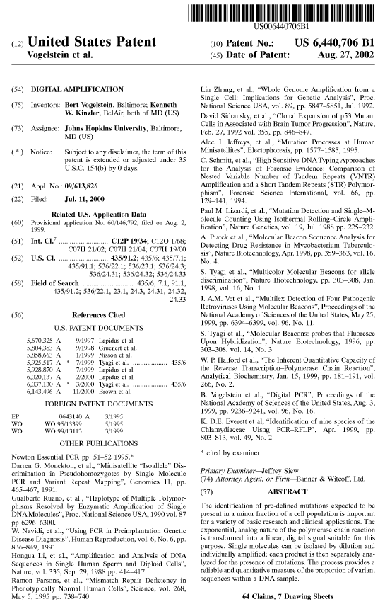
1. A method for determining the ratio of a selected genetic sequence in a population of genetic sequences, comprising the steps of: diluting nucleic acid template molecules in a biological sample to form a set comprising a plurality of assay samples; amplifying the template molecules within the assay samples to form a population of amplified molecules in the assay samples of the set; analyzing the amplified molecules in the assay samples of the set to determine a first number of assay samples which contain the selected genetic sequence and a second number of assay samples which contain a reference genetic sequence; comparing the first number to the second number to ascertain a ratio which reflects the composition of the biological sample.
2. The method of claim 1 wherein the step of diluting is performed until at least one-tenth of the assay samples in the set comprise a number (N) of molecules such that 1/N is larger than the ratio of selected genetic sequences to total genetic sequences required for the step of analyzing to determine the presence of the selected genetic sequence.
3. The method of claim 1 wherein the step of diluting is performed until between 0.1 and 0.9 of the assay samples yield an amplification product when subjected to a polymerase chain reaction.
4. The method of claim 1 wherein the step of diluting is performed until all of the assay samples yield an amplification product when subjected to a polymerase chain reaction and each assay sample contains less than 10 nucleic acid template molecules containing the reference genetic sequence.
5. The method of claim 1 wherein the step of diluting is performed until all of the assay samples yield an amplification product when subjected to a polymerase chain reaction and each assay sample contains less than 100 nucleic acid template molecules containing the reference genetic sequence.
6. The method of claim 1 wherein the biological sample is cell-free.
7. The method of claim 1 wherein the number of assay samples within the set is greater than 10.
8. The method of claim 1 wherein the number of assay samples within the set is greater than 50.
9. The method of claim 1 wherein the number of assay samples within the set is greater than 100.
10. The method of claim 1 wherein the number of assay samples within the set is greater than 500.
11. The method of claim 1 wherein the number of assay samples within the set is greater than 1000.
12. The method of claim 1 wherein the step of amplifying and the step of analyzing are performed on assay samples in the same receptacle.
13. The method of claim 1 wherein a molecular beacon probe is used in the step of analyzing, wherein a molecular beacon probe is an oligonucleotide with a stem-loop structure having a photoluminescent dye at one of the 5' or 3' ends and a quenching agent at the opposite 5' or 3' end.
14. The method of claim 1 wherein the step of analyzing employs gel electrophoresis.
15. The method of claim 1 wherein the step of analyzing employs hybridization to at least one nucleic acid probe.
16. The method of claim 1 wherein the step of analyzing employs hybridization to at least two nucleic acid probe.
17. The method of claim 13 wherein two molecular beacon probes are used, each having a different photoluminescent dye.
18. The method of claim 13 wherein the molecular beacon probe detects a wild-type selected genetic sequence better than a mutant selected genetic sequence.
19. The method of claim 1 wherein the step of amplifying employs a single pair of primers.
20. The method of claim 1 wherein the step of amplifying employs a polymerase which is activated only after heating.
21. The method of claim 1 wherein the step of amplifying employs at least 40 cycles of heating and cooling.
22. The method of claim 1 wherein the step of amplifying employs at least 50 cycles of heating and cooling.
23. The method of claim 1 wherein the step of amplifying employs at least 60 cycles of heating and cooling.
24. The method of claim 1 wherein the biological sample is selected from the group consisting of stool, blood, and lymph nodes.
25. The method of claim 1 wherein the biological sample is blood or bone marrow of a leukemia or lymphoma patient who has received anti-cancer therapy.
26. The method of claim 1 wherein the selected genetic sequence is a translocated allele.
27. The method of claim 1 wherein the selected genetic sequence is a wild-type allele.
28. The method of claim 1 wherein the selected genetic sequence is within an amplicon which is amplified during neoplastic development.
29. The method of claim 1 wherein the selected genetic sequence is a rare exon sequence.
30. The method of claim 1 wherein the nucleic acid template molecules comprise cDNA of RNA transcripts and the selected genetic sequence is present on a cDNA of a first transcript and the reference genetic sequence is present on a cDNA of a second transcript.
31. The method of claim 1 wherein the selected genetic sequence comprises a first mutation and the reference genetic sequence comprises a second mutation.
32. The method of claim 1 wherein the selected genetic sequence and the reference genetic sequence are on distinct chromosomes.
33. A molecular beacon probe comprising: an oligonucleotide with a stem-loop structure having a photoluminescent dye at one of the 5' or 3' ends and a quenching agent at the opposite 5' or 3' end, wherein the loop consists of 16 base pairs, wherein the loop has a T.sub.m of 50-51.degree. C. and the stem consists of 4 base pairs having a sequence 5'-CACG-3'.
34. The probe of claim 33 wherein the molecular beacon probe detects a wild-type selected genetic sequence better than a mutant selected genetic sequence.
35. The probe of claim 33 wherein the molecular beacon probe detects a mutant genetic sequence better than a wild-type genetic sequence.
36. A molecular beacon probe comprising: an oligonucleotide with a stem-loop structure having a photoluminescent dye at one of the 5' or 3' ends and a quenching agent at the opposite 5' or 3' end, wherein the loop consists of 19-20 base pairs, wherein the loop has a T.sub.m of 54-56.degree. C. and the stem consists of 4 base pairs having a sequence 5'-CACG-3'.
37. A pair of molecular beacon probes comprising: a first molecular beacon probe which is an oligonucleotide with a stem-loop structure having a first photoluminescent dye at one of the 5' or 3' ends and a quenching agent at the opposite 5' or 3' end, wherein the loop consists of 16 base pairs having a T.sub.m of 50-51.degree. C. and the stem consists of 4 base pairs having a sequence 5'-CACG-3'; and a second molecular beacon probe which is an oligonucleotide with a stem-loop structure having a second photoluminescent dye at one of the 5' or 3' ends and a quenching agent at the opposite 5' or 3' end, wherein the loop consists of 19-20 base pairs having a T.sub.m of 54-56.degree. C. and the stem consists of 4 base pairs having a sequence 5'-CACG-3'; wherein the first and the second photoluminescent dyes are distinct.
38. A method for determining the ratio of a selected genetic sequence in a population of genetic sequences, comprising the steps of: amplifying template molecules within a set comprising a plurality of assay samples to form a population of amplified molecules in each of the assay samples of the set; analyzing the amplified molecules in the assay samples of the set to determine a first number of assay samples which contain the selected genetic sequence and a second number of assay samples which contain a reference genetic sequence, wherein at least one-fiftieth of the assay samples in the set comprise a number (N) of molecules such that 1/N is larger than the ratio of selected genetic sequences to total genetic sequences required to determine the presence of the selected genetic sequence; comparing the first number to the second number to ascertain a ratio which reflects the composition of the biological sample.
39. The method of claim 38 wherein the number of assay samples within the set is greater than 10.
40. The method of claim 38 wherein the number of assay samples within the set is greater than 50.
41. The method of claim 38 wherein the number of assay samples within the set is greater than 100.
42. The method of claim 38 wherein the number of assay samples within the set is greater than 500.
43. The method of claim 38 wherein the number of assay samples within the set is greater than 1000.
44. The method of claim 38 wherein the step of amplifying and the step of analyzing are performed on assay samples in the same receptacle.
45. The method of claim 38 wherein a molecular beacon probe is used in the step of analyzing, wherein a molecular beacon probe is an oligonucleotide with a stem-loop structure having a photoluminescent dye at one of the 5' or 3' ends and a quenching agent at the opposite 5' or 3' end.
46. The method of claim 38 wherein the step of analyzing employs gel electrophoresis.
47. The method of claim 38 wherein the step of analyzing employs hybridization to at least one nucleic acid probe.
48. The method of claim 38 wherein the step of analyzing employs hybridization to at least two nucleic acid probe.
49. The method of claim 45 wherein two molecular beacon probes are used, each having a different photoluminescent dye.
50. The method of claim 45 wherein the molecular beacon probe detects a wild-type selected genetic sequence better than a mutant selected genetic sequence.
51. The method of claim 38 wherein the step of amplifying employs a single pair of primers.
52. The method of claim 38 wherein the step of amplifying employs a polymerase which is activated only after heating.
53. The method of claim 38 wherein the step of amplifying employs at least 40 cycles of heating and cooling.
54. The method of claim 38 wherein the step of amplifying employs at least 50 cycles of heating and cooling.
55. The method of claim 38 wherein the step of amplifying employs at least 60 cycles of heating and cooling.
56. The method of claim 38 wherein the template molecules are obtained from a body sample selected from the group consisting of stool, blood, and lymph nodes.
57. The method of claim 38 wherein the template molecules are obtained from a body sample of a leukemia or lymphoma patient who has received anti-cancer therapy, said body sample being selected from the group consisting of blood and bone marrow.
58. The method of claim 38 wherein the selected genetic sequence is a translocated allele.
59. The method of claim 38 wherein the selected genetic sequence is a wild-type allele.
60. The method of claim 38 wherein the selected genetic sequence is within an amplicon which is amplified during neoplastic development.
61. The method of claim 38 wherein the selected genetic sequence is a rare exon sequence.
62. The method of claim 38 wherein the nucleic acid template molecules comprise cDNA of RNA transcripts and the selected genetic sequence is present on a cDNA of a first transcript and the reference genetic sequence is present on a cDNA of a second transcript.
63. The method of claim 38 wherein the selected genetic sequence comprises a first mutation and the reference genetic sequence comprises a second mutation.
64. The method of claim 38 wherein the selected genetic sequence and the reference genetic sequence are on distinct chromosomes.

Slide 25
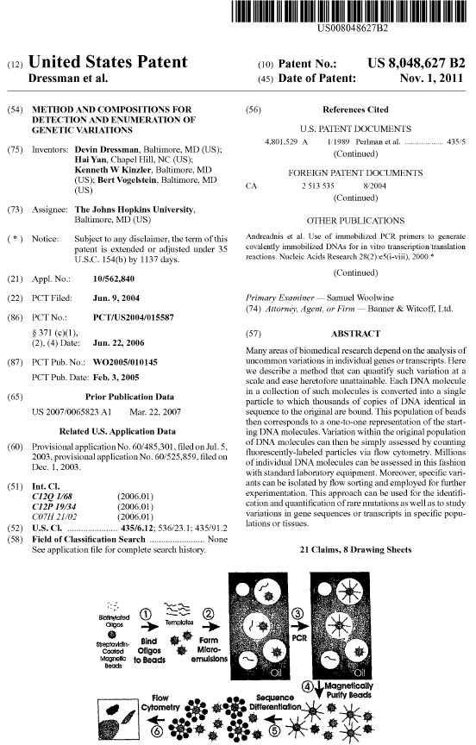
1. A method for analyzing nucleotide sequences, comprising: forming microemulsions comprising more than one species of analyte DNA molecules, such that a plurality of aqueous compartments comprise a single species of analyte DNA molecule; amplifying analyte DNA molecules in the microemulsions in the presence of reagent beads, wherein the reagent beads are bound to a plurality of molecules of a primer for amplifying the analyte DNA molecules, whereby product beads are formed which are bound to a plurality of copies of the single species of analyte DNA molecule; separating the product beads from analyte DNA molecules which are not bound to product beads; determining a sequence feature of the single species of analyte DNA molecule which is bound to the product beads by flow cytometry.
2. The method of claim 1 wherein the analyte DNA molecules are in a sample selected from the group consisting of urine, blood, sputum, stool, tissue, and saliva, of a eukaryotic organism.
3. A method for analyzing nucleotide sequences, comprising: forming microemulsions comprising more than one species of analyte DNA molecules, such that a plurality of aqueous compartments comprise a single species of analyte DNA molecule; amplifying analyte DNA molecules in the microemulsions in the presence of reagent beads, wherein the reagent beads are bound to a plurality of molecules of a primer for amplifying the analyte DNA molecules, whereby product beads are formed which are bound to a plurality of copies of the single species of analyte DNA molecule; separating the product beads from analyte DNA molecules which are not bound to product beads; determining a sequence feature of the single species of analyte DNA molecule which is bound to the product beads; isolating product beads which are bound to a plurality of copies of the single species of analyte DNA; amplifying the single species of analyte DNA molecule from the isolated product beads.
4. The method of claim 3 wherein the analyte DNA molecules are in a sample selected from the group consisting of urine, blood, sputum, stool, tissue, and saliva, of a eukaryotic organism.
5. A method for analyzing nucleotide sequences, comprising: forming microemulsions comprising more than one species of analyte DNA molecules, such that a plurality of aqueous compartments comprise a single species of analyte DNA molecule; amplifying analyte DNA molecules in the microemulsions in the presence of reagent beads, wherein the reagent beads are bound to a plurality of molecules of a primer for amplifying the analyte DNA molecules, whereby product beads are formed which are bound to a plurality of copies of the single species of analyte DNA molecule; separating the product beads from analyte DNA molecules which are not bound to product beads; determining a sequence feature of the single species of analyte DNA molecule which is bound to the product beads by hybridization to oligonucleotide probes which are differentially labeled.
6. The method of claim 5 wherein the analyte DNA molecules are in a sample selected from the group consisting of urine, blood, sputum, stool, tissue, and saliva, of a eukaryotic organism.
7. A method for analyzing nucleotide sequences, comprising: forming microemulsions comprising more than one species of analyte DNA molecules, such that a plurality of aqueous compartments comprise a single species of analyte DNA molecule; amplifying analyte DNA molecules in the microemulsions in the presence of reagent beads, wherein the reagent beads are bound to a plurality of molecules of a primer for amplifying the analyte DNA molecules, whereby product beads are formed which are bound to a plurality of copies of the single species of analyte DNA molecule; separating the product beads from analyte DNA molecules which are not bound to product beads; determining using flow cytometry an amount of product beads comprising the single species of analyte DNA molecule as a fraction of product beads.
8. The method of claim 7 wherein the analyte DNA molecules are in a sample selected from the group consisting of urine, blood, sputum, stool, tissue, and saliva, of a eukaryotic organism.
9. A method for isolating nucleotide sequences, comprising: forming microemulsions comprising more than one species of analyte DNA molecules, such that a plurality of aqueous compartments comprise a single species of analyte DNA molecule; amplifying analyte DNA molecules in the microemulsions in the presence of reagent beads, wherein the reagent beads are bound to a plurality of molecules of a primer for amplifying the analyte DNA molecules, whereby product beads are formed which are bound to a plurality of copies of the single species of analyte DNA molecule; separating the product beads from analyte DNA molecules which are not bound to product beads; isolating using fluorescence activated cell sorting product beads which are bound to a plurality of copies of the single species of analyte DNA molecule from product beads which are bound to a plurality of copies of a second species of analyte DNA molecule.
10. The method of claim 9 wherein the analyte DNA molecules are in a sample selected from the group consisting of urine, blood, sputum, stool, tissue, and saliva, of a eukaryotic organism.
11. A method for isolating nucleotide sequences, comprising: forming microemulsions comprising more than one species of analyte DNA molecules, such that a plurality of aqueous compartments comprise a single species of analyte DNA molecule; amplifying analyte DNA molecules in the microemulsions in the presence of reagent beads, wherein the reagent beads are bound to a plurality of molecules of a primer for amplifying the analyte DNA molecules, whereby product beads are formed which are bound to a plurality of copies of the single species of analyte DNA molecule; separating the product beads from analyte DNA molecules which are not bound to product beads; isolating product beads which are bound to a plurality of copies of the single species of analyte DNA molecule from product beads which are bound to a plurality of copies of a second species of analyte DNA molecule; amplifying the second species of analyte DNA molecule from the isolated product beads.
12. The method of claim 11 wherein the analyte DNA molecules are in a sample selected from the group consisting of urine, blood, sputum, stool, tissue, and saliva, of a eukaryotic organism.
13. A method for analyzing nucleotide sequences, comprising: forming microemulsions comprising more than one species of analyte DNA molecules, such that a plurality of aqueous compartments comprise a single species of analyte DNA molecule; amplifying analyte DNA molecules in the microemulsions in the presence of reagent beads, wherein the reagent beads are bound to a plurality of molecules of a primer for amplifying the analyte DNA molecules, whereby product beads are formed which are bound to a plurality of copies of the single species of analyte DNA molecule; separating the product beads from analyte DNA molecules which are not bound to product beads; determining a sequence feature of the single species of analyte DNA molecule which is bound to the product beads by a technique selected from the group consisting of: hybridization to a fluorescently labeled oligonucleotide probe; allele specific priming; single nucleotide extension; hybridization to a fluorescein-conjugated oligonucleotide probe; and hybridization to a biotin-conjugated oligonucleotide probe.
14. The method of claim 13 wherein the analyte DNA molecules are in a sample selected from the group consisting of urine, blood, sputum, stool, tissue, and saliva, of a eukaryotic organism.
15. The method of claim 13 wherein the technique used for determining is hybridization to a fluorescently labeled oligonucleotide probe.
16. The method of claim 15 wherein the oligonucleotide probe has a stem and loop structure.
17. The method of claim 13 wherein the technique used for determining is allele specific priming.
18. The method of claim 13 wherein the technique used for determining is single nucleotide extension.
19. The method of claim 13 wherein the technique used for determining is hybridization to a fluorescein-conjugated oligonucleotide probe.
20. The method of claim 19 wherein the oligonucleotide probe has a stem and loop structure.
21. The method of claim 13 wherein the technique used for determining is hybridization to a biotin-conjugated oligonucleotide probe.

Slide 26
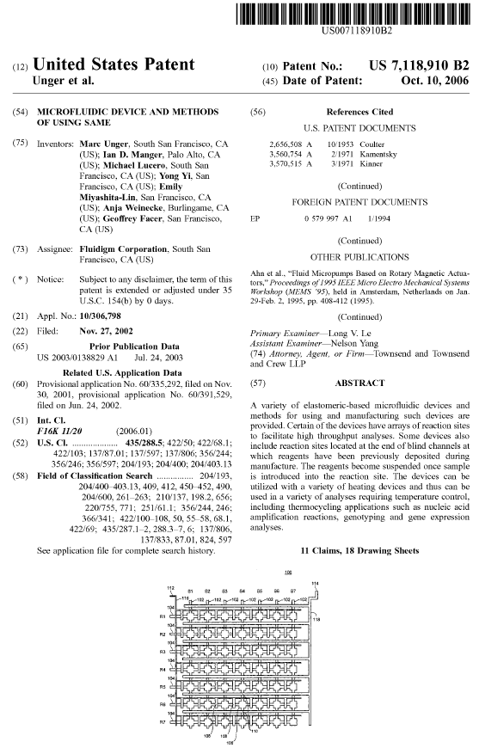

Slide 27
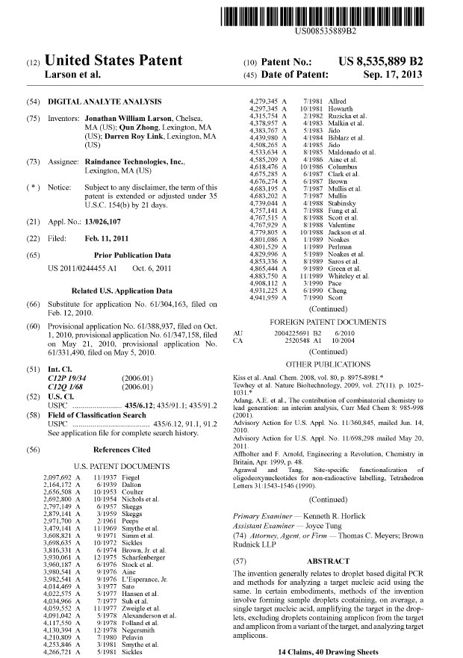

Slide 28
Digital PCR has many applications, including the detection and quantification of low-level pathogens, rare genetic sequences, copy number variations, and relative gene expression in single cells. This method provides the information with accuracy and precision.[neutrality is disputed] Clonal amplification enabled by single-step digital PCR is a key factor in reducing the time and cost of many of the "next-generation sequencing" methods and hence enabling personal genomics

Slide 29
COLD-PCR (co-amplification at lower denaturation temperature-PCR) is a modified Polymerase Chain Reaction (PCR) protocol that enriches variant alleles from a mixture of wildtype and mutation-containing DNA. The ability to preferentially amplify and identify minority alleles and low-level somatic DNA mutations in the presence of excess wildtype alleles is useful for the detection of mutations.

Slide 30
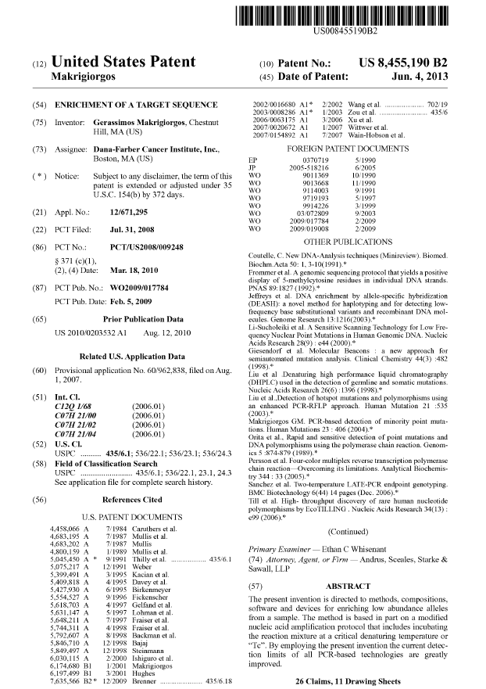
1. A method for enriching a target nucleic acid sequence in a reaction mixture, said method comprising: a. subjecting a reaction mixture suspected of having a target sequence duplex and a reference sequence duplex to a first denaturing temperature that is above the melting temperature (T.sub.m) of the target sequence duplex and the reference sequence duplex so as to permit the denaturation of said target sequence duplex and said reference sequence duplex to form target strands and reference strands, wherein said target sequence duplex comprises one or more insertion, deletion or substitution and differs by at least one nucleotide from said reference sequence duplex and is amplifiable by the same primer pair as said reference sequence duplex; b. reducing the temperature of the reaction mixture so as to permit formation of target strand/reference strand duplexes; c. subjecting said reaction mixture to a critical temperature (T.sub.c) that is below the T.sub.m of said reference sequence duplex so as to permit the preferential denaturation of said duplex of step (b) to form denatured target and reference strands; d. reducing the temperature of the reaction mixture so as to permit said primer pair to anneal to said target and reference strands; and e. extending said primer pair so as to enrich said target sequence relative to said reference sequence.
2. A method of enriching a target sequence as recited in claim 1 further comprising: alternatively repeating one or more times the steps b) and c) before executing step d).
3. The method of claim 1 wherein said target and reference sequences are first amplified by subjecting the reaction mixture to PCR and then subjecting at least a portion of the reaction mixture to the enrichment method of claim 1.
4. The method of claim 1 wherein said target sequence is a mutant allele comprising one or more deletions, insertions or alterations.
5. The method of claim 1 wherein said target sequence is differentially methylated from the reference sequence.
6. The method of claim 1 wherein said target and reference sequences comprise at least 25 bases.
7. The method of claim 1 wherein said T.sub.c is 0.3.degree. C.-5.degree. C. below the Tm of said reference sequence duplex.
8. The method of claim 1 wherein the T.sub.c is below the melting temperature of the target sequence duplex.
9. The method of claim 1 wherein said method is repeated for two or more cycles.
10. The method of claim 1 further comprising the step of analyzing said reaction mixture with enriched target sequence using one or more of the methods selected from the group consisting of: MALDI-TOF, HR-Melting, Di-deoxy-sequencing, Single-molecule sequencing, pyrosequencing, SSCP, RFLP, dHPLC, CCM, digital PCR and quantitative-PCR.
11. The method of claim 1 wherein said T.sub.c is applied for 1 second-5 minutes.
12. The method of claim 1 wherein said reaction mixture contains a nucleic acid detection dye.
13. The method of claim 12 wherein said method is performed in a real-time PCR device.
14. The method of claim 1 performed under real-time reaction conditions utilizing a labeled probe.
15. A computer readable medium comprising program instructions for performing the method of claim 1.
16. The method of claim 1 wherein said method is used to enrich two or more different target sequences and said method further comprises one or more additional pairs of primers specific to said different target sequences.
17. The method of claim 1 wherein said primer pair has a melting temperature that is below the temperature applied in step (b).
18. The method of claim 16 wherein the melting temperature of said primer pairs are at least 5.degree. C. below the temperature in step (b).
19. The method of claim 1 wherein the reaction mixture includes a modified nucleic acid.
20. The method of claim 1, wherein said method is repeated for two or more cycles.
21. The method of claim 1, wherein said method is repeated for between 5 and 40 cycles.
22. The method of claim 1, wherein said method is repeated for between 10 and 30 cycles.
23. The method of claim 5, wherein prior to implementing the method of claim 1 on the reaction mixture, the reaction mixture is treated with sodium bisulfite.
24. The method of claim 1, wherein the target sequence is at least 70% homologous to the reference sequence.
25. The method of claim 1, wherein the target sequence is at least 80% homologous to the reference sequence.
26. The method of claim 1, wherein the target sequence and the reference sequence differ by between 1 and 10 nucleotides.

Slide 31
New Variants of PCR Temperature Cycling Protocols are continually emerging, but no Dominant IP

Slide 32
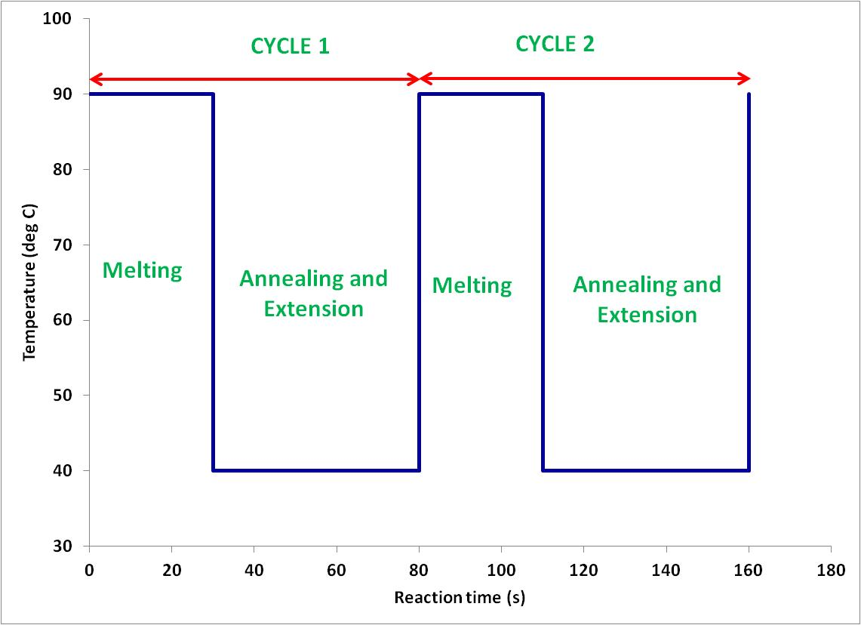
New Variants of PCR Cycling Protocols
Last two decades several new PCR have been proposed – Heuristic approach
Two step PCR¹
1. Skladny et al, Journal of Clinical Microbiology (1999), 37, 3865 - 3871

Slide 33
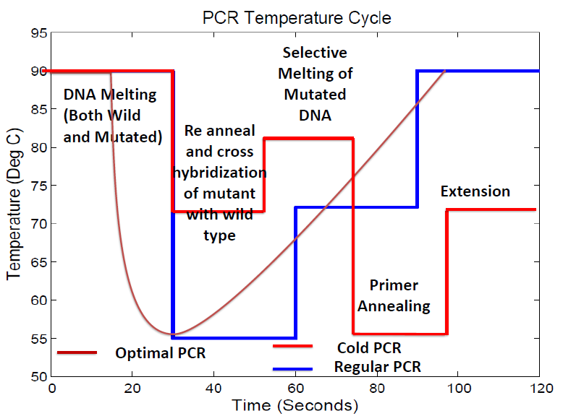
New Variants of PCR Cycling Protocols
Last two decades several new PCR have been proposed – Heuristic approach
Two step PCR¹
COLD PCR² in Cancer Diagnosis
2. Jin et al, Nature Medicine (2008), 14, 579 – 584

Slide 34
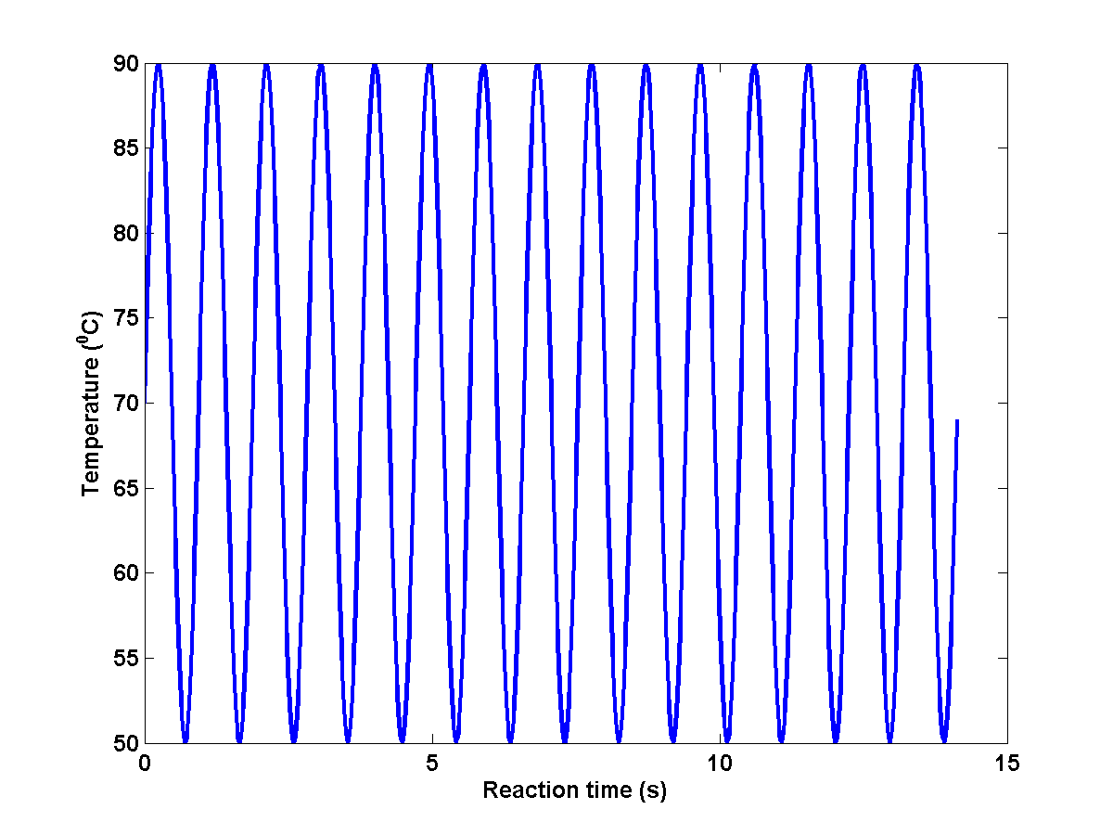
New Variants of PCR Cycling Protocols
Last two decades several new PCR have been proposed – Heuristic approach.
Two step PCR¹
COLD PCR² in Cancer Diagnosis
Rapid PCR³
3. Wittwer CT and Garling DJ (1991) BioTechniques 10: 7683

Slide 35
Input sequence and output temperature protocol, with latter being determined by the control objective (fast, cold, etc)
Examples?

Slide 36
Unified Framework for DNA Amplification Reactions
Heuristic Approaches – In the absence of predictive model.
Requires a large number of experiments – Expensive and time consuming.
Huge variation in the composition of target DNA (large number of target sequence) – Each target DNA in principle constitutes a new PCR.
Can all of these and other reactions be unified under one principle?
A general approach to dynamic optimization of DNA amplification has applications to the design of new types of amplification reactions, in addition to enhancement of existing reactions.

Slide 37
Unified Framework for DNA Amplification Reactions
Systems Biology Approach
First Principle Sequence Dependent Modeling of system
Optimal Control
Target DNA sequence
Optimal Reaction Conditions
This necessitates the development of new paradigms for modeling and control wherein first principle Sequence-Dependent Modeling of Biochemical Reaction Network is essential.

Slide 38
DNA Amplification Models – Literature Review
Sequence Independent Annealing Modeling
Craig et al (1971) , J. Mol. Bio
Porschke and Eigen (1971) – J. Mol. Bio
Sequence and Temperature Independent PCR Model
Equilibrium Thermodynamics of Enzyme Binding
Datta and LiCata (2003),
Nucleic Acids Research
Mehra and Hu (2005), Biotechnology Bioengineering
Stolovitzky and Cecchi (1996), PNAS
Gevertz et al (2005) - Biotechnology Bioengineering
Temperature independent Kinetics of Extension Reaction for Non – Taq Enzymes
Kuchta at al (1987), Biochemistry
Hung, M., N. Arnheim, and M. Goodman. (1992), Nucleic Acids Research

Slide 39
DNA Amplification Models – Literature Review
Sequence and Temperature Independent PCR model
Thermodynamically Inconsistent
Optimization Framework can’t be developed
There is no optimal control framework on this problem

Slide 40
Objectives & Approach
PCR Model
Melting
Annealing
Enzyme Binding and Extension
Optimal Control
Objective: Maximize the Desired DNA Concentration
Model
Optimal Control Solver
Optimal Reaction Condition
Sequence and Temperature dependent Kinetic Model

Slide 41
PMC-AT Licensed IP

Slide 42
PMC-AT Amplification Technology
Manipulate time-independent
PCR parameters (media
engineering)
Engineering Optimization
& Control of PCR
Control time-dependent
temperature inputs (thermal
cycling)
Licensed patents
New patents
Current Equilibrium Models | New Kinetic Models
Cancer Mutation Diagnosis
Triplet Repeat Diagnosis
Downstream
sequence analysis
methods
MALDI-TOF
Sanger Sequencing
Pyrosequencing

Slide 43
Patents: R. Chakrabarti and C.E. Schutt, US Patent 7,772,383, issued 8-10-10; US Patent 7,276,357, issued 10-2-07; US Patent 6,949,368, issued 9-27-05.
Licensees: 1) Celera, Abbott Diagnostics: 1st FDA approved Fragile X PCR diagnostic (2008);
2) Quest Diagnostics (2011)
3) New England Biolabs: other undisclosed disease diagnostics (Dec 2011)
4) Roche Molecular Diagnostics*; Undisclosed (possibly Asuragen)* * under negotiation
Trinucleotide Repeat Mutations
HTT (Huntington’s Disease)
DMPK (Muscular Dystrophy)
FMR-1 (Fragile X; Autism’s leading cause)

Slide 44
Prior Licensed PMC-AT PCR Patents (cont’d)
Trinucleotide repeat
diagnosis
Preexpansion
Full expansion
50-200 base pairs
High chance of expanding to
full mutation in future generations
>= 200 base pairs
causes hypermethylation of a regulatory CpG region upstream of gene, which silences transcription
Problem 1: Avoid multiple nonspecific annealing products due to high-GC primers
nearly 100% GC (annealing)
Problem 2: Increase product yield despite high melting temperature (denaturation)

Slide 45
Section 2:
Optimally Controlled PCR

Slide 46
Technology Significance

Slide 47
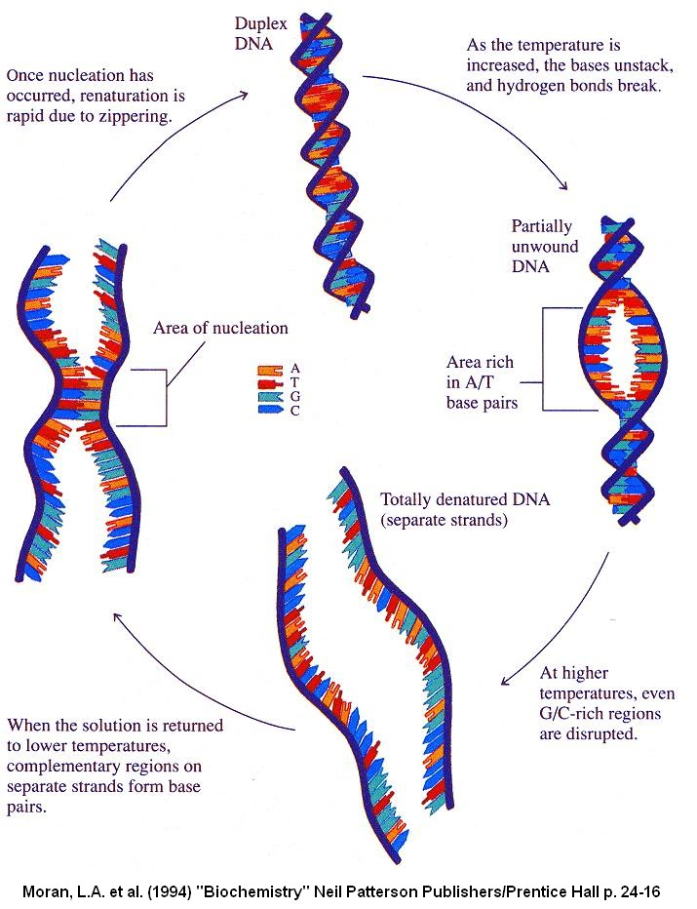
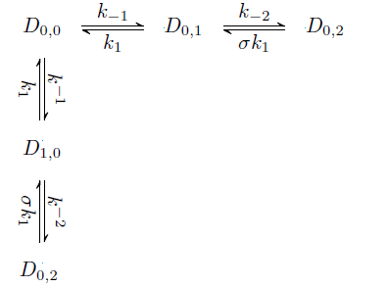
Hybridization /Melting–Mechanism
Two sided modified melting theory.
Identify the rate limiting step and hence the relaxation time.
Marimuthu and Chakrabarti (2014), J.Chem.Phys
Schwarz Jr and Poland (1975), J.Chem.Phys

Slide 48
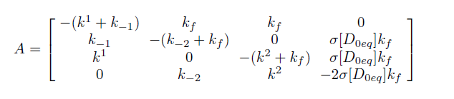
Relaxation time – Exact Model
State Space Representation:
N = 2
Temperature and sequence length dependent model parameters have been estimated using known relaxation time.
Negative reciprocal of the maximum Eigenvalue is the Relaxation time.
Marimuthu and Chakrabarti (2014), J.Chem.Phys

Slide 49
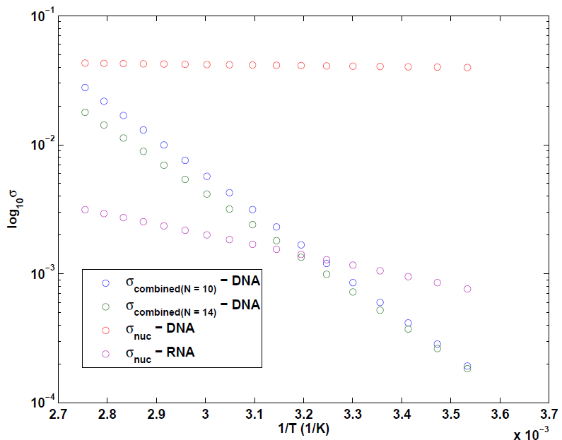
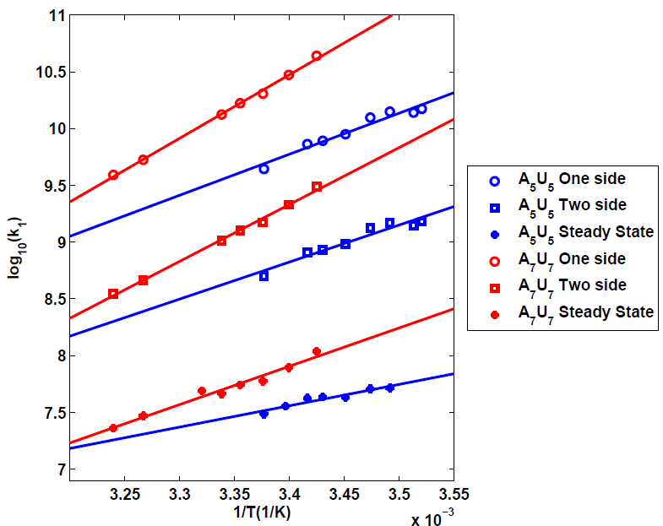
Relaxation Time Model Parameters
Sequence and Temperature Dependent Model Parameters
Marimuthu and Chakrabarti (2014), J.Chem.Phys

Slide 50
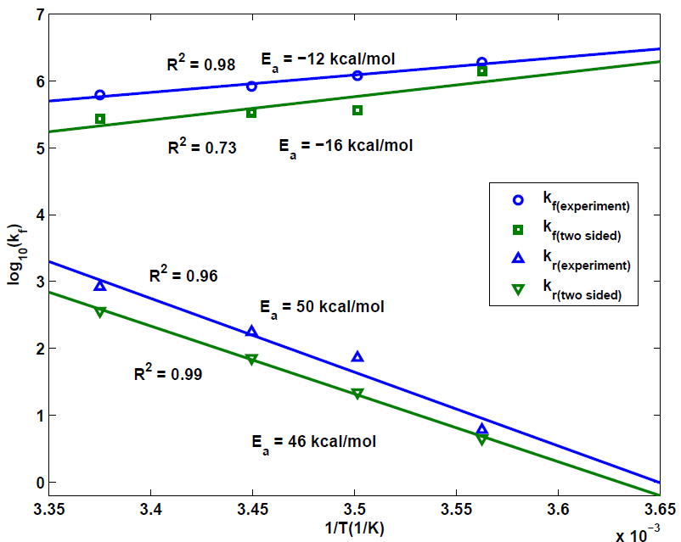
Experimental Validation
Applications other than PCR
Microarray. (Multiplex framework)
Southern blot.
This frame work can be extended to
Multiplex hybridization reactions
Hybridization with mismatches
Cancer
Diagnosis
Our model matches with the
experimental results
Marimuthu and Chakrabarti (2014), J.Chem.Phys

Slide 51
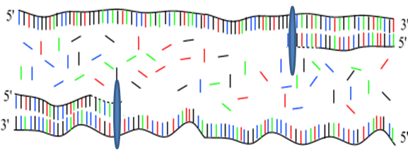
Kinetic Model (Enzyme Binding & Extension)
ENZYME BINDING
EXTENSION

Slide 52
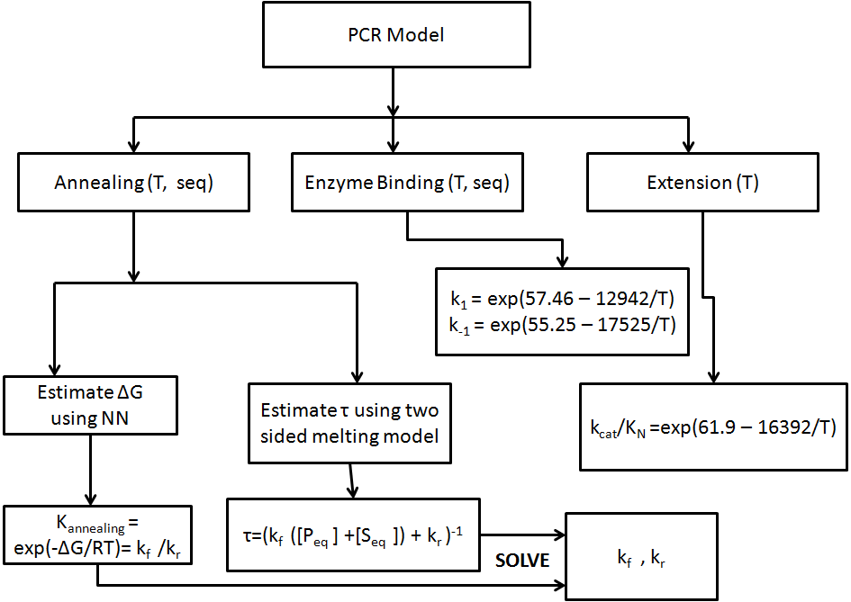
Summary of DNA Amplification Model
Marimuthu et al., Biophysical J (Under Review)

Slide 53
Overall Reaction Scheme of PCR and State Equations
Stiff System of DE
If the length of the target is N, the total number of state equations are 4 N + 9 (N varies from 500 – 2000)

Slide 54
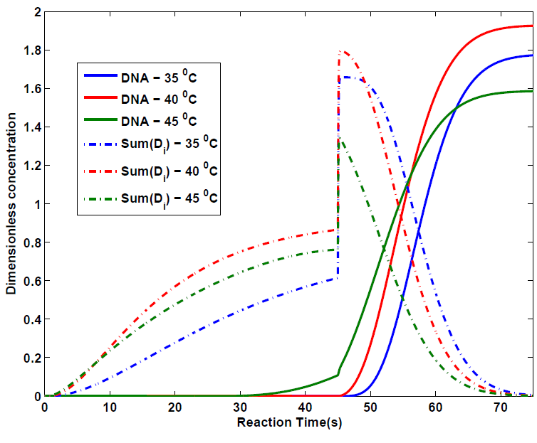
Transient Kinetics – Single Cycle (1st)
Extension Reaction time – 30 seconds.
Annealing Reaction time – 45 seconds.
Extension temperature = 72 ⁰ C
Enzyme Concentration = 10 nM.
Template Concentration = 10⁻¹⁴ M
Primer Concentration = 0.2 μM
If the annealing temperature is 40 deg C, the overall PCR is faster with nearly 100% efficiency.
Length of the target – 1000 bp
Marimuthu et al., Biophysical J (Under Review)

Slide 55
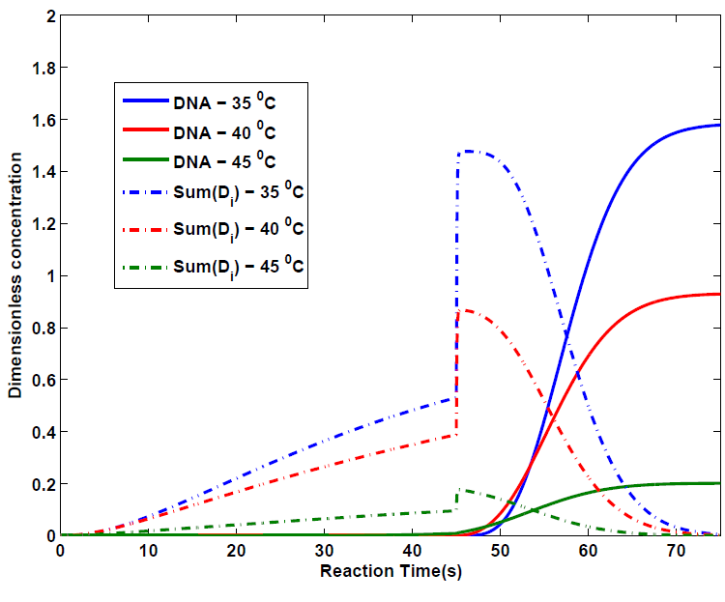
Transient Kinetics – Single Cycle (1st)
Same reaction conditions but different target sequence.
Maximum efficiency (based on these three sampling) of 70% is achieved at 35 ⁰C
Sequence dependent model is the key
Marimuthu et al., Biophysical J (Under Review)

Slide 56
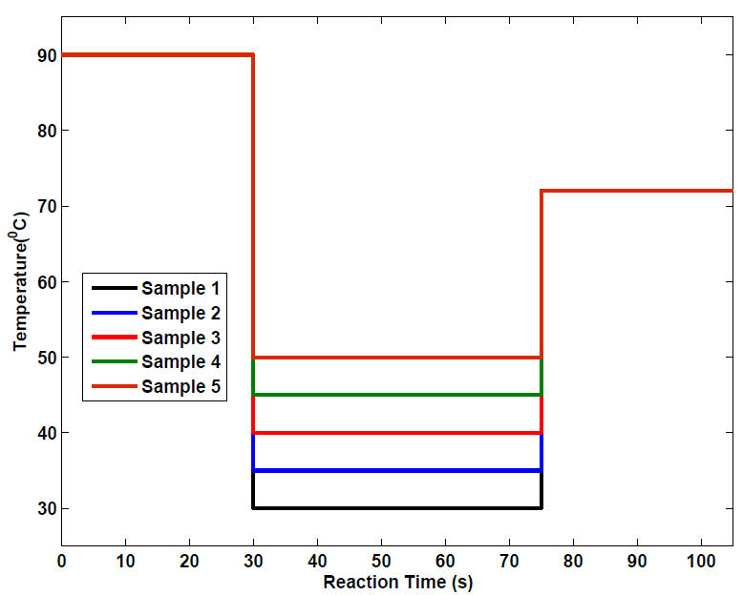
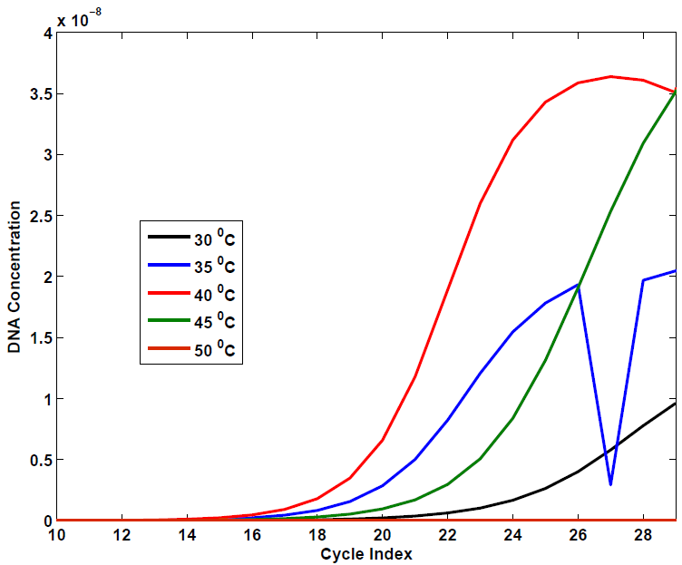
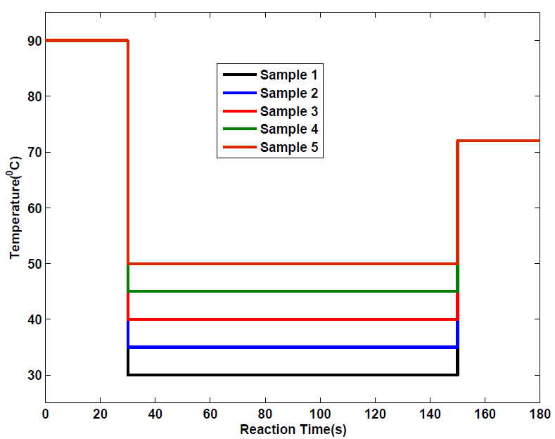
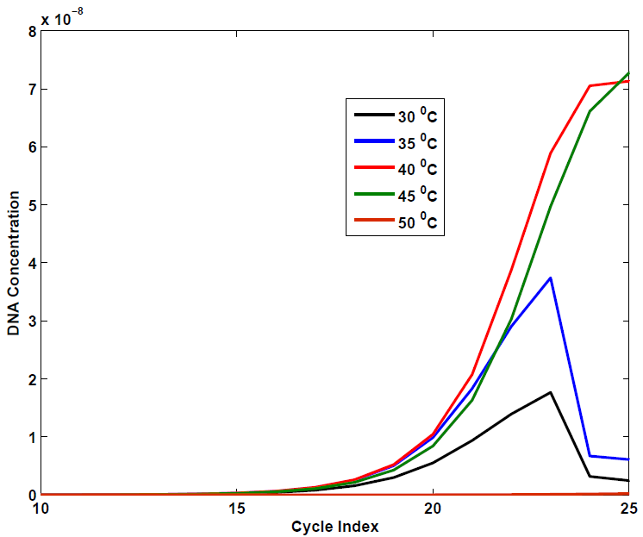
Geometric Growth of Target DNA
Shorter reaction time
Longer
reaction time

Slide 57
Geometric Growth of Target DNA
Enzyme Concentration is constant throughout the PCR
Concentration of DNA increases when cycle no increases
Once single strands concentration exceeds the enzyme concentration, more enzyme is needed.
More enzyme can be provided when we recycle the enzyme.
Enzyme concentration
is in Excess
Enzyme concentration
is limited
Stage 2
Stage 1
SP is in excess
Recycle this enzyme once it produce
some DNA so that it can react with all SP

Slide 58
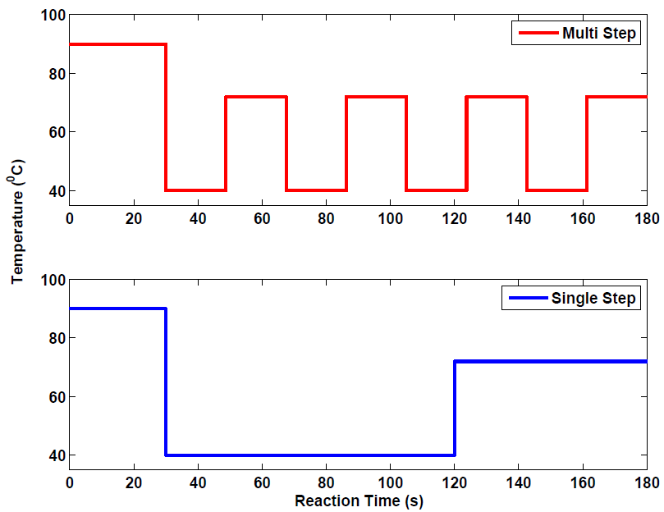
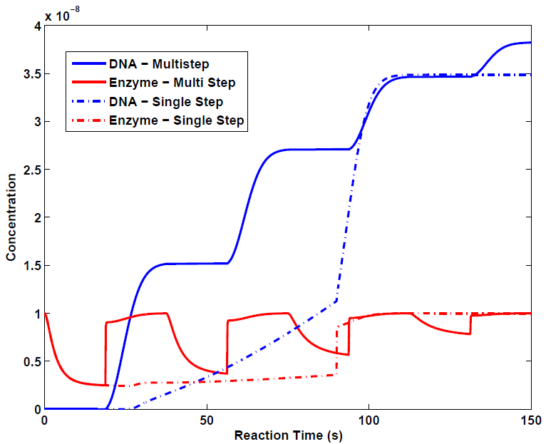
Multistep Approach (i^{th} Cycle)
Two new types of PCR cycling strategies shown to improve the efficiency.
This demonstrates how sequence dependent models can be used to develop new nonstandard PCR cycling strategies.
Marimuthu and Chakrabarti (2014), Journal of Chemical Physics, (Submitted)

Slide 59
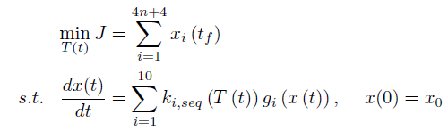
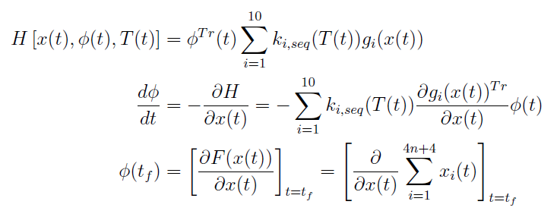
Optimal Control Formulation
Condition for Optimality - Pontryagin’s Maximum Principle

Slide 60
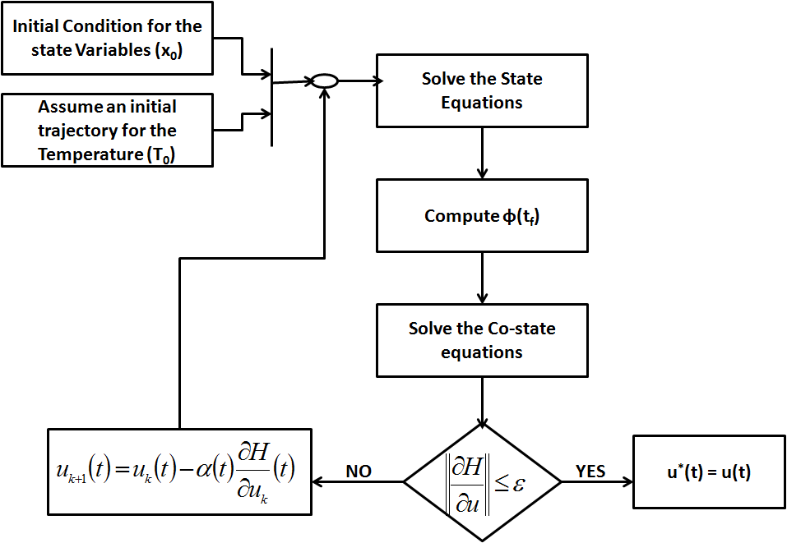
Control Vector Iteration

Slide 61
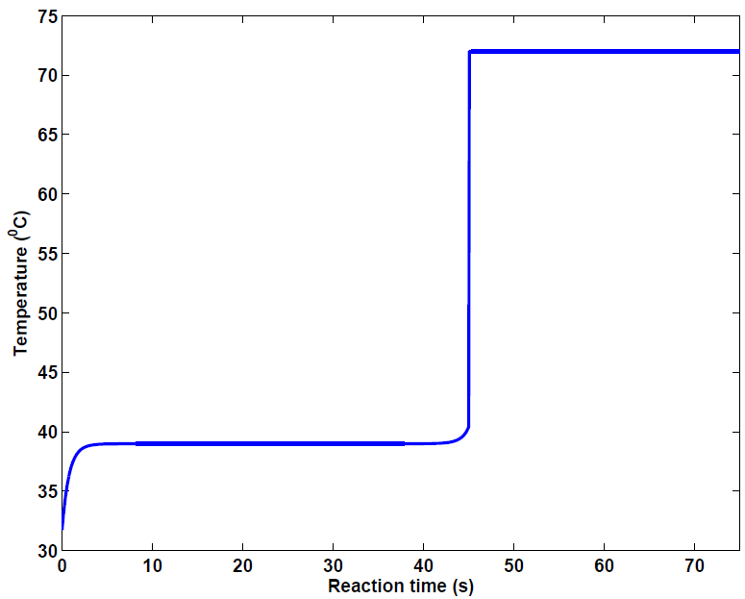
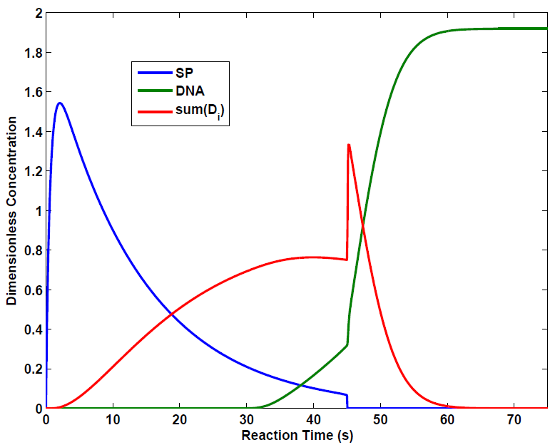
Optimal Control
Optimal control profile.
Optimal DNA concentration
profile.
Initial concentration of DNA is 10⁻¹⁴ M and Initial concentration of Enzyme is 10 nM.

Slide 62


Minimal Time Control of
Geometric Growth
In stage 1, temperature profile is periodic – Pseudo first order reactions due to high enzyme and primer concentrations.
With fixed reaction time, find the cyclic efficiency that can reduce the overall reaction time (For example, Rapid cycle PCR) – 100 % efficiency may not be desirable – Takes long time.
Solve the following optimization problem

Slide 63
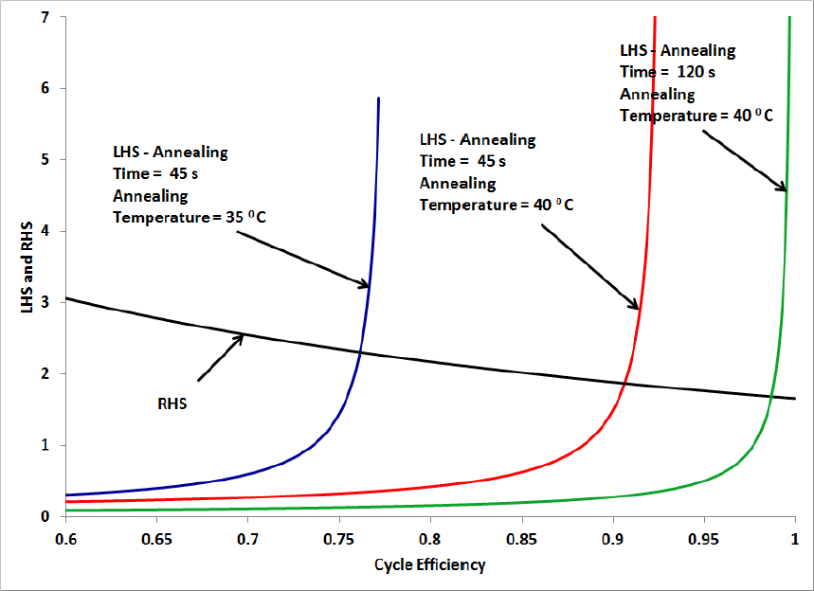
Minimal Time Control of
Geometric Growth
Optimal cyclic efficiency and cycle time that can reduce the overall reaction time.
Marimuthu and Chakrabarti (2014), Journal of Chemical Physics, (Submitted)

Slide 64
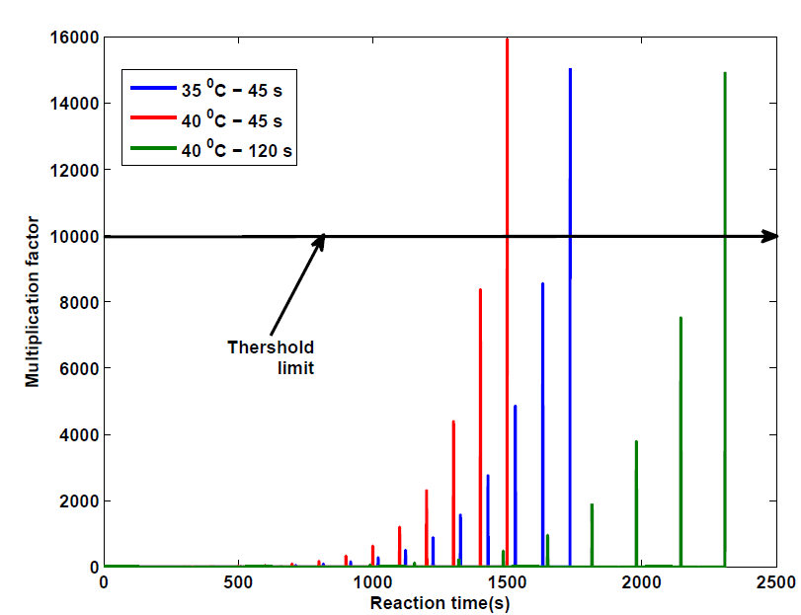
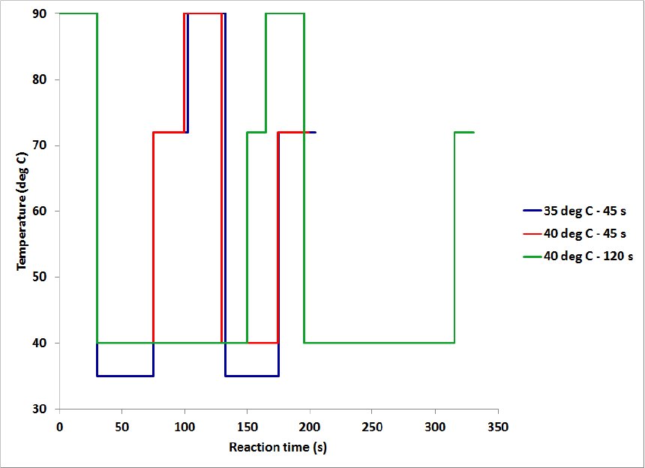
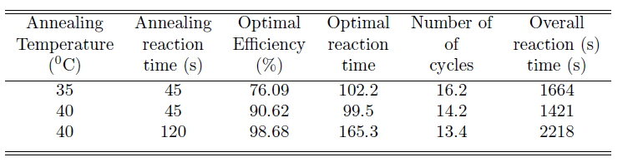
Minimal Time Control of
Geometric Growth
Marimuthu and Chakrabarti (2014), Journal of Chemical Physics, (Submitted)

Slide 65
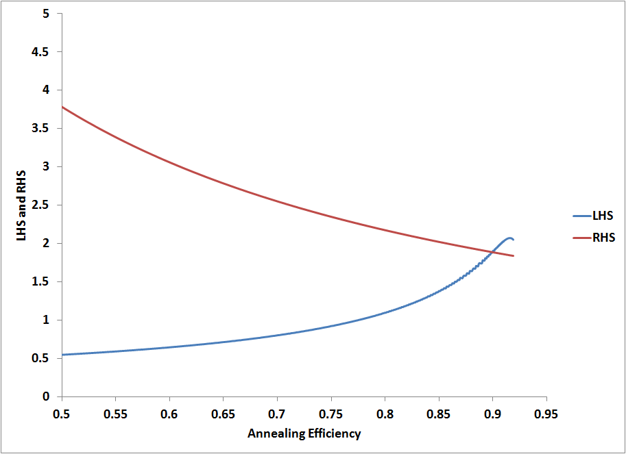
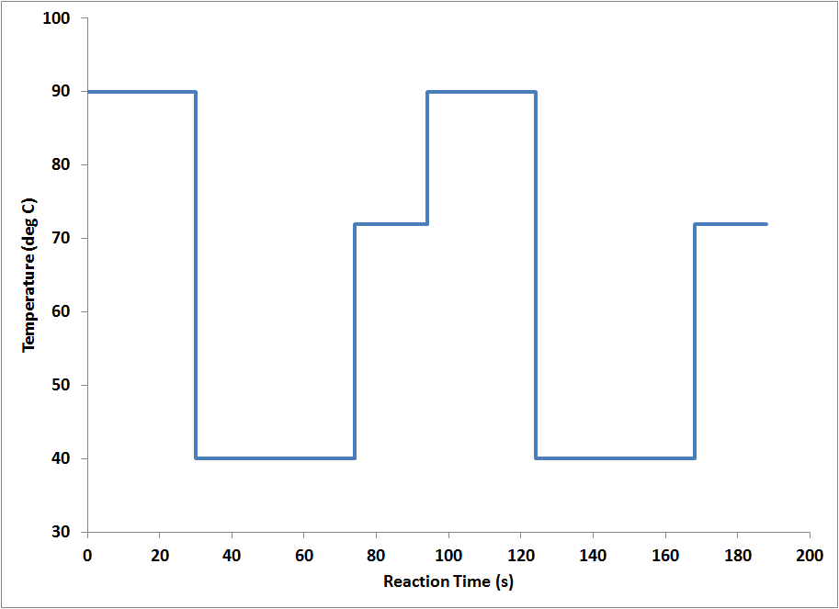
Optimal Switching Time – Approximate Solution
Minimum time analysis using the optimal DNA concentration profile.
Optimal Cyclic Efficiency
Optimal Temperature Profile

Slide 66
Quotes regarding the science behind optimally controlled PCR technology
???

Slide 67
References
Marimuthu, K and Chakrabarti, R - Sequence-dependent theory of oligonuclotide hybridization kinetics - Journal of Chemical Physics – 140 (2) - 2014
Marimuthu, K , Jing, C and Chakrabarti, R - Sequence-dependent biophysical modeling of DNA amplification - Biophysical Journal (Under Review).
Marimuthu, K and Chakrabarti, R – Sequence-dependent theory of DNA amplification dynamics: toward optimally controlled DNA amplification – Journal of Chemical Physics (Under Review).
Jing, C., Moorthy, S., Marimuthu, K., and Chakrabarti, R - Predictive kinetic modeling of DNA polymerases. To be Submitted.
Marimuthu, K and Chakrabarti, R – Optimally Controlled DNA amplification reaction – In Preparation.

Slide 68
Optimal Controlled PCR Patent
“System and methods for determination of temperature cycling protocols for polymerase chain reactions”

Slide 69
Generality and IP Position:
Variants of PCR are Approximations to Specific Instances of Optimally Controlled PCR technology

Slide 70
Phase 1 Milestones: Pertain to Completion and Testing of Optimally Controlled PCR Technology, IP
SBIR Research Milestone 1 (Phase 1): Complete Testing of Minimal Time PCR Control Strategy (using State of the Art Control Algorithms); Apply to Infectious Disease Analyte for Point-of-Care Applications. File Patent
SBIR Research Milestone 2 (Phase 1): Assess Interest in Optimal PCR Licensing by PCR IP Leaders (e.g., Roche, Life Technologies)
SBIR Research Milestone 3 (Phase 1): Complete Testing of Computational DNA Melting Model (Denaturation Step); Apply to Target Enrichment. File Patent.
US/European Patents Filed on Optimally Controlled PCR:
  Sequence-Dependent Annealing Model
  Polymerase-Dependent Extension Model
  Sequence-Dependent Melting Model
  Optimally Control of PCR (Minimal Time) based on a-c) and Optmal Control Theory

Slide 71
Sections 3:
Optimally Controlled PCR: Applications to Fast PCR, Diagnostics and NGS

Slide 72
Fast PCR: instrumentation and enzyme systems
Many of the growing market such as Infectious Diseases detection requires faster PCR technology
The length of the cycling time-block is dominated by the properties of the thermal cycling instrument (ramp rates and temperature profiles) and DNA polymerase (processivity and extension rates) generally employed.
  Reliability, accuracy, and speed of thermal cyclers represent PCR's core technology
  The development of fast PCR Master Mixes, especially DNA polymerase with better extension rate and processivity

Slide 73
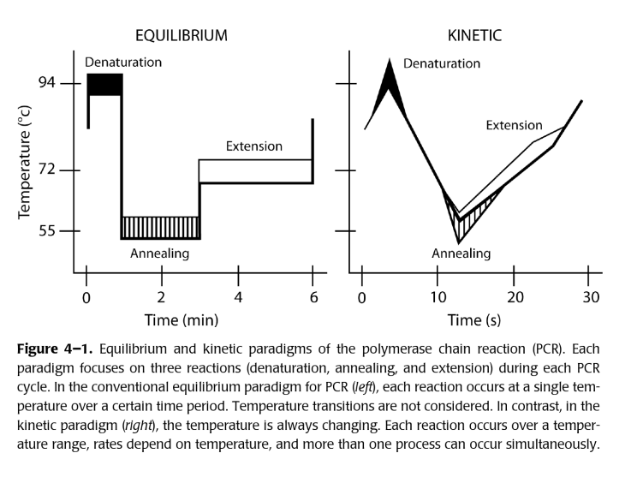
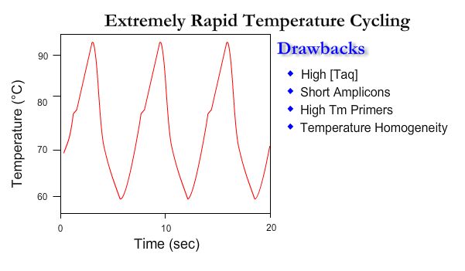
Rapid Cycler PCR
Carl Wittwer is a Professor of Pathology at the University of Utah Medical School. In the early 1990s he developed rapid-cycle PCR techniques for DNA amplification in 10-15 min, by which he claimed “When PCR is performed rapidly, the quality of PCR products is often better. Back in 1990, we were amplifying PCR products of 500 bp in about 15 min. This was accomplished by using little or no holds at extension, denaturation or annealing temperatures. Advancement in instrumentation and technology now allows even faster PCR.”

Slide 74
Development of Thermal Cycler for Fast PCR
Summary table of the advantages and disadvantages for each method of temperature control in nucleic acid amplification
Temperature control | Advantages | Disadvantages
Peltier | Low cost | Relatively slow
 | Flexible | Relatively high power
 | Active cooling | Finite lifespan
Thin-film resistive | Low cost | Relatively slow
(traditional) | Simple electronics
 | Reliable
Thin-film resistive | Relatively fast | Cost
(patterned directly) |  | Complexity
 |  | Heater is disposable
Continuous flow | Low power | Surface treatments (biocompatibility)
 | Very fast | Not flexible
 | Active cooling | Detection difficult to integrate
 |  | Size (pumps/actuators)
Non-contact | Efficient power usage | Cost
 | Very fast | Complexity
 |  | Size
Convective | Low power | Not flexible
 | Low cost | Quantification active R&D area
 | Very fast

Slide 75
Ultra Fast PCR
Many fields require faster PCR testing
  Infectious diseases detection
  Bio-defense (biologic threat detection)
  Food and water testing
  Environmental safety testing
There are several new developments in this area but not yet commercialized.
PCR kinetics study of these ultrafast PCR techniques and optimal PCR control on protocol that minimize time and cycles for quantification and detection should be interesting to these companies/organizations

Slide 76
Mutation Enrichment is essential step in Diagnostics, Deep Sequencing

Slide 77
DNA mutation detection has numerous applications in Cancer Diagnostics and Personalized Medicine
LOW-LEVEL MUTATIONS ARE ALWAYS A POTENTIAL
PROBLEM IN CLINICAL SAMPLES

Slide 78
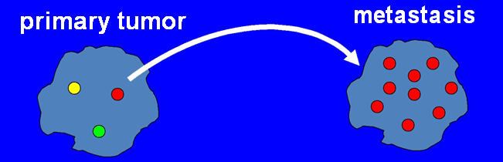
DO LOW-LEVEL MUTATIONS IN SOLID TUMORS MATTER?
Low-level mutations in primary CA may drive metastasis..
e.g. mutations in MORC1 AND KIF1C at the 1-4% level in primary breast CA can become prevalent mutations in brain metastasis
(Shah et al, Nature 2010)
certain low-level mutations in primary tumor may define the propensity of tumors to metastasize

Slide 79
LOW-LEVEL DNA VARIANTS ARE ALSO ENCOUNTERED:
• In pre-natal diagnosis
(i.e. detection of small amounts fetal circulating-DNA in maternal blood)
• In infectious diseases
(i.e. early detection of resistant strains emerging in a population of drug-responsive strains)

Slide 80
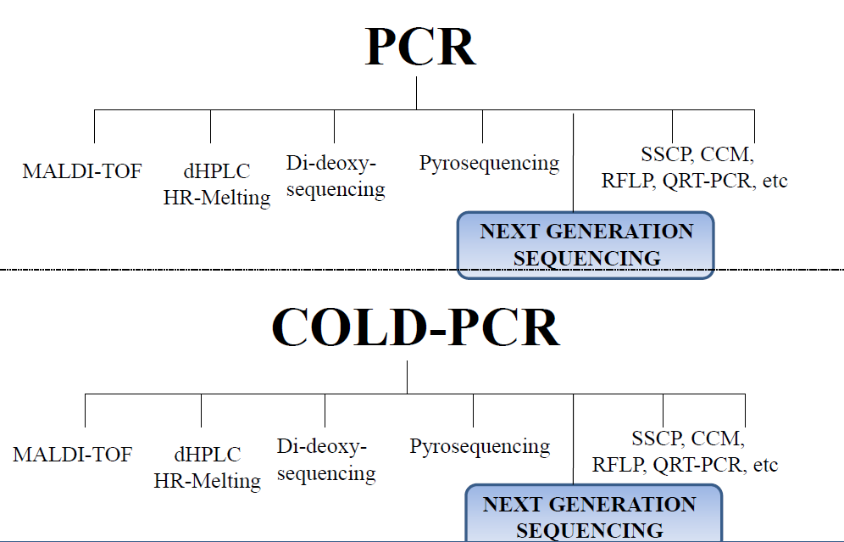
PCR IS PERFORMED PRIOR TO ALMOST
ALL PCR-BASED METHODS FOR MUTATION DETECTION
THEREFORE THE SENSITIVITY OF ALL THESE METHODS INCREASES
BY REPLACING PCR WITH COLD-PCR

Slide 81


Next Generation Sequencing Technology 2011: revolutionizing personalized medicine and tumor biology
but…. good enough for detecting low-level mutations in heterogeneous tumors or mixed clinical samples??

Slide 82


Slide 83
CONVENTIONAL PCR-NGS vs. COLD-PCR-NGS
Clinical specimens
Lung, colon adeno-carcinomas
Some contain low-abundance mutations ranging from <1% to ~17% (independently verified)
Including putatively normal match
Sequenced on the Illumina HiSeq2000 sequencer
Milbury et al, Clinical Chemistry, March 2012

Slide 84


Slide 85


Slide 86
Digital PCR for Next Generation Sequencing

Slide 87
THE PROMISE OF NEXT-GENERATION SEQUENCING
In addition to making it possible to sequence entire genomes, Next-Generation Sequencing (NGS) makes possible new sequencing-based applications, such as targeted resequencing, to identify sequence variations relevant to cancer, disease research, and population genetics.

Slide 89
Digital PCR is emerging as a preferred strategy for multiplexing & alternative to real-time quantitative PCR

Slide 90


Cancer mutation
diagnosis
Unknown mutation in one gene
Known mutations in multiple
genes
Mutated DNA
Mutation 1
Mutation 2
Purpose: Early stage detection of metastasis
Example: p53 exon 8 in plasma
Desired sensitivity: <= 1% mutant/wt
Problem: Detect in heavy wt background
Standard solution: COLD PCR
Purpose: Either assess prognosis or
determine choice of drug treatment
Example: kras, BRAF V600E
Problem: amplify in parallel while
avoiding nonspecific products
Standard approach: primer design
Wild Type DNA

Slide 91
The DNA Amplification Control Problem and Cancer Diagnostics
Wild Type DNA
Mutated DNA
Can’t maximize concentration of target DNA sequence by maximizing any individual kinetic parameter
Analogy between a) exiting a tight parking spot
b) maximizing the concentration of one DNA sequence in the presence of single nucleotide polymorphisms

Slide 92
Kinetic modeling of controlled DNA amplification
Manipulate time-independent
PCR parameters (media
engineering)
Engineering Optimization
& Control of PCR
Control time-dependent
temperature inputs (thermal
cycling)
Existing patents
New patents
Current Equilibrium Models | New Kinetic Models
Cancer Mutation Diagnosis
Triplet Repeat Diagnosis
Downstream
sequence analysis
methods
MALDI-TOF
Sanger Sequencing
Pyrosequencing
Aim of this talk: to establish the need for a) kinetic models b) engineering control theory
in developing these general diagnostic solutions.

Slide 93
Optimally Controlled DNA amplification: a unified platform
for molecular disease diagnostics
Optimally controlled DNA amplification
New Patents
Noncompetitive Problems
Competitive problems
Cancer Diagnostics:
One unknown mutation, standard sensitivity
COLD PCR
Trinucleotide
repeat diagnostics
Cancer diagnostics: One unknown mutation, enhanced sensitivity
Cancer diagnostics: known mutations in multiple genes

Slide 94
Proposed a unified framework to design the new types of DNA amplification reactions.
We have developed the first sequence and temperature-dependent kinetic model for PCR reactions that is suitable for engineering control, validating this state space model through comparison to experimental data.
Our Systems Biology approach can be applied to various types of applications such as Polymerase Chain Reactions, Microarray applications, Southern Blot, etc.

Slide 95
Using the theory of Optimal control, optimal temperature profile for a given PCR has been developed.
The time optimal switching time calculation can be used to determine proper time for a given cycling approach.
Our kinetic model can be extended to application such as Rapid PCR, PCR with mismatches, Multiplex PCR, Cold PCR – Cancer Diagnosis.
New England Bio labs has shown interest to commercialize our work upon successful experimental validation.

Slide 96
Section 4:
Examples of Cold and digital PCR
COLD PCR enrichment often falls short of predictions based on melting curves
Optimally Controlled PCR can replace COLD PCR
Digital DNA Amplification analysis is a counting method. Optimally Controlled PCR can be used as a preferred amplification method for Digital DNA analysis
  Ideal application of model-based temperature protocol calculations due to lack of background DNA
  Improve target enrichment with Optimally Controlled PCR prior to digital analysis

Slide 97

COLD-PCR Clinical application 1
Z. Zuo, et al, R. Luthra, Modern Pathology. 2009, 22, 1023

Slide 98

COLD-PCR Clinical application 1
Z. Zuo, et al, R. Luthra, Modern Pathology. 2009, 22, 1023

Slide 99
COLD-PCR Clinical application 1
Z. Zuo, et al, R. Luthra, Modern Pathology. 2009, 22, 1023

Slide 100
COLD-PCR Clinical application 1
Z. Zuo, et al, R. Luthra, Modern Pathology. 2009, 22, 1023

Slide 101

COLD-PCR: how it works
http://en.wikipedia.org/wiki/COLD-PCR

Slide 102

COLD-PCR: various protocols
http://en.wikipedia.org/wiki/COLD-PCR

Slide 103
Competitive amplification example 2: mutation enrichment
Mutation Enrichment:
competition between mutant DNA
causing cancer and wild-type
DNA amplification.
A competitive amplification
problem in diagnostics that has
been addressed w/ only
equilibrium cycling strategies
State-of-the-art approach:
COLD PCR (licensed by
Transgenomic from HMS)

Slide 104

Digital PCR: how it works

Slide 105

qPCR Vs. Digital PCR

Slide 106
qPCR Vs. Digital PCR
C.M. Hindson, et al, M. Tewari, Nat. Methods 2013, 10, 1003

Slide 107
qPCR Vs. Digital PCR
C.M. Hindson, et al, M. Tewari, Nat. Methods 2013, 10, 1003

Slide 108
Digital PCR: Instrumentation
M. Baker, Nat. Methods 2012, 9, 541
Notes:
Monya Baker, Digital PCR hits its stride. Nat. Methods 2012, 9, 541

Slide 109

Droplet-based digital PCR
D. Pekin, et al, V. Taly. Lab Chip 2011, 11, 2156

Slide 110
Droplet-based digital PCR
Detection of KRAS mutation among 200,000 fold excessive wt background
D. Pekin, et al, V. Taly. Lab Chip 2011, 11, 2156

Slide 111

Digital PCR: rare allele detection
B.J. Hindson, et al, B.W. Colston. Anal. Chem. 2011, 83, 8604

Slide 112
Digital PCR: rare allele detection (con’t)
B.J. Hindson, et al, B.W. Colston. Anal. Chem. 2011, 83, 8604

Slide 113
Digital PCR: clinical application
Non-invasive pre-natal diagnosis
Quantification of viral DNA
Detection of rare allele
Detection of mutants in free circulating DNA

Slide 114


Digital PCR: clinical application 1
V. Taly, et al, P. Laurent-Puig. Clinical Chem. 2013, 59, ASAP

Slide 115
Digital PCR: clinical application 1
V. Taly, et al, P. Laurent-Puig. Clinical Chem. 2013, 59, ASAP

Slide 116
Digital PCR: clinical application 1
V. Taly, et al, P. Laurent-Puig. Clinical Chem. 2013, 59, ASAP

Slide 117
Digital PCR: clinical application 1
V. Taly, et al, P. Laurent-Puig. Clinical Chem. 2013, 59, ASAP

Slide 119

B. Boisselier, et al, M. Sanson, Neurology 2012, 79, 1693

Slide 120
COLD-PCR and digital PCR
B. Boisselier, et al, M. Sanson, Neurology 2012, 79, 1693

Slide 121

COLD-PCR and digital PCR
B. Boisselier, et al, M. Sanson, Neurology 2012, 79, 1693

Slide 122
Section 5: Software Development
Cloud-based server to which any PCR machine client can connect and obtain Optimal PCR protocols
Optimal PCR calculations run on the cloud
Client PCR machines download the sequence-specific optimal protocols
Other PMC-AT Cloud Computing Products have developed an international user base

Slide 123

Software Development
Sequence and Temperature Dependent Kinetic Model
Dynamic Optimization
Optimal Reaction Conditions

Slide 125

Under-three minute PCR: Probing the limits of fast amplification
N. R. Beer et al from Lawrence Livermore National Laboratory developed new technology using convective heat transfer of a thermal fluid through porous media combined with an integrated electrical heater to achieve 30 cycles of PCR in less than three minutes.
They Announces Licensing Opportunity for Fast PCR Technology in May 2013
The two combinations of template and enzyme shown in bold (Eh DNA with both KAPA2G and SpeedSTARTM) have shown amplification below 2 1/2 minutes.

Slide 126



Continuous-flow thermal gradient PCR
Thermal Gradient is a developer of devices and systems for rapid, easy-to-use molecular diagnostic systems. The company’s proprietary fast thermal cycling and nucleic acid extraction and purification technologies enable extremely fast and easy to use systems ranging from point-of-care to high volume high throughput random access reference systems. These same advantages open up significant licensing and cartridge supply opportunities in bio-defense and other molecular biological applications.
Axela and Thermal Gradient to Integrate Ultra Fast PCR technology with Flow-Thru Chips® for Simplified and Rapid Molecular Diagnostics
Axela and Thermal Gradient

Slide 127
Portable Fast PCR
Smaller, faster in-field PCR is another area of fast growing market.
The following are some of the products available now.

Slide 128
Microfluidic Device for PCR
The PCR microfluidics, in particular microchip-based PCR microfluidics, have been developed and nowadays have become an important domain of application of miniaturization technology.
Advanced microfluidic/microPCR systems can achieve far higher ramp rates and much shorter per cycle times but only when used with nanolitre reaction volumes and technologically advanced reaction vessels which may restrict their application.
Chamber stationary PCR microfluidics
Flow-thought PCR microfluidics
Thermal convection-driven PCR microfluidics

Slide 129

Fluidigm
Quantitative real-time digital PCR— qdPCR 37K ™ IFC
Detection Modes: Real-time and end-point
Sensitivity: Single copy
Input Volume per Well: 4 μL
Sample Inlets: 48
Reaction Chambers: 36,960
Individual Reaction Volume: 0.85 nL
Liquid Transfer Steps: 1 per sample
Instrument Compatibility: BioMark HD System, FC1™ Cycler and EP1 Reader, IFC Controller MX
Offers higher accuracy than droplet
and spotted array–based digital methods
Expensive

Slide 130
DNA Polymerase & Master Mixes
There are many new DNA Polymerase & master mixes designed for faster PCR
These companies may be interested in our optimal control software

Slide 131

KAPABIOSYSTEMS
The novel and highly processive KAPA2G Fast DNA Polymerase and its uniquely formulated reaction buffer have been specifically engineered for Fast PCR. With extension times as short as 1 sec/cycle, PCR time can be reduced by up to 70% without compromising sensitivity, yields or consistency.

Slide 132
Roche Applied Science
The AptaTaq Fast PCR Master contains a thermostable, recombinant Taq polymerase with aptamer mediated, reversible hot start. It is immediate activated by heating, ideal for specific priming and fast PCR. Comes with optimized buffer system. Allows reaction setup at room temperature. A one-for-all protocol delivers superb results in less than 30 min for a broad range of templates including GC-rich templates.

Slide 133
New England Biolabs
Q5® High-Fidelity DNA Polymerase is a high-fidelity, thermostable DNA polymerase with 3´→ 5´ exonuclease activity, fused to a processivity-enhancing Sso7d domain to support robust DNA amplification. With an error rate > 100-fold lower than that of Taq DNA Polymerase and 12-fold lower than that of Pyrococcus furiosus (Pfu) DNA Polymerase, Q5 High-Fidelity DNA Polymerase is ideal for cloning and can be used for long or difficult amplicons.
Can be used for fast PCR but without technical details.

