Slide 1
PMC-XG 5-4: Initial rate Honokiol-in-house SIRT3
K_{m, NAD+}, V_{max, NAD+}

Slide 2
Standard curve using synthesized deacetylation AMC peptide
[Standard], uM | HDAC | 5% DMSO | NKL | HKL+NAM
0 | 16.0 | 17.0 | 17.5 | 16.5
0.234375 | 50.5 | 64.0 | 62.5 | 61.0
0.46875 | 86.5 | 107.0 | 103.5 | 106.0
0.9375 | 151.5 | 190.5 | 187.5 | 185.5
1.875 | 244.0 | 336.5 | 322.5 | 327.5
3.75 | 497.0 | 586.0 | 568.0 | 576.0
7.5 | 933.5 | 1052.5 | 1036.5 | 1107.5
15 | 1683.0 | 1810.0 | 1727.0 | 1797.0

Slide 3
Standard curve using synthesized deacetylation AMC peptide

Slide 4
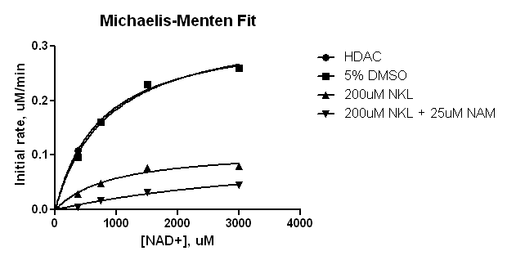
Michaelis-Menten (uM)
 | HDAC | 5% DMSO | 200uM Honokiol | 200uM HKL + 25uM NAM
Vmax | 0.3304 | 0.3425 | 0.1104 | 0.1182
Km | 752.4 | 857.9 | 918.8 | 4635
Std. Error
Vmax | 0.01606 | 0.02501 | 0.01778 | 0.05142
Km | 101.6 | 165 | 379.2 | 2972

Slide 5
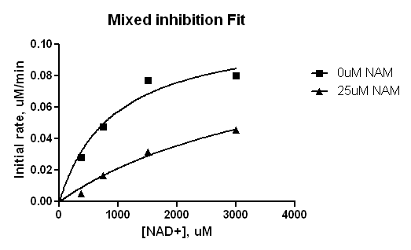
Mixed inhibition-uM
In the presence of 200uM HKL
 | 0uM NAM | 25uM NAM | Global
Vmax | 0.1106 | 0.1106 | 0.1106
I | = 0.0 | = 25.00
Alpha | ~ 3.767e+017 | ~ 3.767e+017 | ~ 3.767e+017
Ki | 7.032 | 7.032 | 7.032
Km | 923.6 | 923.6 | 923.6
Std. Error
Vmax | 0.0137 | 0.0137 | 0.0137
Alpha | ~ | ~ | ~ Value too large
Ki | 3.748 | 3.748 | 3.748
Km | 327.7 | 327.7 | 327.7

Slide 6
Remarks
The addition of 5% DMSO does not change V_{max,NAD+}, but increases K_{m,NAD+} ~16%.
The addition of 200uM Honokiol increased K_{m,NAD+} ~4.9% and decreased V_{max,NAD+} ~67.9%.
The addition of 25 uM NAM in the presence of 200uM Honokoil significantly affect on K_{m,NAD+}.
The data of 0 uM NAM and 25 uM NAM in the presence of 200uM Honokiol was fitted into Mixed inhibition model.
The data are based on one time experiments, no repeat.

