Slide 1
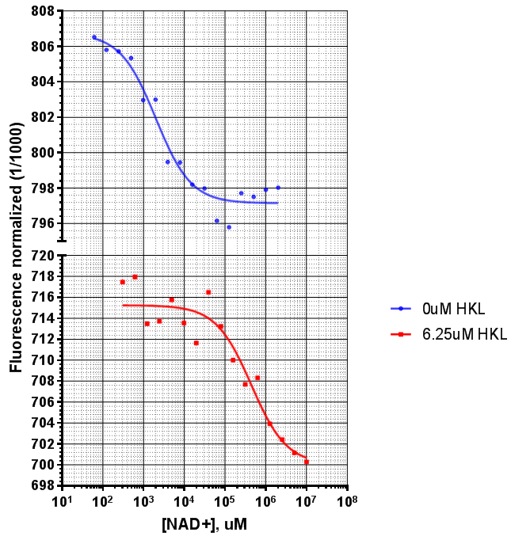
Sirt3 + Saturating MnSOD
w/w/o HKL
 | 0uM HKL | 6.25uM HKL
K_{d_NAD+}, uM | 1.98 | 43.8

Slide 2
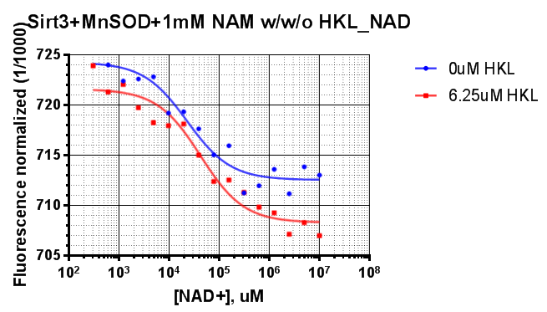
Sirt3 + Saturating MnSOD +1mM NAM
w/ w/o HKL
 | 0uM HKL | 6.25uM HKL
K_{d_NAD+}, uM | 22.9 | 42.6

Slide 3
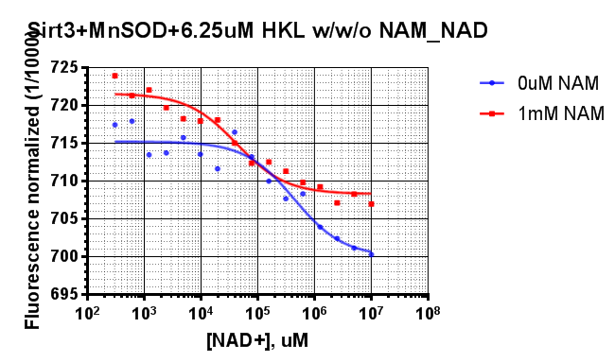
Sirt3 + Saturating MnSOD + 6.25uM HKL
w/ w/o NAM
 | 0uM NAM | 1mM NAM
K_{d_NAD+}, uM | 43.8 | 42.6

Slide 4
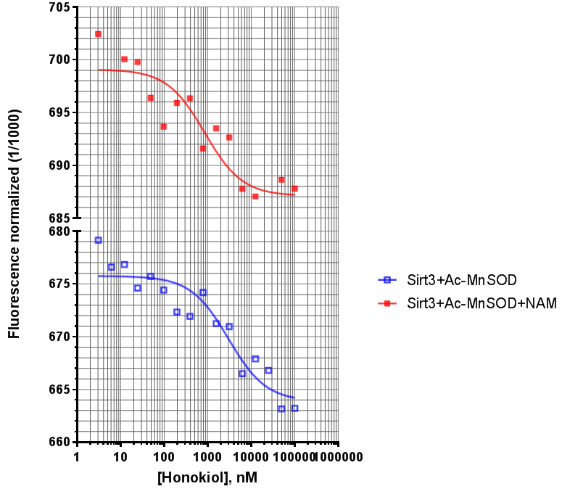
Sirt3 – Titrating Honokiol
 | K_{d_HKL}, uM
Ac-MnSOD | 2.99
Ac-MnSOD + NAM | 0.85

Slide 5
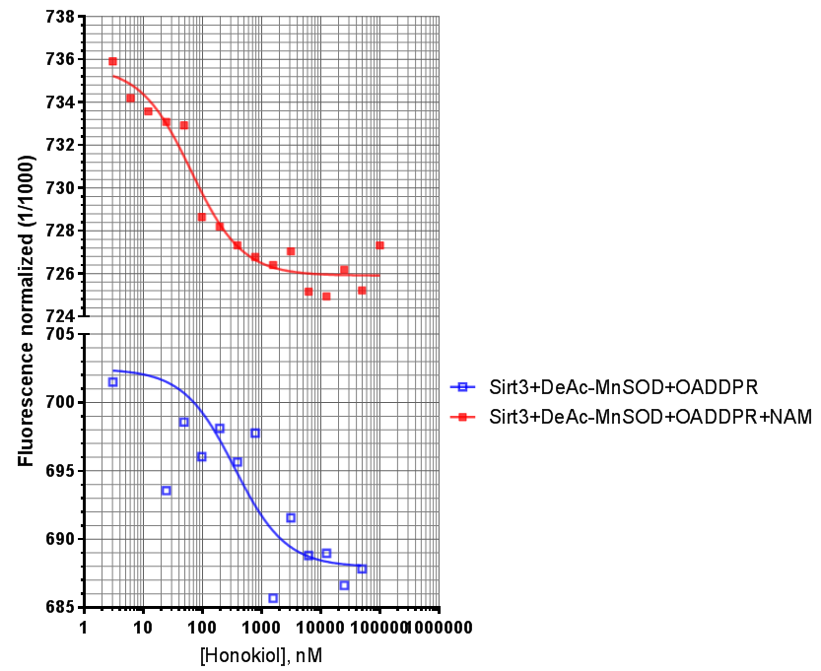
Sirt3 – Titrating Honokiol
 | K_{d_HKL}, uM
DeAc-MnSOD + OADDPR | 0.3487
DeAc-MnSOD + OADDPR + NAM | 0.0634

Slide 6
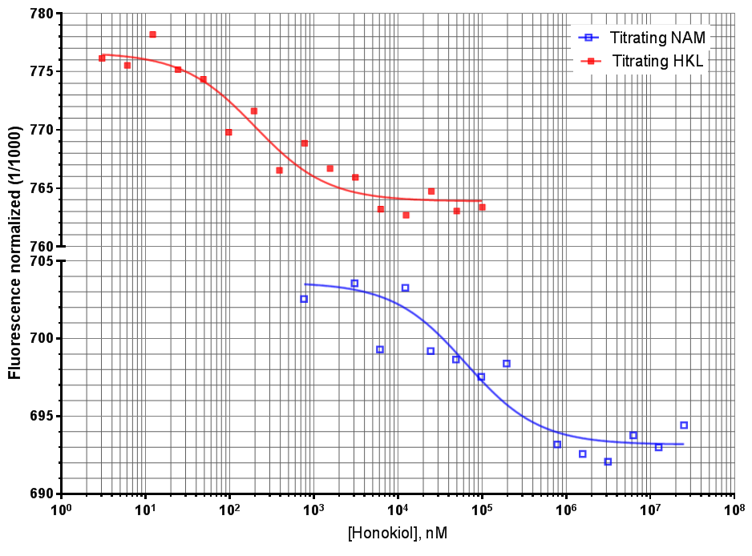
Sirt3 +DeAcMnSOD + NAD⁺ -- Titrating NAM/Honokiol
 | NAM | HKL
K_{d_HKL}, uM |  | 0.198
K_{d_NAM}, uM | 76.679

Slide 7
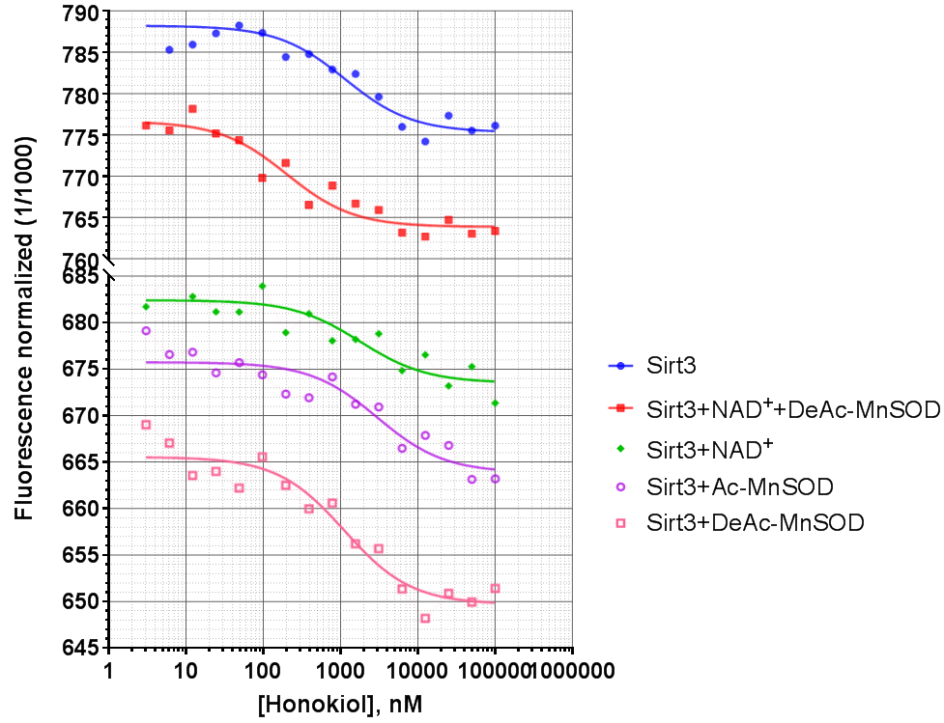
Sirt3 – Titrating Honokiol
 | Sirt3 | Sirt3 + NAD⁺+ DeAc-MnSOD | Sirt3 + NAD⁺ | Sirt3 + Ac-MnSOD | Sirt3 + DeAc-MnSOD
K_{d_HKL}, uM | 1.139 | 0.2 | 1.789 | 2.99 | 1.123

