Slide 1
MST to study enzyme – substrate interactions
Case study on the kinase cascade MEK1 - ERK2

Slide 2
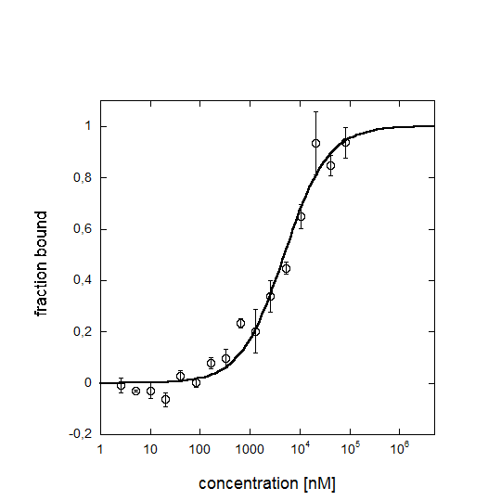
MEK1 binding to ERK2
Activated MEK1 binding to ERK2 (saturating ATP conditions)
K_{d} = 6.0 ± 1.5 µM determined by MST
Literature value: 29 µM in
“A Conserved Docking Site in MEKs Mediates High-affinity
Binding to MAP Kinases and Cooperates with a Scaffold Protein to
Enhance Signal Transmission*”
A. Jane Bardwell‡, Laura J. Flatauer‡, Karen Matsukuma‡, Jeremy Thorner§, and
Lee Bardwell, 2000,
THE JOURNAL OF BIOLOGICAL CHEMISTRY

Slide 3
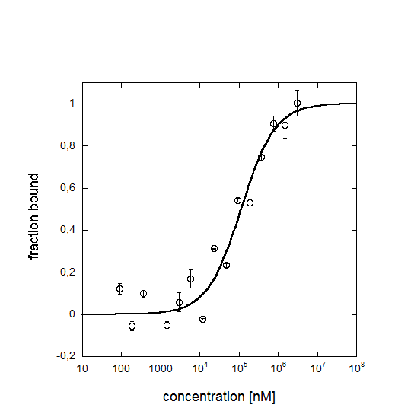
ATP as co-factor of ERK2
Activated ERK2 binding to ATP
K_{d} = 110 ± 39 µM determined by MST
Literature value: 57 ± 8 µM in
“Mechanism of Activation of ERK2 by Dual Phosphorylation”
Claudine N. Prowse‡ and John Lew, 2001, THE JOURNAL OF BIOLOGICAL CHEMISTRY

Slide 4
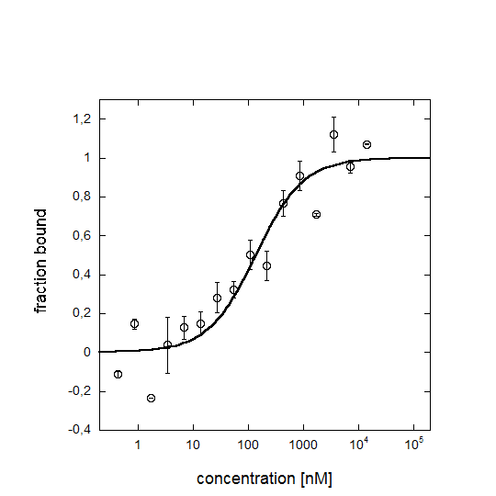
Elk1 as target for ERK2 activity
Activated ERK2 binding to Elk1 (saturating ATP conditions)
K_{d} = 136 ± 55 nM determined by MST
Literature value: 250 nM in
“Quantitative Analysis of ERK2 Interactions with Substrate
Proteins”
Kimberly A. Burkhard, Fengming Chen, and Paul Shapiro, 2011,
THE JOURNAL OF BIOLOGICAL CHEMISTRY

