Slide 1
Melt Kinetics in the CFX96 with 1X Evagreen: Method
Reaction Composition:
Program:
Initial Concentration | Component | Final Concentration (Reac + DNA) | Final Concentration (Buffer Blank)
100ng/ ul | ds Lambda DNA | 40ng/ul | --
10X | Taq Reaction Buffer | 1X | 1X
50mM | MgCl₂ | 2mM | 2mM
20X | Evagreen | 1X | 1X
 | TOTAL | 25ul | 25ul
Step | Temp/time | Function
1 | 37ºC/ 4:55 | Incubation for EG quantitation of ds DNA
2 | 37ºC/ 0:01 + plate read (5 cycles) | 5 RFU reads for quantitation of ds Lambda DNA
3 | 95ºC/ 0:01 + plate read (200 cycles) | 200 RFU reads of Lambda DNA (over ~25 mins) at constant 95ºC temp to determine decreasing signal as DNA melts

Slide 2
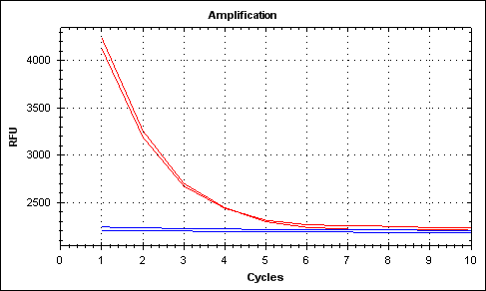
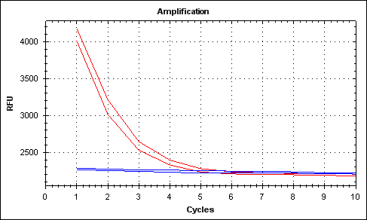
Melt Kinetics in the CFX96 with 1X Evagreen: Results
Two replicates each of samples with Lambda DNA (red) and without (buffer blanks) (blue) were run
Cycle 1 corresponds to time t = 0 mins, for each cycle thereafter add 8 secs
Trial 1
Trial 2

Slide 3
Melt Kinetics in the Cary 100 (UV-Vis Spectrophotometer) (No dye): Method
Test 1:
Both reaction samples were prepared according to the table; however, DNA was not added.
The kinetic run was started and samples were loaded when the desired temperature was attained.
DNA was added to “reac+DNA” cuvette at software prompt*.
Test 2:
Both reaction samples were prepared according to the table. DNA was also mixed thoroughly into the “reac+DNA” sample.
The kinetic run was started and only the buffer blank was loaded when the desired temperature was attained.
The “reac+DNA” sample was loaded at the software prompt*.
*:In the kinetic application, the software prompts for the addition of the active agent. It allows 2 mins for the addition. The measurements start at the end of 2 mins or if the user clicks OK.
Reaction Composition:
Application: Kinetic (Lambda mthd 1)
Initial Concentration | Component | Final Concentration (Reac + DNA) | Final Concentration (Buffer Blank)
100ng/ ul | ds Lambda DNA | 1.33ng/ul | --
10X | Taq Reaction Buffer | 1X | 1X
50mM | MgCl₂ | 2mM | 2mM
 | TOTAL | 1500ul | 1500ul
Instrument Parameters
Run temp | 95ºC (monitored by probe 2; block set to 96ºC)
Averaging time | 0.5secs
Dwell Time | 2secs
Wavelength | 260nm

Slide 4
Test 1 Trial 2 053013: Result
Incubation at 95ºC for 45mins; in the first 1min after addition of DNA there is a drop in Abs (see plot II) ;
Plot III is a scale up of Plot I: both show Abs from time t= 1min to time t= 45min
(red represents reac+DNA, blue represents buffer blank.
Plot I
Plot II
Plot III

Slide 5
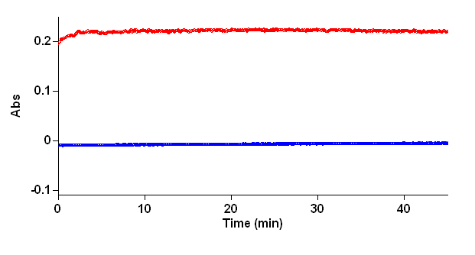
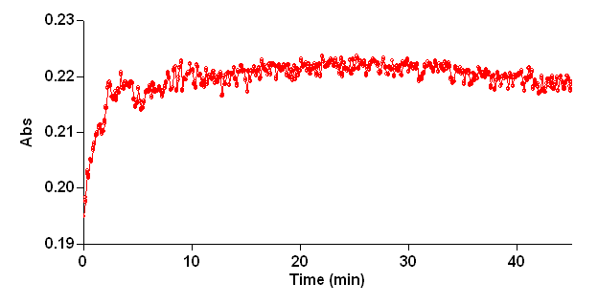
Test 1 Trial 3 053113: Result
Incubation at 95ºC for 45mins; (No spikes or dips in Abs in the first 1min) ;
Plot II is a scale up of Plot I: both show Abs from time t= 0 min to time t= 45min
(red represents reac+DNA, blue represents buffer blank.
Plot I
Plot II

Slide 6
Test 2 Trial 1 052913: Result
Incubation at 95ºC for 35mins;
In the first 1min there is a spike in Abs in both reac+DNA as well as buffer blank (see plot II); since the buffer blank (at least) is equilibrated at 95ºC, this spike is unexplained. Test 2 in Trials 2 & 3 do not show such a spike.
Plot III is a scale up of Plot I: both show Abs from time t= 1min to time t= 35min
(red represents reac+DNA, blue represents buffer blank).
Plot I
Plot II
Plot III

Slide 7
Test 2 Trial 2 053013: Result
Incubation at 95ºC for 45mins;
Plot II is a scale up of Plot I: both show Abs from time t= 0min to time t= 45min
(red represents reac+DNA, blue represents buffer blank).
Plot I
Plot II

Slide 8
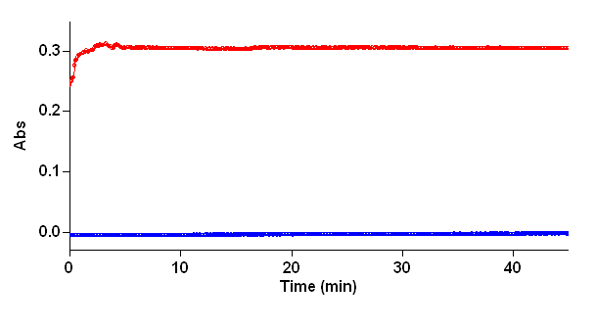
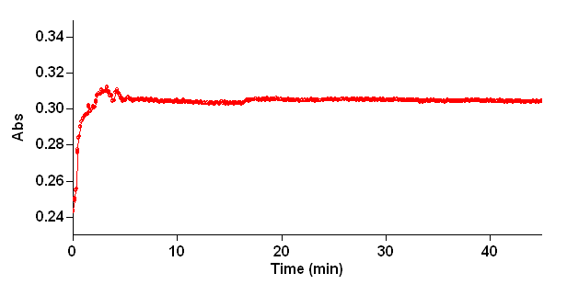
Test 2 Trial 3 053113: Result
Incubation at 95ºC for 45mins;
Plot II is a scale up of Plot I: both show Abs from time t= 0min to time t= 45min
(red represents reac+DNA, blue represents buffer blank).
Plot I
Plot II

