Slide 1
LEA3D
Ligand by Evolutionary Algorithm
& Comparison with MOE

Slide 2
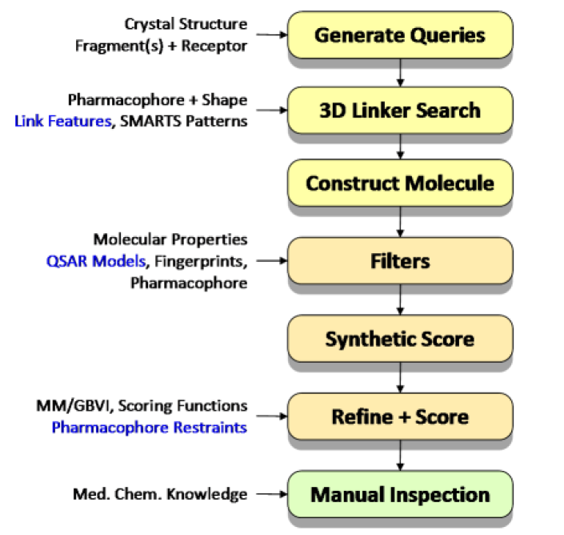
MOE workflow for scaffold replacement and ligand optimization
A simple-to-use interface for automatically create complex scaffold replacement queries; generate 3D molecules; filter using pharmcophore model or other properties; estimate synthetic feasibilities; score with receptors.

Slide 3
Fragment library in MOE
4.3 million molecules were obtained from vendor catalogues and 10 years of medicinal chemistry literature.
A rule-based tautomer and ionization state enumerator was applied, retaining most minor tautomers and protonation states.
Scarffolds as ring blocks, retaining either the ring block plus exocyclic double bonds, or ring blocks connected by a single rotatable bond; or fragmentation by using RECAP rules or Schuffenhauer decomposition.
The resulting unique fragments were subjected to a full conformational search to produce a set of conformations with low strain energy, as determined using the MMFF94 forcefield.
The resulting database contained 800,000 fragments and 16.5 million conformations.

Slide 4
Filtering rules and synthetic feasibility
Filters were set up to ensure reasonable, drug-like molecules using molecular weight, SlogP and TPSA.
Use some scoring scheme or disconnection protocol to estimate synthesis feasibility.

Slide 5
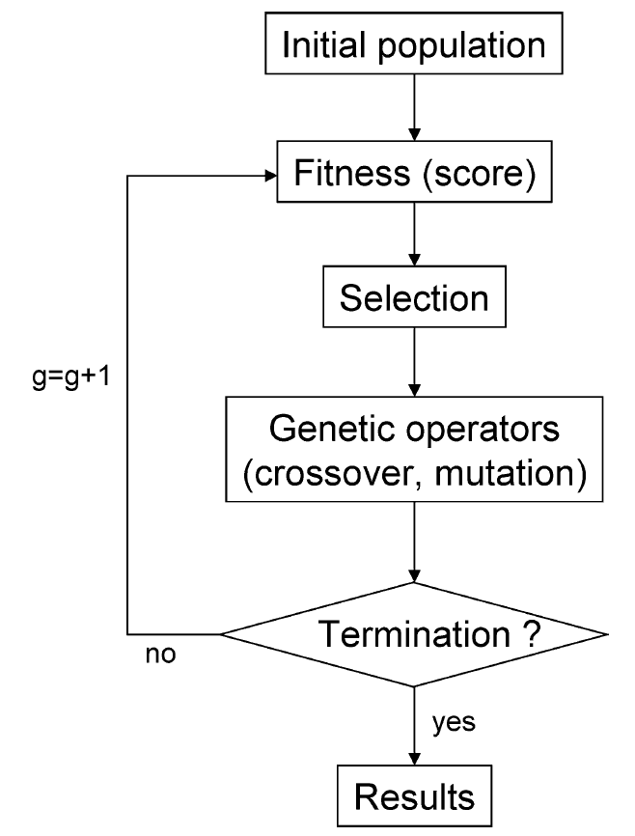
LEA3D Workflow for lead generation
LEA3D, is designed to conceive organic molecules by combining 3D fragments.
Fragments were extracted from both biological compounds and known drugs.
A fitness function guides the search process in optimizing the molecules toward an optimal value of the properties.
The fitness function is build up by combining several independent property evaluations, including the score provided by the FlexX or other docking program.

Slide 6
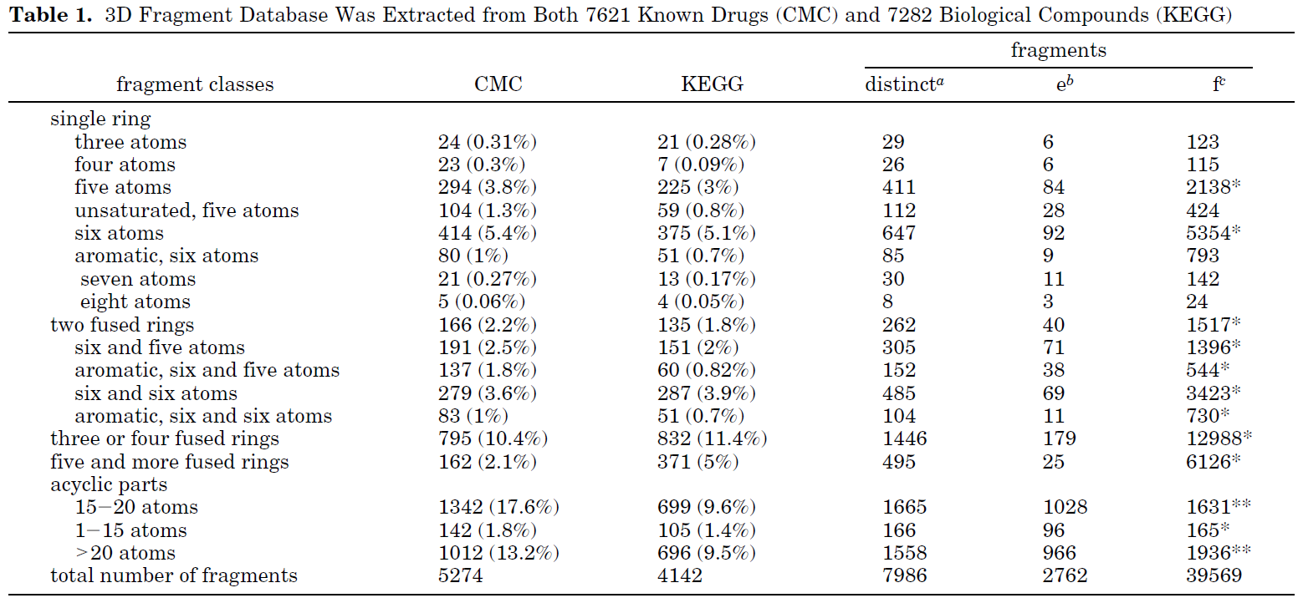
Fragment library creation
7621 drugs from the Comprehensive Medicinal Chemistry database and 7282 compounds from the LIGAND database of KEGG were dissected into rings and acyclic parts.
Approximately 8000 fragments that led potentially to a virtual size library of 10¹⁴

Slide 7
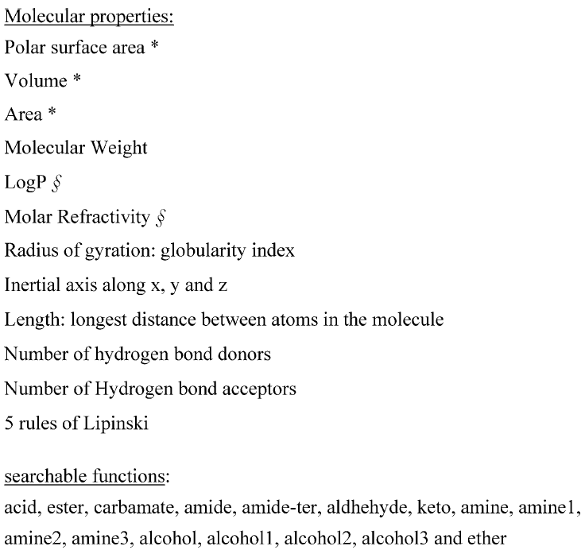
Fitness Function
Scores from docking can be used for optimization, therefore provides an option for structure-based drug design.
Other scores can be designed and used for ligand-based design or other type of designs.

Slide 8
Genetic Algorithm
Parent molecules obtained using roulette wheel selection.
A new population is created by performing crossover and mutation (including permutation, deletion, addition, and substitution) operations on the selected parent molecules.
A parametrization study similar to the previous one performed with LEA showed that 100 generations along with a population of 40 individuals, an elitism strategy, and a fitness scale of 2-5 are optimal to efficiently optimize our molecules and thereby avoid a premature convergence.

Slide 9
Tools used in LEA3D
FROG2 (free) or Corina (commercial) program for 3D conformer generation
PLANTS (free) or FlexX (commercial) or Surflex (commercial) program for docking calculations
XLOGP for estimate Xlogp property
XSCORE for re-evaluating dock scores
CHEMICALC2 for solubility estimation

