Slide 1
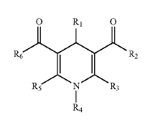
Certain Chemical Entities, Compositions, and Methods. Collibee S, Bergnes G, Hamilton MR, Morgan BP, and Morgans JR DJ. US 2007/0161683 A1.
Provided are certain chemical entities that cause mitotic arrest and cell death and are useful in the treatment of cellular proliferative diseases, for example cancer.
Provided is at least one chemical entity chosen from compounds of Formula 1:
(Formula I)
and pharmaceutically acceptable salts, solvates, chelates, non-covalent complexes, prodrugs, and mixtures thereof,
Wherein
R1 is chosen from optionally substituted cycloalkyl, optionally substituted phenyl, and optionally substituted heterocycloalkyl, optionally substituted aryl and optionally substituted het eroaryl…
R2 is chosen from optionally substituted aryl, optionally substituted heteroaryl, optionally substituted alkoxy (ethoxy, and hydroxy), and optionally substituted amino…
R3 is chosen from hydrogen and optionally substituted alkyl…
R4 is chosen from hydrogen, optionally substituted alkyl, optionally substituted heterocycloalkyl, optionally substituted acyl, optionally substituted aryl, optionally substituted heteroaryl, aminocarbonyl, sulfonyl, option ally substituted alkoxycarbonyl, and optionally substituted cycloalkyl;
R5 is chosen from hydrogen and optionally substituted alkyl…
R6 is chosen from optionally substituted aryl, optionally substituted heteroaryl, optionally substituted alkoxy(ethoxy, and hydroxy), and optionally substituted amino.

Slide 2
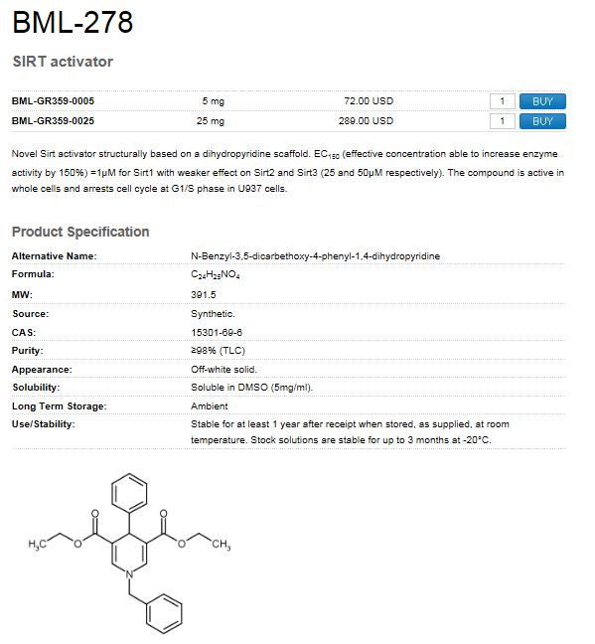
The compound 1c is available at Enzo Life Sciences.
Molecule, 1c | M.W., g/mol | Mass, mg | Amount, mol
 | 391.46 | 5 | 1.28E-05
Amount required for one reaction | Volume, ul | [Compound ], uM | Amount, mol
 | 50 | 50 | 2.50E-09
How many reactions can be run |  |  | 5109.1

