Slide 1
SIRT3 activation by Honokiol
Remarks
Honokiol does not provide auto fluorescence.
Minor SIRT3 activation by 10uM honokiol with FdL2 peptide was detected only in the presence of 100uM NAD⁺ and 10uM FdL2 peptide.
In order to validate the reported results in 2015 Nature Communication paper , SIRT3 activation experiments by honokiol need to be tested using MnSOD protein/peptide.

Slide 2
Honokiol Fluorescence Scan
Solubility: 36mg/ml (135.1 mM) in 100% DMSO
M.W.: 266.33 g/mol
Remarks:
Honokiol emits light at 354-356nm which is not overlapping with FdL fluorophore (~460nm).

Slide 3
Honokiol (HKL) / SIRT3 activity
SIRT3 activation by Honokiol Dose Response
[SIRT3]=5U/reaction
[NAD⁺]=500 μM
[FdL2 peptide]=250 μM
[Honokiol]=0, 10, 100, 200 μM
% DMSO= 5%
Time points= 0, 60 min
Temp.= 37oC
 | 0min | 60min | ΔAFU | % Activation
Assay buffer | 356 | 992 | 636 | 70.7
5% DMSO | 502 | 1401 | 899 | 100.0
10uM HKL | 480 | 1395 | 915 | 101.8
100uM HKL | 445 | 1174 | 729 | 81.1
200uM HKL | 426 | 865 | 439 | 48.8
Remarks
1.8% increase of AFU was detected in the presence of 10 uM honokiol. Too small to say if this is activation conclusively.
No activation was detected in the presence of 100 and 200uM honokiol under current conditions.

Slide 4
Honokiol (HKL) / SIRT3 activity
Low NAD⁺ concentration_100uM
10uM FdL2 peptide | 0min | 60min | Δ AFU | % Activation
Assay buffer | 40 | 122 | 82 | 160.8
1% DMSO | 41 | 92 | 51 | 100.0
10uM HKL in 1% DMSO | 36 | 100 | 64 | 125.5
25uM FdL2 peptide
Assay buffer | 61 | 197 | 136 | 114.3
1% DMSO | 64 | 183 | 119 | 100.0
10uM HKL in 1% DMSO | 57 | 169 | 112 | 94.1
50uM FdL2 peptide
Assay buffer | 97 | 273 | 176 | 110.0
1% DMSO | 98 | 258 | 160 | 100.0
10uM HKL in 1% DMSO | 92 | 253 | 161 | 100.6
100uM FdL2 peptide
Assay buffer | 174 | 383 | 209 | 97.2
1% DMSO | 175 | 390 | 215 | 100.0
10uM HKL in 1% DMSO | 165 | 344 | 179 | 83.3
200uM FdL2 peptide
Assay buffer | 303 | 539 | 236 | 111.8
1% DMSO | 305 | 516 | 211 | 100.0
10uM HKL in 1% DMSO | 278 | 512 | 234 | 110.9
250uM FdL2 peptide
Assay buffer | 372 | 528 | 156 | 101.3
1% DMSO | 365 | 519 | 154 | 100.0
10uM HKL in 1% DMSO | 344 | 458 | 114 | 74.0
[SIRT3]=5U/reaction
[NAD⁺]=100 μM
[FdL2 peptide]=10, 25, 50, 100, 200, 250 μM
[Honokiol]=0, 10 μM
% DMSO= 1%
Time points= 0, 60 min
Temp.= 37oC
Remarks
25% activation of SIRT3 by 10uM honokiol in the presence of 100uM NAD and 10uM FdL2 peptide.
10.9% activation of SIRT3 by 10uM honokiol in the presence of 100uM NAD and 200uM FdL2 peptide.

Slide 5
Honokiol (HKL) / SIRT3 activity
High NAD⁺ concentration_100uM (Repeat the experiments)
10uM FdL2 peptide | 0min | 60min | Δ AFU | % Activation
Assay buffer | 33 | 114 | 81 | 158.8
1% DMSO | 34 | 85 | 51 | 100.0
10uM HKL in 1% DMSO | 34 | 91 | 57 | 111.8
200uM FdL2 peptide
Assay buffer | 241 | 488 | 247 | 110.3
1% DMSO | 222 | 446 | 224 | 100.0
10uM HKL in 1% DMSO | 197 | 411 | 214 | 95.5
[SIRT3]=5U/reaction
[NAD⁺]=100 μM
[FdL2 peptide]=10, 200 μM
[Honokiol]=0, 10μM
% DMSO= 1%
Time points= 0, 60 min
Temp.= 37oC
Remarks
The experiments under conditions in which the activation was spotted were repeated.
11.8% activation of SIRT3 by 10uM honokiol in the presence of 100uM NAD and 10uM FdL2 peptide.
No activation of SIRT3 by 10uM honokiol in the presence of 100uM NAD and 200uM FdL2 peptide.

Slide 6
Honokiol (HKL) / SIRT3 activity
High NAD⁺ concentration_1500uM
[SIRT3]=5U/reaction
[NAD⁺]=1500 μM
[FdL2 peptide]=10, 25, 50, 100, 200, 250 μM
[Honokiol]=0, 10μM
% DMSO= 1%
Time points= 0, 60 min
Temp.= 37oC
10uM FdL2 peptide | 0min | 60min | Δ AFU | % Activation
Assay buffer | 40 | 587 | 547 | 119.7
1% DMSO | 41 | 498 | 457 | 100.0
10uM HKL in 1% DMSO | 40 | 389 | 349 | 76.4
25uM FdL2 peptide
Assay buffer | 56 | 630 | 574 | 185.8
1% DMSO | 63 | 372 | 309 | 100.0
10uM HKL in 1% DMSO | 40 | 315 | 275 | 89.0
50uM FdL2 peptide
Assay buffer | 114 | 1518 | 1404 | 123.2
1% DMSO | 105 | 1245 | 1140 | 100.0
10uM HKL in 1% DMSO | 104 | 1060 | 956 | 83.9
100uM FdL2 peptide
Assay buffer | 148 | 834 | 686 | 110.8
1% DMSO | 132 | 751 | 619 | 100.0
10uM HKL in 1% DMSO | 111 | 590 | 479 | 77.4
200uM FdL2 peptide
Assay buffer | 348 | 1878 | 1530 | 111.4
1% DMSO | 346 | 1719 | 1373 | 100.0
10uM HKL in 1% DMSO | 326 | 1499 | 1173 | 85.4
250uM FdL2 peptide
Assay buffer | 322 | 1603 | 1281 | 191.8
1% DMSO | 304 | 972 | 668 | 100.0
10uM HKL in 1% DMSO | 247 | 698 | 451 | 67.5
Remarks
No activation was detected in the presence of 10uM honokiol under current conditions.

Slide 7
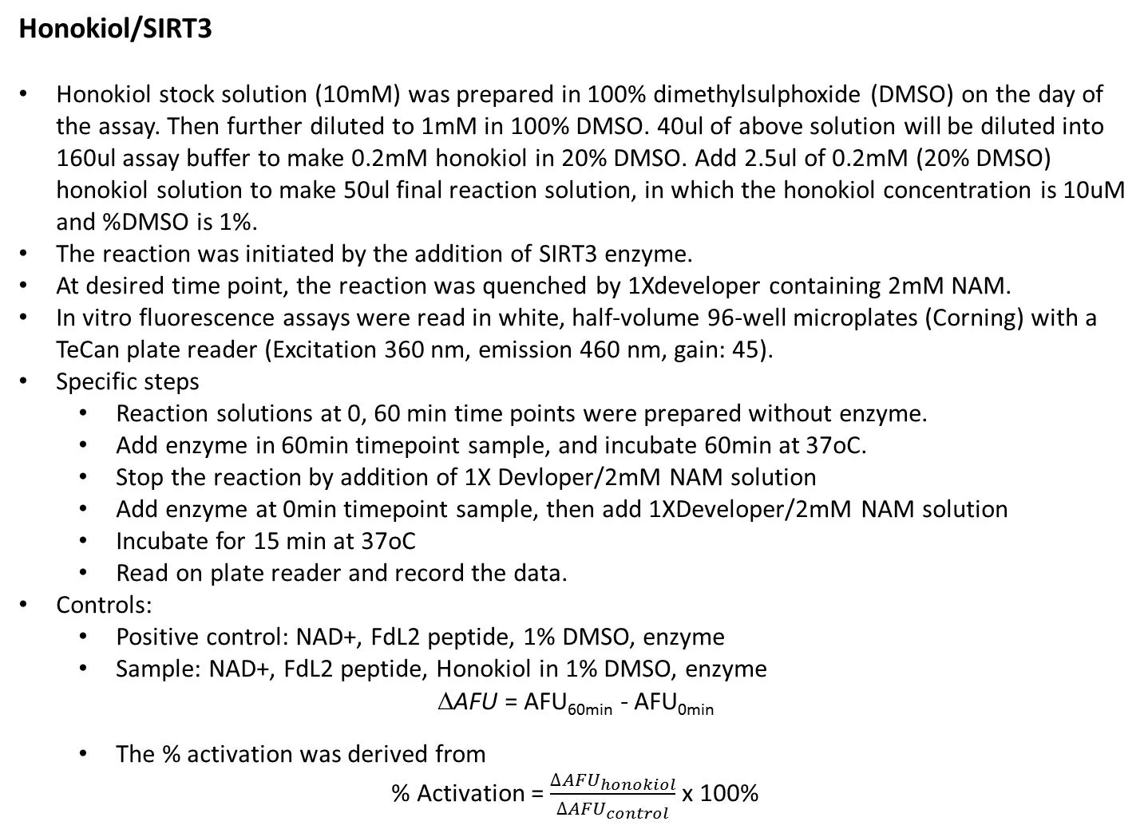
Honokiol/SIRT3
Honokiol stock solution (10mM) was prepared in 100% dimethylsulphoxide (DMSO) on the day of the assay. Then further diluted to 1mM in 100% DMSO. 40ul of above solution will be diluted into 160ul assay buffer to make 0.2mM honokiol in 20% DMSO. Add 2.5ul of 0.2mM (20% DMSO) honokiol solution to make 50ul final reaction solution, in which the honokiol concentration is 10uM and %DMSO is 1%.
The reaction was initiated by the addition of SIRT3 enzyme.
At desired time point, the reaction was quenched by 1Xdeveloper containing 2mM NAM.
In vitro fluorescence assays were read in white, half-volume 96-well microplates (Corning) with a TeCan plate reader (Excitation 360 nm, emission 460 nm, gain: 45).
Specific steps
  Reaction solutions at 0, 60 min time points were prepared without enzyme.
  Add enzyme in 60min timepoint sample, and incubate 60min at 37oC.
  Stop the reaction by addition of 1X Devloper/2mM NAM solution
  Add enzyme at 0min timepoint sample, then add 1XDeveloper/2mM NAM solution
  Incubate for 15 min at 37oC
  Read on plate reader and record the data.
Controls:
  Positive control: NAD+, FdL2 peptide, 1% DMSO, enzyme
  Sample: NAD+, FdL2 peptide, Honokiol in 1% DMSO, enzyme
  ΔAFU = AFU_{60min} - AFU_{0min}
  The % activation was derived from
% Activation = $\frac{{∆AFU}_{honokiol}}{{∆AFU}_{control}}$ x 100%

