Slide 1
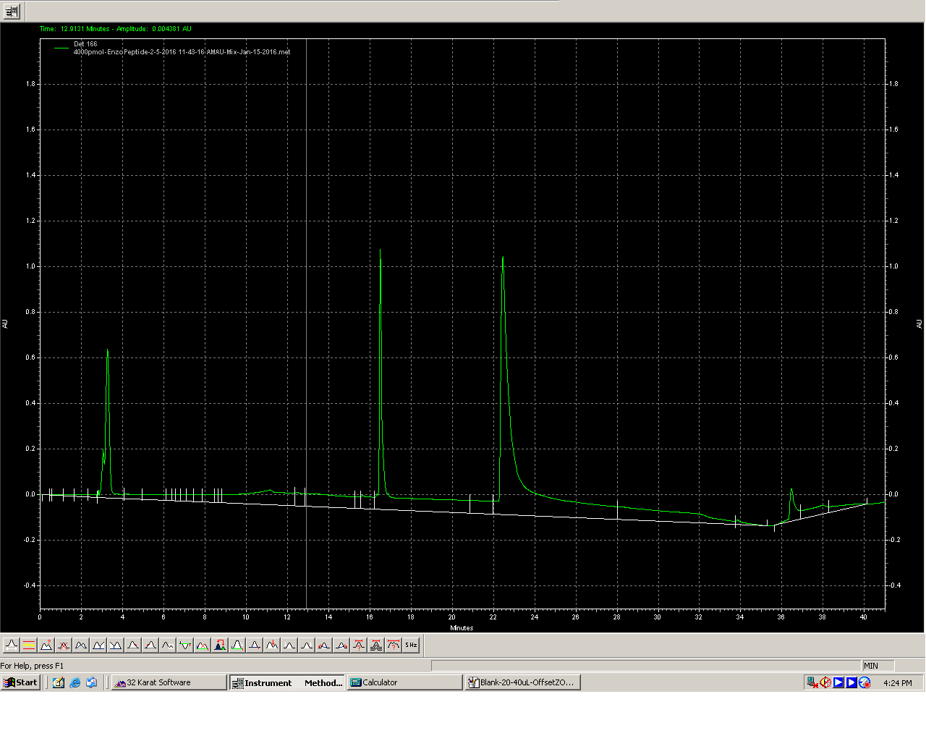
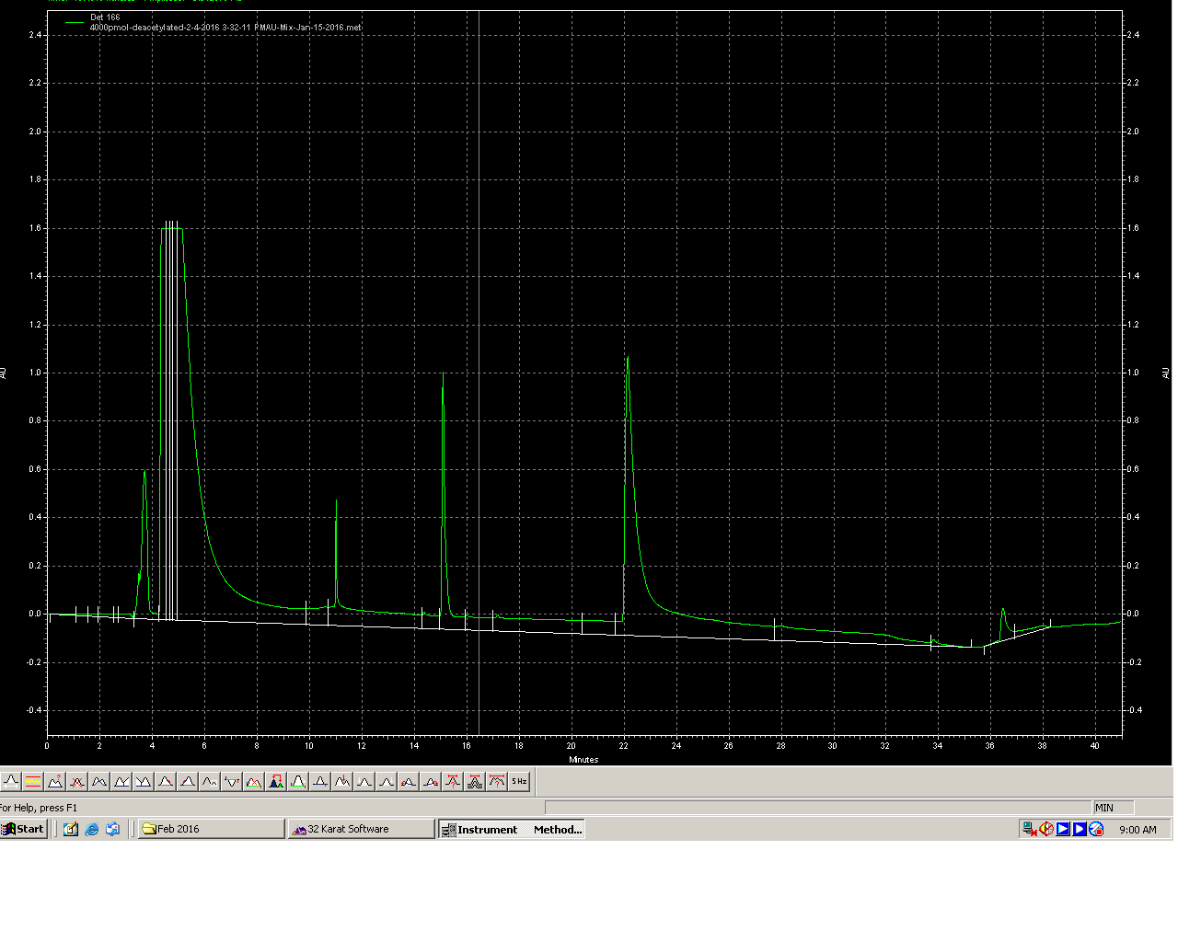
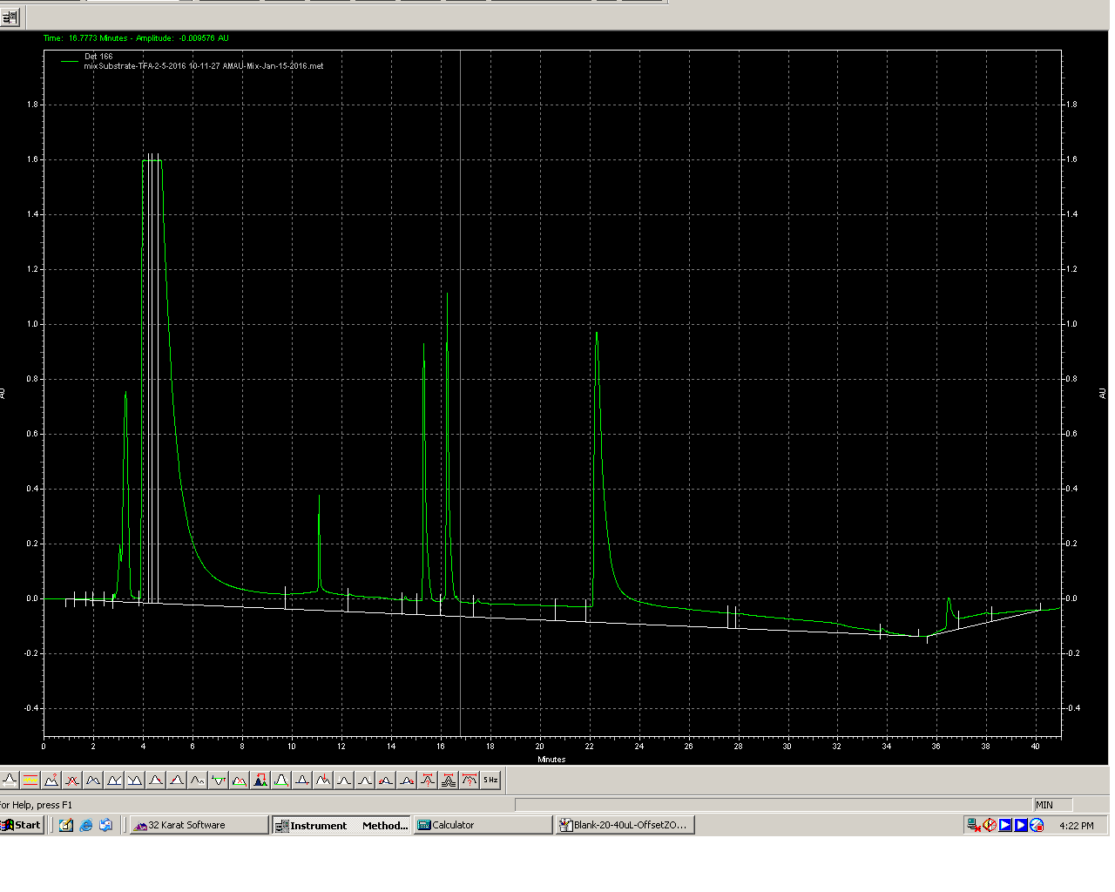
Identification of Deacetylated peak
Enzo-Ac-Pep
Enzo-DeAc-Standard
BSA
1: Enzo-Ac-Pep
BSA
2: Enzo-DeAc-Standard
I tried couple of changes in the HPLC run program to see if
I can resolve ADP-Ribose from initial peak (void peak) but I could not do so, may be because the compound may be hydrophilic and un-retained on the RP column.
The ADP-Ribose I am using in Non-acetylated. I could not find exact O-Ac-ADP-Ribose from commercial sources. I think even if there is peak formed (which I could see earlier when I ran ADP-Ribose without TFA), it is merging with the initial peak. Since I do not have much time, I decided to see if I can use Enzo’s “deacetylated standard” for quantification. The question was if this standard was full deacetylated peptide or cleaved product. I contacted Enzo to confirm but they denied to answer the question saying it is proprietary information. Then I decided to run on HPLC to see what it is? Seems like This deacetylated standard is a peptide with retention time 1 minute less than Ac-peptide substrate.
Chromatogram 3: shows the relative retention time of the peaks and difference is ~1 min. So any unique peak appearing in the reaction could be “deacetylated peak”
DeAc-Std
Ac-Pep
BSA
3: Enzo-Ac-Pep+ DeAc standard

Slide 2
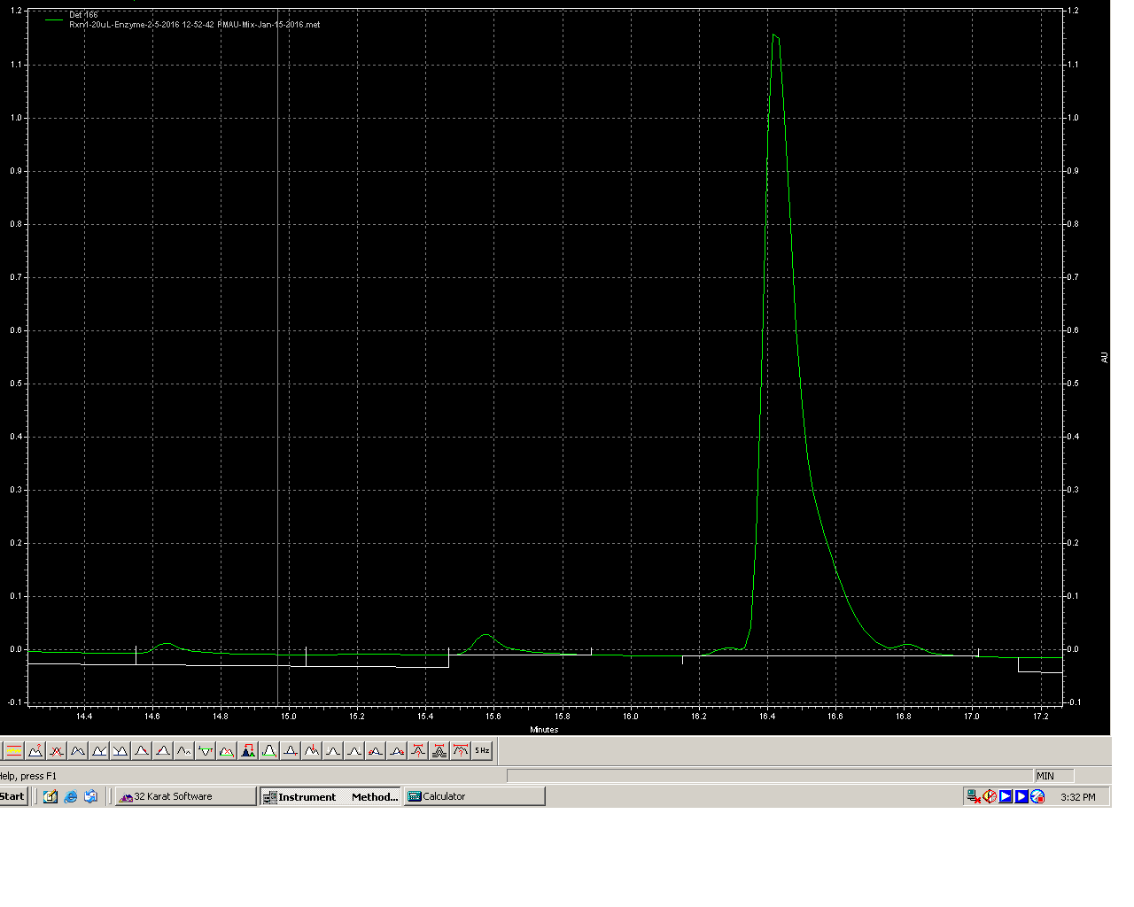
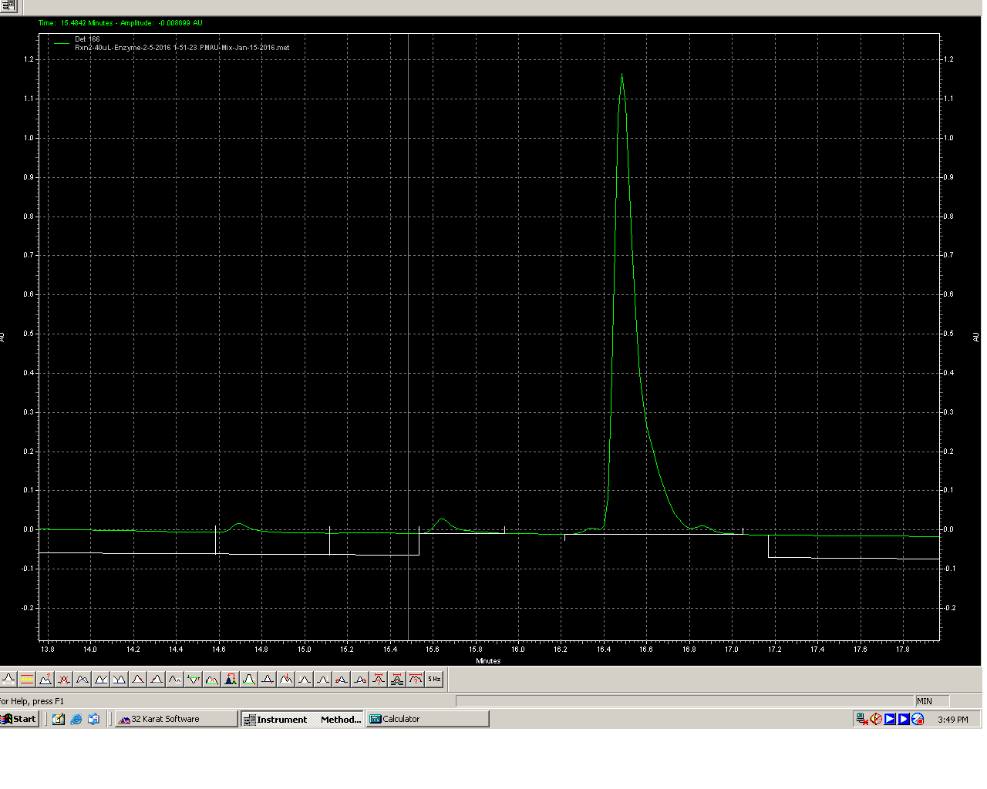
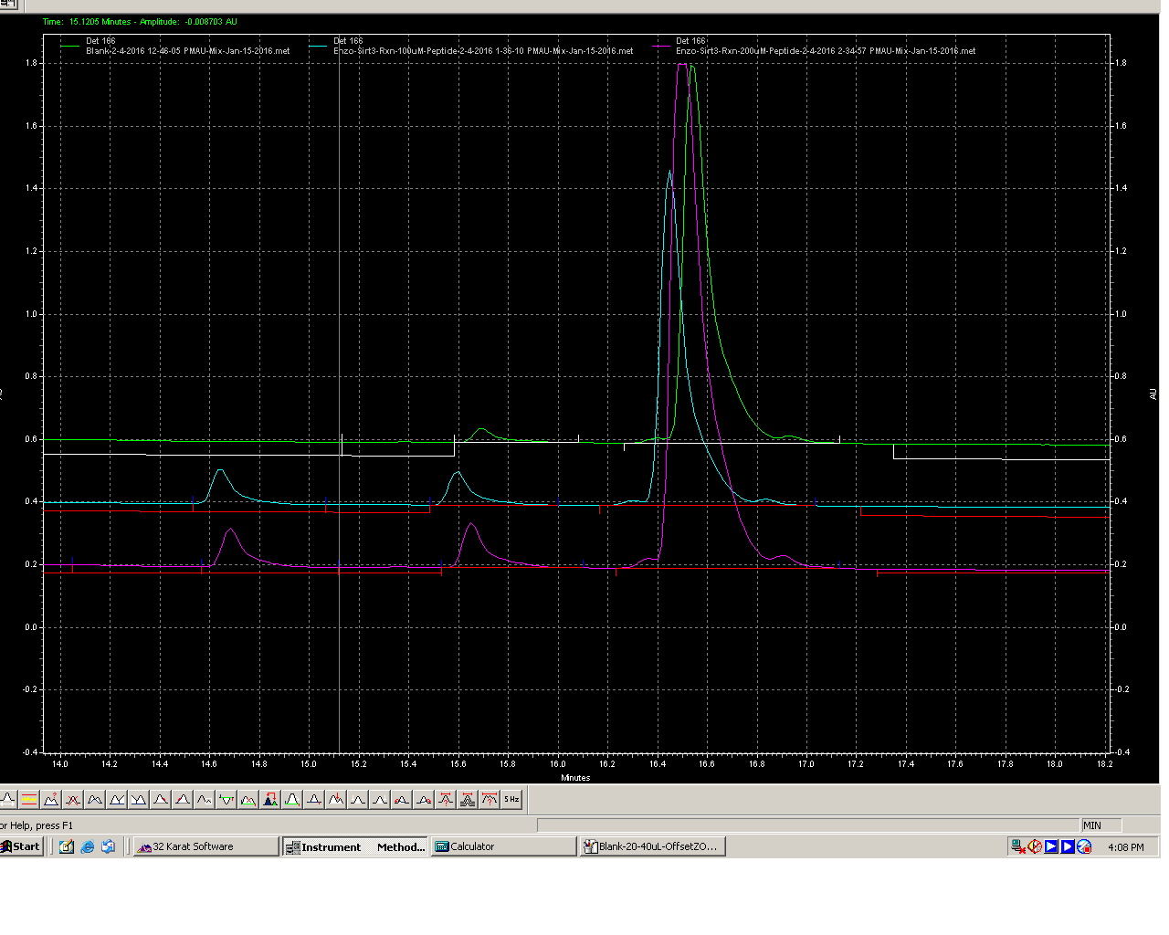
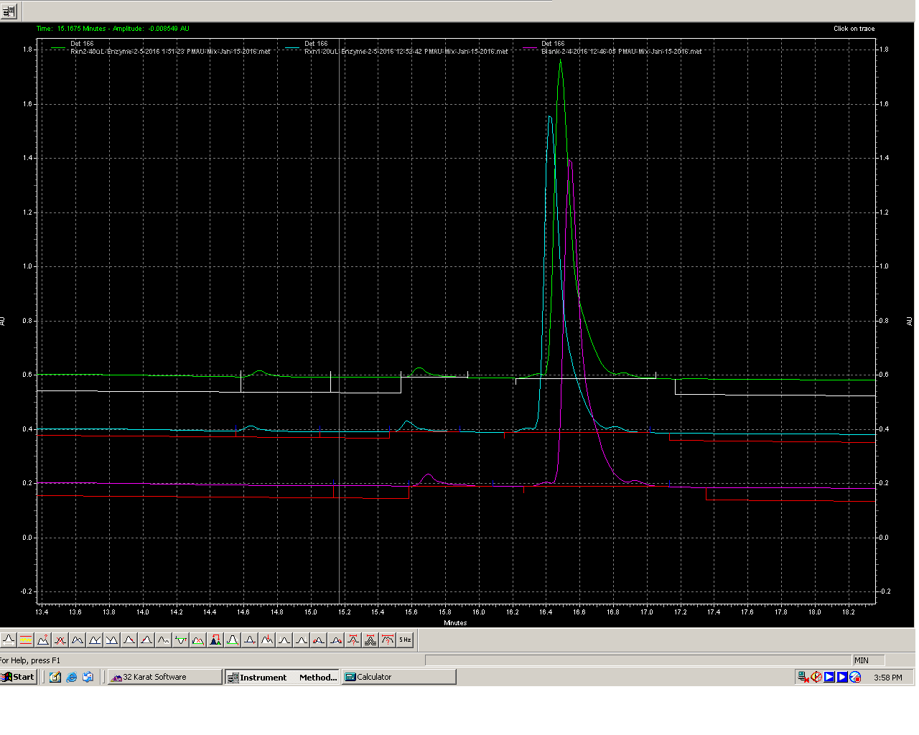
Deacetylated peak with in reactions
Enzo-Ac-Pep
Rxn with 40 uL
In-house Sirt3
Enzo-Ac-Pep
Rxn with 20 uL
In-house Sirt3
De-Ac-Peak
De-Ac-Peak
1 min apart
1 min apart
Enzo Sirt3
In-house Sirt3
De-Ac-Peak
Un-used Enzo-Ac-Pep
De-Ac-Peak
Un-used Enzo-Ac-Pep
Blank
Rxn with 40 uL
100 uM Pep
200 uM Pep
Rxn with 20 uL
Blank Rxn
Overlapping Rxn with 20, 40 uL with Blank to show the relative amount
Overlapping Rxn with Enzo Sirt3 (100, 200 uM peptide) and Blank to show the relative amount

Slide 3
Peak quantification
“The areas of the peaks are integrated for quantification. To calculate the percent deacetylation, the area of the deacetylated peptide peak is compared to the combined areas of the acetylated and deacetylated peptide peaks. Because a known amount of acetylated peptide is used, the percentage of the deacetylation is then used to determine the amount of deacetylated product formed over the particular time of the assay”
Borra and Denu 2003
Calculations:
Corrected DeAc-Peak = (DeAc-Peak area minus Blank area)
% Deacetylation = (CorrectedDeAc-Peak area*100)/(CorrectedDeAc-Peak area+Ac-Peak area)
e.g. Enzo Sirt3 100 uM Pep reaction:
= (408779*100)/(408779+8277626)
= 40877900/8686405
= 4.7%
pmoles product formed:
Since total Ac-pep (Substrate) in reaction was 100 uM (in 50 uL) which will equal to 5000 pmoles.
After reaction, I loaded only 40 uL (4000 pmoles).
4.7 % of 4000 pmoles = 188.23 pmoles product in 2 hours at 37^{O}C
The question is why there is DeAc-peak in Blank, ideally there should not be any. To confirm that there is some amount of deacetylated peptide
present in the substrate, I ran just a Ac-peptide (4000 pmoles) to see if there is a peak 1 min earlier. Indeed there is a small peak present giving
background. This may be due to contamination. I did not compare this with blank which, qualitatively, has higher signal. This might be due to the
fact that Blank is undegoing similar condition as actual reaction e.g. incubating 2 hrs at 37^{O}C. If this incubation enhance, to some extent, the
degradation of Ac-Pep to DeAc-Pep is pure speculation. This may lead to background signal.
Reactions | De-Ac-Peak Area | Ac-Peak Area | Corrected DeAc-Peak Area | % Deacetylation | pmole product
Blank | 312664 | 9755520 | 0
20 uL in-house E, 100 uM Pep | 263273 | 9379852 | -49391
40 uL in-house E, 100 uM Pep | 242936 | 9087645 | -69728
Enzo Sirt3 100 uM Pep | 721443 | 8277626 | 408779 | 4.705962939 | 188.2385175
Enzo Sirt3 200 uM Pep | 1020590 | 16224551 | 707926 | 4.180876785 | 334.4701428

