Slide 1
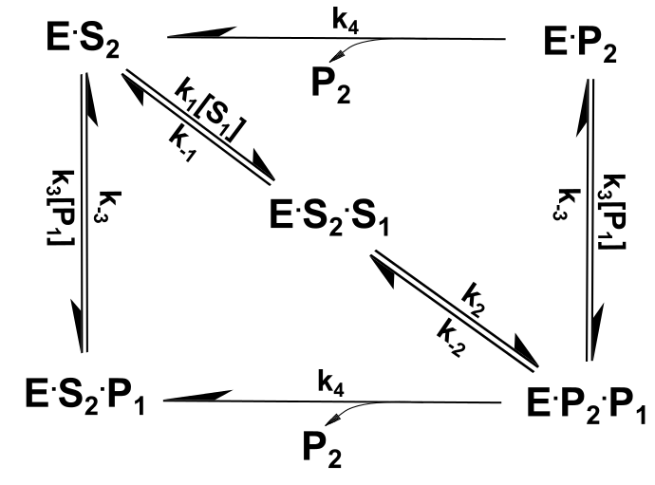
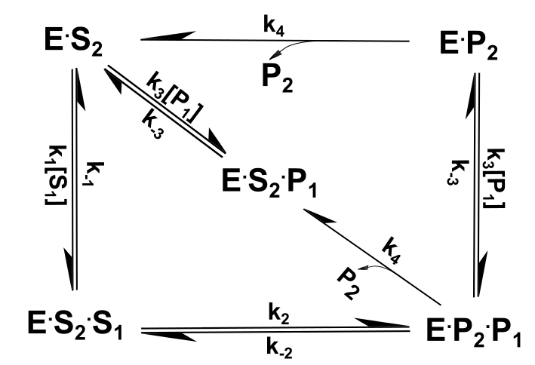
Figure 1
Version A
Version B

Slide 2
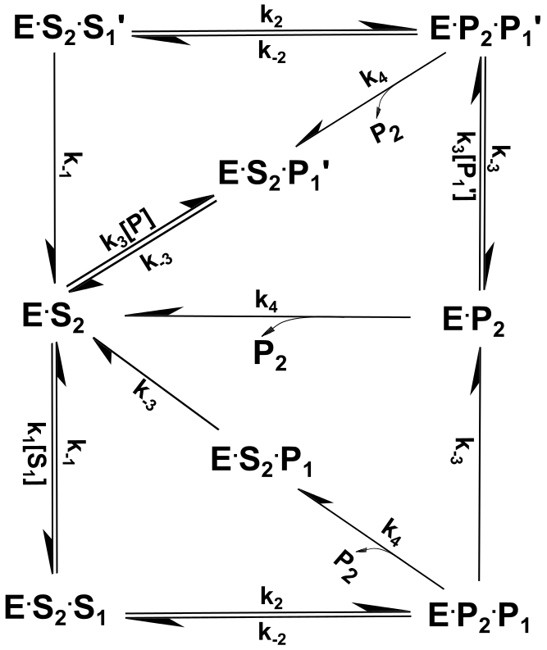
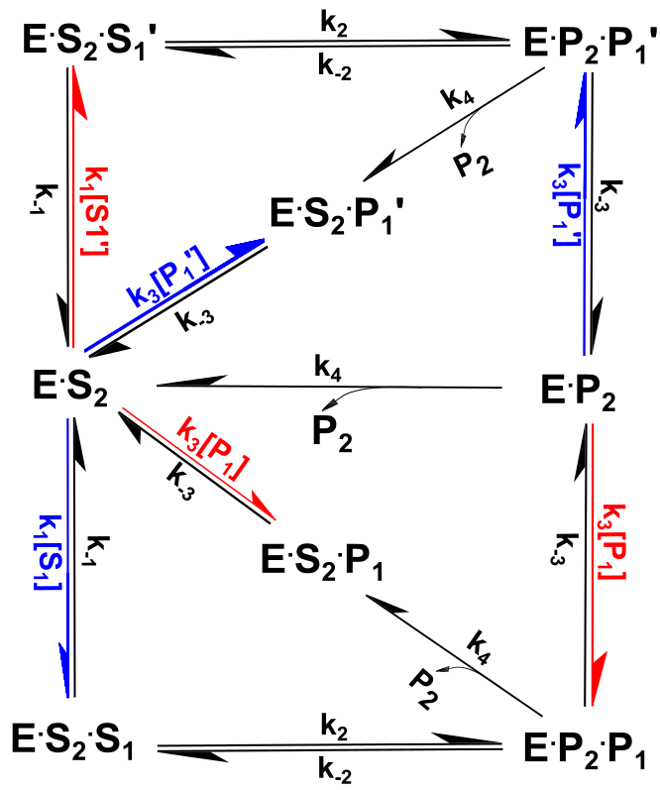
Figure 2
Black/white
Color code

Slide 3
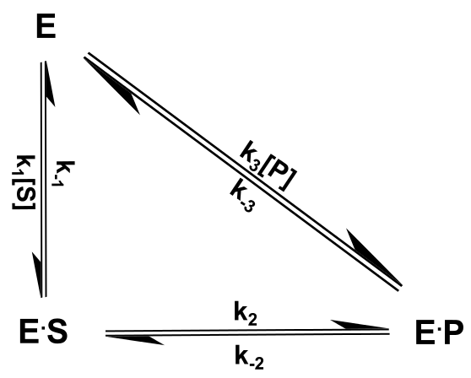
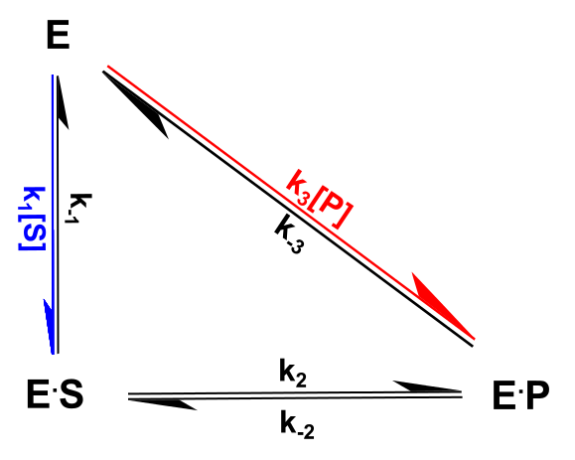
Single Triangle
Black/white
Color code

Slide 4
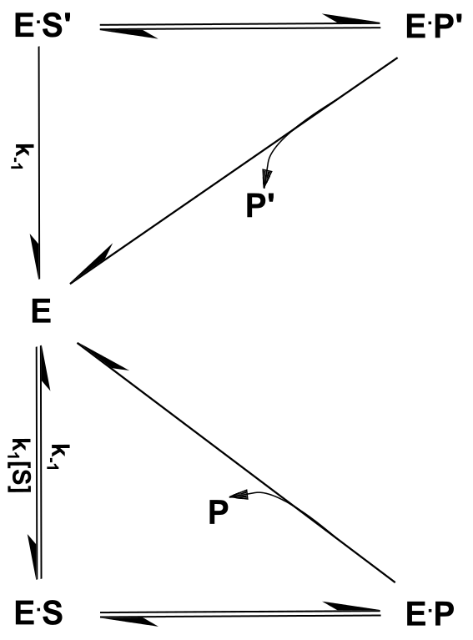
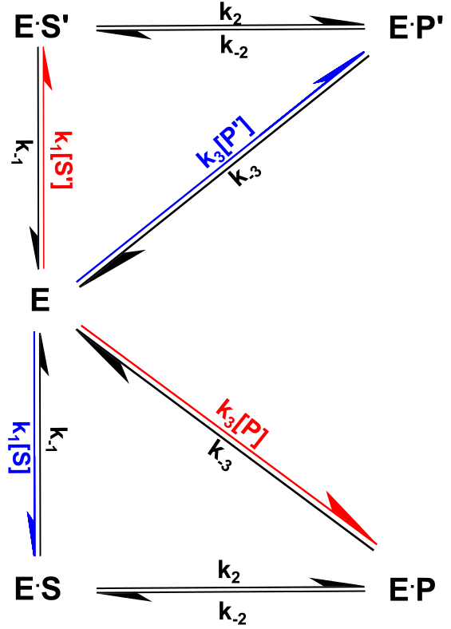
Double Triangle
Black/white
Color code

Slide 5
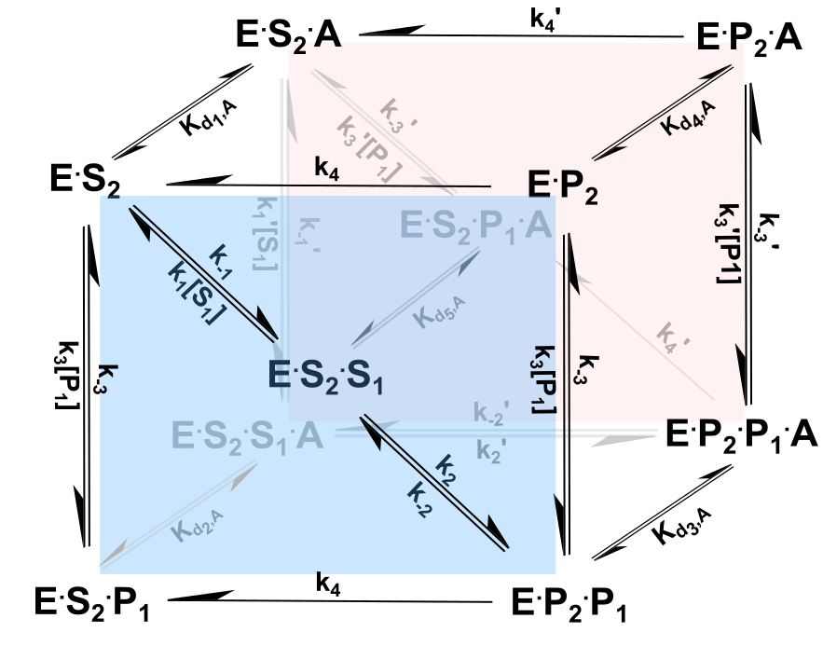
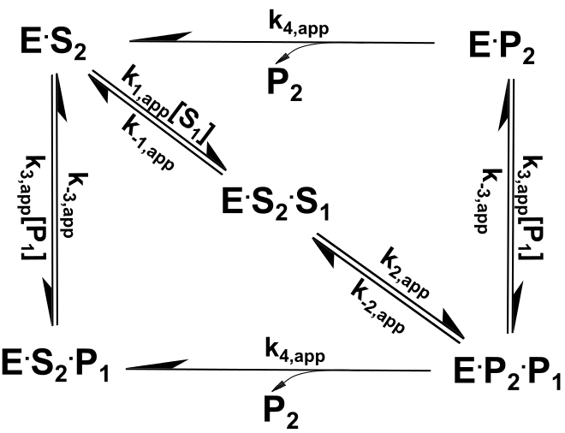
Cubic Figure
Version A

Slide 6
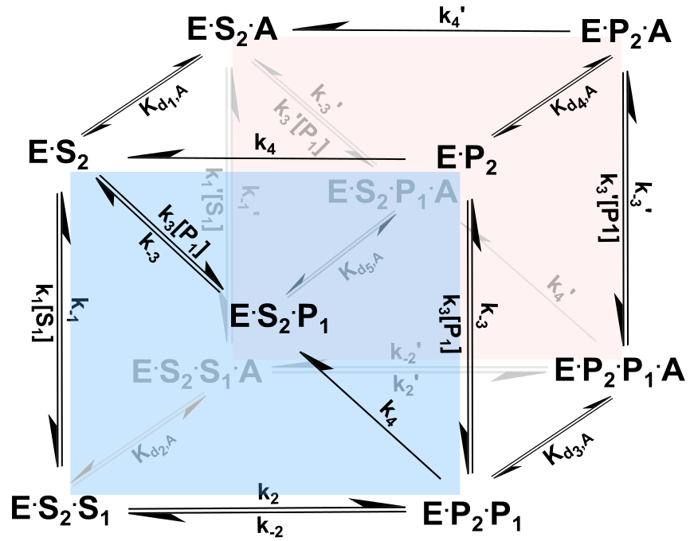
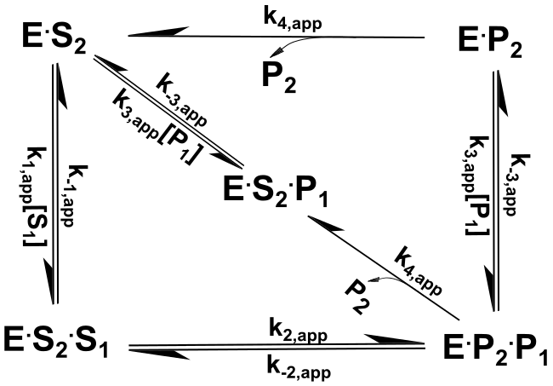
Cubic Figure
Version B

Slide 7
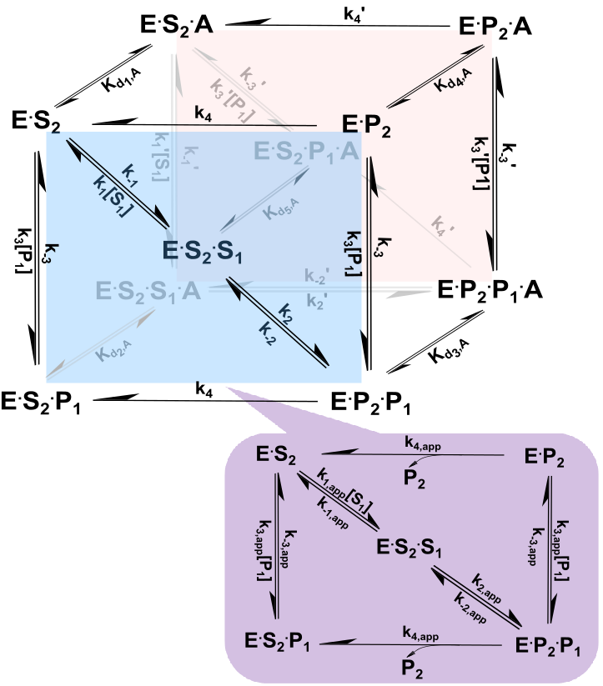
Cubic + Rectangle
Version A
Mixed Noncompetitive modulation of forward reaction
Mixed noncompetitive inhibition of reverse reaction
Hyperbolic modulation of forward reaction
Hyperbolic modulation
of reverse reaction

Slide 8
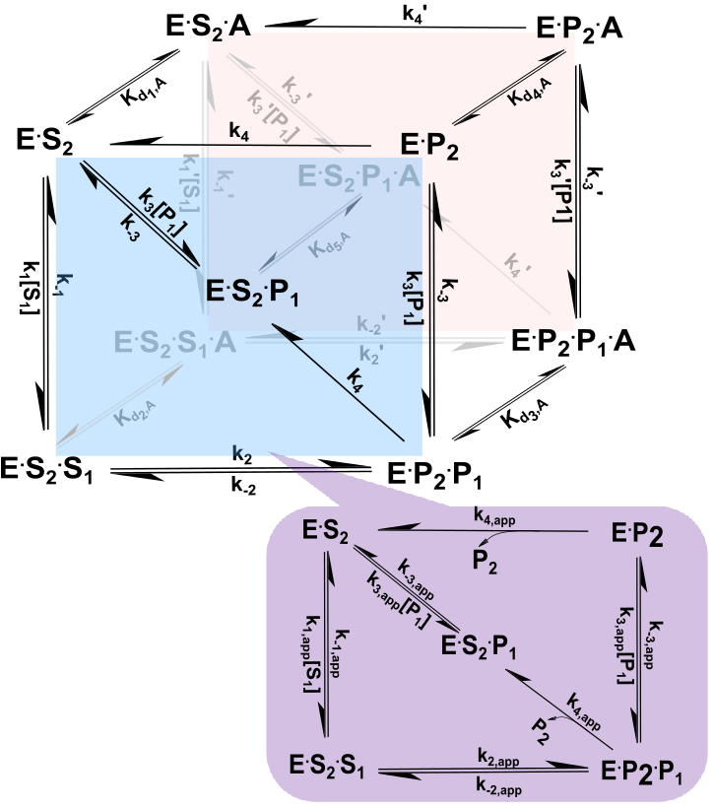
Cubic + Rectangle
Version B
Mixed Noncompetitive modulation of forward reaction
Mixed noncompetitive inhibition of reverse reaction
Hyperbolic modulation of forward reaction
Hyperbolic modulation
of reverse reaction

Slide 9
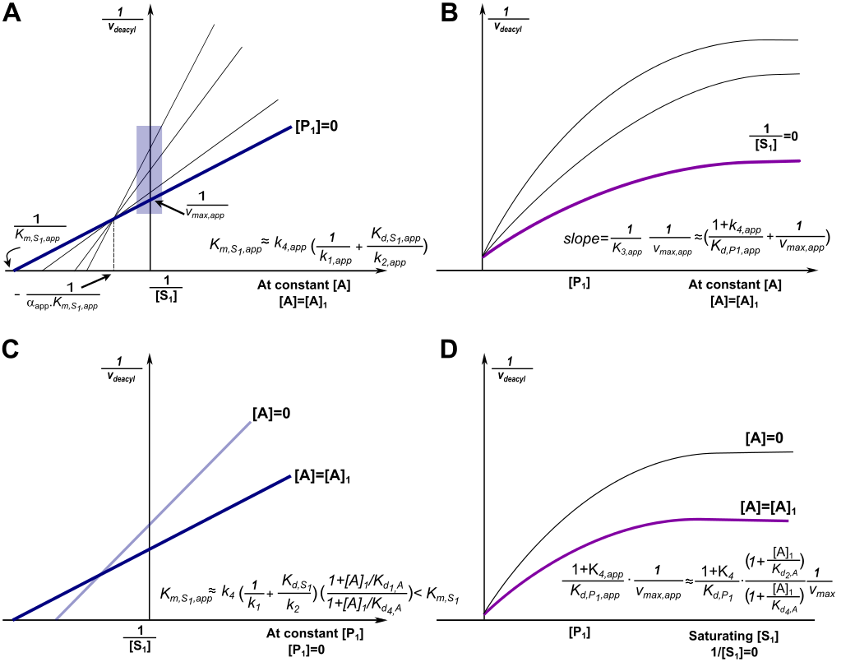
Double reciprocal /Dixon schematics

Slide 10
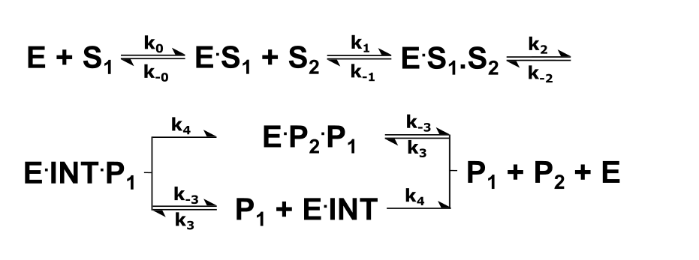
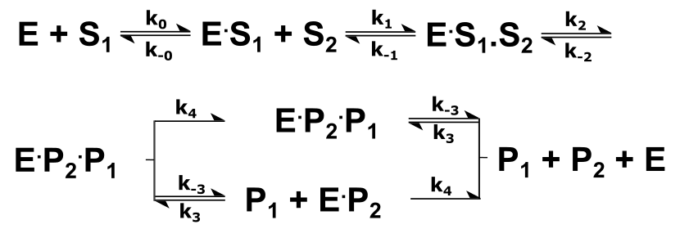
Linear reaction scheme
Questions:
RC: Please make versions of all figs where INT is replaced by P2.
XG: After replacing the INT by P2, two E.P2.P1 in the Scheme down there.

