Slide 1
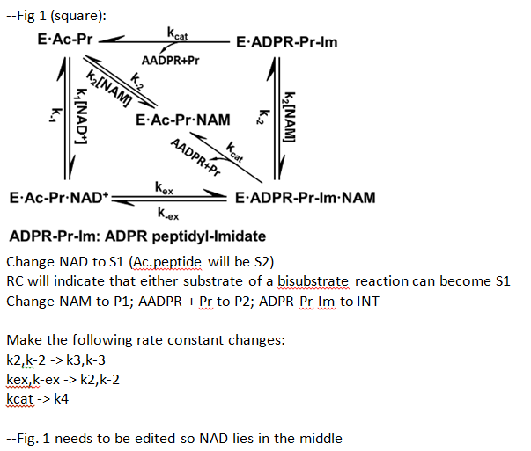
Comments from RC

Slide 2
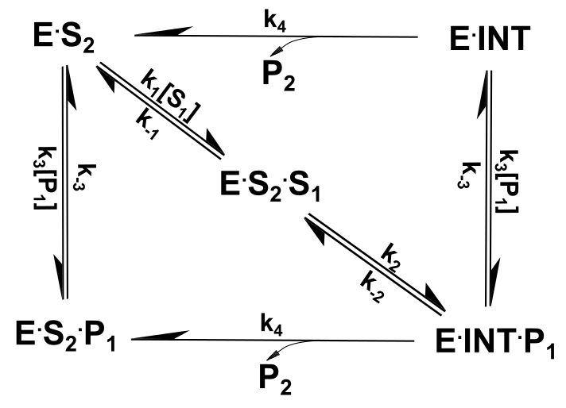
Modified Figure by XG-----E.S2.S1 in the middle
Figure 1_vA

Slide 3
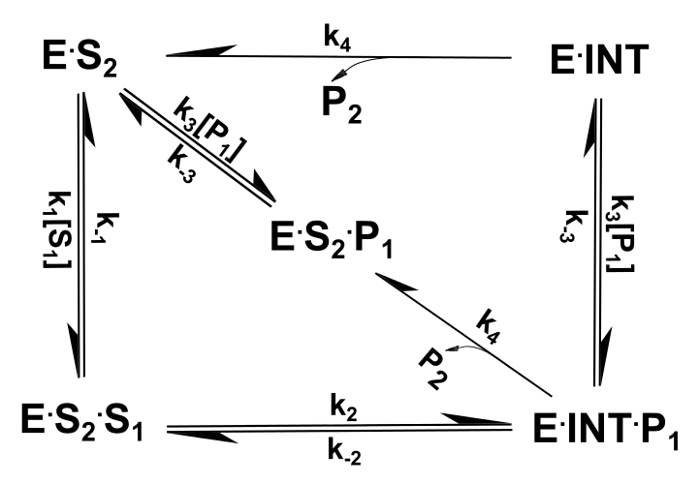
Modified Figure by XG-----E.S2.P1 in the middle
Figure 1_vB

Slide 4
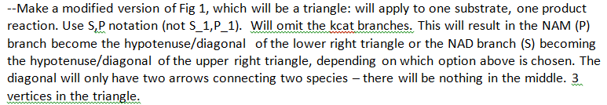
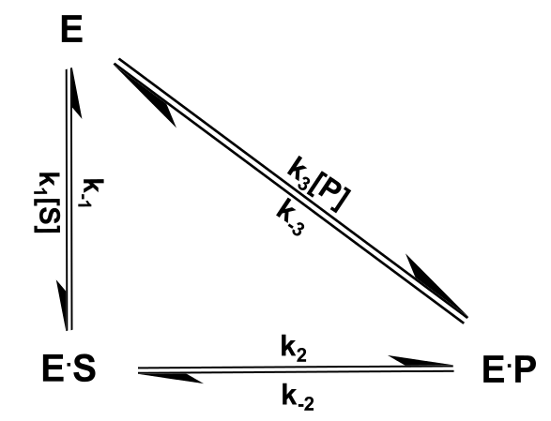
Comments from RC
Modified Figure by XG
We'd rate constants 2,-2 3 in triangle.There needs to be two arrows on diagonal, with k3[P] and k-3
Single Triangle-black

Slide 5
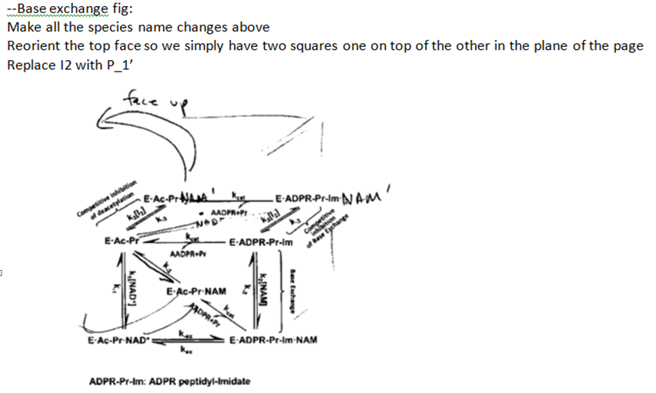
Comments from RC

Slide 6
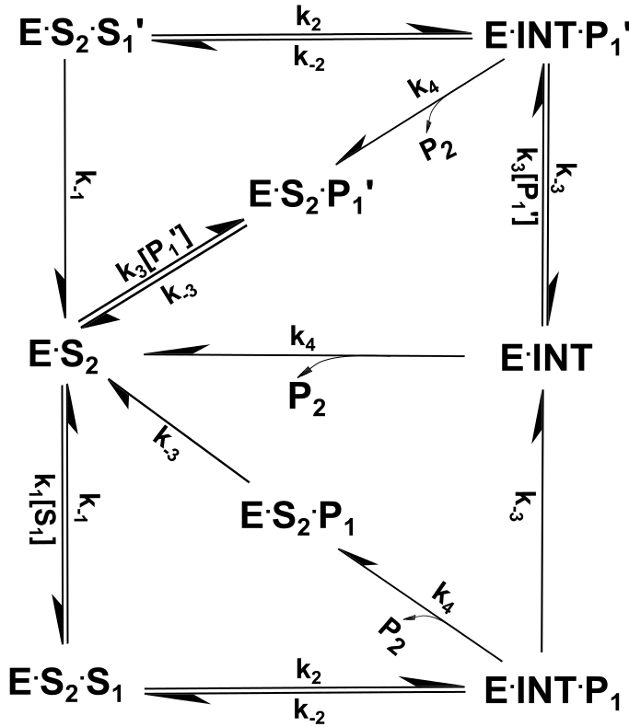
Modified Figure by XG
Comments from RC
In base exchange fig
*in the top square, do no include the arrow with k1[NAD+'] in the top square
*in the bottom square, omit the arrows with k3[NAM].
a) all arrows need rate constants. You are missing k-1 on top square left hand side.
You are missing k3[P1'] and k-3 on diagonal double arrow in top square. You are missing k2,-2 on top
side of top square
b) bottom square right side should not have k3[P1] arrow
c) there is no k3' -- it is k3. Only P1' has prime.
Base Exchange Fig.

Slide 7
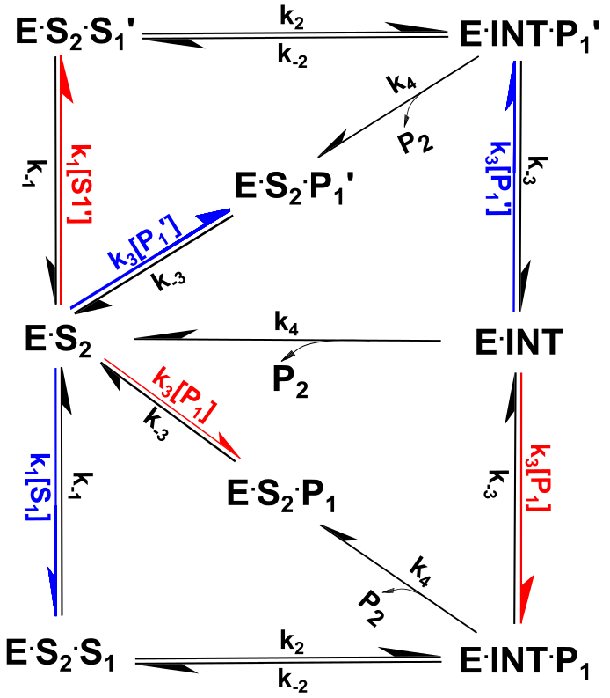
Modified Figure by XG
Comments from RC
Regarding the two square fig, in your original version you may color code in red the arrows with [S1'],[P1] and with
and in blue the arrows with [S1],[P1']. (There is another version to be made as I mentioned below as well.)
Also make sure that the E.S2.S1 (with,without primes) are in the same place in the top and bottom squares as I mentioned below.

Slide 8
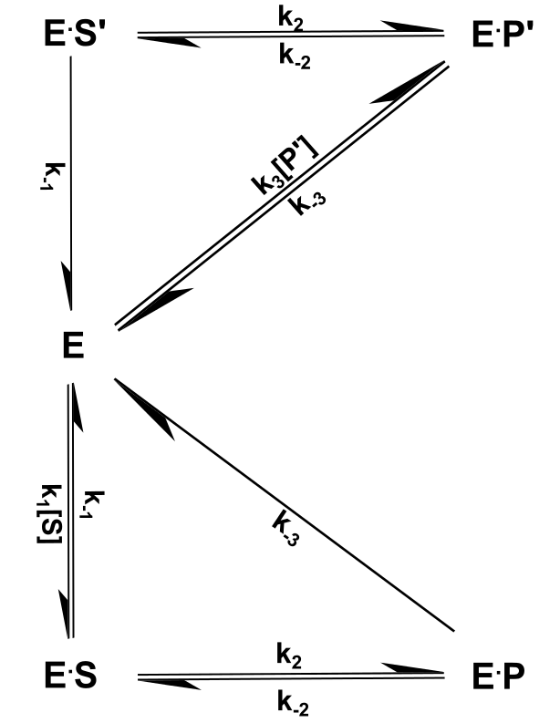
Comments from RC
For base exchange fig there will also be a 2 triangle version (two triangles on top of each other)by omitting the species that were not color coded in Fig1 above. You’ll have S’ and P’ in the top triangle – omit the K1[S’] arrow from top triangle and the k3[P] arrow from bottom triangle.
Modified Figure by XG
Base Exchange Fig.

Slide 9
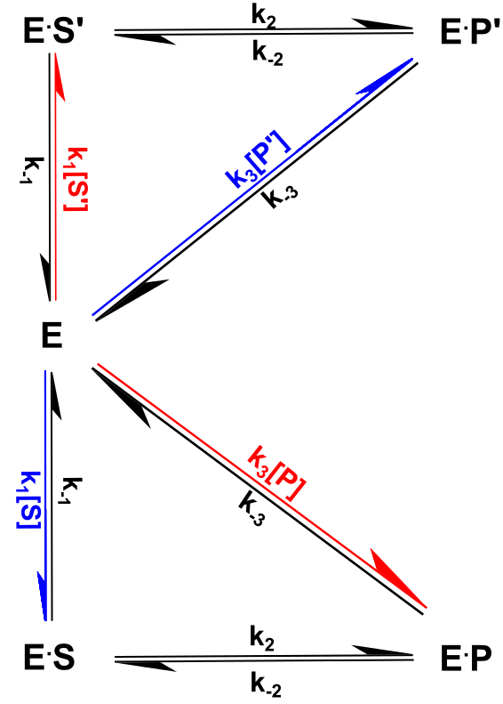
Comments from RC
The double triangle schematic should also be prepared in color coded version with all arrows but with red/blue coloring analogous to that in the double square.

Slide 10
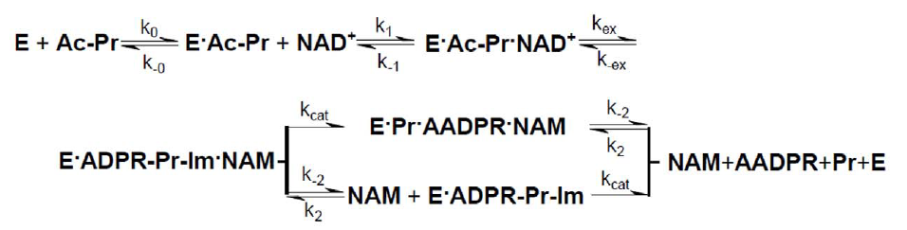
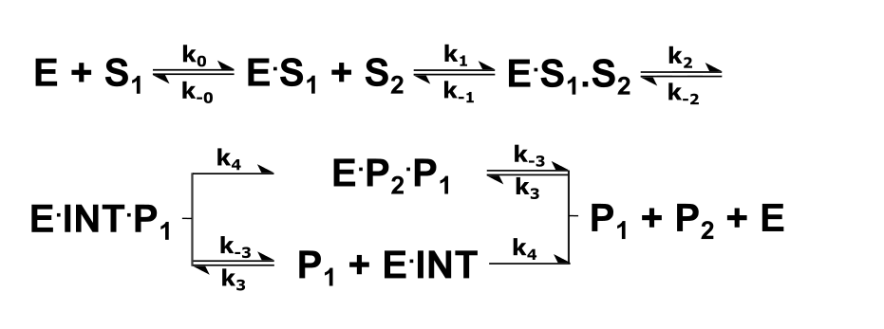
Comments from RC
Also, please take the linear reaction scheme from PLOS paper and replace the notations with the new notations.
Modified Figure by XG
PLOS Linear Fig.

Slide 11
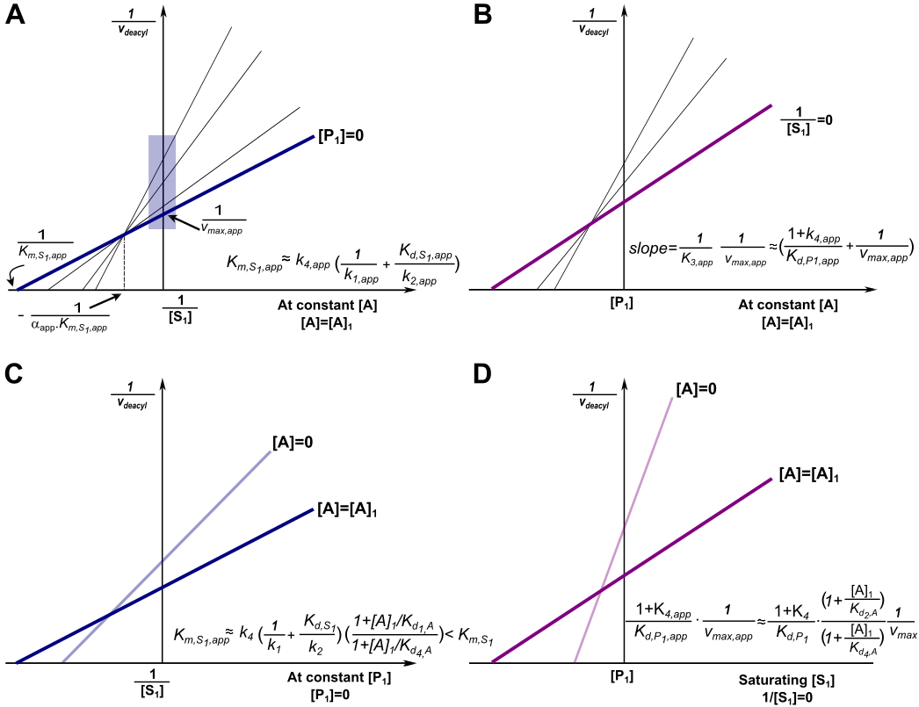
Comments from RC Finally, we will also be editing the notations correspondingly in the double reciprocal /Dixon schematics from PNAS paper (schematics, not exptl data) for this purpose -- will involve changing Km,NAD,app, kex,app, kcat,app etc to the notations corresponding to the new ones I listed in my previous email.
Modified Figure by XG

Slide 12
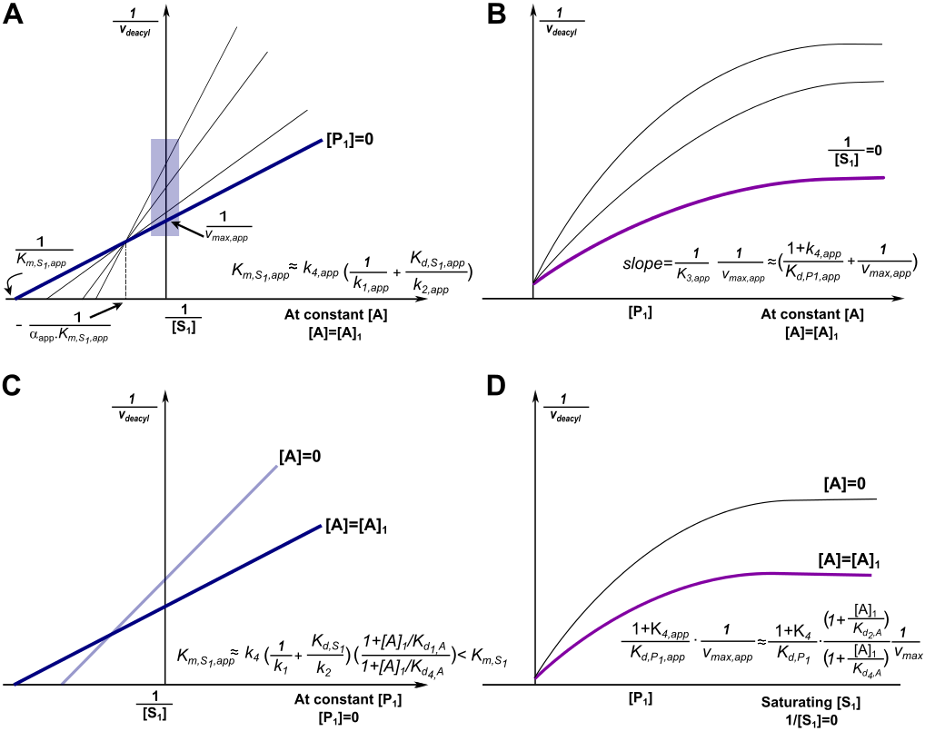
Comments from RC --Dixon schematics: can you redraw these by replacing the lines with the hyperbolic curves like those you plotted before for our recent analyses (see e.g. Dixon eq 1 predicted plots at 500.15000uM ppt)? You can use the equation 1 with everything except [NAD] specified and make the plot for a few diff NAD in subfigure b. If you have any questions let me know. Later we may add depiction of location of plateau.

Slide 13
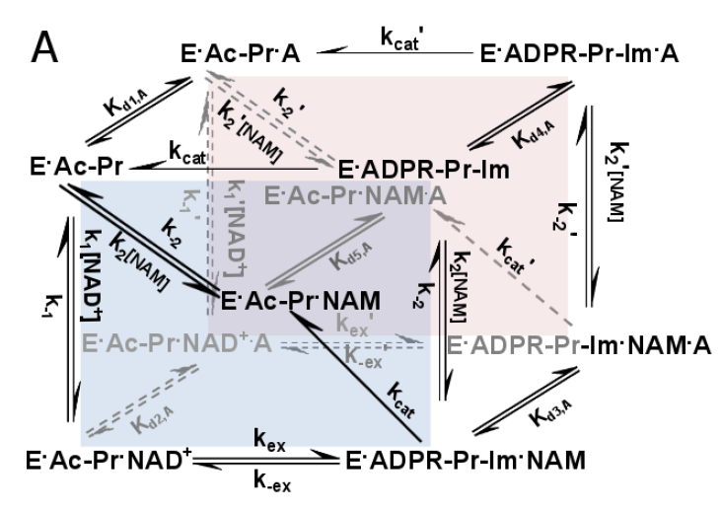
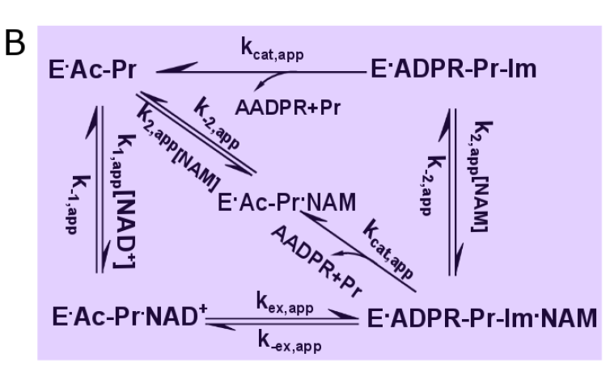
Comments from RCThere is also a cube fig in biorxiv. Can you edit this (separate version) so the notations are updated accordingly throughout?

Slide 14
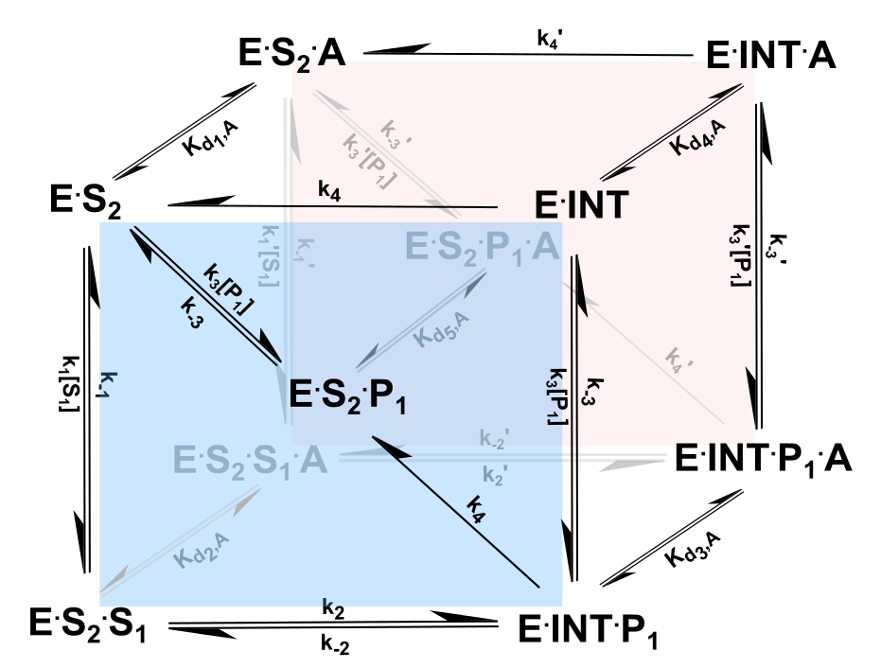
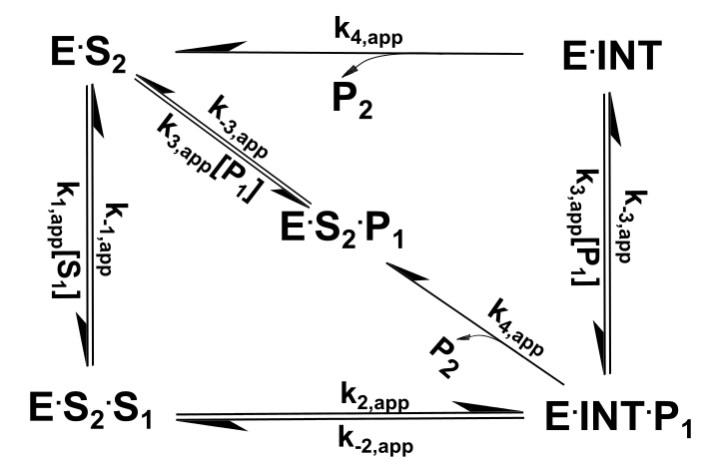
Modified Figure by XG-----E.S2.P1 in the middle

Slide 15
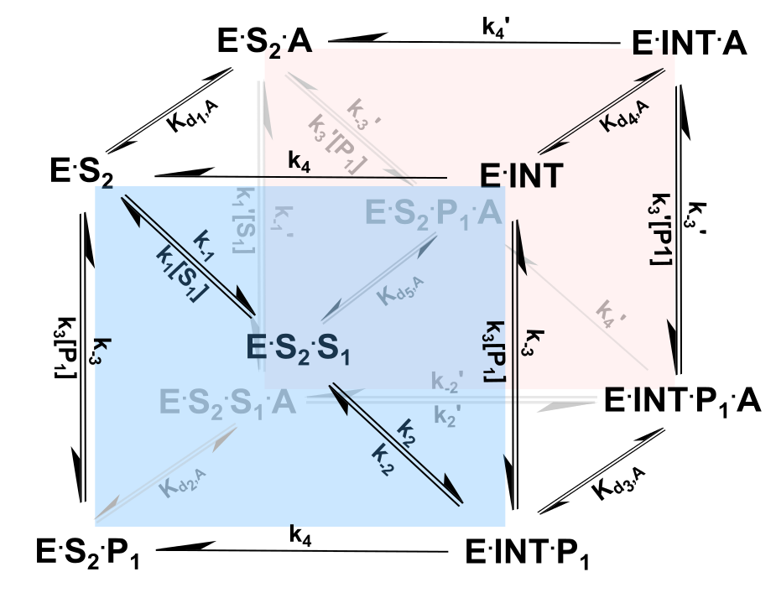
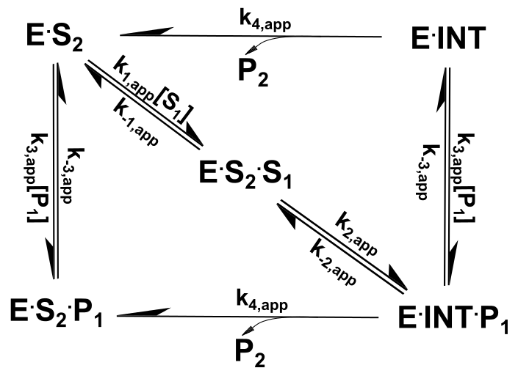
Modified Figure by XG-----E.S2.S1 in the middle

Slide 16
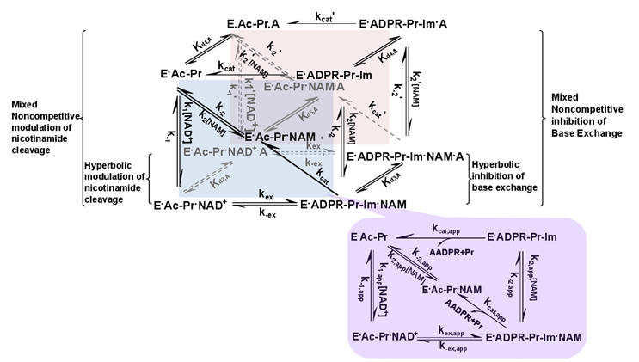
RC: We also need this fig to be edited:

Slide 17
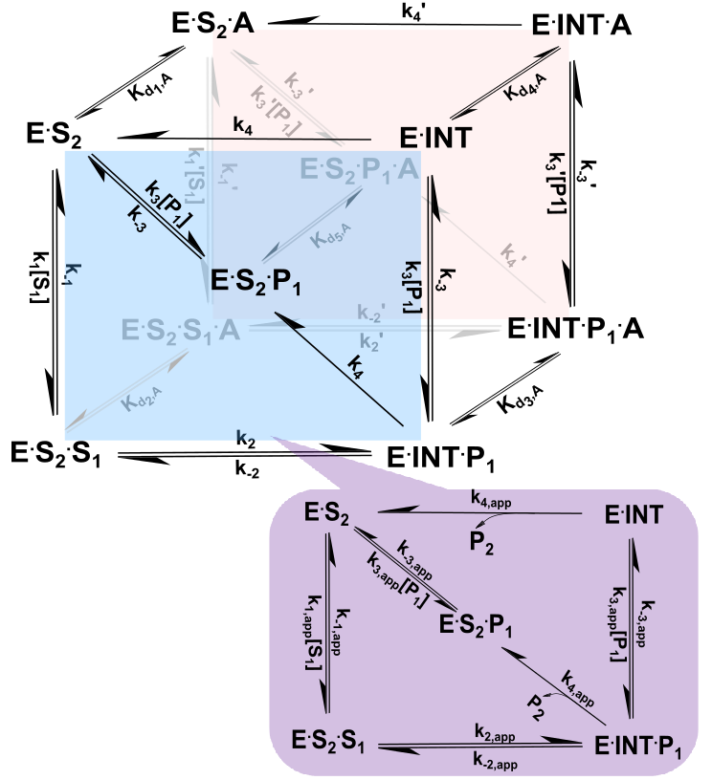
Modified Figure by XG-----E.S2.P1 in the middle
Mixed Noncompetitive modulation of forward reaction
Mixed noncompetitive inhibition of reverse reaction
Hyperbolic modulation of forward reaction
Hyperbolic modulation
of reverse reaction

Slide 18
Modified Figure by XG-----E.S2.S1 in the middle
Mixed Noncompetitive modulation of forward reaction
Mixed noncompetitive inhibition of reverse reaction
Hyperbolic modulation of forward reaction
Hyperbolic modulation
of reverse reaction

