Slide 1
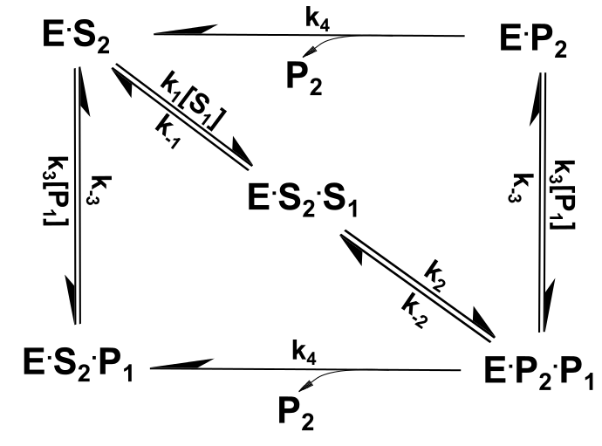
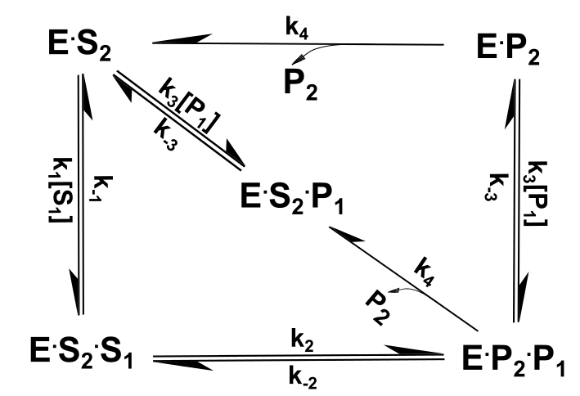
Figure 1
Version A
Version B

Slide 2
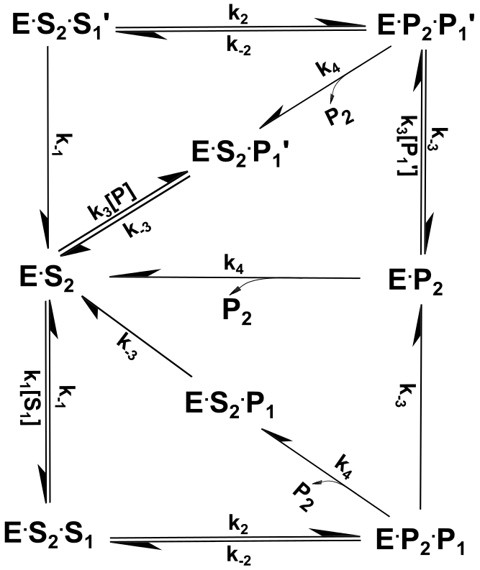
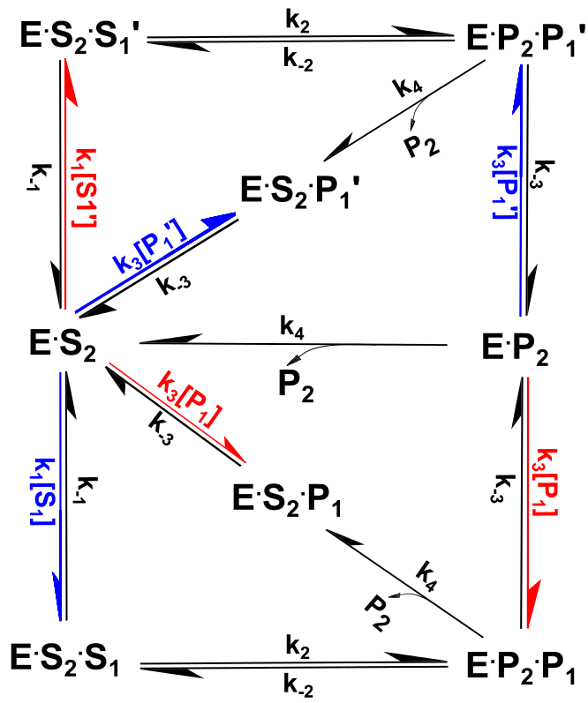
Figure 2
Black/white
Color code

Slide 3
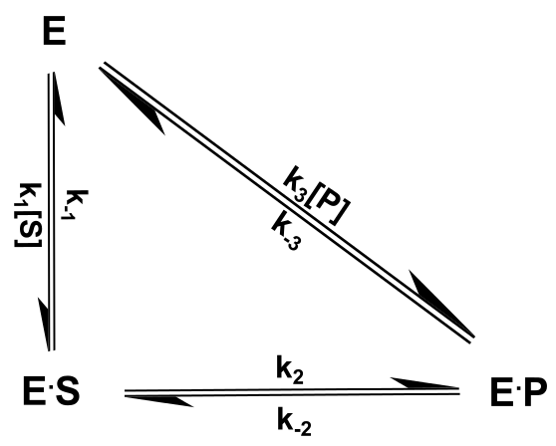
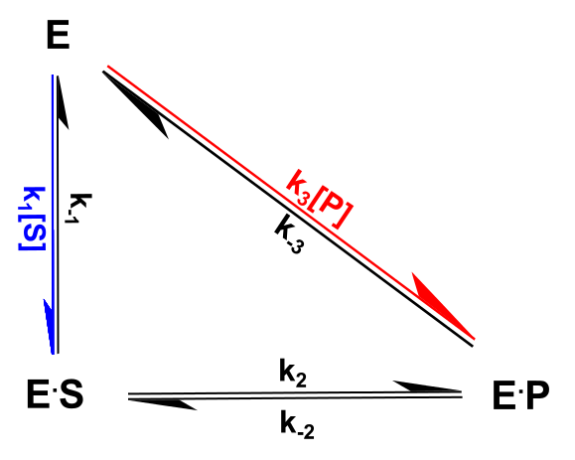
Single Triangle
Black/white
Color code

Slide 4
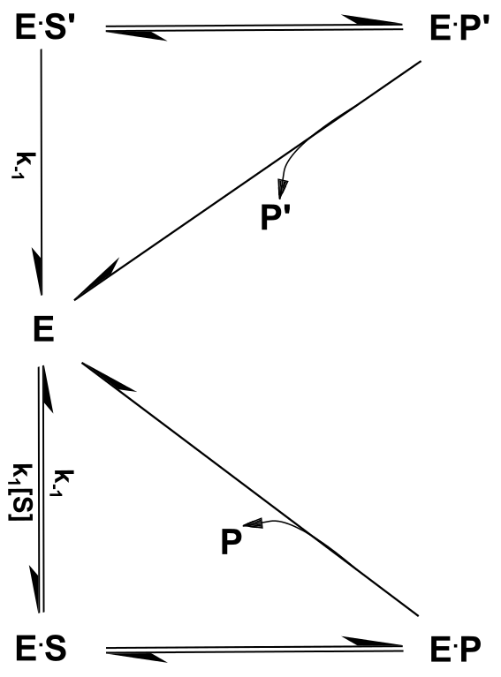
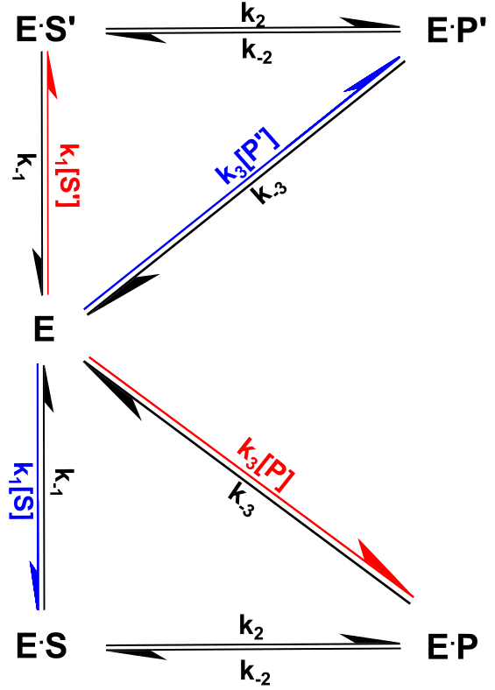
Double Triangle
Black/white
Color code

Slide 5
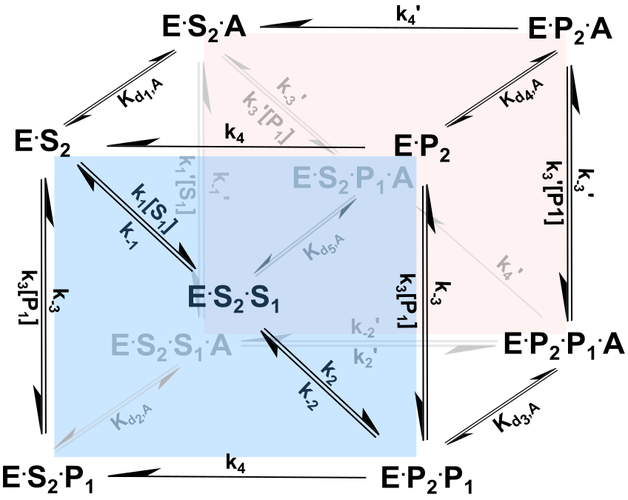
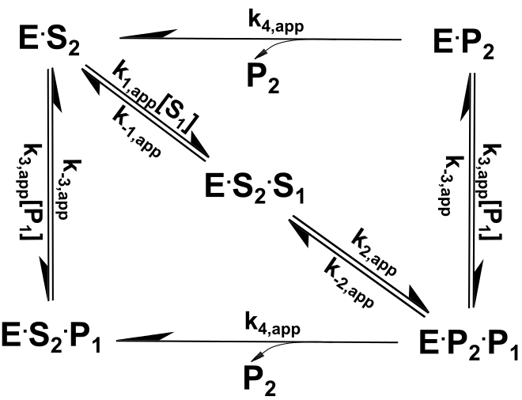
Cubic Figure
Version A

Slide 6
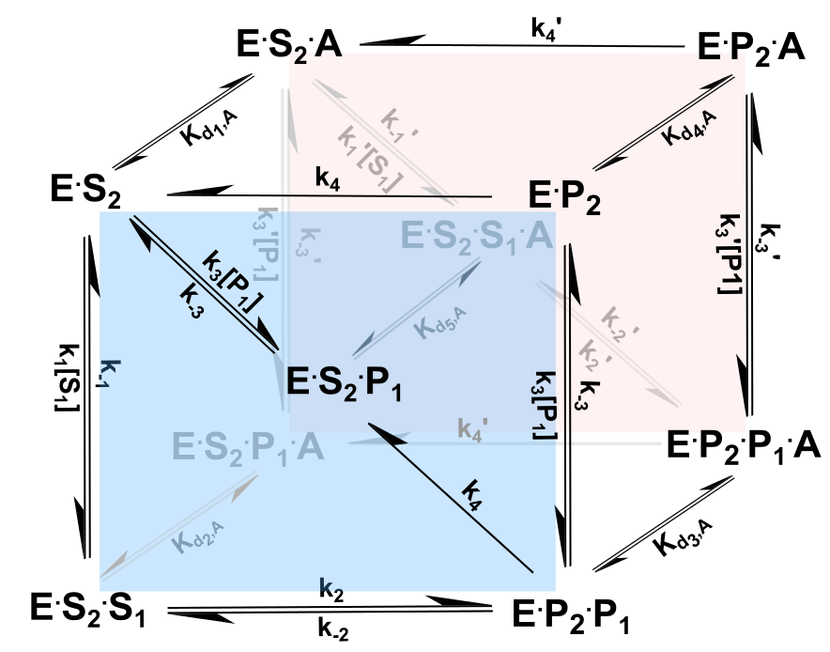
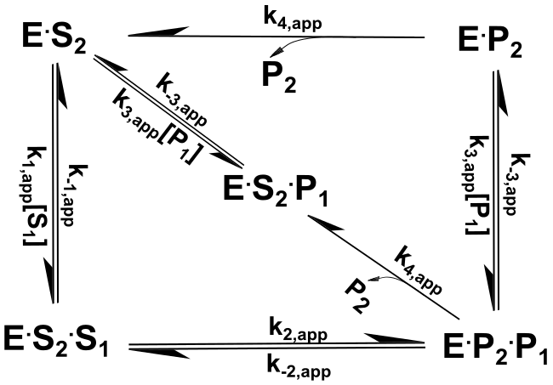
Cubic Figure
Version B

Slide 7
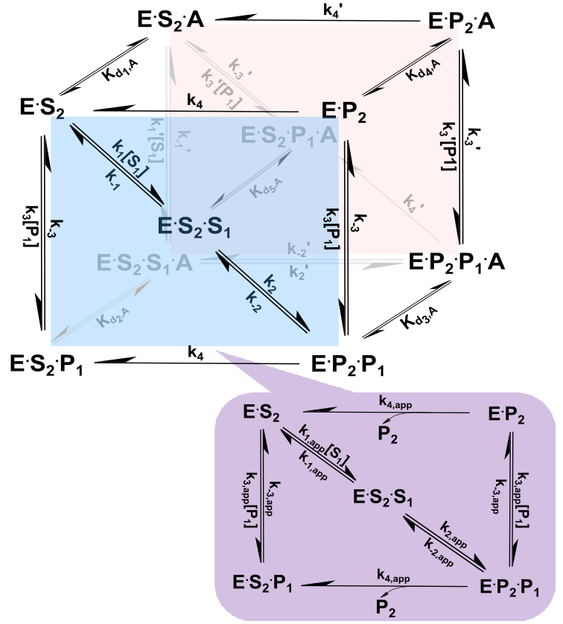
Cubic + Rectangle
Version A
Mixed Noncompetitive modulation of forward reaction
Mixed noncompetitive inhibition of reverse reaction
Hyperbolic modulation of forward reaction
Hyperbolic modulation
of reverse reaction

Slide 8
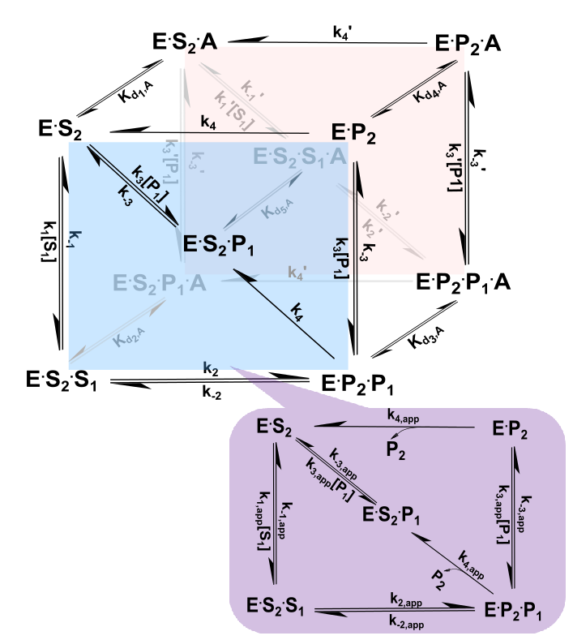
Cubic + Rectangle
Version B
Mixed Noncompetitive modulation of forward reaction
Mixed noncompetitive inhibition of reverse reaction
Hyperbolic modulation of forward reaction
Hyperbolic modulation
of reverse reaction

Slide 9
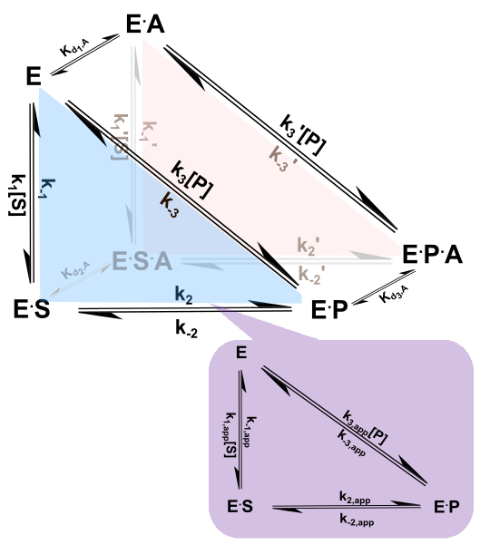
3D Triangle
Mixed noncompetitive inhibition of reverse reaction
Mixed Noncompetitive modulation of forward reaction

Slide 10
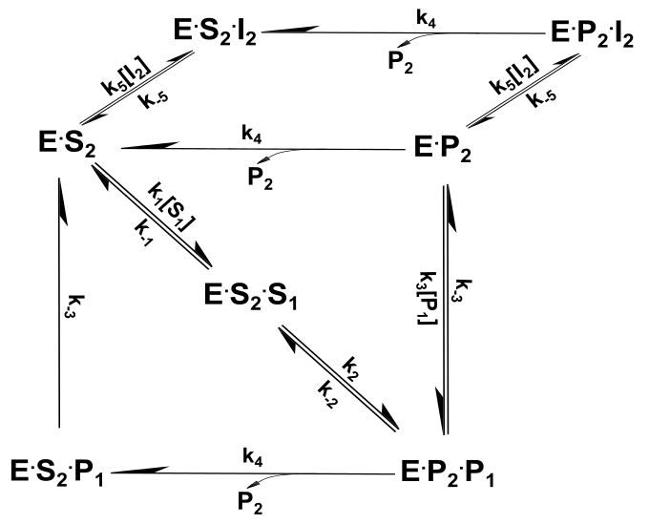
Depression Figure-Version A
Competitive inhibition
of forward reaction
Competitive inhibition
of reverse reaction
Reverse
reaction

Slide 11
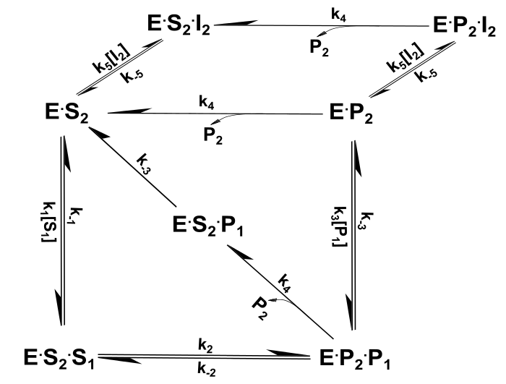
Depression Figure-Version B
Competitive inhibition
of forward reaction
Competitive inhibition
of reverse reaction
Reverse
reaction

Slide 12
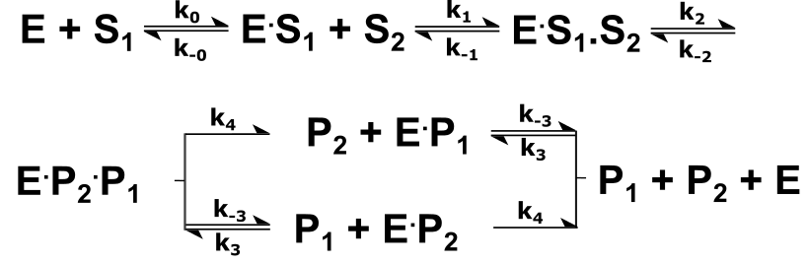
Linear reaction scheme

Slide 13
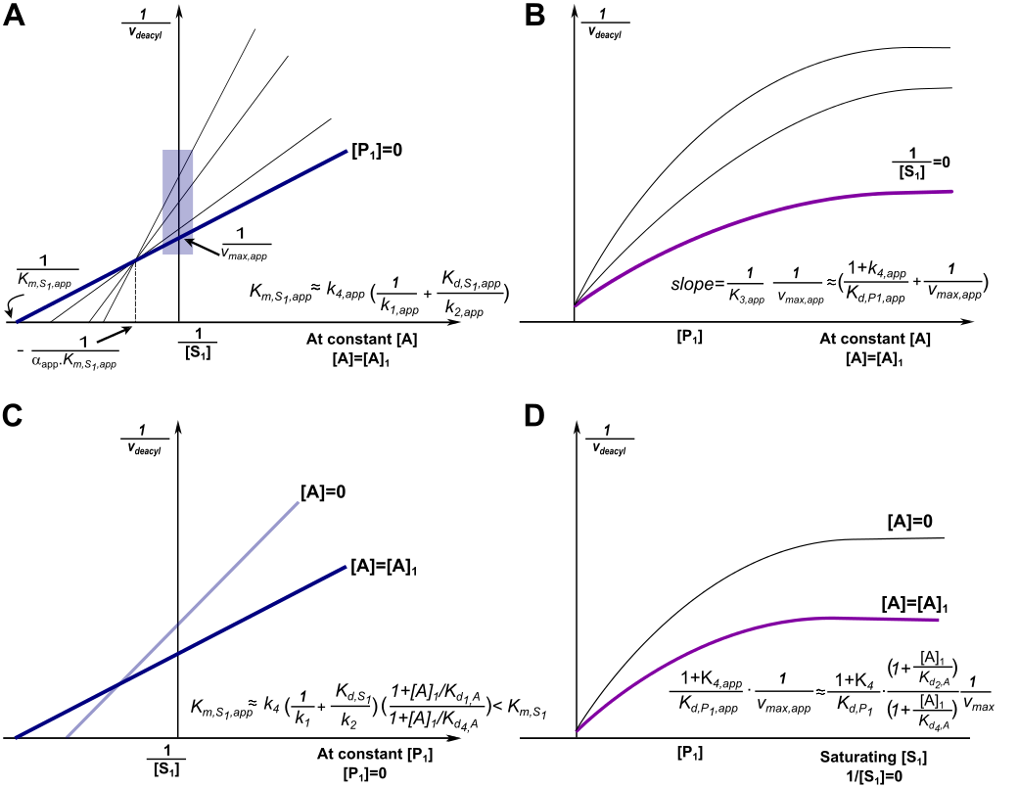
Double reciprocal /Dixon schematics

Slide 14
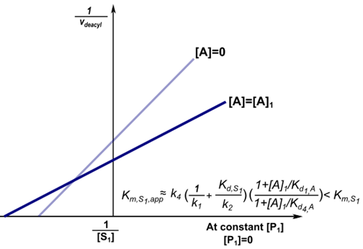
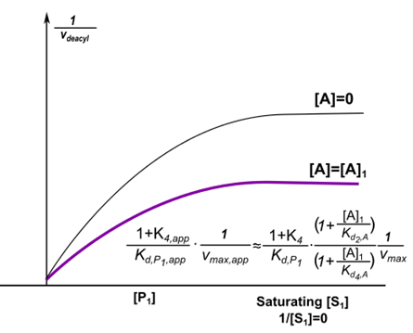
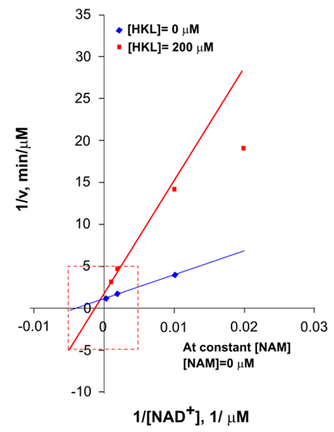
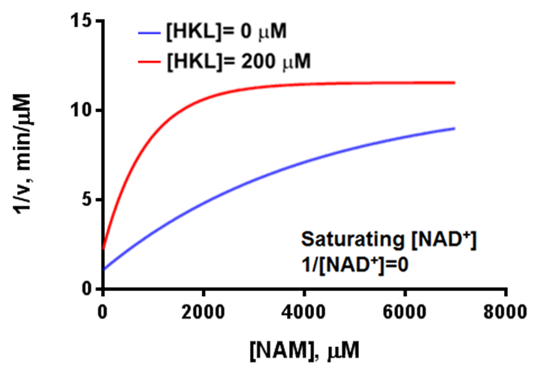
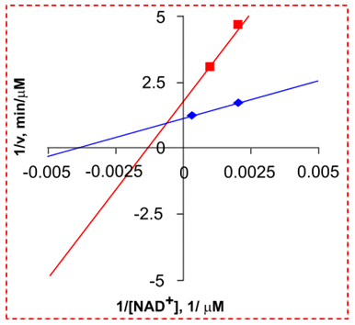
A B

Slide 15
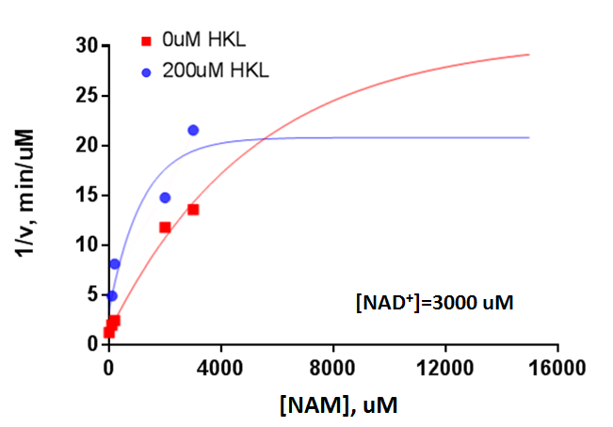
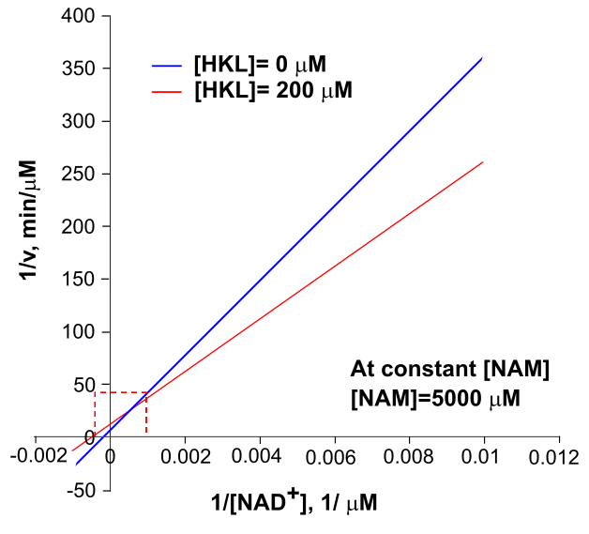
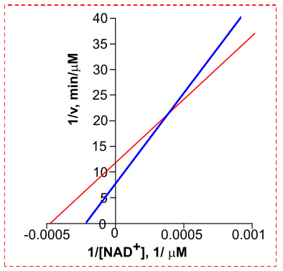
C D

Slide 16
A B
C D

Slide 17
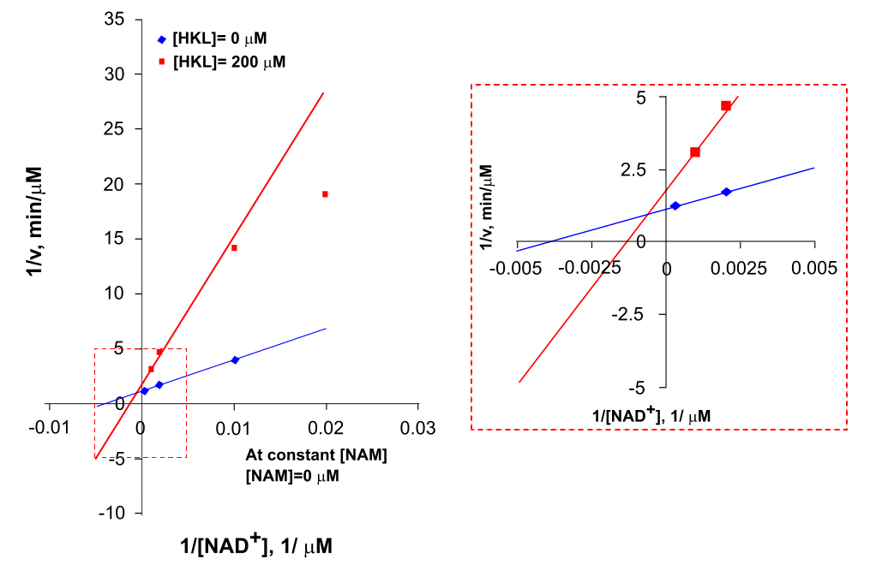
Double Reciprocal Plot – [NAM] = 0uM
(A) (B)

Slide 18
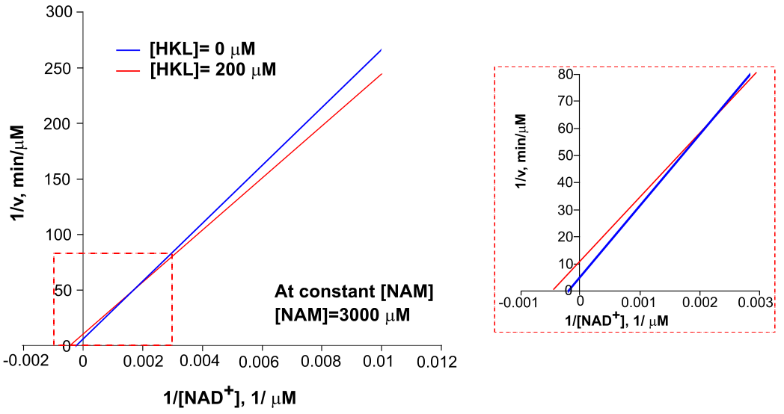
Double Reciprocal Plot – [NAM] = 3000uM

Slide 19
Double Reciprocal Plot – [NAM] = 5000uM
(A) (B)

Slide 20
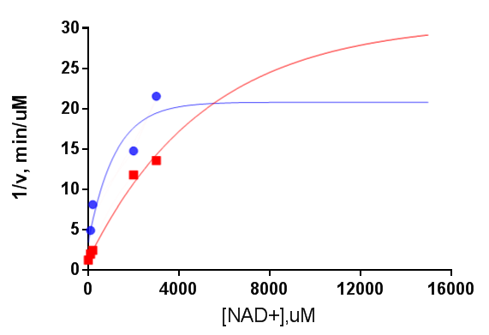


Dixon Plot-[NAD⁺] = 3000uM
[NAD⁺]=3000 uM
[NAM], uM

Slide 21
Dixon Plot-Saturating NAD+

