Slide 1
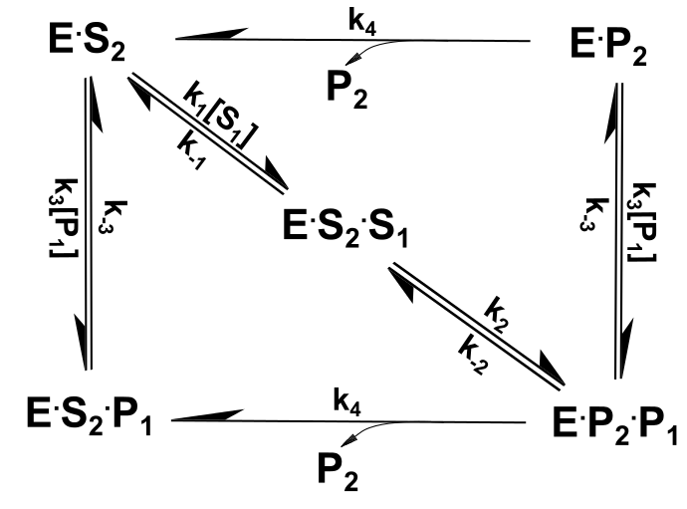
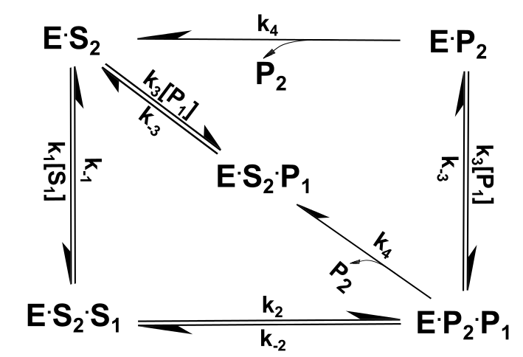
Figure 1
Version A
Version B

Slide 2
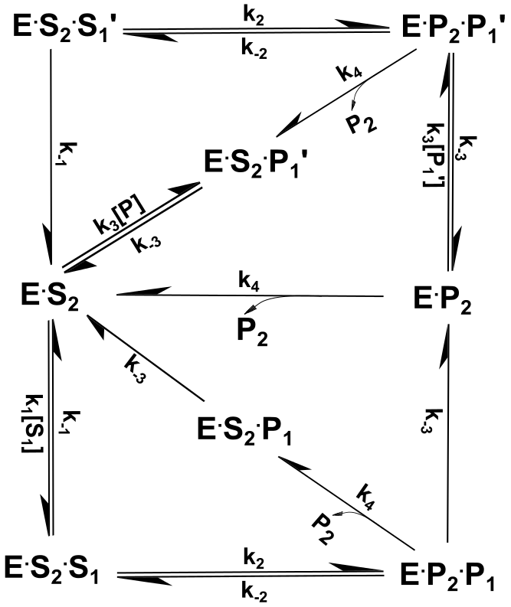
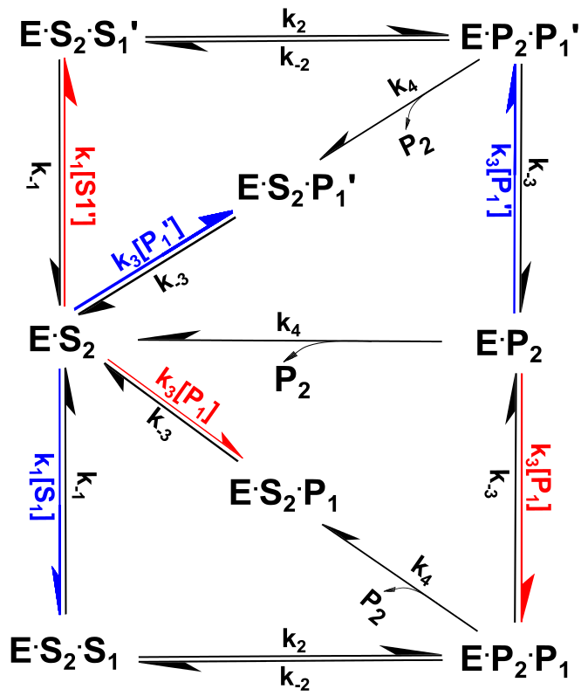
Figure 2
Black/white
Color code

Slide 3
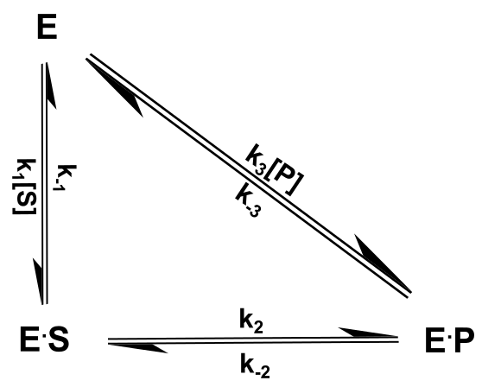
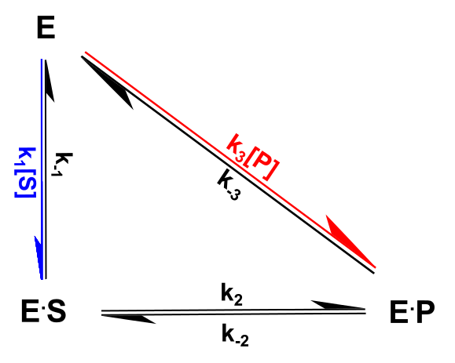
Single Triangle
Black/white
Color code

Slide 4
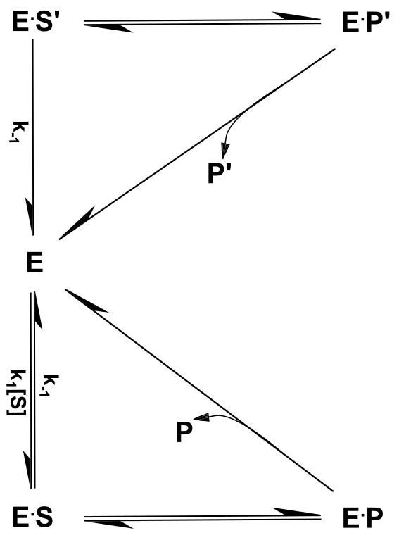
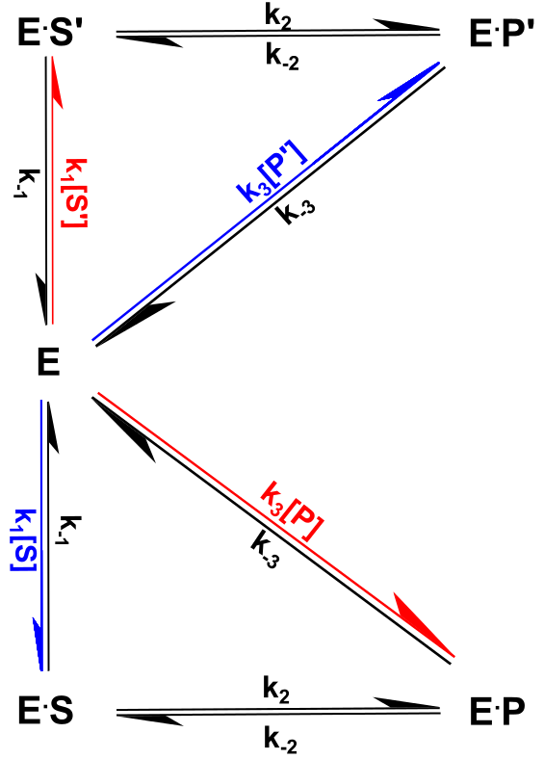
Double Triangle
Black/white
Color code

Slide 5
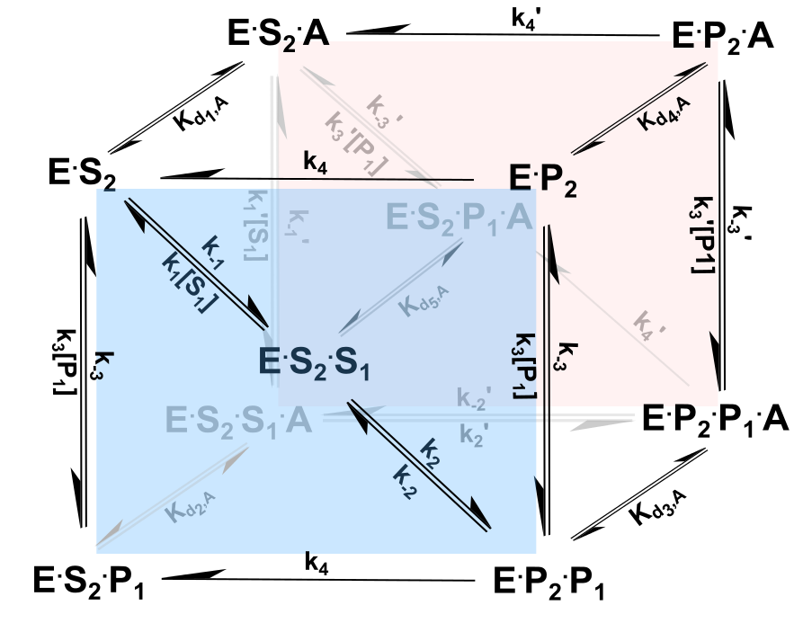
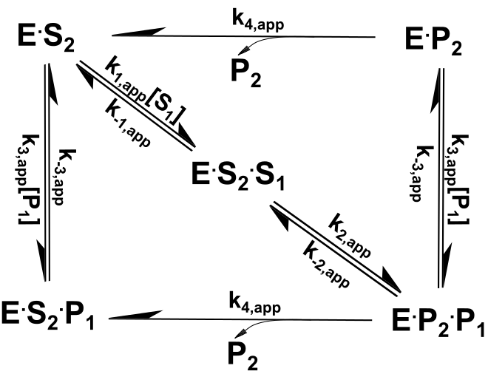
Cubic Figure
Version A

Slide 6
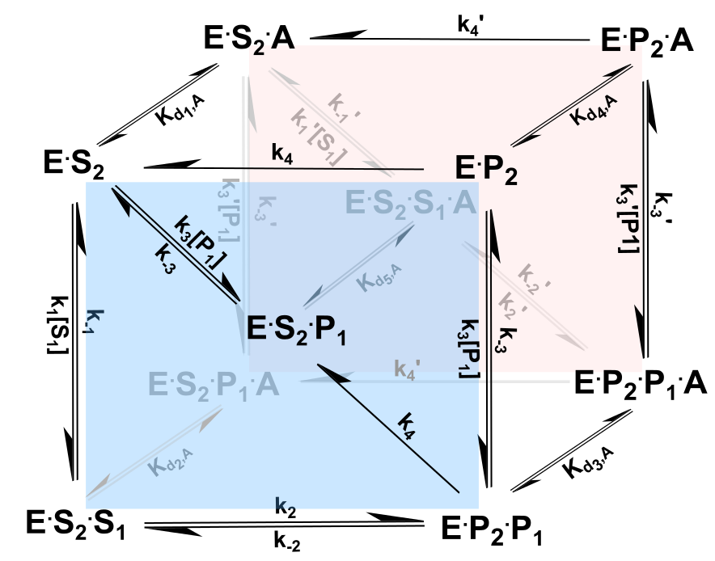
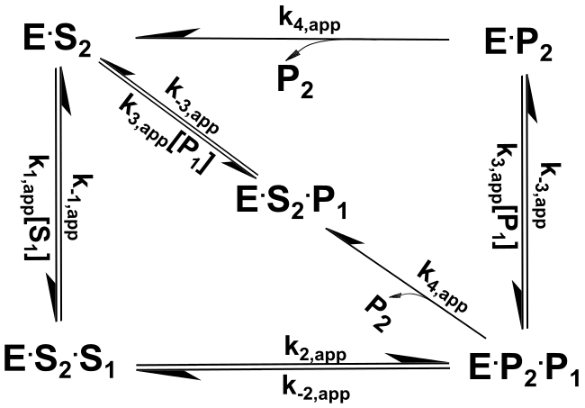
Cubic Figure
Version B

Slide 7
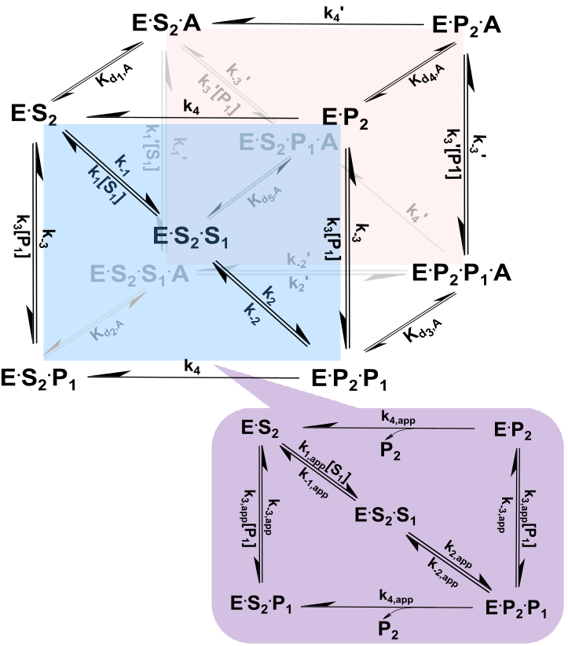
Cubic + Rectangle
Version A
Mixed Noncompetitive modulation of forward reaction
Mixed noncompetitive inhibition of reverse reaction
Hyperbolic modulation of forward reaction
Hyperbolic modulation
of reverse reaction

Slide 8
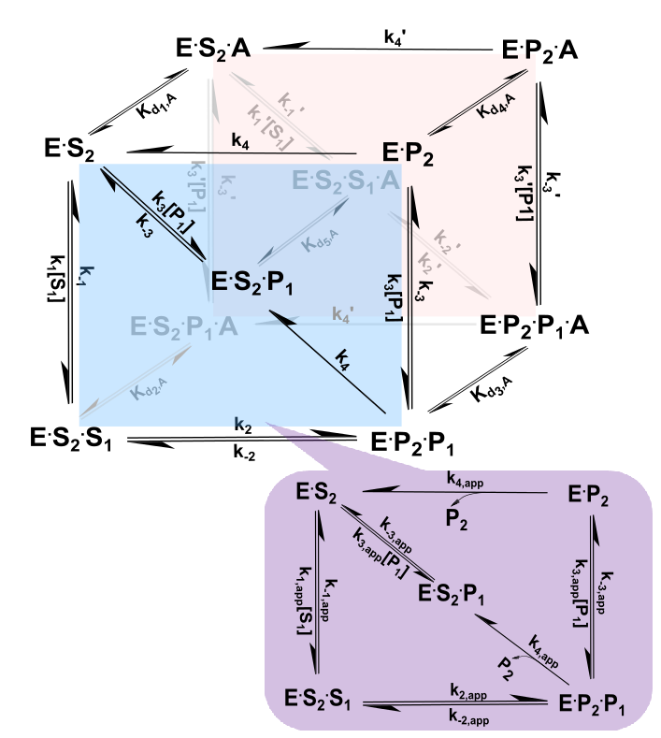
Cubic + Rectangle
Version B
Mixed Noncompetitive modulation of forward reaction
Mixed noncompetitive inhibition of reverse reaction
Hyperbolic modulation of forward reaction
Hyperbolic modulation
of reverse reaction

Slide 9
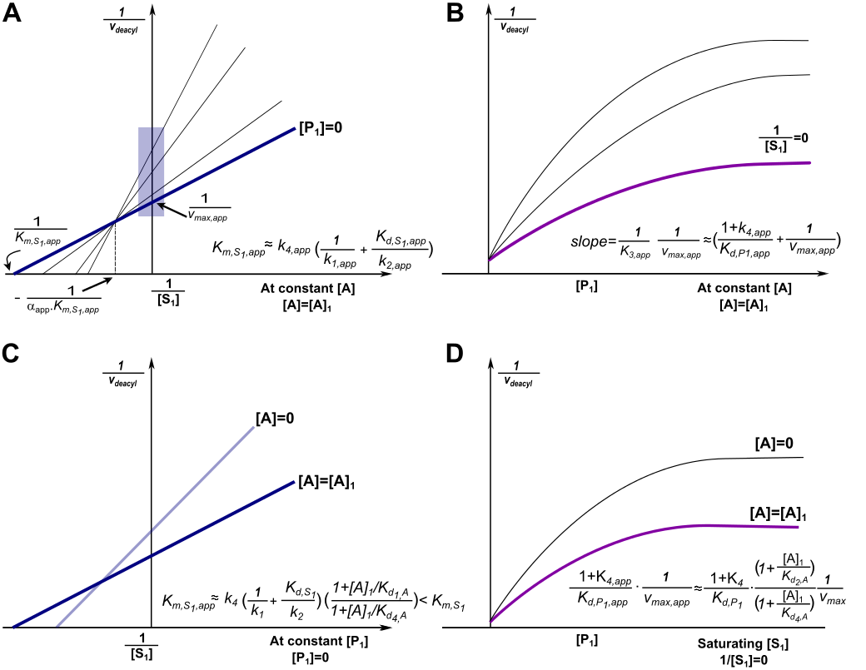
Double reciprocal /Dixon schematics

Slide 10
Linear reaction scheme

Slide 11
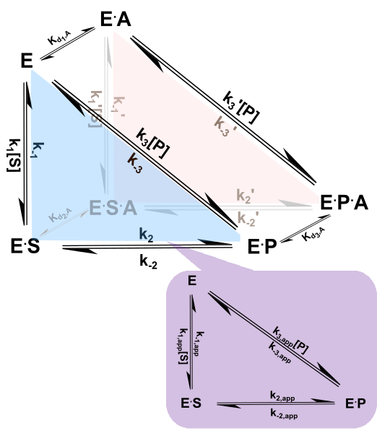
3D Triangle
Mixed noncompetitive inhibition of reverse reaction
Mixed Noncompetitive modulation of forward reaction

Slide 12
