Slide 1
Fast PCR Survey

Slide 2
PCR Global Market Watch
The global PCR market is projected to reach around US$27.4 billion by 2015, with a Compounded Annual Growth Rate (CAGR) of 13.9% for the analysis period, 2009-2015. North America is estimated as the largest market with a market share of 40% of global market and projects US$10.7 billion by end-2010. Europe and Asia-Pacific together account for more than 50% of the global market share. Interestingly, Latin America is seen as the fastest growing market with a CAGR of 14.8%, to worth around US$1.3 billion in 2015.
Among the techniques used, Q-PCR appears to be the fastest growing market with a CAGR of 14.9%. Reverse-Transcription PCR (RT-PCR) and Assembly PCR are expected grow with a CAGR of 14.3% and 14% respectively.
Based on the classification by products/tools, PCR Reagents are expected to be fastest growing market with a CAGR of 14.6%. PCR Consumables and PCR Machines are expected grow with a CAGR of 14.2% and 13.1% respectively.
Global PCR Research market forecasts a CAGR of 13.3% during the analysis period 2009-2015. PCR Diagnosis market is expected to represent the market share of 29.9% by 2015. PCR Infectious Diseases stand as the fastest growing market.
Quoted from online summary of “Polymerase Chain Reaction (PCR) In Medical Application - An Analytical Report, 2009-2015” Published in June 2013

Slide 3
Fast PCR: instrumentation and enzyme systems
Many of the growing market such as Infectious Diseases detection requires faster PCR technology
The length of the cycling time-block is dominated by the properties of the thermal cycling instrument (ramp rates and temperature profiles) and DNA polymerase (processivity and extension rates) generally employed.
  Reliability, accuracy, and speed of thermal cyclers represent PCR's core technology
  The development of fast PCR Master Mixes, especially DNA polymerase with better extension rate and processivity

Slide 4
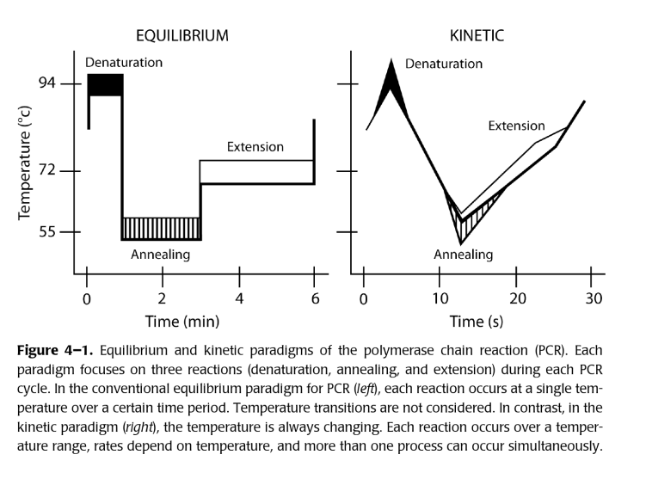
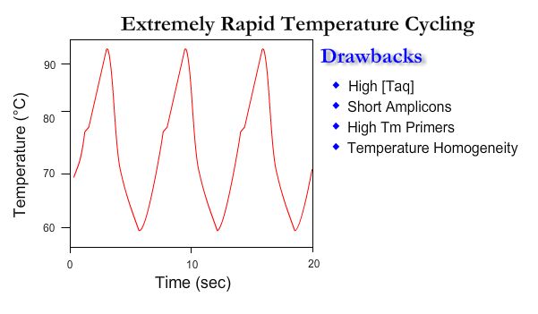
Rapid Cycler PCR
Carl Wittwer is a Professor of Pathology at the University of Utah Medical School. In the early 1990s he developed rapid-cycle PCR techniques for DNA amplification in 10-15 min, by which he claimed “When PCR is performed rapidly, the quality of PCR products is often better. Back in 1990, we were amplifying PCR products of 500 bp in about 15 min. This was accomplished by using little or no holds at extension, denaturation or annealing temperatures. Advancement in instrumentation and technology now allows even faster PCR.”

Slide 5
Development of Thermal Cycler for Fast PCR
Summary table of the advantages and disadvantages for each method of temperature control in nucleic acid amplification
Temperature control | Advantages | Disadvantages
Peltier | Low cost | Relatively slow
 | Flexible | Relatively high power
 | Active cooling | Finite lifespan
Thin-film resistive | Low cost | Relatively slow
(traditional) | Simple electronics
 | Reliable
Thin-film resistive | Relatively fast | Cost
(patterned directly) |  | Complexity
 |  | Heater is disposable
Continuous flow | Low power | Surface treatments (biocompatibility)
 | Very fast | Not flexible
 | Active cooling | Detection difficult to integrate
 |  | Size (pumps/actuators)
Non-contact | Efficient power usage | Cost
 | Very fast | Complexity
 |  | Size
Convective | Low power | Not flexible
 | Low cost | Quantification active R&D area
 | Very fast

Slide 6
Fast PCR Based on Traditional Thermal Cycler
Currently many instruments use either a thermo-electrically heated & cooled metal block or a hot & cold air system to produce the required temperature cycle
These thermal cycler can use both standard and fast PCR protocol. The maximum temperature ramp rate is about 5.0°C per second.
The fast PCR using two-step protocol can reduce the PCR time from about 90 minutes to 30 minutes.
Optimal PCR control on protocol that maximize the efficiency for quantitative measurement and minimize time and cycles should be interesting to these companies

Slide 7
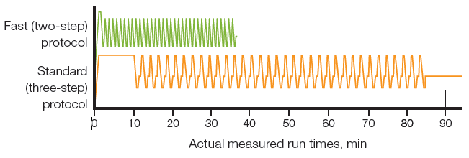
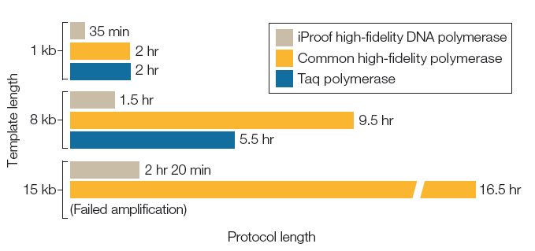
Bio-Rad Thermal Cyclers for Fast PCR

Slide 8
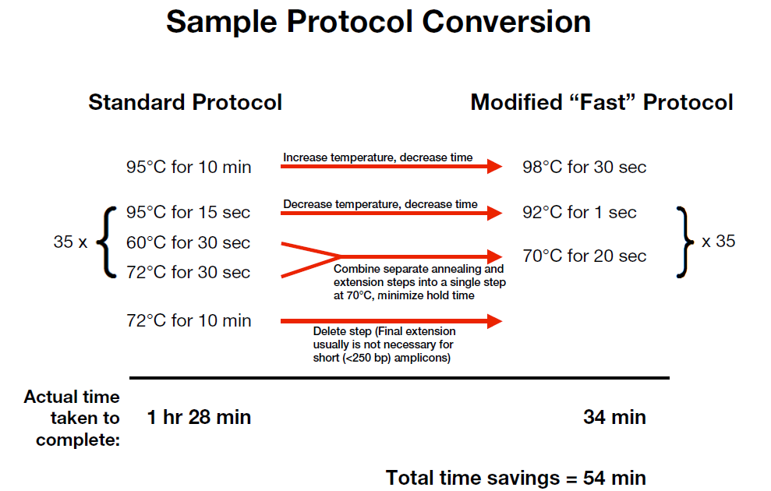

Slide 9
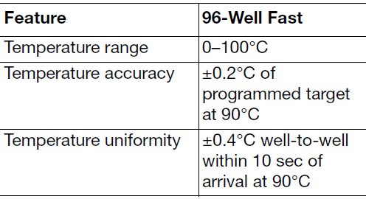
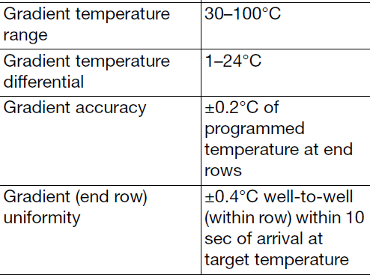
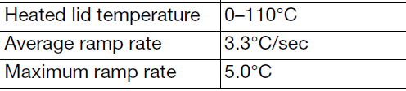
BIO-RAD C1000™ Thermal Cycler
The qPCR machine in our lab is capable of rapid cycle PCR
Optimizing a Protocol for Faster PCR using Protocol AutoWriter
  Shorten the denaturing step during cycling
  Use two-step protocol by combining annealing and extension steps
  Optimize temperature steps to minimize the ramping time (using Temperature Gradient)
  Minimize the final extension step
  Minimize the number of repeats (cycles) in a GOTO step

Slide 10
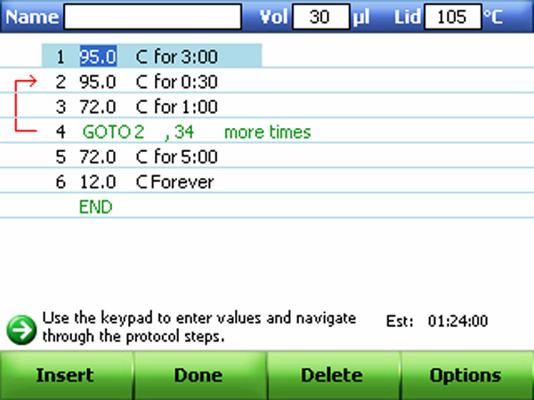
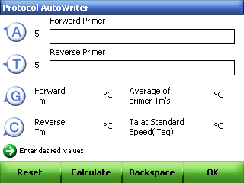
Use AutoWriter to create new Protocol
T_{m} estimated using the nearest neighbor method for sequences longer than 14 bp; parameters taken from Breslauer interaction constants. Annealing Temperature T_{a} for protocol is baed on the average primre T_{m} values.
Additional parameters can be set;
Choose the desired speed.

Slide 11
Techne Thermal Cycler Products
Techne® established thermal cycler range to provide easier programming and increased instrument flexibility.
It uses multiple peltier element/block
Maximum heating rate 5.0°C per second
Maximum cooling rate 3.0°C per second
Temperature accuracy* <±0.25°C
Temperature uniformity* <±0.3°C
Bibby Scientific Limited, UK

Slide 12
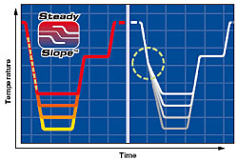
Mastercycler® Series
Ultimate reduction of evaporation (vapo.protect technology)
Extremely fast heating and cooling rates using peltier technology
Gradient blocks with SteadySlope technology
up to 8°C/s with silver block
  Heating rate* approx. 4 °C/s
  Cooling rate* approx. 3 °C/s
Eppendorf

Slide 13
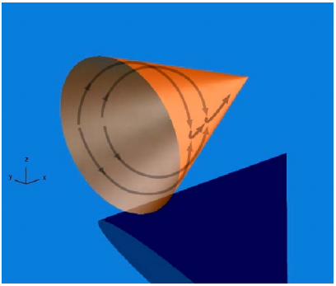
AlphaHelix Technologies
Amp™ is a very rapid thermal cycler utilizing SuperConvection™ technology that makes the instrument significantly faster than conventional thermal cyclers.
  40 cycle PCR in 20 minutes
  24 samples per run
  20 - 100 μl volume range
  Accommodates the reagent cartridge Capillette®
The SuperConvection technology and Amp enable very fast and accurate PCR assays at 20 μl scale without compromising sensitivity or specificity, thereby reducing run times to minutes instead of hours.
Average in-sample ramping speed: 6 °C/s between 50 - 90 °C
AlphaHelix Technologies AB, SWEDEN

Slide 14
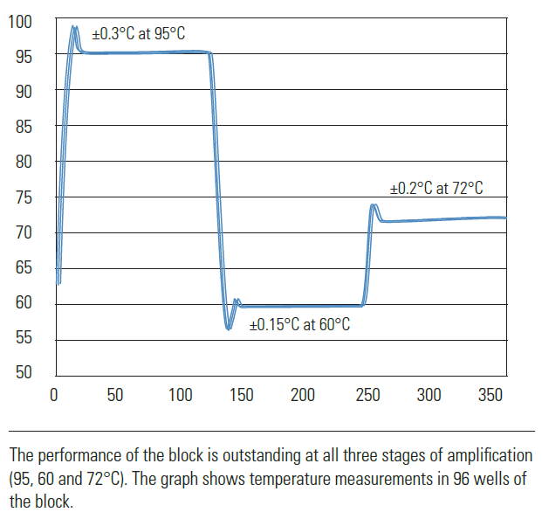
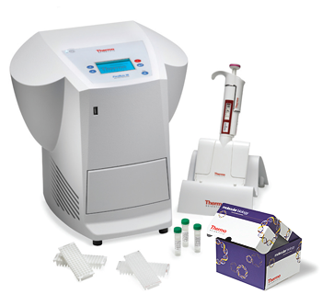
Thermo Scientific PikoReal
Real-Time PCR System
Thermo Scientific Finnzymes Molecular Biology Solutions can achieve fast PCR in 10 minutes
  Ultra-thin wall (UTW) PCR plates
  The unique patented block design
  Max cooling rate 4.5°C/sec
  Max heating rate > 5°C/sec
qPCR kits for SYBR Green and probe chemistries – fast qPCR
  DyNAmo Flash and ColorFlash qPCR Kits deliver extremely short cycling times (combined annealing and extension step of only 15 s) and are the superior choice to achieve fast qPCR. DyNAmo ColorFlash qPCR kits incorporate an innovative multicolor system that ensures correct pipetting.

Slide 15
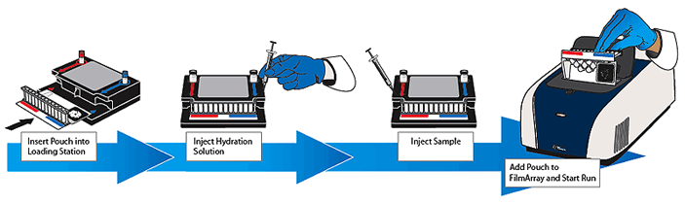
From Previous “Idaho Technology Inc.”
Air Thermo-Cycler
  with capillary tubes and air heating, transition rates of 5-10°C/sec are easily obtained. Complete 30-cycle reactions can be finished in as little as 10 min.
User-friendly Multiplex PCR - The FilmArray System
  Set Up In 2 Minutes
infectious disease diagnostics
BioFire Diagnosics

Slide 16
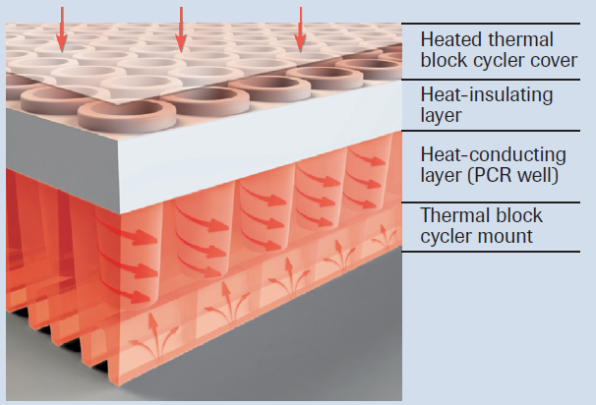
Roche Applied Science
LightCycler® Real-Time PCR System
The LightCycler® 1536 Multiwell Plate is the first high-density qPCR plate for real-time PCR analyses enabling unsurpassed thermal performance in miniaturized reaction volumes of only 0.5-2 μl. The plate consists of two components (Thermaxis® technology): a thermally conductive part containing well-like structures for the reaction liquid and an insulating top-layer which prevents the impact derived from the heated cover of the instrument. Continuous V-shaped grooves at the bottom of the multiwell plate support a perfect fit to the thermal cycler mount and optimal thermal coupling are compatible with fast hot-start protocols, thereby ensuring maximum speed during thermal cycling
LightCycler® 96 Real-Time PCR System
Peltier-based, 96-well block calibration-free for all applications including HRM

Slide 17
Ultra Fast PCR
Many fields require faster PCR testing
  Infectious diseases detection
  Bio-defense (biologic threat detection)
  Food and water testing
  Environmental safety testing
There are several new developments in this area but not yet commercialized.
PCR kinetics study of these ultrafast PCR techniques and optimal PCR control on protocol that minimize time and cycles for quantification and detection should be interesting to these companies/organizations

Slide 18
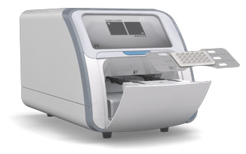
xxpress® Thermal Cycler
Its Fast qPCR thermal cycler
  40 cycle qPCR in under 10 minutes
  With ultra-low thermal mass and high conductivity, xxpress’ patented resistive heating system delivers its performance more efficiently and with greater accuracy than traditional based solutions.
  Up to 5 PCR cycles per minute with fluorescence measurement every cycle
  Faster than 10°C per second thermal ramp rate in the sample
  Active control over thermal uniformity throughout the cycle producing better than ±0.3°C
BJS Biotechnologies, UK

Slide 19
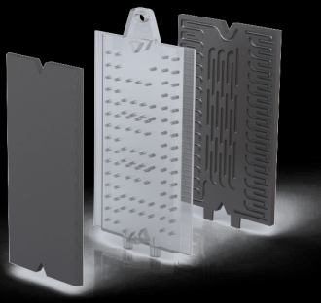
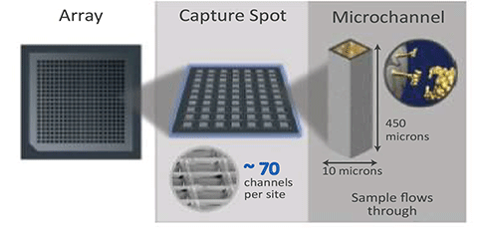
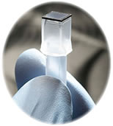
Continuous-flow thermal gradient PCR
Thermal Gradient is a developer of devices and systems for rapid, easy-to-use molecular diagnostic systems. The company’s proprietary fast thermal cycling and nucleic acid extraction and purification technologies enable extremely fast and easy to use systems ranging from point-of-care to high volume high throughput random access reference systems. These same advantages open up significant licensing and cartridge supply opportunities in bio-defense and other molecular biological applications.
Axela and Thermal Gradient to Integrate Ultra Fast PCR technology with Flow-Thru Chips® for Simplified and Rapid Molecular Diagnostics
Axela and Thermal Gradient

Slide 20
Photonase technology
Photonase has patented a novel method of heating PCR which directly couples heat (direct laser heating method) into the reactant mixture producing an almost instant temperature increase rise along with uniform heating throughout the reactant mixture. Cooling times are also reduced in this methodology due to the low thermal mass in comparison to the conventional indirect heating techniques.
Key Benefits
  Ultrafast ramp rates
  No need for specialised or proprietary plates, tubes, or microfluidic chips
  Potential for portable, low power PCR-based PoC diagnostic systems
The ability to conduct very sensitive, highly specific, and very rapid testing is important to:
  Identifying infectious disease and cancer in the healthcare market.
  Advanced safety and quality assurance in the food and agricultural markets.
  Environmental testing in industrial markets.
  Identifying bioterrorism agents in biotreat markets.
Currently seeking an industrial collaborator to accelerate integration of the technology into PCR systems.
Institute of Photonics, University of Strathclyde, UK

Slide 21
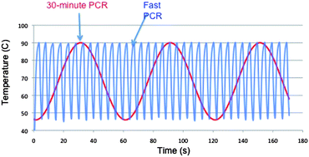
Under-three minute PCR: Probing the limits of fast amplification
N. R. Beer et al from Lawrence Livermore National Laboratory developed new technology using convective heat transfer of a thermal fluid through porous media combined with an integrated electrical heater to achieve 30 cycles of PCR in less than three minutes.
They Announces Licensing Opportunity for Fast PCR Technology in May 2013
The two combinations of template and enzyme shown in bold (Eh DNA with both KAPA2G and SpeedSTARTM) have shown amplification below 2 1/2 minutes.

Slide 22
thermoelectric cooler, (a Peltier cooler), heater, or thermoelectric heat pump is a solid-state heat pump that transfers heat from one side of the device to the other side against a temperature gradient (from cold to hot).
Thin-film thermoelectric coolers (eTECs) operate in the same manner as conventional ones but offer several key advantages that are particularly well suited for PCR. These advantages are:
  Smaller footprint and thickness for the same heat pumping capacity (Fig. 3).
  More rapid thermal response (up to 10X greater)
  Advanced integration capability. The small size enables integration into systems with minimal impact.
Nextreme Thermal Solutions, Inc. acquired by Laird PLC

Slide 23
Shorter throughput times for DNA amplification
  Fast temperature transition (10ºC per second)
  Small mass of thermal cycler
Higher density of wells per machine
  Physical size of conventional TEC prevents this versus the micro-size of eTECs
Precise temperature control
  Ultra-fast response time
  Uniquely high power pumping capability
Rapid thermal cycling time is becoming increasingly important as PCR becomes more
widely used in point-of-service applications.

Slide 24
Portable Fast PCR
Smaller, faster in-field PCR is another area of fast growing market.
The following are some of the products available now.

Slide 25

RAZOR™ EX BioDetection System
The advanced RAZOR EX system employs Real-time PCR technology to deliver the most reliable and sensitive detection and identification of biological pathogens in the field. Designed specifically for field use, the compact and lightweight design of the RAZOR EX allows it to be hand carried and minimal sample preparation requirements make it easy to use. Used with The 10® Target Screen Kit, the RAZOR EX simultaneously tests ten pathogens with reliable, DNA-based results available in less than 30 minutes.
BioFire Defense/BioFire Diagnosics

Slide 26
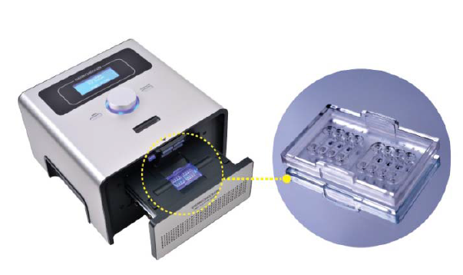
GENECHECKER™ Ultra-Fast PCR System
special polymer chip named Rapi:chip™ which enables even faster thermal treatment of samples
This unique chip has 8 wells and each well accommodates 10μL of sample and reagent in total
Bottom surface of this chip has only 0.15mm of thickness
30 thermal cycles in 12 minutes
Dongwoo Science, Korea

Slide 27
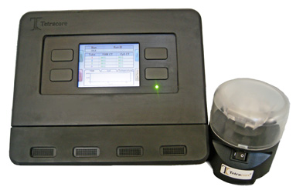
T-COR 4™ Real-time PCR Thermocycler
Tetracore is a biotechnology research and development organization that develops highly innovative diagnostic reagents and assays for infectious diseases and biological warfare (BW) threat agents.
Highly portable – four independent sample wells
Multiplex capability – 1 color + IC, or 2 color
Rechargeable battery
Eight hour thermocycling battery life
Runs in stand-alone mode or PC daisy chain
Tetracore, Inc.

Slide 28
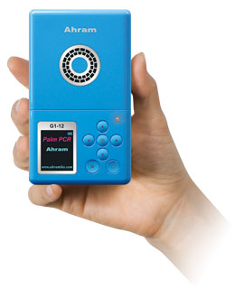
Palm PCR
Founded in 2001, Ahram Biosystems has its headquarters in Seoul, Korea and a subsidiary in Santa Clara, CA, USA.
Palm PCR is powered by a rechargeable Li polymer battery that enables more than 4 hours of continuous operation on a single charge. It can be also operated with AC power using an AC/DC adapter. It is designed to conform to the standard 9 mm-spacing well format to use with a disposable plastic sample tube, specially developed for the Palm PCR system. Nearly all kinds of DNA samples, including human genomic DNA of ≤ 0.1 ng, can be amplified within 30 minutes for up to 1 kbp amplicon. Small amplicons of up to 400 bp can be amplified in as little as 18 minutes with extreme sensitivity down below 10 copies. The dynamic range can be extended to up to 2 kbp using slow protocols.
End-point PCR Detection
• PalmTaq High-Speed PCR Kit
Description: PCR kit consisting of 250 units of PalmTaq High-Speed DNA polymerase (50 μL), 5X HS buffer, dNTP mix and MgCl solution
Ahram Biosystems, Korea

Slide 29
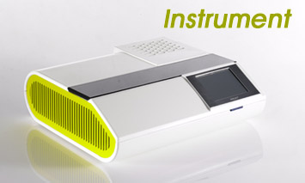
POCKIT Nucleic Acid Analyzer
POCKIT is a qualitative PCR detection system based on insulated isothermal PCR (iiPCR), and is specially designed for point-of-care use in aquaculture, agriculture, companion animal and livestock industries
Features:
  Dual channel fluorescence detection
  Single program to finish both PCR and reverse transcription PCR within 1 hour
  Touchpanel control
  Built-in Android smartphone chip for automatic data interpretation
  Throughput: 1-8 samples/run
GeneReach Biotechnology Corp., Taiwan

Slide 30
Microfluidic Device for PCR
The PCR microfluidics, in particular microchip-based PCR microfluidics, have been developed and nowadays have become an important domain of application of miniaturization technology.
Advanced microfluidic/microPCR systems can achieve far higher ramp rates and much shorter per cycle times but only when used with nanolitre reaction volumes and technologically advanced reaction vessels which may restrict their application.
Chamber stationary PCR microfluidics
Flow-thought PCR microfluidics
Thermal convection-driven PCR microfluidics

Slide 31
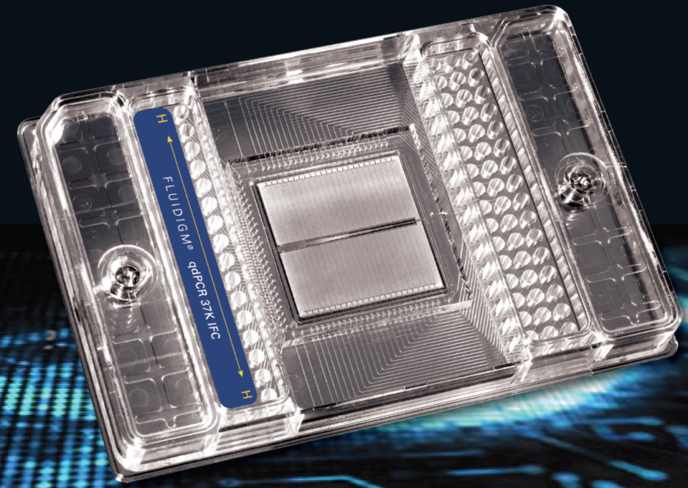
Fluidigm
Quantitative real-time digital PCR— qdPCR 37K ™ IFC
Detection Modes: Real-time and end-point
Sensitivity: Single copy
Input Volume per Well: 4 μL
Sample Inlets: 48
Reaction Chambers: 36,960
Individual Reaction Volume: 0.85 nL
Liquid Transfer Steps: 1 per sample
Instrument Compatibility: BioMark HD System, FC1™ Cycler and EP1 Reader, IFC Controller MX
Offers higher accuracy than droplet
and spotted array–based digital methods
Expensive

Slide 32
DNA Polymerase & Master Mixes
There are many new DNA Polymerase & master mixes designed for faster PCR
These companies may be interested in our optimal control software

Slide 33
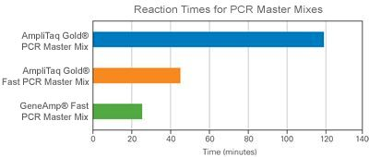
Applied Biosystems (Life Technologies)
GeneAmp® Fast PCR Master Mix
  For researchers who want extremely fast endpoint PCR, Applied Biosystems® GeneAmp® Fast PCR Master Mix offers you quick results.
  This hot-start enzyme delivers fast PCR on sequences up to 2 kb in under 50 minutes and standard 500 bp targets from genomic DNA in under 25 minutes.
  Sensitive and specific, you can detect a single copy of a gene in 10 ng of human genomic DNA. If you are speeding up your workflows for applications such as genotyping or endpoint PCR, GeneAmp® Fast PCR Master Mix is for you.
Thermo Fisher Scientific Inc.

Slide 34
Takara Bio Inc.
  SpeedSTAR HS DNA Polymerase: With an extension rate as fast as 10 sec/kb (compared to 60 sec/kb with standard Taq DNA polymerase), SpeedSTAR DNA polymerase dramatically reduces total reaction time.
  TaKaRa Z-Taq DNA Polymerase has greater processivity than standard Taq DNA polymerase and allows rapid PCR amplification.

Slide 35
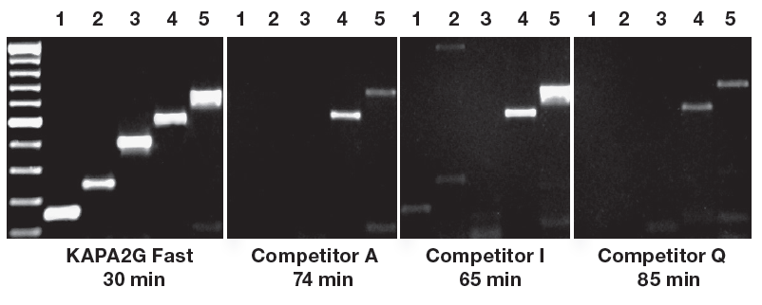
KAPABIOSYSTEMS
The novel and highly processive KAPA2G Fast DNA Polymerase and its uniquely formulated reaction buffer have been specifically engineered for Fast PCR. With extension times as short as 1 sec/cycle, PCR time can be reduced by up to 70% without compromising sensitivity, yields or consistency.

Slide 36
Agilent Technologies: Genomics
Brilliant III Probe MM
Brilliant III QPCR & QRT-PCR Master Mixes increase overall sensitivity and speed through the novel, quick-activating hot start and the engineered Taq-mutant.

Slide 37
Roche Applied Science
The AptaTaq Fast PCR Master contains a thermostable, recombinant Taq polymerase with aptamer mediated, reversible hot start. It is immediate activated by heating, ideal for specific priming and fast PCR. Comes with optimized buffer system. Allows reaction setup at room temperature. A one-for-all protocol delivers superb results in less than 30 min for a broad range of templates including GC-rich templates.

Slide 38
New England Biolabs
Q5® High-Fidelity DNA Polymerase is a high-fidelity, thermostable DNA polymerase with 3´→ 5´ exonuclease activity, fused to a processivity-enhancing Sso7d domain to support robust DNA amplification. With an error rate > 100-fold lower than that of Taq DNA Polymerase and 12-fold lower than that of Pyrococcus furiosus (Pfu) DNA Polymerase, Q5 High-Fidelity DNA Polymerase is ideal for cloning and can be used for long or difficult amplicons.
Can be used for fast PCR but without technical details.

Slide 39
Thermo Scientific
Phusion Flash II DNA Polymerase
  Extreme speed: extension times of 15 s/kb or less
  Hot start modification allowing “zero-time reactivation”
  Accuracy: proofreading DNA polymerase with a fidelity of 25X Taq
  High yields in reduced time
Thermo Fisher Scientific, Inc.

Slide 40
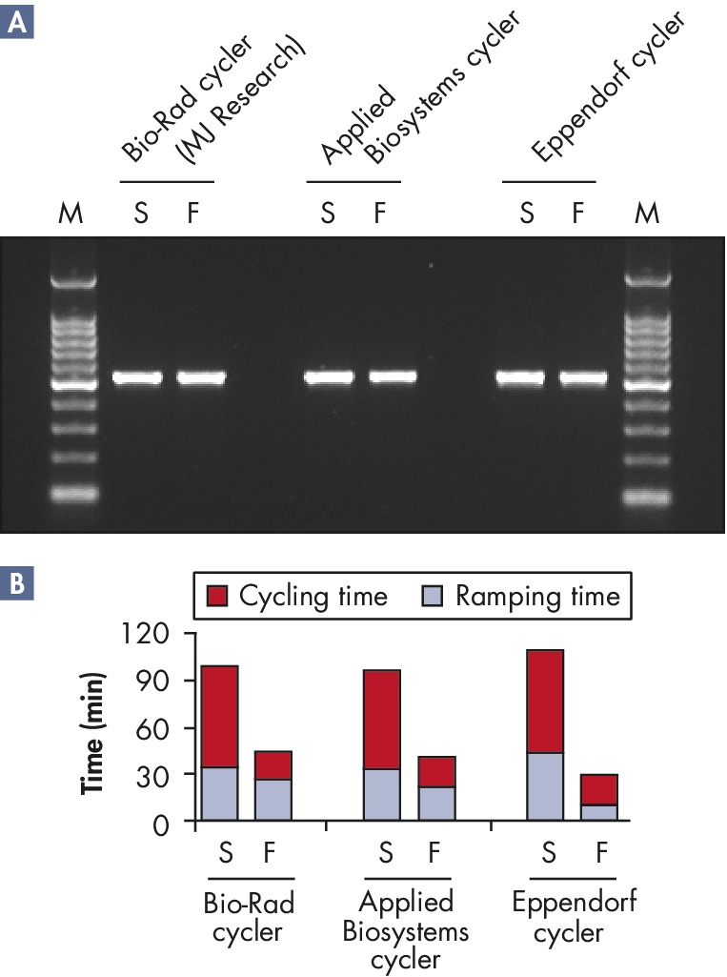
QIAGEN Fast Cycling PCR Kit
Hot-start PCR amplification in as little as 15 minutes (35 cycles)
Highly suited for use with any thermal cycler
Ready-to-use master mix with HotStarTaq Plus DNA Polymerase
Optional ready-to-load PCR dye for easier handling
No need to redesign primers for fast PCR

Slide 41
QIAGEN Fast Cycling PCR Kit
For ultrafast and specific PCR on any thermal cycler
Hot-start PCR amplification in as little as 15 minutes (35 cycles)
Highly suited for use with any thermal cycler
Ready-to-use master mix with HotStarTaq Plus DNA Polymerase
Optional ready-to-load PCR dye for easier handling
No need to redesign primers for fast PCR
The fast-cycling PCR master mix contains HotStarTaq Plus DNA Polymerase for highly specific and sensitive PCR, and a unique buffer formulation for extremely short denaturation, annealing, and extension steps. The proprietary PCR buffer significantly reduces the time required to form the polymerase, primer, and template complex, reducing the total PCR cycling time from approximately 1.5 hours to just 20 minutes. Optional CoralLoad Dye (also included with the kit) contains gel-tracking dyes for convenient analysis. In addition, Q-Solution, a novel additive that enables efficient amplification of "difficult" (e.g., GC rich) templates, is also provided.

Slide 42
Bio-Rad
Fast PCR With Long Targets
  Bio-Rad’s iProof™ polymerase. In general, longer targets (>1 kb) need longer extension times, resulting in runs that last several hours. The enhanced processivity of iProof polymerase, however, enables it to overcome these limitations. The iProof polymerase is perfectly suited for two-step protocols and shortened extension times, and it can save many hours in long PCR applications.

Slide 43
Epicentre
TAQXpedite™ PCR System -- With a standard thermocycler, the TAQXpedite™ PCR system achieves fast PCR results with total reaction time as little as 16 minutes for a 500-bp amplicon
Increased sample throughput.
High fidelity due to proofreading capabilities.
Two convenient MasterMixes for universal and difficult/long amplifications.
Epicentre® (an Illumina company)

Slide 44
Quanta BioSciences
qScript™ One-Step Fast qRT-PCR Kit, ROX™
  Flexible - Use Fast or standard qPCR cycling Conditions
  No additional primer/probe optimization required for Fast cycling
  Broad dynamic range- Reliable data from your precious samples every time
  Fast protocol- Results in less than 40 minutes
  Concentrated 4X SuperMix- allows analysis of higher sample volume for rare targets
Quanta BioSciences

Slide 45
Bioline
SensiFAST™ Real-Time PCR Kits
  Outstanding Real-Time PCR assay results from both DNA and RNA templates, ideal for use in fast-cyclers.

Slide 46
Other systems

Slide 47
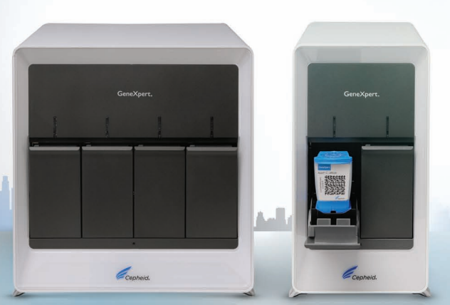
Cepheid GenXpert Systems
Fully integrated and automated single module on-demand molecular diagnostic system.
OPTICS
  Dye detection limit < 1 nM
REACTION SITE THERMAL CONTROLS
  Solid state heater and forced-air cooling at each site
  Reaction chamber thermistors calibrated to ± 1.0°C using National Institute of Standards and Technology (NIST)-traceable standards
  Up to 16 independently-controlled reaction sites
CARTRIDGES
  Single-use disposable cartridges
  Polypropylene construction
PERFORMANCE PARAMETERS
  Heating ramp rates (max.): 10°C/sec from 50°C to 95°C
  Cooling ramp rates (max.): 2.5°C/sec from 95°C to 50°C
  Temperature duration accuracy: ± 1.0 sec from programmed time
  Temperature accuracy: ± 1.0°C from 60°C to 95°C
  Melt curve programmable ramp rates: 0.01°C/sec to 1.0°C/sec
Cepheid

Slide 48
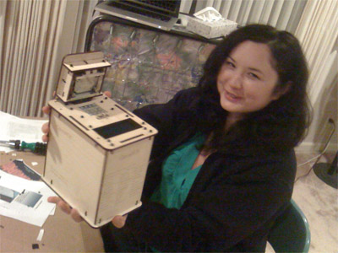
OpenPCR
OpenPCR is a low-cost ($599), yet accurate thermocycler you build yourself, capable of reliably controlling PCR reactions for DNA detection, sequencing, and other applications.
  Sample capacity:16 0.2 ml tubes
  Average ramp rate:1 C/s
  Temp range:10 C - 100 C
  Temp accuracy:+/- 0.5 C
  Temp uniformity:+/- 0.3 C
  Heated lid range:Ambient - 120 C

