Slide 1
Experiment AU37

Slide 2
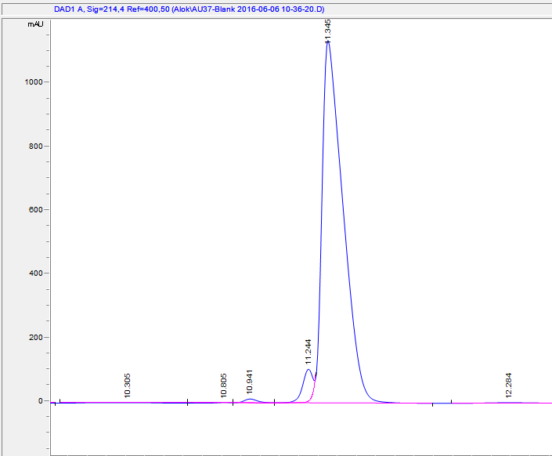
Blank

Slide 3
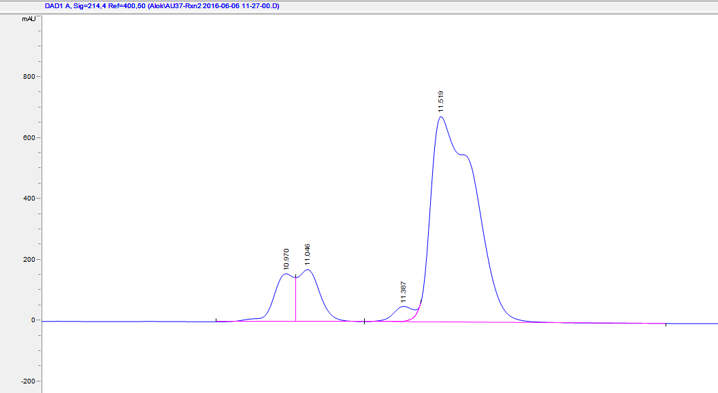
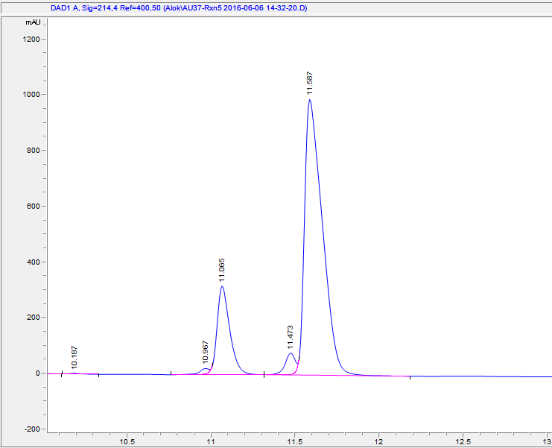
Rxn2 and 5
Rxn2
Rxn5
Rxn 2 and 5 are pre-thaw and post thaw respectively. 1.6U/ul

Slide 4
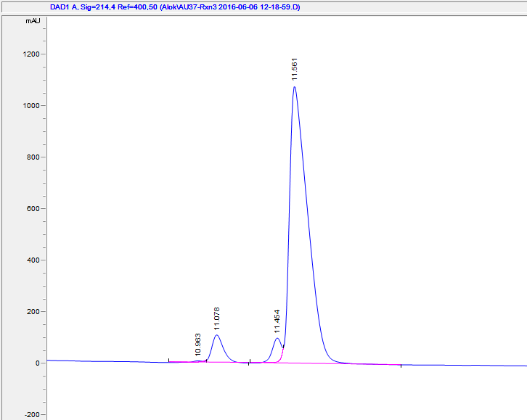
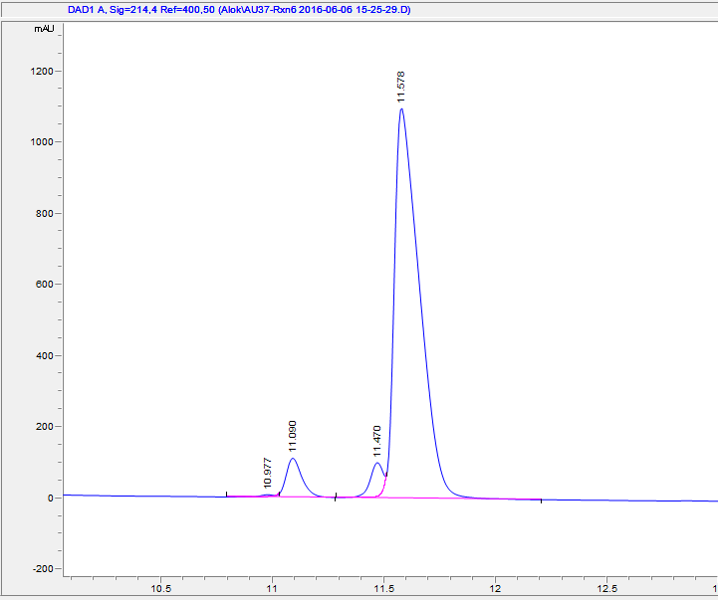
Rxn3 and 6
Rxn3
Rxn6
Rxn 3 and 6 are pre-thaw and post thaw respectively. 0.5U/ul

