Slide 1
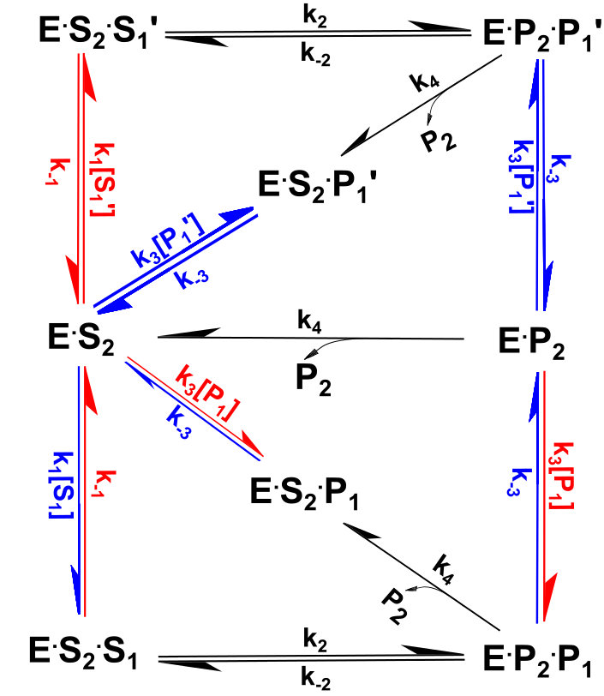
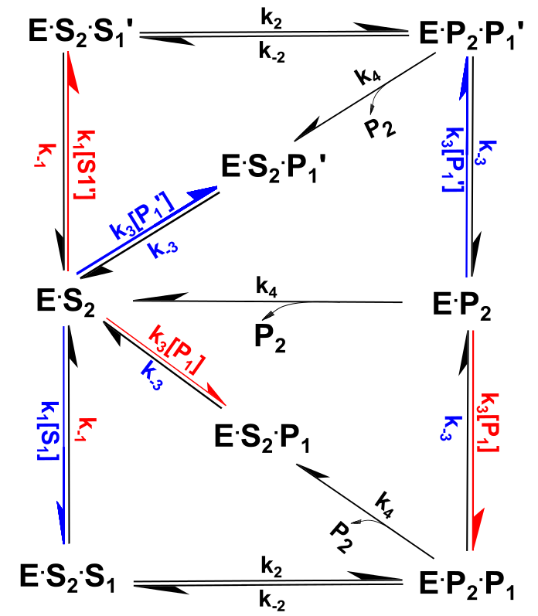
Figure 2. in the double square stacked 2d schematics, please make an alt version where k-1 is colored red and k-3 is colored blue in addition to the existing colored arrows.
Color code on both letter and arrow
Color code only on letter

Slide 2
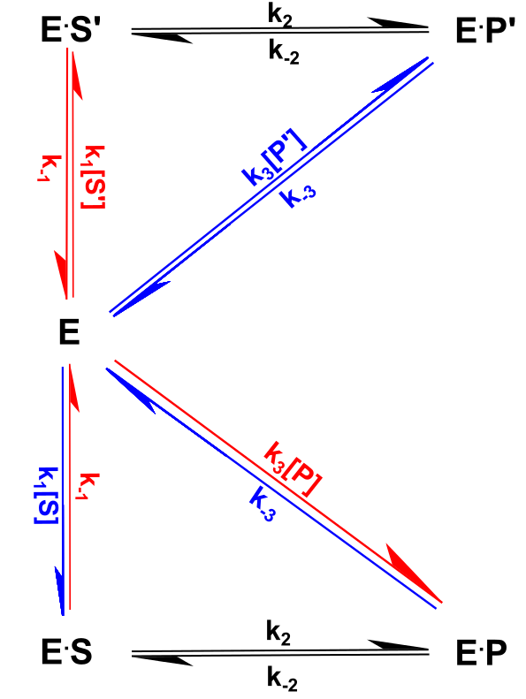
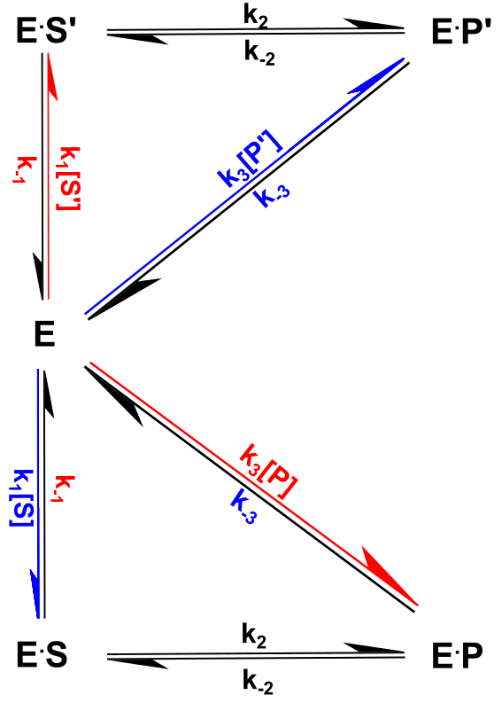
Figure 2. in the double triangle stacked 2d schematics, please make an alt version where k-1 is colored red and k-3 is colored blue in addition to the existing colored arrows.
Color code on both letter and arrow
Color code only on letter

