Slide 1
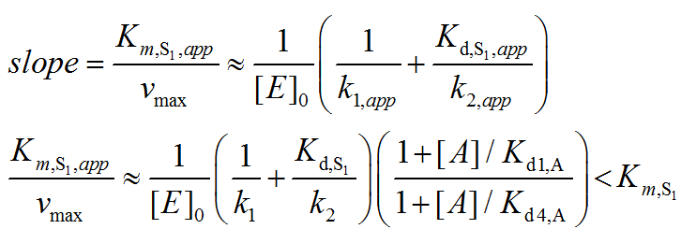
RC(4/7/17): -extend the plots she made of the high NAM Dixon curves to even higher NAM so I can see the plateau more clearly -calculate the 1/v value at plateau: this is done by using 1/v = (1/Vmax)*{ (Km/[S])* (K1/K2) + K1/K3 } The eqn is supposed to specify horizontal line for plateau. Please put this general form of eqn in first schematic in your ppt and in the experimental one, please substitute the actual values of the parameters as we did before to get the plateaus.
RC (4/7/17): Dotted lines can cross y axis unless that's cluttered. You can use judgment on that. The first Dixon in your ppt needs the eqn below next to the dotted line. The second and third Dixons need the actual numbers for plateau generated by eqn below. RC(4/10/17): Also in part D) can we make the Dixon at 15000uM NAD so we can show the exptl data? And extent x axis to same values as in part F). Finally, remember this fig is not supposed to have 6 parts -- keep A,B part of the previous schematic fig w 4 parts and pts C-F should be A-D of a diff fig. RC(4/10/17): --Also, in the original schematic fig double reciprocal plots (parts A,C) mentioned below, an eqn for Km,S1 is shown. Can you replace that with slope = Km,S1,app/vmax <curvy equals> 1/ [E]_0 ( 1/k1,app + Kd,S1,app/k2,app ) for part A). For part C), Km,S1,app/vmax <curvy equals> 1/ [E]_0 ( 1/k1 + Kd,S1/k2 )(1+[A]/Kd1,A / 1+[A]/Kd4,A) < Km,S1.
Please see below for the equations rendered.

Slide 2
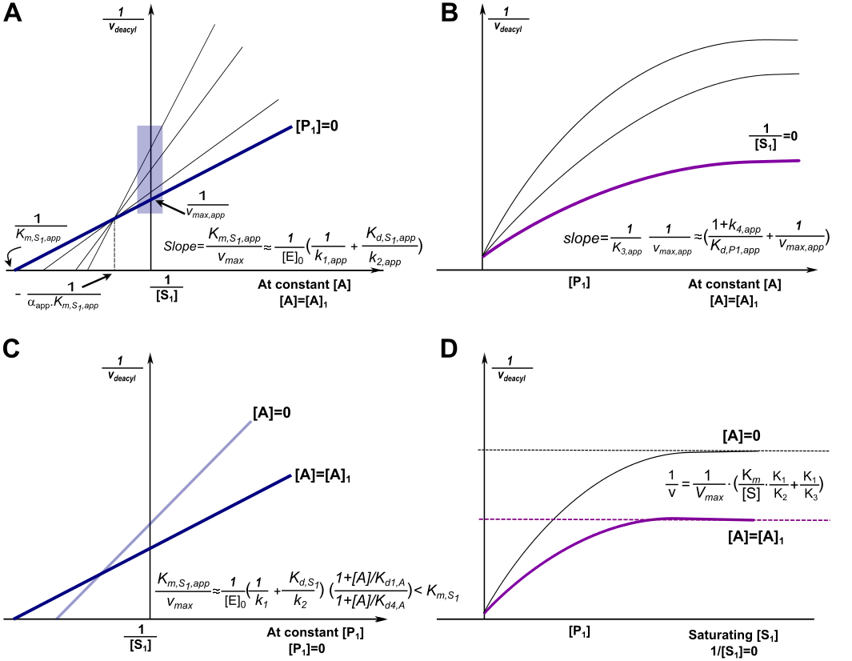

Slide 3
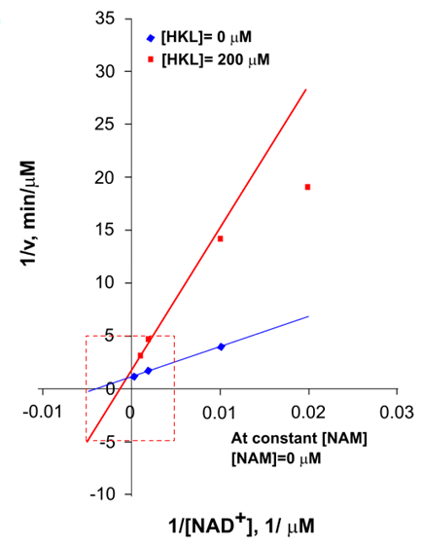
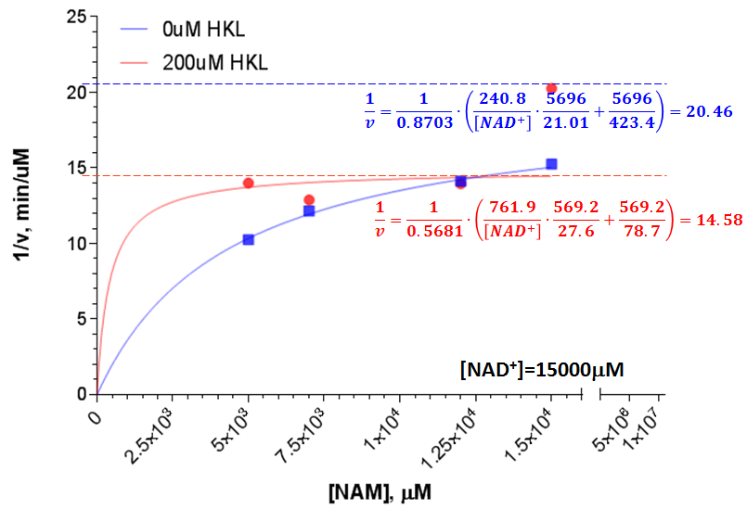
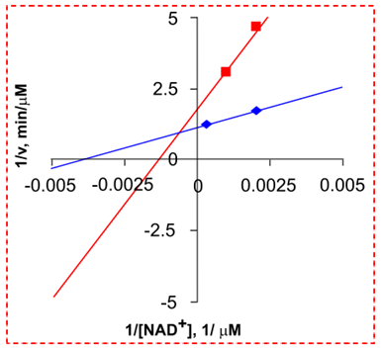
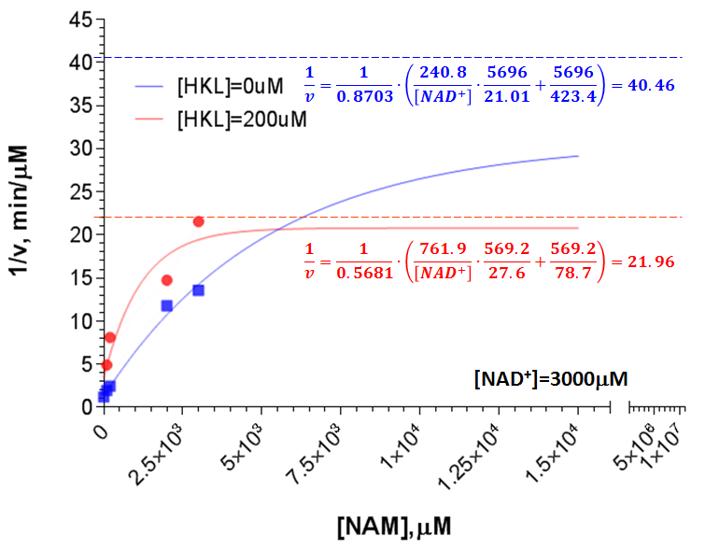
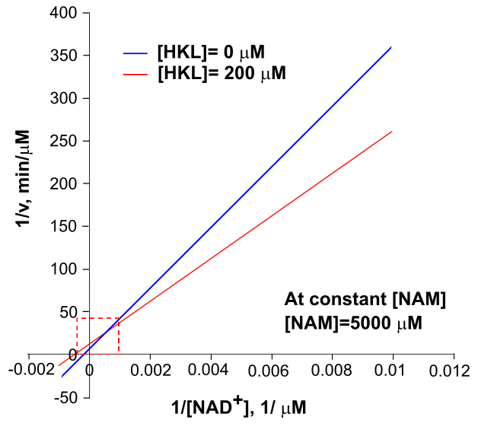
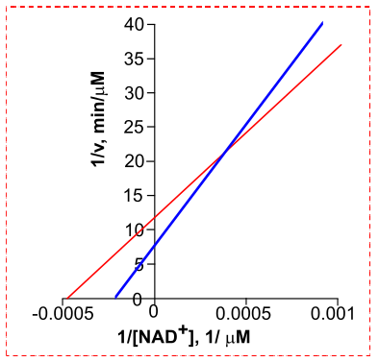
A B
1
2
C D
3
4

