Slide 1
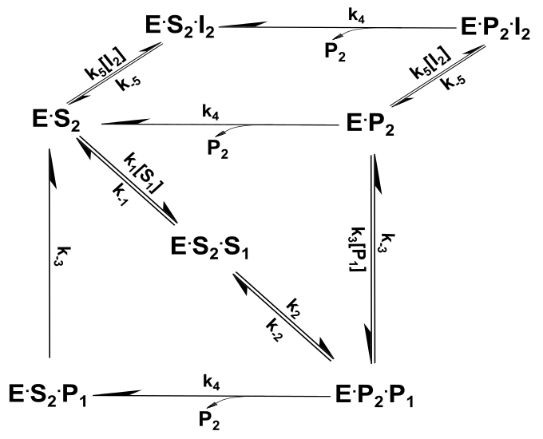
Depression Figure-Version A
Competitive inhibition
of forward reaction
Competitive inhibition
of reverse reaction
Reverse
reaction

Slide 2
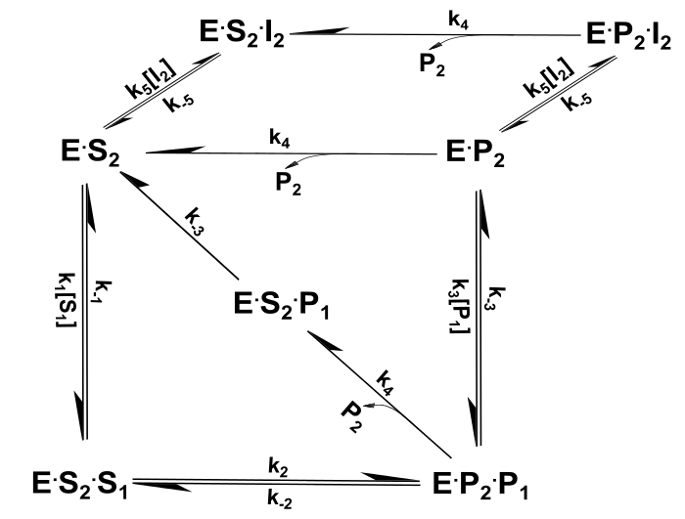
Depression Figure-Version B
Competitive inhibition
of forward reaction
Competitive inhibition
of reverse reaction
Reverse
reaction

